Slide 1
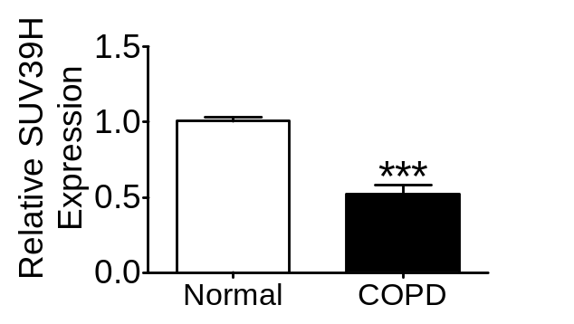
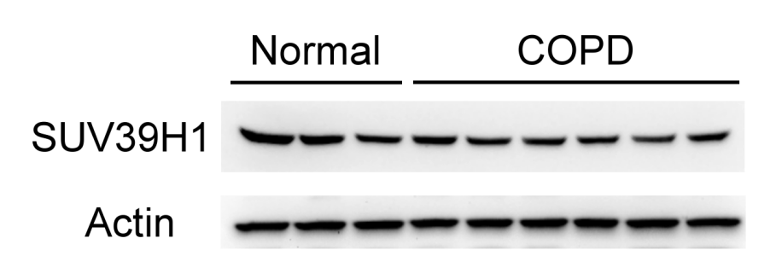
A
B
Figure 1
Figure 1. SUV39H1 levels are reduced in the peripheral blood mononuclear cells (PBMCs) of COPD patients.
(A) The representative SUV39H1 expression in PBMC samples from normal control (n=3) and COPD subjects (n=6) was measured by immunoblotting. The levels of SUV39H1 expression were significantly reduced in the PBMCs from COPD patients compared with those from normal controls. Actin served as a loading control. The panel represent different blots due to similar molecular weights of SUV39H1 (48 kDa) and actin (43 kDa). Images from approximate regions of western blots were cropped and arranged to match the panel. (B) The densitometry values for SUV39H1 in normal (n=10) or COPD PBMCs (n=14) were quantified and normalized to the actin value. Relative expression values are expressed as the fold change over the normal control value. ***p<0.001.

Slide 2
Another specimens
Normal
COPD
SUV39H1
#1 #2#3
#1#2#3 #4 #5#6

Slide 3
WB-SUV39H1
Image

Slide 4
PVDF
Membrane
Image

Slide 5
PVDF
Membrane
Merged
Image
UVP
Image
system

Slide 6
KDa
Normal
COPD
72-
SUV39H1
(48 kDa)
55-
43-
Mr
#1 #2 #3
#1 #2#3 #4 #5 #6

Slide 7
Another specimens
Normal
COPD
Actin
#1 #2#3
#1#2#3 #4 #5#6

Slide 8
WB-Actin
Image

Slide 9
PVDF
Membrane
Image

Slide 10
PVDF
Membrane
Merged
Image
UVP
Image
system

Slide 11
Same specimens were performed in different WB membrane (no stripping) due to similar MW of SUV39H1 (48kD) and Actin (43kD).
KDa
Normal
COPD
55-
Actin
(43 kDa)
43-
Mr
#1 #2#3
#1#2#3 #4 #5#6

