Slide 1
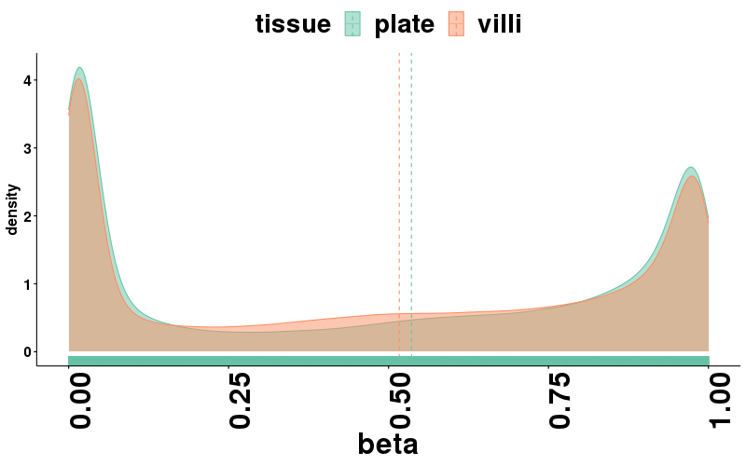
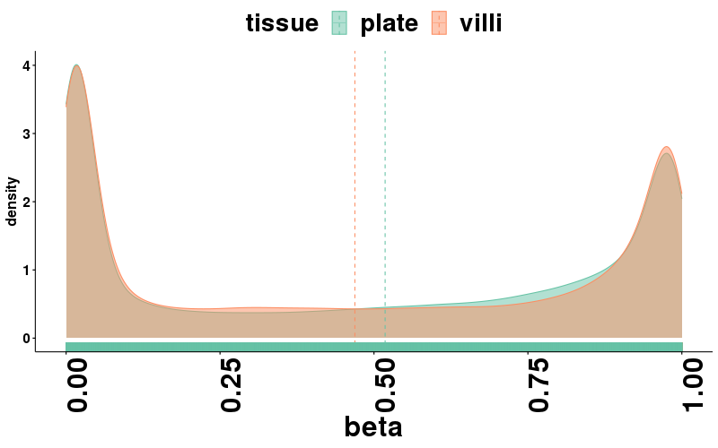
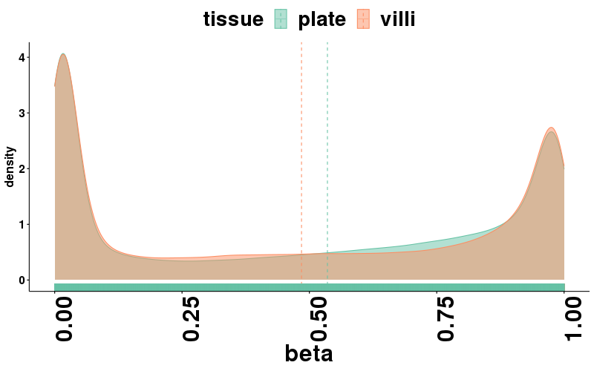
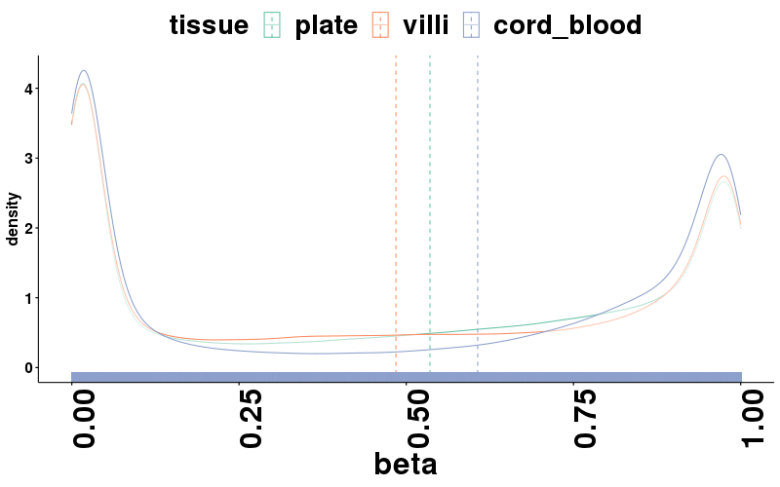
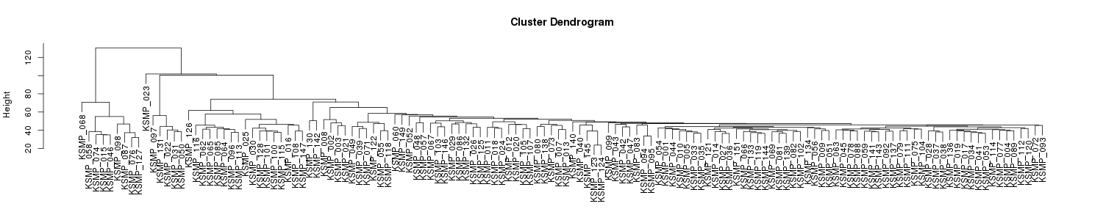
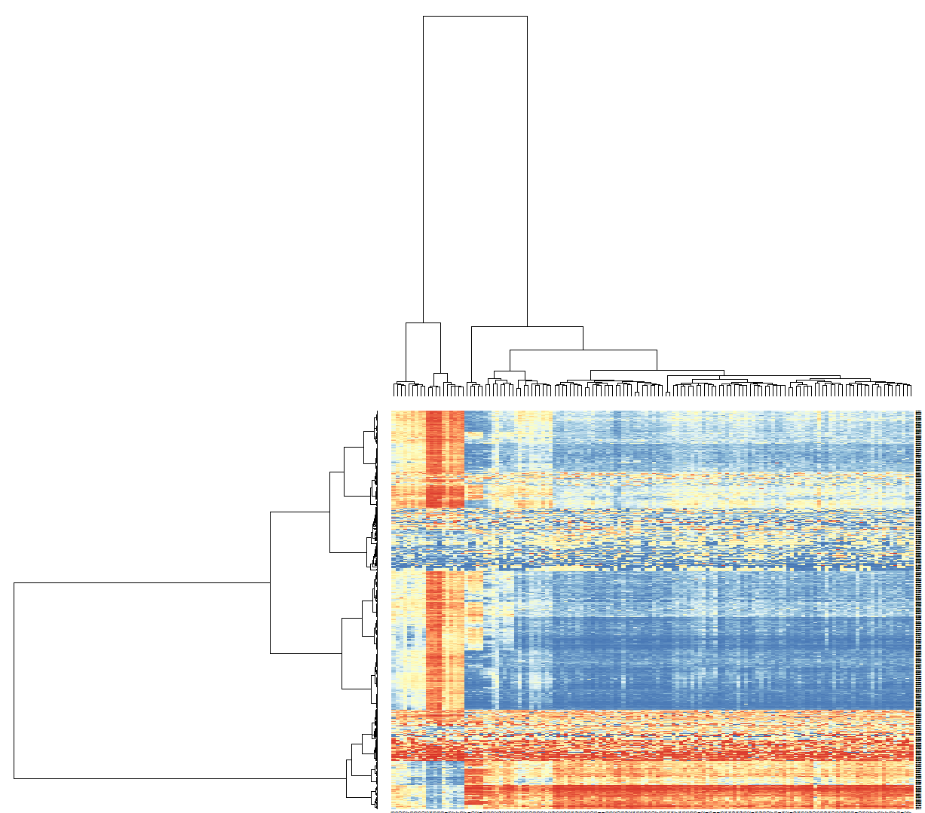
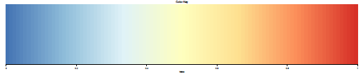
A
Participant 1
Participant 2
Participant 3
Fig. S1
Mean of each tissue
B
C
Beta value
0
1
*
*
*
*
Notes:
Supplementary Figure 1
DNA methylation pattern of chorionic plates
Distribution of beta values of chorionic plates and chorionic villi in the identical placenta of three individuals measured by 450K. Median beta values were shown in the dot lines. Comparison of beta values between four tissues were done using mean beta values of three chorionic plates, three chorionic villi, and 47 cord blood cells.
Clustering of 136 chorionic plates based on the beta values of 754,101 probes.
Unsupervised clustering of 136 chorionic plates based on the beta values of the top 1,000 probes that showed most variable methylation values between samples. Red lines on the row dendrogram indicates the probes which showed uniform DNA methylation pattern in two major sample clusters.

Slide 2
Supplementary Figure 1
DNA methylation pattern of chorionic plates
Distribution of beta values of chorionic plates and chorionic villi in the identical placenta of three individuals measured by 450K. Median beta values were shown in the dot lines. Comparison of beta values between four tissues were done using mean beta values of three chorionic plates, three chorionic villi, and 47 cord blood cells.
Clustering of 136 chorionic plates based on the beta values of 754,101 probes.
Unsupervised clustering of 136 chorionic plates based on the beta values of the top 1,000 probes that showed most variable methylation values between samples. Red lines on the row dendrogram indicates the probes which showed uniform DNA methylation pattern in two major sample clusters.

Slide 3
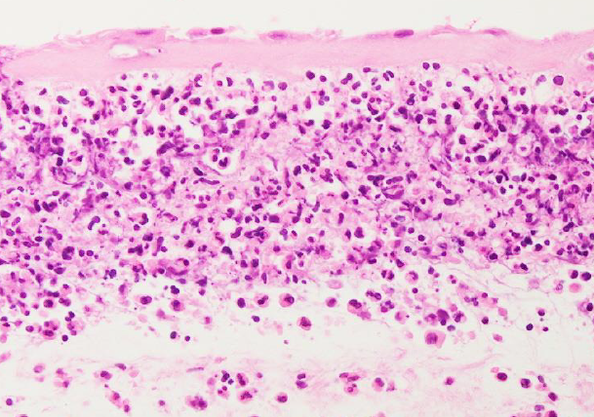
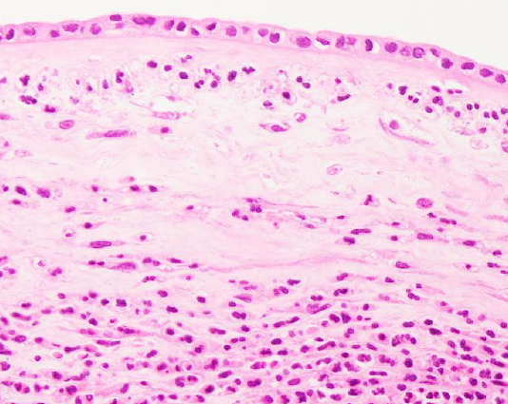
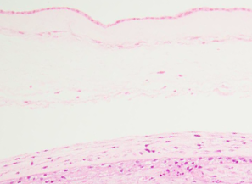
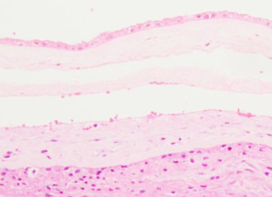
Fig. S2
CP_1
CP_3
CP_4
CP_5
Supplementary Figure 2
HE staining of chorionic membranes
CP_1, _3, _4, and _5 are corresponding to the number in Fig. 1A.

Slide 4
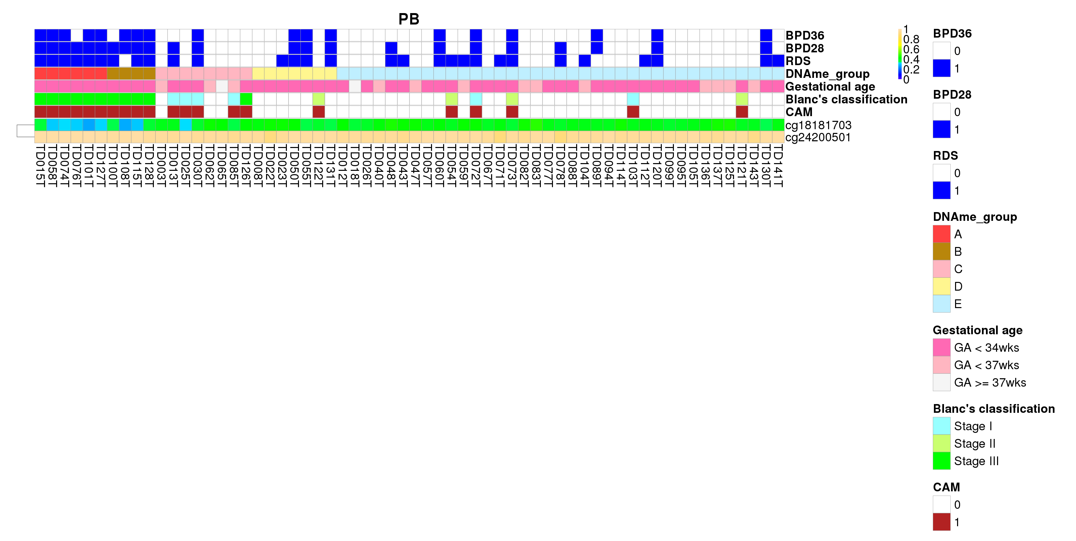
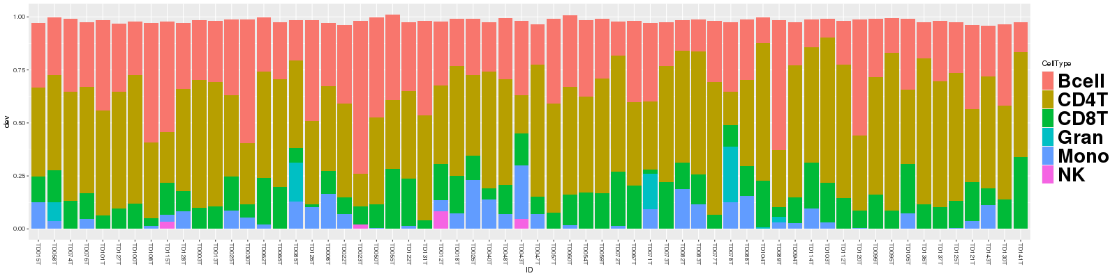
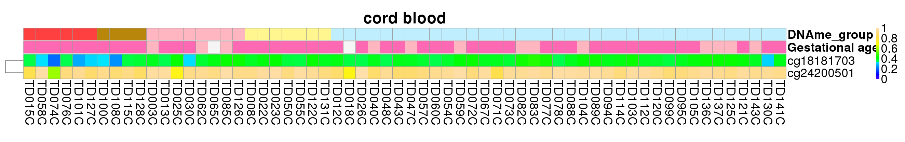
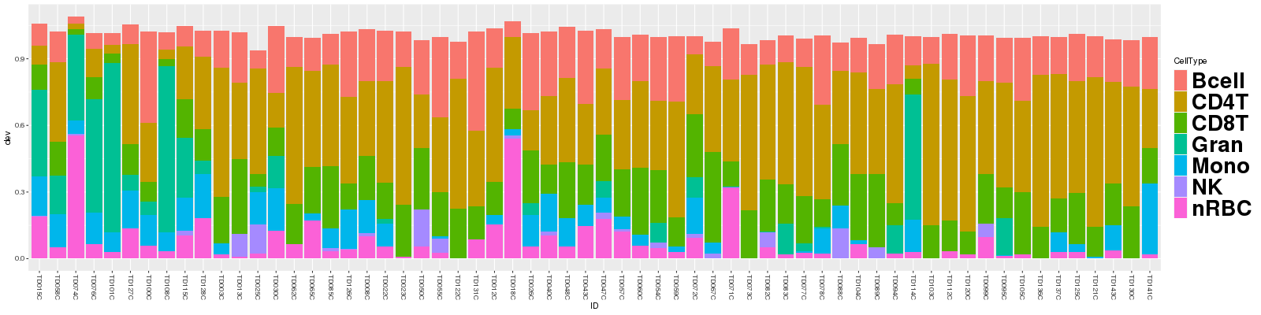
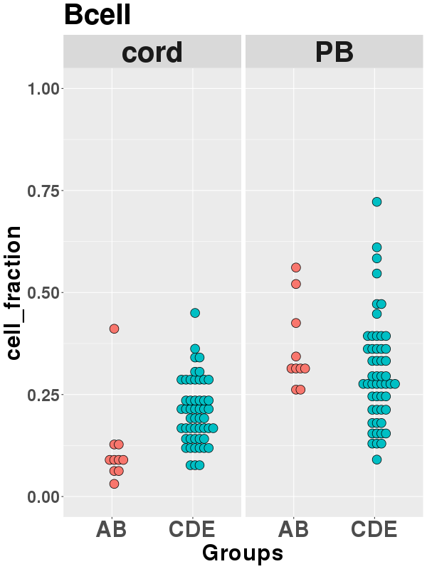
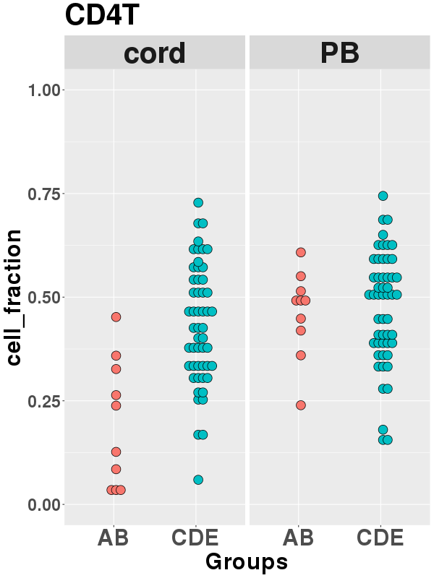
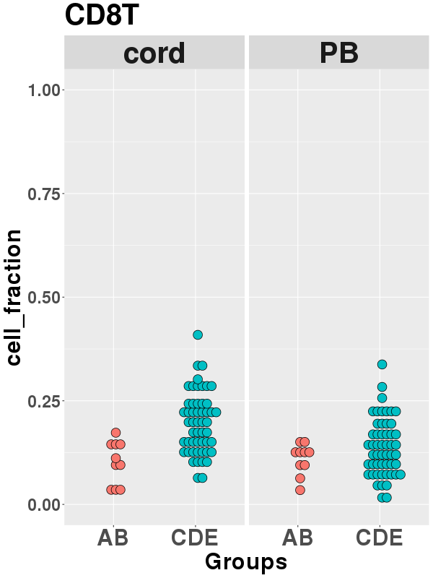
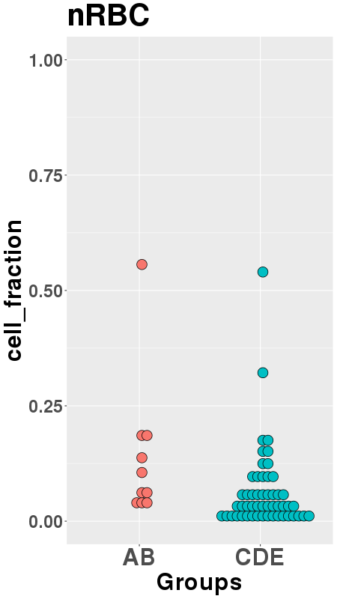
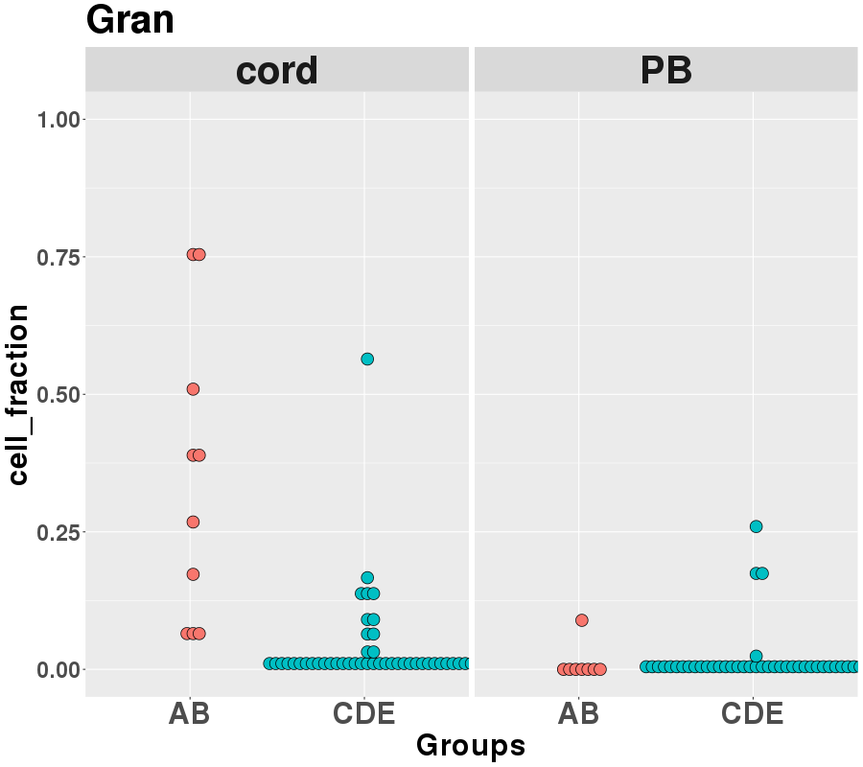
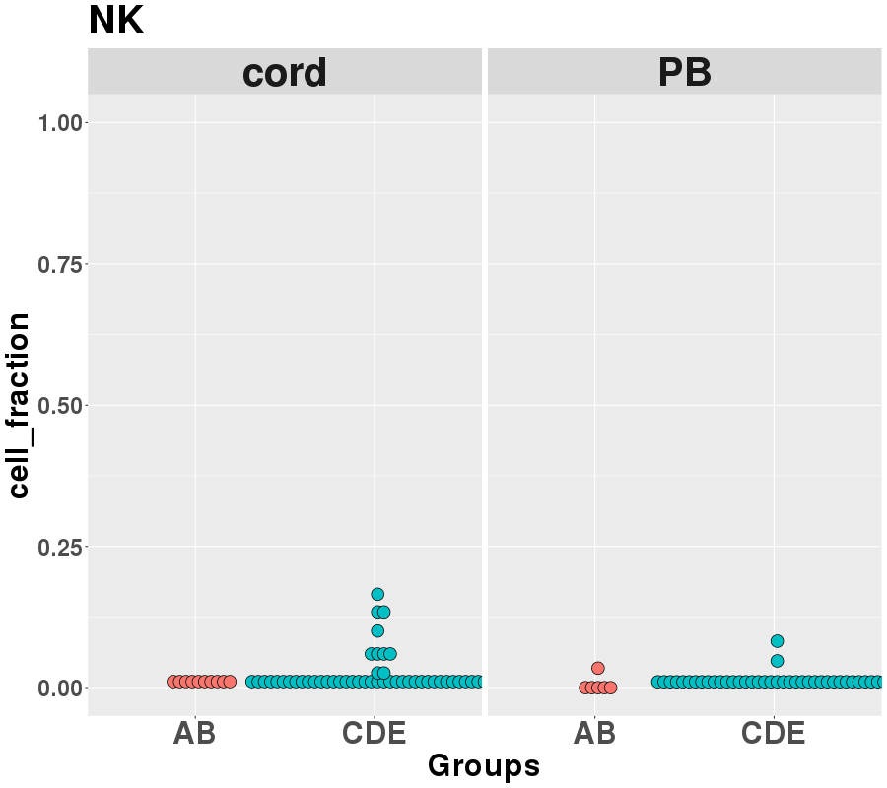
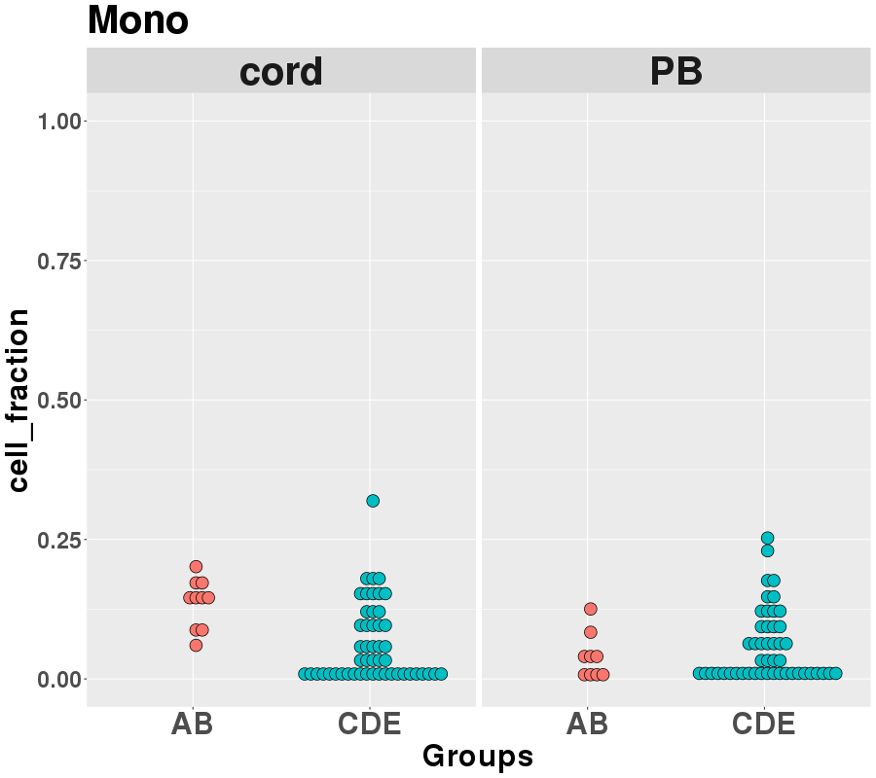
A
Fig. S3
B
C
p = 0.0005
p = 0.0002
p = 0.0005
p = 0.009
p = 0.000006
p = 0.001

Slide 5
Supplementary Figure 3
DNA methylation comparison between postnatal peripheral blood cells and cord blood cells of the 62 individuals
Postnatal pulmonary diseases (RDS, BPD28, BPD36), group classification by DNA methylation patterns in chorionic plates, gestational age at birth, and diagnosis of CAM are shown in upper panel of DNA methylation changes at cg18181703 and cg24200501 in postnatal peripheral blood (PB) cells which associated with the group A against group E. Estimated blood cell compositions in PB are shown in lower panel.
Group classification by DNA methylation patterns in chorionic plates, gestational age at birth are shown in upper panel of DNA methylation changes at cg18181703 and cg24200501 in cord blood cells. Estimated blood cell compositions in cord blood are shown in lower panel.
Comparison of each estimated blood cell composition between groups A,B and C,D,E of cord blood and PB, respectively. p. values are resulted from t-test.

Slide 6
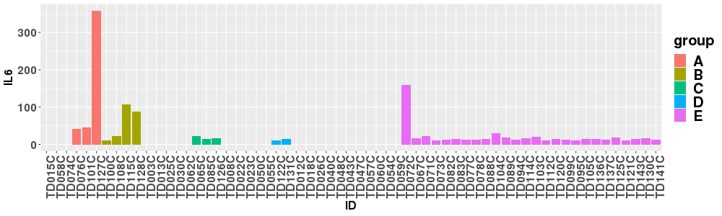
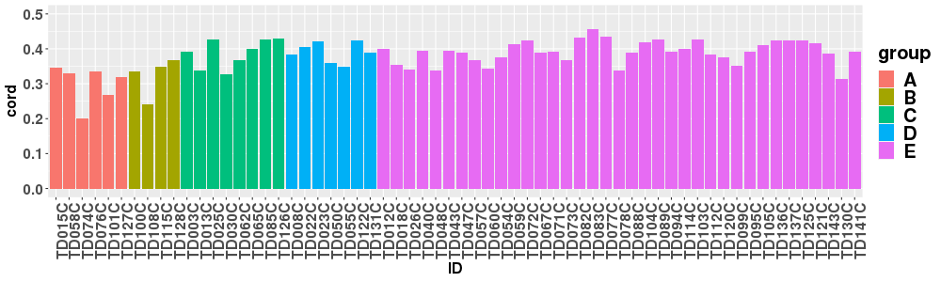
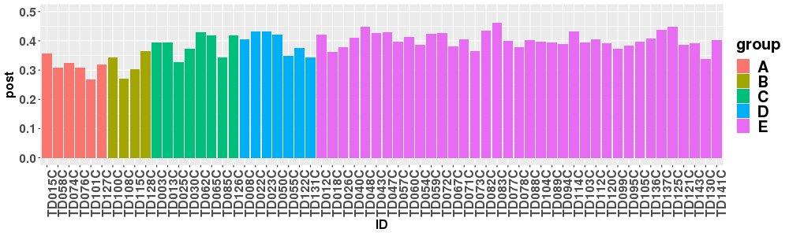
Fig. S4
A
IL-6 (pg/ml) in cord blood
IL-6 (pg/ml)
n.a.
n.a.
n.a.
n.a.
B
cg18181703 in cord blood cells
DNA methylation
(beta value)
cg18181703 in postnatal peripheral blood cells
DNA methylation
(beta value)
Supplementary Figure 4
IL-6 levels in cord blood and DNA methylation levels of cg18181703 in blood cells.
IL-6 in each cord blood were shown in order of the groups defined by DNA methylation patterns of chorionic plates.
DNA methylation levels of cg18181703 were shown in order of the groups defined by DNA methylation patterns of chorionic plates in cord blood cells and postnatal peripheral blood cells, respectively.

