Slide 1
Supplementary Figures and Tables

Slide 2
Supp Table 1. SSc studies used to create the SSc bulk RNA-seq compendium
12 publicly available SSc studies selected from both GEO and ArrayExpress data repositories used in creating the bulk RNA-seq SSc compendium. All the datasets are from microarray, with one exception of bulk RNA-seq data GSE130955.
ID | Accession # | Platform | # Samples (417 total) | Breakdown | Main factors | Comments
1 | GSE9285 | Microarray | 32 | 6 Ctrl / 19 dSSc / 7 lSSc | Disease state, position Age, gender, disease history, race | Multitissue SSC, Part of GSE76809
2 | GSE32413 | Microarray | 31 | 21 dSSc / 12 Ctrl | Disease state, position, Drug treatment, timeline | Skin biopsies, Rituximab treatment; Part of GSE76809
3 | GSE45485 | Microarray | 32 | 11 Ctrl / 21 SSc | Sample type, disease state, Drug treatment, timeline, position | Arm and back biopsies, Part of GSE59787(Hinchcliff165), Mycophenolate mofetil treatment
4 | GSE58095 | Microarray | 62 | 36 Ctrl / 23 dSSc / 3 lSSc | Disease state, Affected status, Race, gender,antibody, skin score, FVC70 | Very detailed study, subset of GENISOS
5 | GSE59785 | Microarray | 13 | 1 Ctrl / 12 SSc | Sample type, disease state, Drug treatment, timeline, position | Part of GSE59787 (Hinchcliff 165), GSE76809 (Multitissue SSC) and GSE76886 (Hinchcliff 359)
6 | GSE76885 | Microarray | 42 | 11 Ctrl / 31 SSc | Disease state, Drug treatment,Timeline, position | Biopsies, Part of GSE76886, Hinchcliff 359 data set
7 | E-MEXP-1214 | Microarray | 10 | 4 dSSc / 2 lSSc / 4 Control | Disease State, Age, gender, biopsy | Processed data, Skin biopsies, GCRMA+quantile norm
8 | GSE76807 | Microarray | 15 | 10 lSSc / 5 Ctrl | Disease state, Tissue source | Skin punch biopsies, Part of GSE76809, skin, lSSc and normal controls
9 | GSE76806 | Microarray | 24 | 24 SSc | Disease State, gender | Skin punch biopsies, Part of a multi-organ study
10 | GSE66321 | Microarray | 8 | 8 SSc | Disease State, MRSS score | Skin biopsies, A abatacept vs placebo study
11 | GSE65405 | Microarray | 6 | 6 SSc | Disease State, treatment status | Leisonal skin biopsies, A Nilotinib treatment study
12 | GSE130955 | bulkRNA | 81 | 33 control, 48 SSc | Disease state, Age, MRSS, treatment | Punch biopsies, PRESS, Prospective Registry for Early Systemic Sclerosis (PRESS) cohort
 | Internal | NGS | 59 | 26 dSSc /33 Ctrl | Disease state, Biopsy affected status | GENISOS, Genetics versus Environment in Scleroderma Outcomes Study

Slide 3
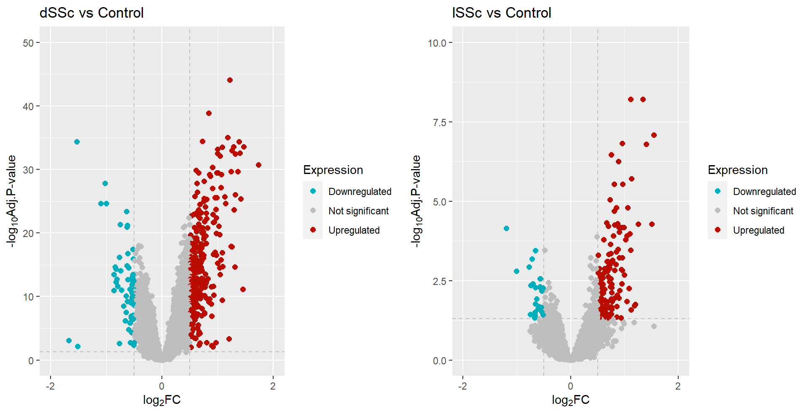
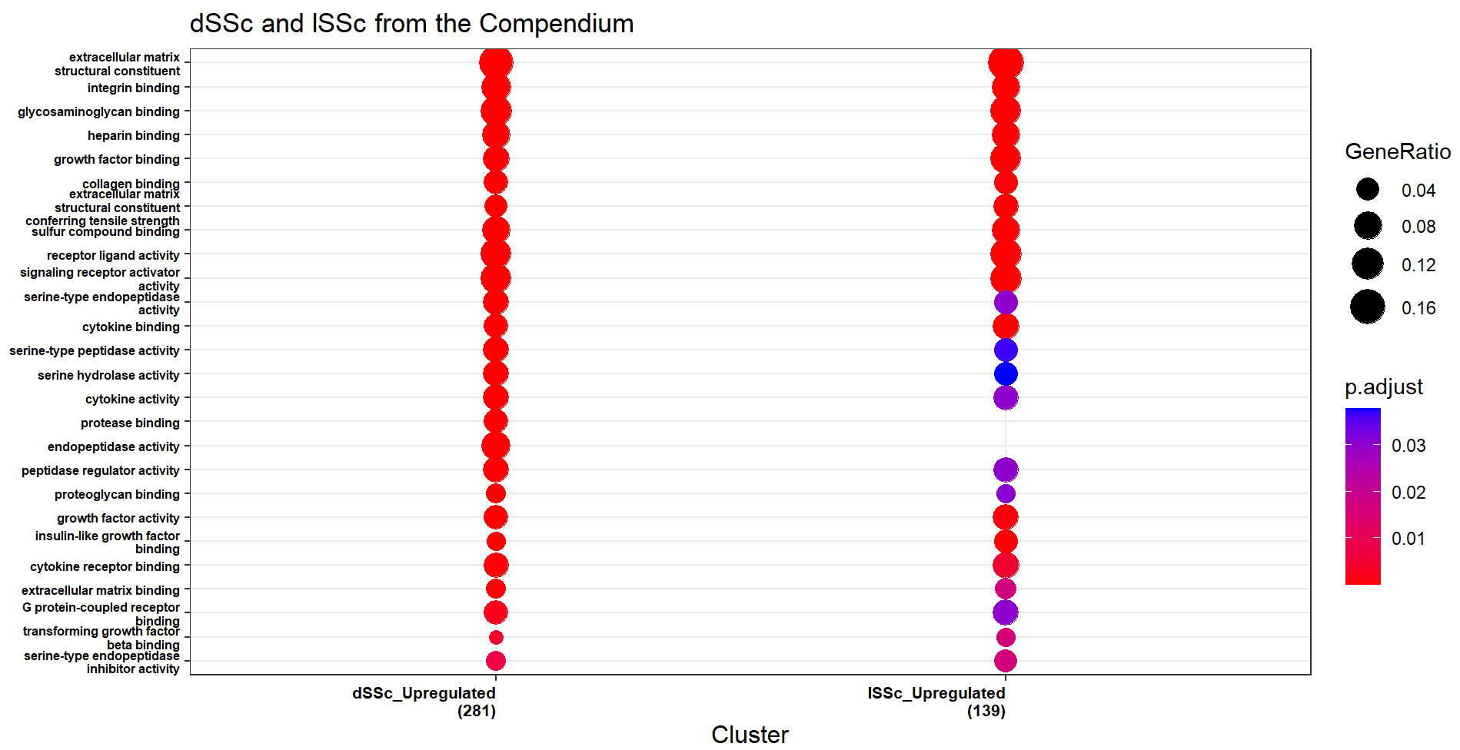
a
b
Supp Fig 1. Analysis of the SSc bulk RNA-seq compendium
(a) LIMMA output of the SSc bulk RNA-seq compendium showing 300 upregulated and significant DEGs (< 0.05 adjusted p-value and > 0.5 logFC) in dSSc and 144 upregulated and significant DEGs (< 0.05 adjusted p-value and > 0.5 logFC) in lSSc. (b) Pathway analysis for upregulated and significant DEGs from dSSc and from lSSc.

Slide 4
ID | Accession # | Platform | Patients | Breakdown | Tissue | Samples | Treatment | Other
1 | GSE195452 (Gur et al, 2022) | Single Cell | 147 | 54 Ctrl / 52 dSSc / 41 lSSc | Forearm skin, Leg skin | 488 | - | 483 forearm skin samples/ 5 leg skin samples 157 Ctrl samples / 183 dSSc samples / 148 lSSc samples
2 | GSE209635 (Khanna et al, 2022) | Single Cell | 15 | 15 dSSc | Skin | 30 | Tofacitinib or matching placebo | 5 Placebo / 10 Treated Two timepoints
3 | GSE138669 (Tabib et al, 2022) | Single Cell | 22 | 10 Ctrl / 12 SSc | Skin | 22 | - | 12 SSc / 10 healthy controls
Supp Table 2. SSc studies used to create the SSc single cell atlas
scRNA datasets from 3 publicly available SSc studies used to create the SSc single cell atlas.

Slide 5
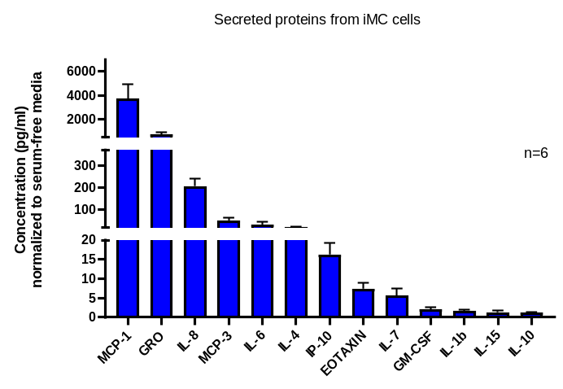
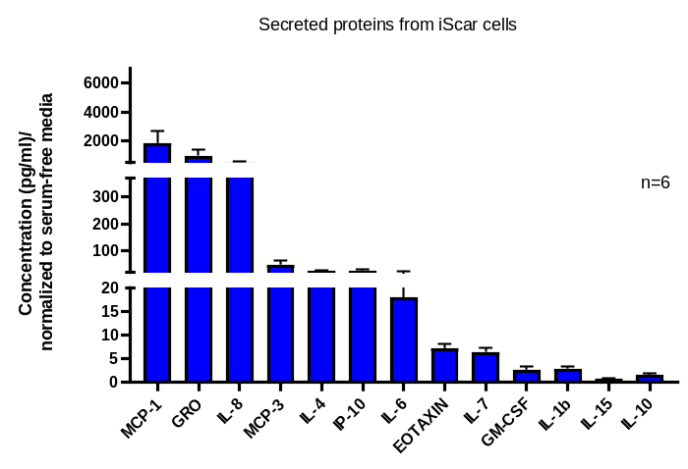
Supp Fig 2. Concentration of secreted proteins from iMC cells on plastic and on hydrogel
Cytokine/chemokines secreted by iMC cells grown on plastic and on hydrogel

Slide 6
Upregulated in iSCAR-P DMSO vs iSCAR-Ctrl DMSO | Upregulated genes shared between iSCAR-P and iSCAR-T DMSO vs iSCAR-Ctrl DMSO | Upregulated in iSCAR-T DMSO vs iSCAR-Ctrl DMSO
MYLIP,SYN1,TG,NGFR,KIF26A,NEO1,PDZD4,CA12,CEACAM1,PCDHB4,HSD17B14,FER1L4,ANKRD24,NRCAM,TF,UNC13D,YPEL1,PIK3IP1,RASD2,SALL4,HTR2A,AP3B2,RP1,NDRG1,IL7,TLE6,PTGDS,CUBN,CDH23,SEPTIN4,CPZ,HPX,MDK,VEGFA,PCDHB6,THBS4,ARRDC3,PEX5L,FBXO2,MMP8,SPP1,PCDHB10,SARDH,COL10A1,LRRC17,SAT1,LGALS3,DMGDH,DCLK1,C1QTNF6,UNC79,PTPN22,KLRD1,LRP4,PDGFRA,IL6,ALPK3,ENPP2,CILP,ITGB7,CBLN3,PTGR2,CCDC33,NTN5,ADAMTS10,SYT14,PLEKHA6,IGFBP3,WDR31,SESN3,BTBD11,TDO2,MERTK,SLC25A27,ABCA9,ABCA6,ABCA10,LY96,CFAP70,ALX3,GPR153,RHBDL2,STC1,LRRC56,TAMALIN,BEND5,DRAXIN,DHRS3,PBXIP1,ELF3,EFHB,GEM,LRFN5,PRRT2,RHEBL1,ANGPTL4,FTH1,DDIT4,DEGS2,LGALS9,COL22A1,SMPDL3A,SLCO2A1,P2RY14,GRAMD2A,ORAI3,TCIM,MUC20,PSAPL1,NA..224,VWA1,LACC1,ADGRB1,CACNB4,EPHB3,PTP4A3,ANO9,CCDC30,PCLO,RHCE,FSIP2,LRRC66,SEMA4A,MAML3,ZNF763,SULT1C2,C20orf203,PAX9,TGM2,RNU4.1,RNU4.2,ADD3.AS1,PRRT1,NALF1,ASPDH,C4orf47,MUC12,INSYN1,CFI,SNORA3B,PRCD,CD27.AS1,RNF212B,NA..2578,MEG9,NA..2769,CACNA2D1.AS1,NA..3041,NA..3122,SVIL.AS1,NA..3593,ELFN1,LINC02798,MEIS1.AS2,PDE4DIPP6,NA..6068,HMGB3P31,PBX1.AS1,LINC01239,PRRX2.AS1,LINC02921,NA..8030,MAP3K2.DT,NA..8992,CDKN2B.AS1,STON1,NA..9638,MEF2C.AS1,PURPL,RN7SKP253,OXR1.AS1,NA..11932,NA..12353,NA..12547,NA..12665,NA..12808,SMIM3,NA..13417,NA..14434,NA..14492,NA..14640,NA..14931,NA..15243,CEROX1,NA..15818,NA..15961,MYO15B,GAPLINC,LOC105372321,NA..18286,TTC23L.AS1,NA..19062,NA..19091,LOC107985216,NA..19544,NA..19715,LINC01138,LINC02930,NA..20003,NA..20290,NA..22444,NA..22458,NA..22502,NA..23002 | CFH,SOX8,CRLF1,CACNA1G,ETV1,GAS7,CAMK1G,SYT7,RAB27B,COL9A2,CAMK2B,PSD,PTPRU,CA11,ABCA7,NTN1,TRPC5,MOV10L1,GPC4,ITGA8,MAP2,COL5A3,CXCL2,SERTAD4,CD82,ARHGAP28,CHGB,SLC7A8,COL9A3,PTGS1,MMP11,HMOX1,RPS6KA5,MMP9,SGK2,NFATC2,ISM1,BPI,SYNDIG1,MXRA5,PHEX,RUBCNL,WFDC1,IL21R,ATP8B4,BMF,IL4I1,OLFM2,CFAP69,SFRP4,ASPN,UNC5B,NEURL1,RASD1,AREG,PPARGC1A,SLC1A2,TSPAN11,MGP,BACH2,LAMA4,ST8SIA4,KLHL24,IL1R1,IL18R1,KYNU,ATP6V1B1,PLA2G4A,RGS2,SIPA1L2,MFAP2,IRF6,MAN1C1,NR4A3,PGF,TGFB3,PCDHB14,PCDHB12,PLXDC2,EGR2,NR4A1,G0S2,PTGIS,COL21A1,SOX4,CXCL6,C3,BMP2,TNFRSF19,FGL2,RASL11B,KDR,MCHR1,RNF112,ISLR,ACKR4,BBOX1,CDKN1C,APOE,UNC13A,ANO1,PODNL1,SERPINF1,KANK4,RNF128,DGLUCY,SOX5,FAIM2,GPNMB,KLF4,TMOD1,ANGPTL2,CCN3,IL33,ARHGAP20,MMP13,STRA6,SEMA6D,IFI44,CLCA2,B4GALNT3,PHLDA1,LUM,TMEM132B,KCNH5,FGF7,NKD1,SLC14A1,RGS16,HMCN1,CTSK,VASH2,KCNN3,CNIH3,ACKR3,BOC,IQGAP2,MEGF10,RSPO3,SYTL5,GPC3,CSGALNACT1,PTGES,FAM13C,HTR7,PAMR1,TENM4,P4HA3,KIAA1755,CCDC102B,EDNRA,RNF144A,PART1,BCL2L11,BMP6,NR4A2,PLA2R1,PTPRD,ANKH,ANGPT1,AFF2,PCDH1,FBXO32,KCNJ6,KCNJ15,NBL1,C1R,SPON2,TPPP3,CYGB,LHX8,GBP2,SNED1,KIF26B,ADAMTS9,RBM47,CXCL3,CXCL5,CXCL1,EMCN,SPRY1,GRIK2,TXLNB,SAMD3,PI16,HEY1,ABCA1,AQP3,MFAP4,CCDC68,BEAN1,RRAD,PRRX2,BEST1,BDKRB2,HR,TNXB,LDLRAD4,LRP1B,ZNF608,CXCL8,WNT10B,FOS,HTRA3,MTSS1,PDGFD,KCNK3,KNDC1,SCG2,SYT12,C1QTNF1,PODN,CNTNAP2,CMKLR1,FGFBP3,A2M,FIBIN,LRRN4CL,EGR3,GAS1,GREM2,C1orf105,CHRM2,RGMA,C1S,TSHZ2,CRIP2,GPC6,TMEM119,GRIN2A,TNFAIP8L3,B3GALT5,COLEC10,SLITRK6,SORCS2,TNFAIP2,PPIL6,METTL7A,DLK1,LSAMP,OLFML2A,PBX1,IFITM1,GNG2,PCDHB13,SAMD11,COL14A1,CFAP54,AKR1C3,SRGAP3,NLGN3,RFX8,SULF2,MMP1,LAMB3,TMEM26,SVIL,DACT3,DIO3,SSPOP,AKR1B10,SULT1C4,RASSF9,ZNF521,SUCNR1,MAFB,COL15A1,PCDHA7,DOK6,RNU6.171P,SP9,YAP1P1,PLXNA4,SLC12A8,NA..2659,LINC02593,NA..2948,ZMIZ1.AS1,NA..3175,NA..3388,NA..3526,MIAT,NA..3907,NA..3924,RLIMP1,NA..5681,NA..5736,NA..5869,LINC01305,KIF26B.AS1,NA..6493,NA..6542,LOC349160,NA..7346,CASP4LP,MXRA5Y,HNRNPA1P29,LINC01844,NA..8319,UNC5B.AS1,AMY2B,AQP1,LSAMP.AS1,RPL35P6,IFITM10,LUCAT1,NA..10185,LINC01091,NA..10364,NA..10839,NA..11104,NA..12167,NA..12169,RTL1,LOC100287896,NA..12825,TRIL,DIO3OS,NA..15052,PECAM1,NA..15819,NA..15825,NA..17047,NA..17911,NA..18273,ATP2B1.AS1,NA..18972,NA..19032,NA..19279,NA..21776,NA..22639,NA..22927 | HS3ST1,HECW1,TENM1,DAPK2,ARHGAP6,TNFRSF9,EPN3,ELN,LAMA3,PTPRN,GUCY1B1,TLE2,NGEF,GAL,DHRS9,ACACB,HOXA9,BRINP1,EBF4,CPXM1,TBX5,GGT5,NTSR1,LIPG,PCYT1B,CRISPLD2,COMP,PTN,HOXA5,NSUN5P2,MEOX2,OGN,CCL7,ABCC3,SLC16A6,PCDHB7,PROC,PLCL1,HSD11B1,GPR68,TBX4,FABP3,TNFAIP6,EREG,PTGER2,A4GALT,ATP1B2,FGF13,PTPRE,SNAP25,CHI3L1,MYBPH,CYP27A1,FRAS1,PIK3C2G,ACVRL1,CBLN2,SYTL1,MALL,OTULINL,SLC22A3,ADAM33,CNKSR2,FOXO1,KCNE4,PLEKHH2,PDLIM3,APCDD1,ATP2B2,FZD1,ACAN,DUSP2,ACE,ZFYVE28,PLXDC1,DIRAS3,OLFML2B,OBSCN.AS1,CTSS,CADPS,HAND2,NA..96,BAALC,ZMAT4,TMEM100,ANPEP,ISLR2,GPRC5B,FAM83B,FABP4,LONRF2,TRH,COL8A2,CALB2,HSPB7,KY,CHST1,MYO1D,FAM216B,C3orf80,FOXL2,NA..330,ROBO2,SOCS1,NKAIN3,AKR1C1,NA..373,LHFPL3,C11orf96,CDHR4,SKOR1,PCDH18,LAMA2,ENPP1,DPP4,DNM3,SFMBT2,CSAG1,NA..806,LRRC73,HLA.F,GPR20,NA..1277,FOXL2NB,TMEM200C,MAGEA12,S1PR3,CPEB1,LINC00548,RN7SKP110,NA..2753,NA..3405,GAS1RR,NA..5653,NA..5899,NA..6107,OSBPL10.AS1,CNIH3.AS2,NA..7142,NA..7685,LOC100421775,HAND2.AS1,NFIA.AS2,IFNWP19,LINC01119,PRICKLE2.AS1,NA..9268,LINC01391,LINC01252,LINC01060,HOXA10.AS,HOXA10,NA..11721,TBX5.AS1,NA..13038,LOC100996333,FMNL1.DT,NA..17008,NA..17361,NA..18102,NA..18544,MMP28,NA..21146,NA..22687
Supp Table 3. iSCAR-P DMSO and iSCAR-T DMSO vs iSCAR-Ctrl DMSO
204 upregulated and significant DEGs from iSCAR-P DMSO vs iSCAR-Ctrl DMSO unique to early scar formation, 164 upregulated and significant DEGs from iSCAR-T DMSO vs iSCAR-Ctrl DMSO unique to late scar formation, and 332 genes shared between the two comparisons.

Slide 7
Upregulated in iSCAR-P DMSO vs iSCAR-T DMSO | Upregulated in iSCAR-T DMSO vs iSCAR-P DMSO
HSPB6, SLC2A3, SEMA3A, PGK1, SRPX2, NDRG1, BNIP3L, WSB1, ALDOC, MDK, ENO2, VEGFA, LOX, ARRDC3, ST8SIA4, FAM162A, PFKFB4, KDM3A, MXI1, TGFBI, P4HA1, PPDPF, GPCPD1, FBXL16, LIF, WARS1, ARRDC4, PPFIA4, VLDLR, DPYSL4, PDK1, HK2, AK4, VCAM1, ANKZF1, ZNF91, SLC43A2, ANGPTL4, DDIT4, GOLGA8A, BNIP3, VWA1, MTURN, C1S, ERO1A, OGA, RNA5SP298, SH3D21, SNORA11, PCDHGB7, TXNIP | NCAPH2, ARNTL2, TLL1, LAMA3, PITX1, EZR, ABLIM1, RANGAP1, MYBL2, CXCL12, UBE2S, AREG, FOXM1, MCM3, DHCR24, PHF19, DUSP4, PKMYT1, HOXD10, PIMREG, CHI3L1, SORT1, TROAP, TCF19, ARHGAP29, FRAS1, LHX9, NCAM1, ADAM33, KCNE4, CLGN, NRG1, PKN3, HACD1, EXO1, LMNB2, CDH4, KIF18B, H2AX, H1.0, S100A4, ENPP1, SLC5A3, SFMBT2, MAGEA12, C12orf75, MRPS6, HOXA10, H2BC17, H2AC12, UHRF1, H4C9, H2BC7
Supp Table 4. iSCAR-P DMSO and iSCAR-T DMSO direct comparison
51 upregulated and significant DEGs in iSCAR-P DMSO vs iSCAR-T DMSO representing early scar formation. 53 upregulated and significant DEGs in iSCAR-T DMSO vs iSCAR-P DMSO representing late scar formation.

Slide 8
dSSc_Early scar formation | dSSc_Late scar formation
ASPN,SCG2,HMCN1,MMP11,LUM,IL6,C1QTNF6,SYNDIG1,CXCL1,COL15A1,ADAMTS9,TGFB3,A2M,C3,THBS4,TGM2,SPP1,COL14A1,SULF2,RGS16,G0S2,CMKLR1,GEM,P2RY14,AKR1B10,WFDC1,MMP9,IL4I1,CFI,MDK,IFITM1,IFI44,MMP1,MXRA5,RSPO3,C1S,CCN3,CXCL2,PGF,ANGPTL2,NGFR,HTRA3,MFAP2,CPZ,LY96,PTGDS,IGFBP3,ENPP2,SMIM3,PECAM1,TCIM,C1R,SERPINF1,IL1R1,KDR,ANGPT1,ANGPTL4,VWA1,SAMD11,CRLF1,IL21R,TSPAN11,SLCO2A1,UNC5B,CNTNAP2,SYT12,EDNRA,LDLRAD4,FGF7,MAN1C1,ARHGAP28,PIK3IP1,ARHGAP20,PTP4A3,DACT3,NR4A3,STON1,KIF26B,CEACAM1,IL33,GPC3,KYNU,CSGALNACT1,ACKR3,PLXNA4,LAMA4 | COMP,ASPN,CPXM1,SCG2,HMCN1,MMP11,LUM,KCNE4,ELN,SYNDIG1,CXCL1,COL15A1,ADAMTS9,TGFB3,A2M,C3,COL14A1,SULF2,RGS16,G0S2,CMKLR1,AKR1B10,WFDC1,ACAN,MMP9,IL4I1,IFITM1,IFI44,MMP1,MXRA5,C11orf96,RSPO3,C1S,CRISPLD2,CCN3,GGT5,CXCL2,PGF,ANGPTL2,GPR68,HTRA3,MFAP2,GUCY1B1,LAMA2,PLXDC1,COL8A2,ACVRL1,PECAM1,CTSS,C1R,SERPINF1,IL1R1,KDR,FGF13,ANGPT1,OLFML2B,SAMD11,CRLF1,PTN,TNFAIP6,IL21R,TSPAN11,SFMBT2,UNC5B,CNTNAP2,SYT12,EDNRA,LDLRAD4,FGF7,MAN1C1,ARHGAP28,MYO1D,ARHGAP20,MEOX2,DACT3,NR4A3,KIF26B,IL33,PTPRE,GPC3,KYNU,CSGALNACT1,ACKR3,HS3ST1,PLXNA4,LAMA4
Supp Table 5. Lead genes from early and late scar formation mapped to dSSc
Lead genes from GSEA analysis showing positive and significant enrichment of dSSc genes in both early (adj. p-value=4.37E-15) and late (adj. p-value=1.06E-14) scar formation.

Slide 9
dSSc_Prevention Skin_Autotaxin Inhibitor_v_DMSO_DOWN | Shared between dSSc_Therapeutic and dSSc_Prevention Skin_Autotaxin Inhibitor_v_DMSO_DOWN | dSSc_Therapeutic Skin_Autotaxin Inhibitor_v_DMSO_DOWN
SYNDIG1, C2, AKR1B10, STARD8, SLC1A3, MMP9, CFB, SPRY4, PLXDC1, STEAP1, PTPRB, KALRN, ARHGAP20, MEOX2, RHOH, MPZL2, MGAT4A, HIP1, ENPP1, PBX1 | MMP11, GEM, PECAM1, SYT12 | TNC, HMCN1, COL6A3, TGFB3, A2M, C3, COL1A1, G0S2, CMKLR1, LHFPL2, COL1A2, SH3TC1, ANGPTL2, P2RY6, MFAP2, FGF18, PMEPA1, IGFBP3, COL3A1, DACT1, SLC7A7, FAM20C, COL16A1, ANGPTL4, IL27RA, SAMD11, PDGFRB, CRLF1, TGFB1, TSPAN11, EDNRA
Supp Table 6. Lead genes from Autotaxin inhibitor early and late scar formation mapped to dSSc
Lead genes from GSEA analysis showing iSCAR-P_autotaxin inhibitor enrichment in dSSc (not significant) and iSCAR-T_autotaxin inhibitor enrichment in dSSc (NES=2.1465, FDR q-val=0), and genes shared between the two enrichment studies

Slide 10
dSSc_Prevention Skin_EX00015097_v_DMSO_DOWN | Shared between dSSc_Therapeutic and dSSc_Prevention Skin_EX00015097_v_DMSO_DOWN | dSSc_Therapeutic Skin_EX00015097_v_DMSO_DOWN
NID2, SYNDIG1, THBS4, C2, COL14A1, NRP2, C7, AKR1B10, STARD8, CD53, MMP9, ADAMTS4, C1QTNF3, RSPO3, GGT5, EMID1, FERMT3, CPZ, PLXDC1, MMP2, COL3A1, COL8A2, FLRT2, HPR, NRP1, CSF1R, HTRA1, ROR2, FGF13, ANGPT1, GLT8D2, CRLF1, HGF, PDE4B, IL21R, LDLRAD4, KALRN, TRANK1, ANTXR1, ARHGAP28, INPP5D, ARHGAP20, PTP4A3, RHOH, CEACAM1 | CPXM1, SCG2, TNC, HMCN1, MMP11, COL6A3, CDH11, C1QTNF6, TGFB3, SULF2, GEM, EMILIN1, VWCE, C1S, ANGPTL2, HTRA3, MFAP2, TRIB2, ENPP2, PECAM1, SERPINF1, SAMD11, PDGFRB, PLEKHA4, TSPAN11, UNC5B, SYT12, EDNRA, UBA7, ZCCHC24, DACT3, STON1, KIF26B | ADAMTS9, C3, TGM2, RGS16, CMKLR1, LHFPL2, RAB31, COL1A2, LAMB1, MXRA5, MXRA8, C11orf96, RASSF4, CRISPLD2, SEMA6B, SH3TC1, PCOLCE, TMEM88, SLC6A6, PLTP, PLPP4, GXYLT2, VASH1, VAT1L, FGF18, LAMA2, KIAA1217, PMEPA1, IGFBP3, DACT1, ACVRL1, SLC7A7, PTK7, FAM20C, C1R, BCL3, IL1R1, COL16A1, MEF2C, ST6GAL1, TGFB1, BTN3A1, PDZRN3, SOD2, DUSP6, CD4, C1orf54, GLI1, PIK3IP1, CASC15, MYO1G, NR4A3, CXCR3, SLC2A10, C1RL, ARHGEF3, CSGALNACT1, SRPX2, ARHGEF40, ACKR3, ZNF423, LAMA4, BHLHE40, ATXN1, TCF4, RASL12, PHLDA1, SNED1, HIP1, BAHCC1, PBX1, TRO, MOB3C, PRICKLE2, DNMT3A, GPC6, ETV1, LDB2, IER5L, ZNF521, KANK2, DCHS1, MIAT, COL5A3, MYOZ3, MDFI, SLC43A1, C1QTNF1, SETBP1, ARRB1, ADGRL1, ABCA1, SOX4
Supp Table 7. Lead genes from EX00015097 early and late scar formation mapped to dSSc
Lead genes from GSEA analysis showing iSCAR-P_EX00015097 enrichment in dSSc (NES=1.8449, FDR q-val=0.004015) and iSCAR-T_EX00015097 enrichment in dSSc (NES=1.8685, FDR q-val=0.00169), and genes shared between the two enrichment studies

