Slide 1
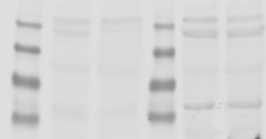
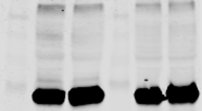
A
B
Marker
[kDa]
NMuLi/EV-2
NMuLi/UGCG OE
Marker
[kDa]
Marker
[kDa]
n1
n2
n3
n1
n2
n1
n2
75
50
55 kDa Complex V
50
48 kDa Complex III
UGCG
(46 kDa)
37
40 kDa Complex IV
36
25
30 kDa Complex II
20
20 kDa Complex I
50
36
14-3-3
(30 kDa)
Ponceau S
Supplement 1

Slide 2
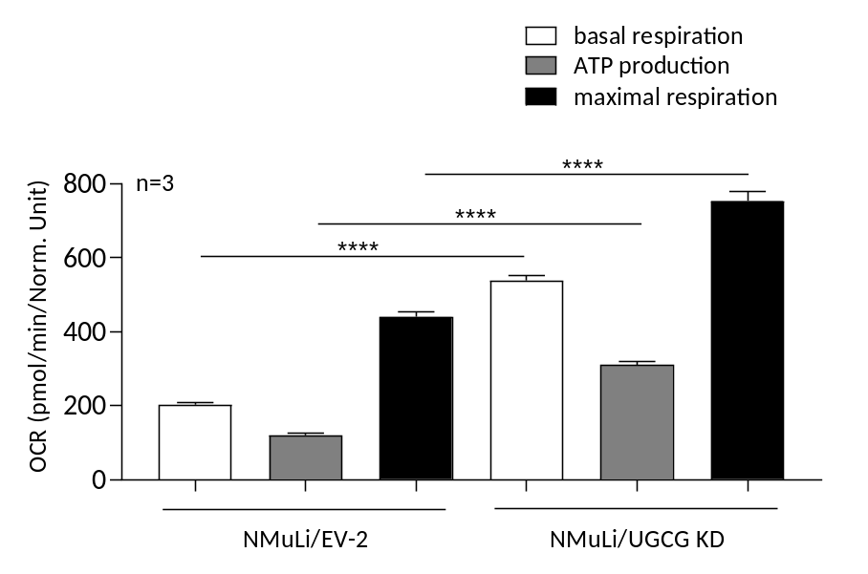
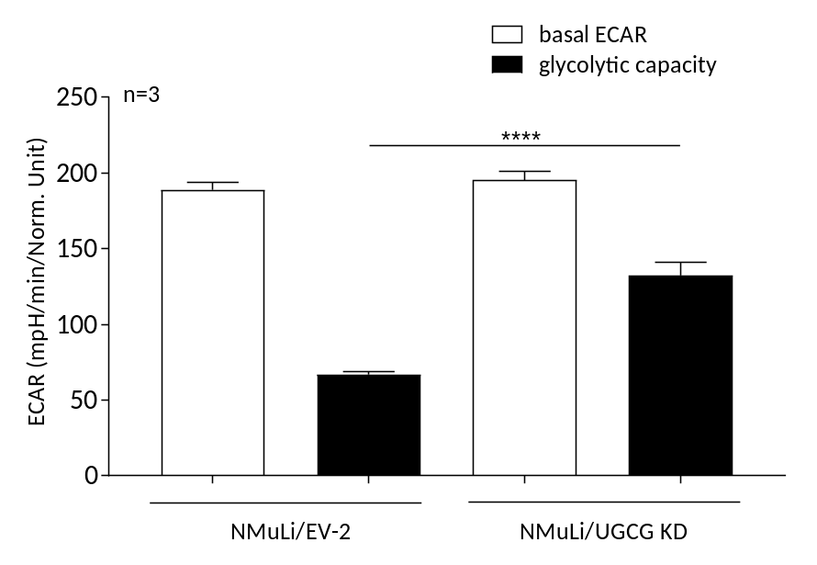
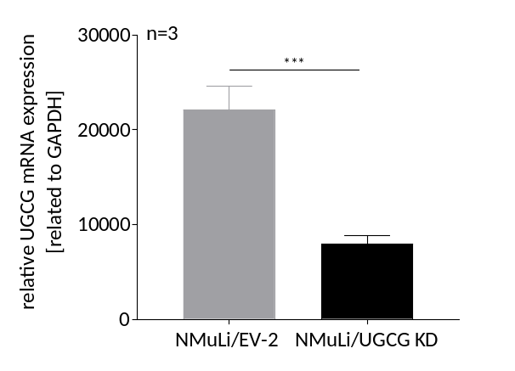
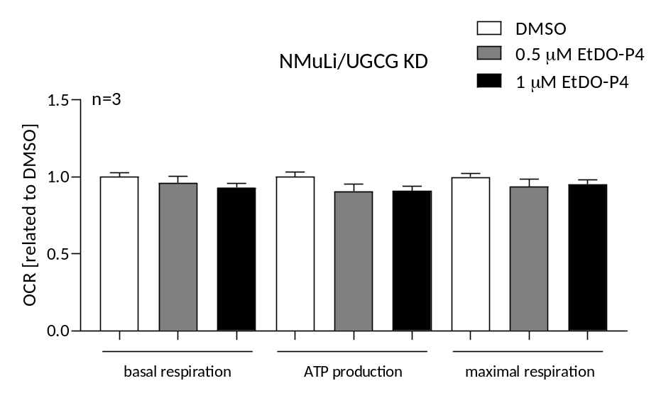
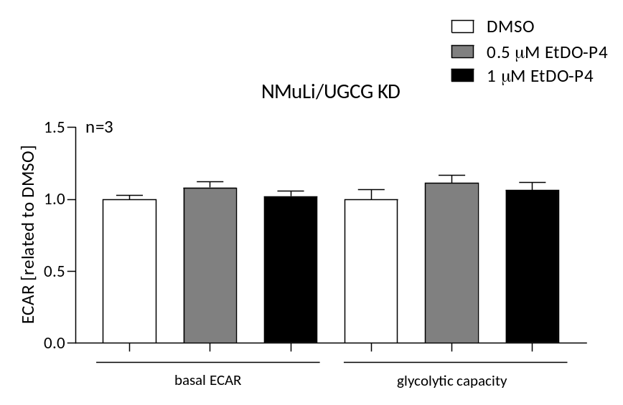
C
D
E
F
Supplement 1

Slide 3
Supplemental 1: A UGCG protein concentration determination by Western blot analysis. B Oxidative phosphorylation (OXPHOS) protein concentration determination by Western Blot analysis. C Expression analysis of UGCG mRNA in NMuLi/UGCG KD and control cells by qRT-PCR. mRNA expression is normalized to the housekeeping gene GAPDH. Data are represented as a mean of n = 3 ± SEM. Unpaired t test with Welch’s correction. D Oxygen consumption rate (OCR) determined by Seahorse XFe analyzer. ATP production (basal respiration − respiration after oligomycin injection), maximal respiration rate (respiration after N5,N6-bis(2-fluorophenyl)-[1,2,5]oxadiazolo[3,4-b]pyrazine-5,6-diamine (BAM15) injection − respiration after antimycin a/rotenone injection). Data are presented as mean of n = 3 ± SEM. Tukey’s multiple comparison test. E Extracellular acidification rate (ECAR) quantified by Seahorse XFe analyzer. Glycolytic capacity is deduced from ECAR after oligomycin treatment − basal ECAR. Data are presented as mean of n = 3 ± SEM. Tukey’s multiple comparison test. F OCR following EtDO-P4 treatment determined by Seahorse XFe analyzer. ATP production, maximal respiration rate. Data are presented as mean of n = 3 ± SEM. Tukey’s multiple comparison test. ECAR following EtDO-P4 treatment quantified by Seahorse XFe analyzer. Data are presented as mean of n = 3 ± SEM. Tukey’s multiple comparison test. *p ≤ 0.05, ***p ≤ 0.001, ****p ≤ 0.0001
Material and Methods
sgRNA cloning and virus production
Three sgRNAs targeting murine UGCG were selected:
Sequences (5’ - 3’)
UGCG No. 1 – gccgattacacctcaacaaga
UGCG No. 2 – gtggccaaagcgatagctgac
UGCG No. 3- gcatcatgatcttgtacacaa
To generate lentiviral supernatant, HEK-293T cells were plated 24 h prior to transfection at a density of 1E6 cells per well in 2 ml volume of DMEM media (Gibco, Dublin, Ireland). Transfection was performed using GeneJuice Transfection Reagent (Merck Millipore, Burlington, Massachusetts, US). The transfection mixture for one 6-well contained 100 µl OptiMEM I media (Gibco, Dublin, Ireland), 21 µg GeneJuice, 2.7 µg psPAX2 (Addgene 12260, Watertown, Massachusetts, US), 1 µg pMD2.G (Addgene 12259, Watertown, Massachusetts, US), and 3.3 µg of each transfer vector, 7 µg in total per pool. The mixture was incubated for 15 min at room temperature and added drop-wise to the cells. After 8 h, the media was replaced by fresh media. After 24 h the supernatant was harvested and replaced by fresh DMEM and after 48 h the supernatant was harvested a second time and combined with the 24 h time point of supernatant. The combined supernatant was frozen at -80° and stored for later use.
Lentiviral transduction of NMuLi cells
NMuLi cells were incubated with 4 µg/ml polybrene and 1/10 viral supernatant for 48 h at 37 °C. Subsequently, the viral supernatant was removed, and stable cell lines were selected by adding Puromycin (1 µg/ml).
Supplement 1

