Slide 1
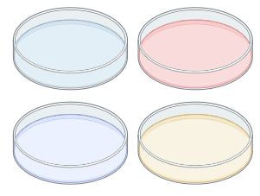

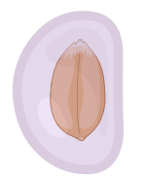
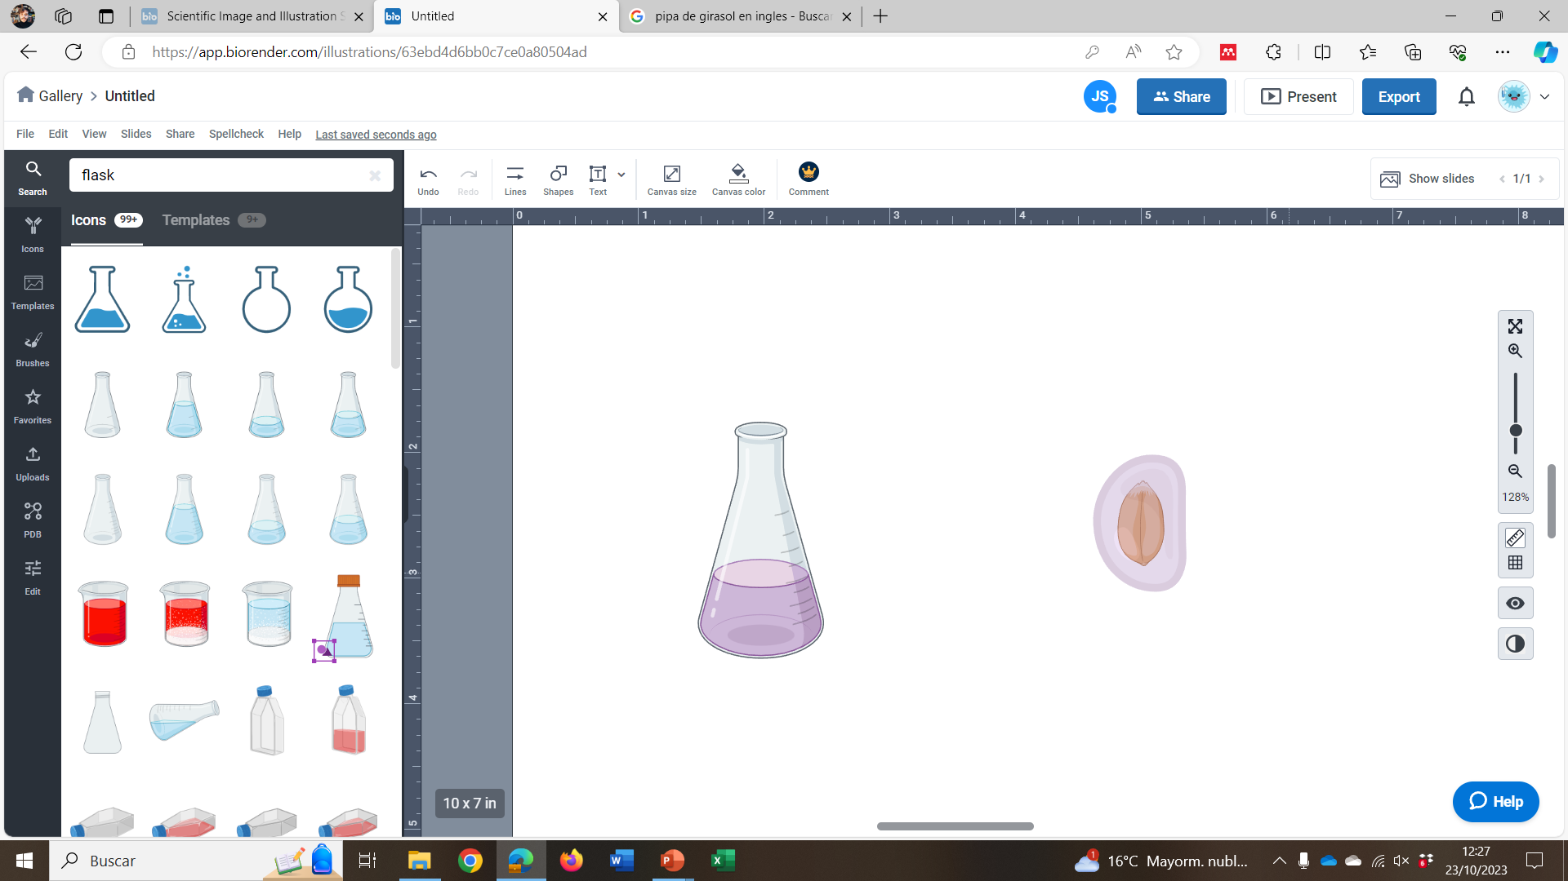
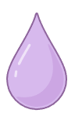
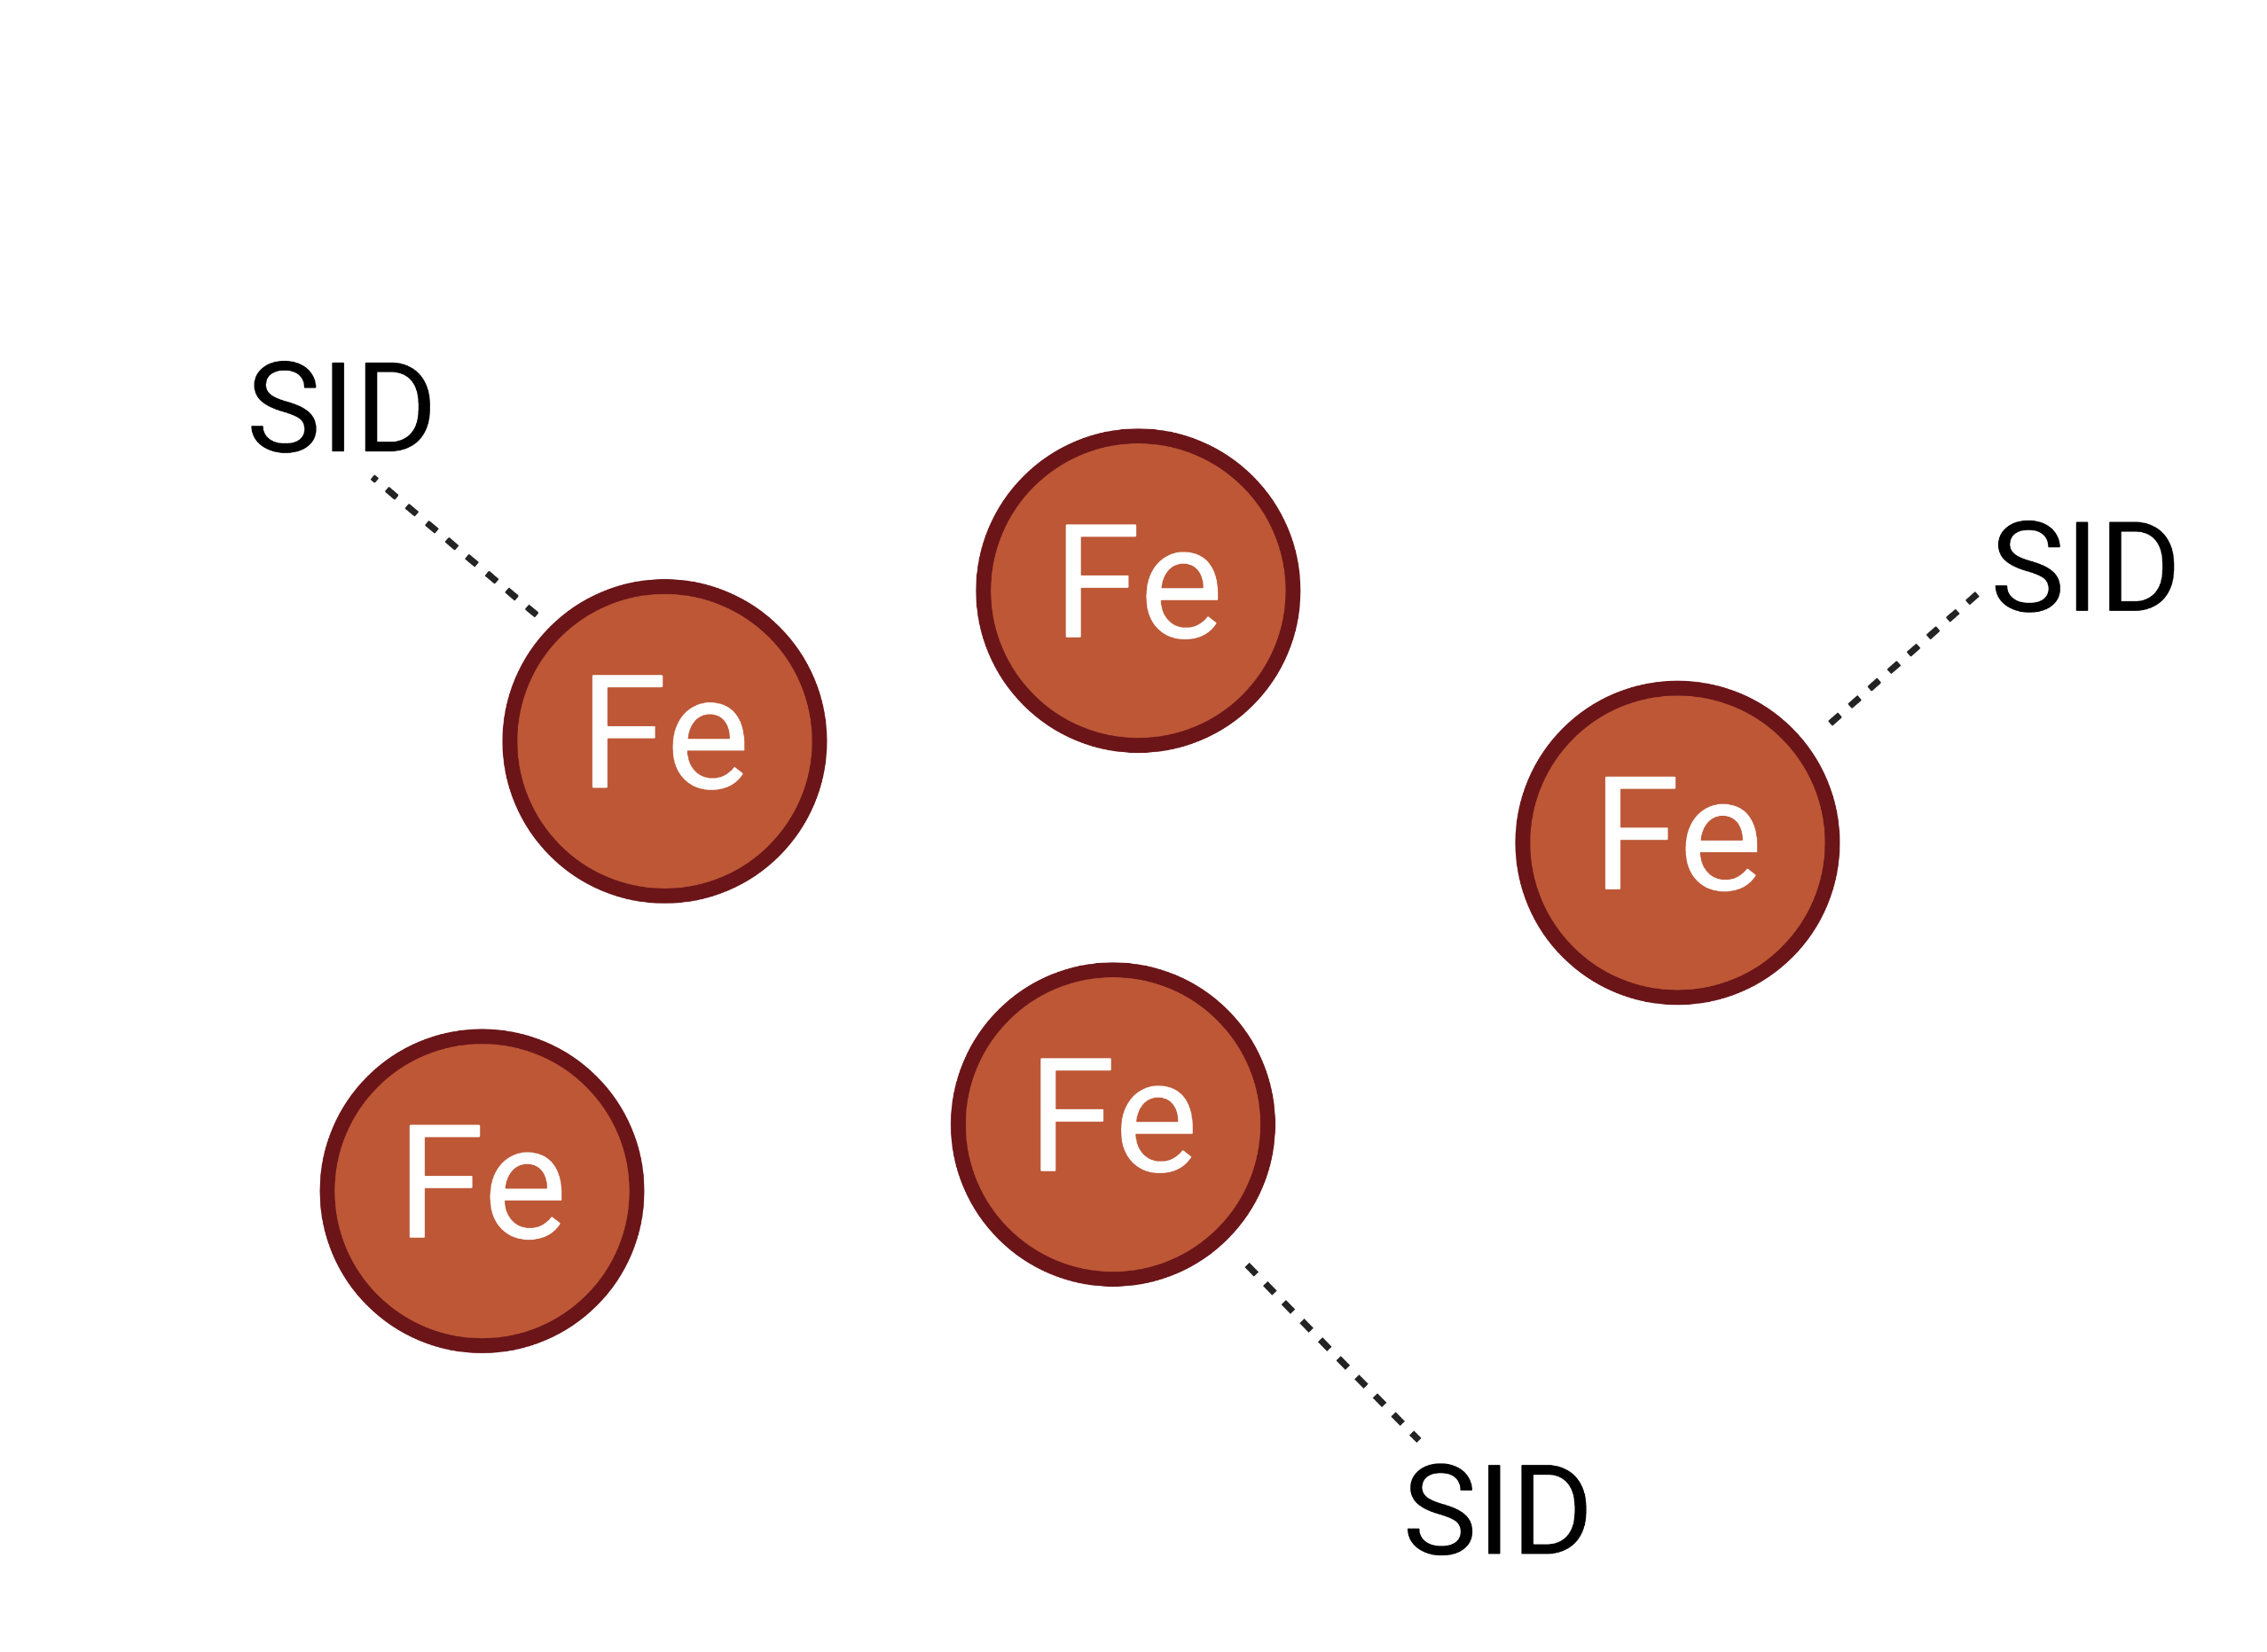

The non-pathogenic strain Fusarium oxysporum FO12 enhances sunflower and wheat performance by altering the phytohormone profile and soil properties
Potential of FO12 for increasing nutrient availability in vitro
Crop growth, nutrient uptake and plant hormone production under differing soil conditions
Czapek-dox media inoculated or not with FO12 and incubated for 35 days
Sunflower and wheat grown on two calcareous and two non-calcareous soils
No mineral
+Fe
FO12 increased reproductive biomass (+30%) in non-calcareous and calcareous soils
Seed dressing (Sd)
Dose (0, 10, 50 and 150 mg kg⁻¹)
or
Soil treatment (St)
+Zn
+P
S
W
200 experimental units
240 experimental units
S
P
Fe
S
ABA
JA
ACC
Fe
202%
Zn
57%
P
7%
W
P
Ca
Zn
Fe
Mn
W
JAIle
ACC
FO12 showed its ability to produce siderophores
FO12 increased nutrient bioavailability
St increased nutrient uptake in sunflower grown on calcareous soils and in wheat on non-calcareous soils
Sd increased hormone production in sunflower grown on non-calcareous soils and in wheat on calcareous soils
Created with Biorender.com

