Slide 1
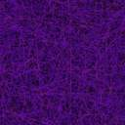
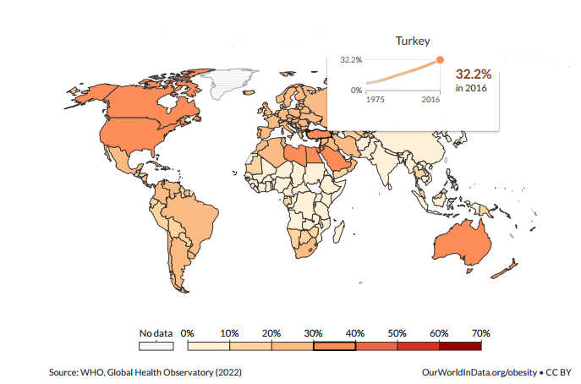
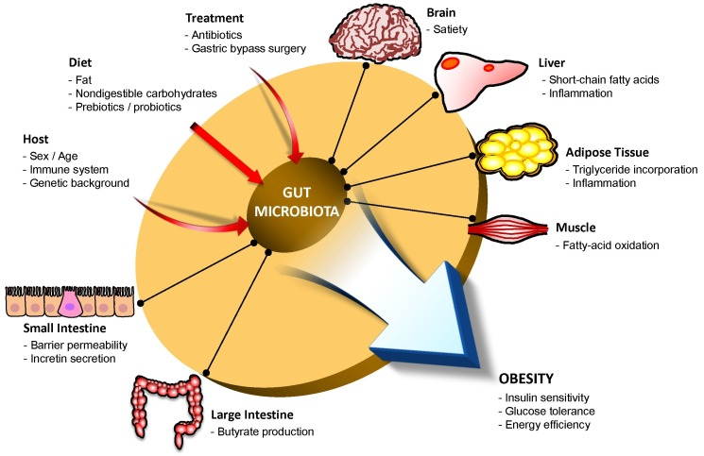


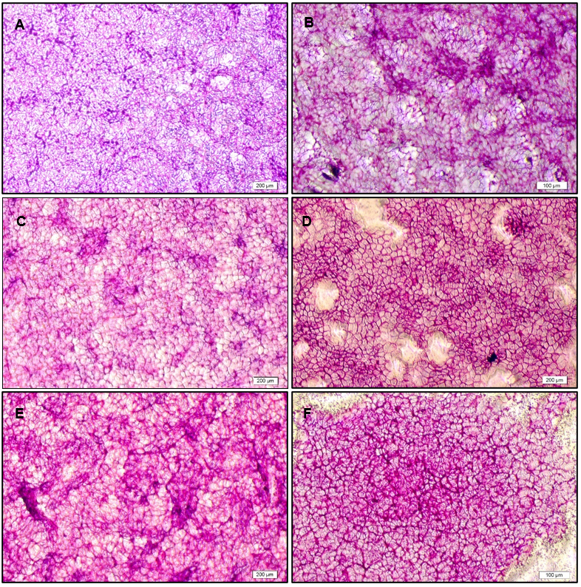
High Mucin Layer with Lactıc acıd bacterıa to Customize a Gastroıntestınal Niche
OBESITY
Modulation of Microbiota by triggering AkkermAnsia
MICROBIOTA & OBESITY
What is Akkermansia muciniphila?
Relationship with
Obesity
Akkermansia as Super Probiotics
Probiotic Effect on Akkermansia
[1]
[2]
Percentage of Obesity in the World
MATERIAL & METHODS
OBESE PEOPLE
↑ Firmicutes & ↓ Bacteroidetes
LEAN PEOPLE
↓ Firmicutes & ↑ Bacteroidetes
Determination of Mucin Degradation & Growth Ability of Isolates
Bacterial Adhesion on Mucin
Biofilm Formation
Sugar Fermentation Tests
Determination of Lactate Production
Determination of the Bacterial Cultures
Stability of LABs in Simulated Gastrointestinal Conditions
Determination of Antimicrobial Properties
Qualitative (PAS Staining) & Quantitative Determination of Mucin Layer
RESULTS & DISCUSSION
16 LAB strains adhered to mucin/mucus layer and kept their viability in the GIT.
LAB did not degrade mucin, showed biofilm formation, lactate production, and antimicrobial properties.
L. casei NRRL-B 441 showed the highest improvement in the mucin thickness.
CONCLUSION
A suitable niche was created for Akkermansia muciniphila, a new generation probiotic, and 6 anti-obesity prototype candidate LAB isolated from various sources were determined.
HT-29 cell + mucin with 20 mM/50 mM lactate increases the amount of mucin layer!
References:
[1] Ritchie H., & Roser M. (2017). Obesity. Retrieved from https://ourworldindata.org/obesity. Accessed December 17, 2022
[2] Yang, J. Y., & Kweon, M. N. (2016). The gut microbiota: a key regulator of metabolic diseases. BMB reports, 49(10), 536.

