Slide 1
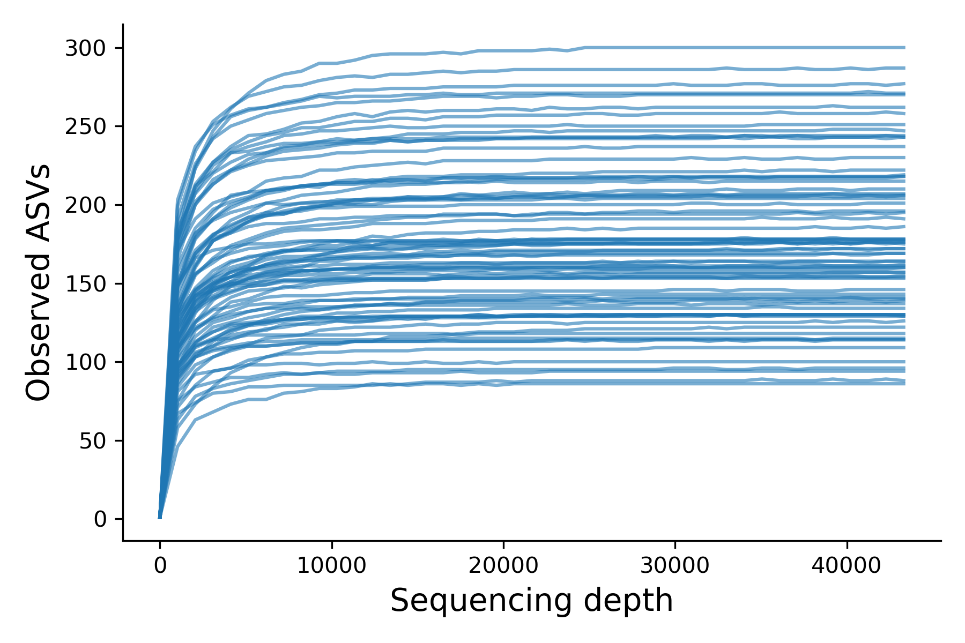
Supplementary Figure S1
Figure S1. Alpha diversity rarefaction curves for 75 samples. The plateau curves indicate a sufficient sequencing depth.

Slide 2
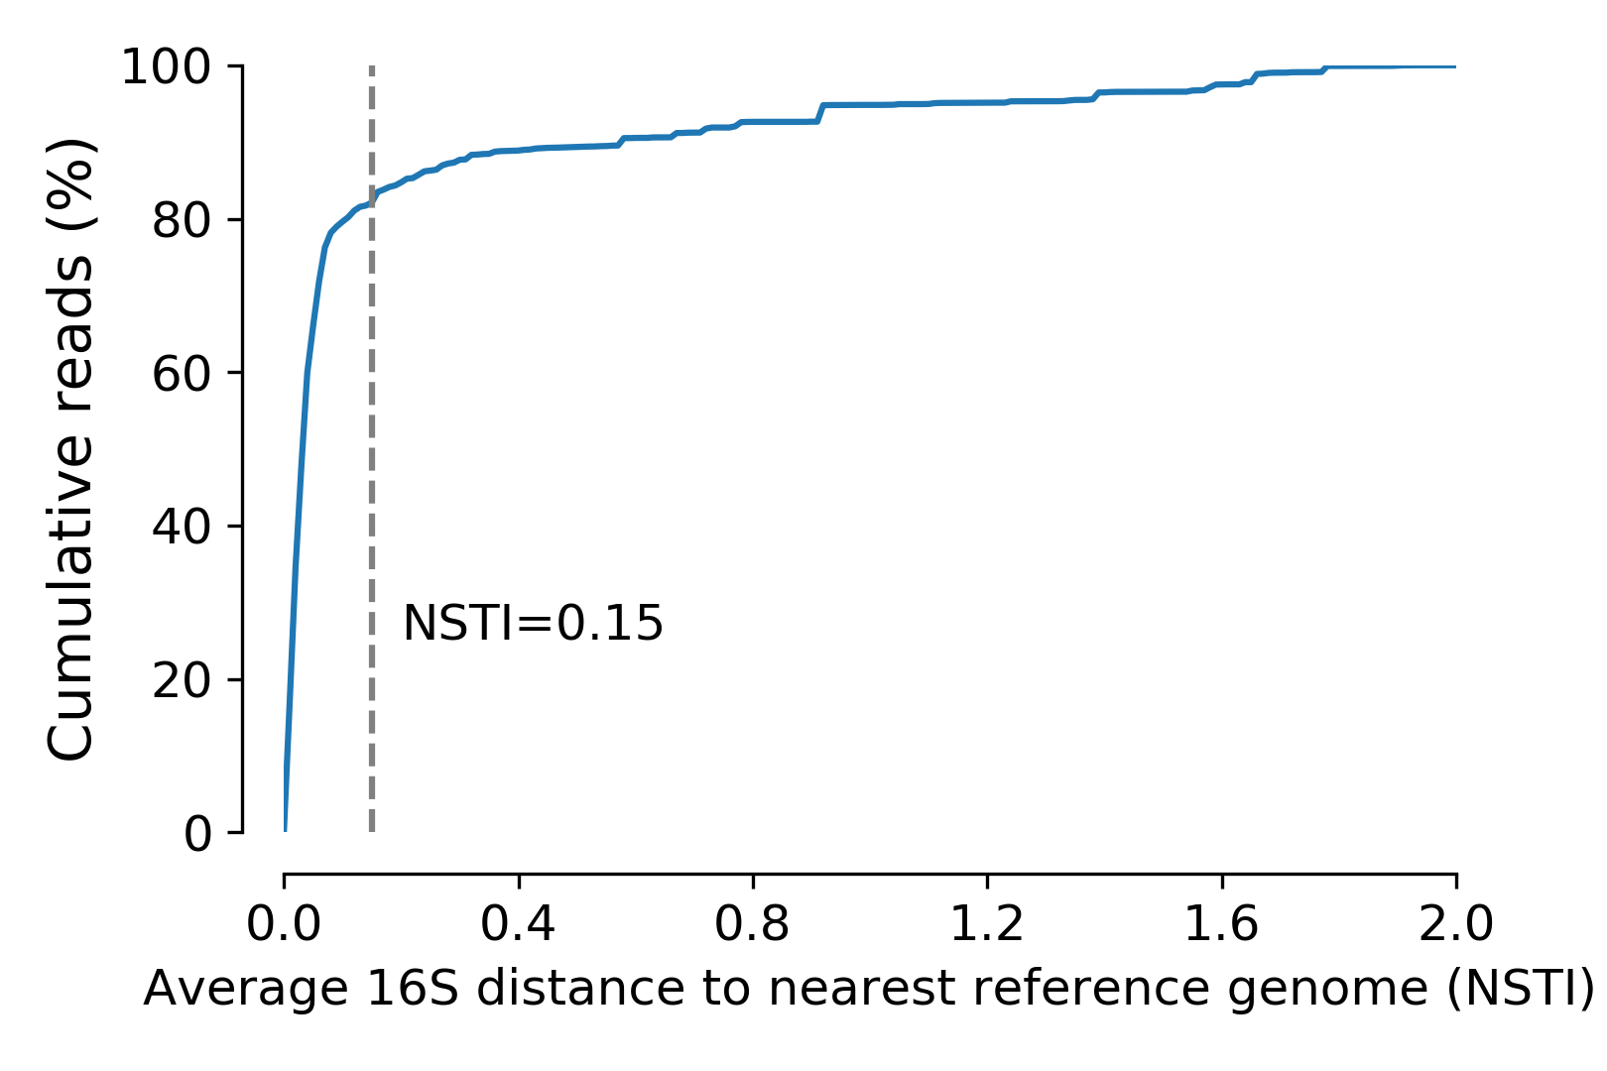
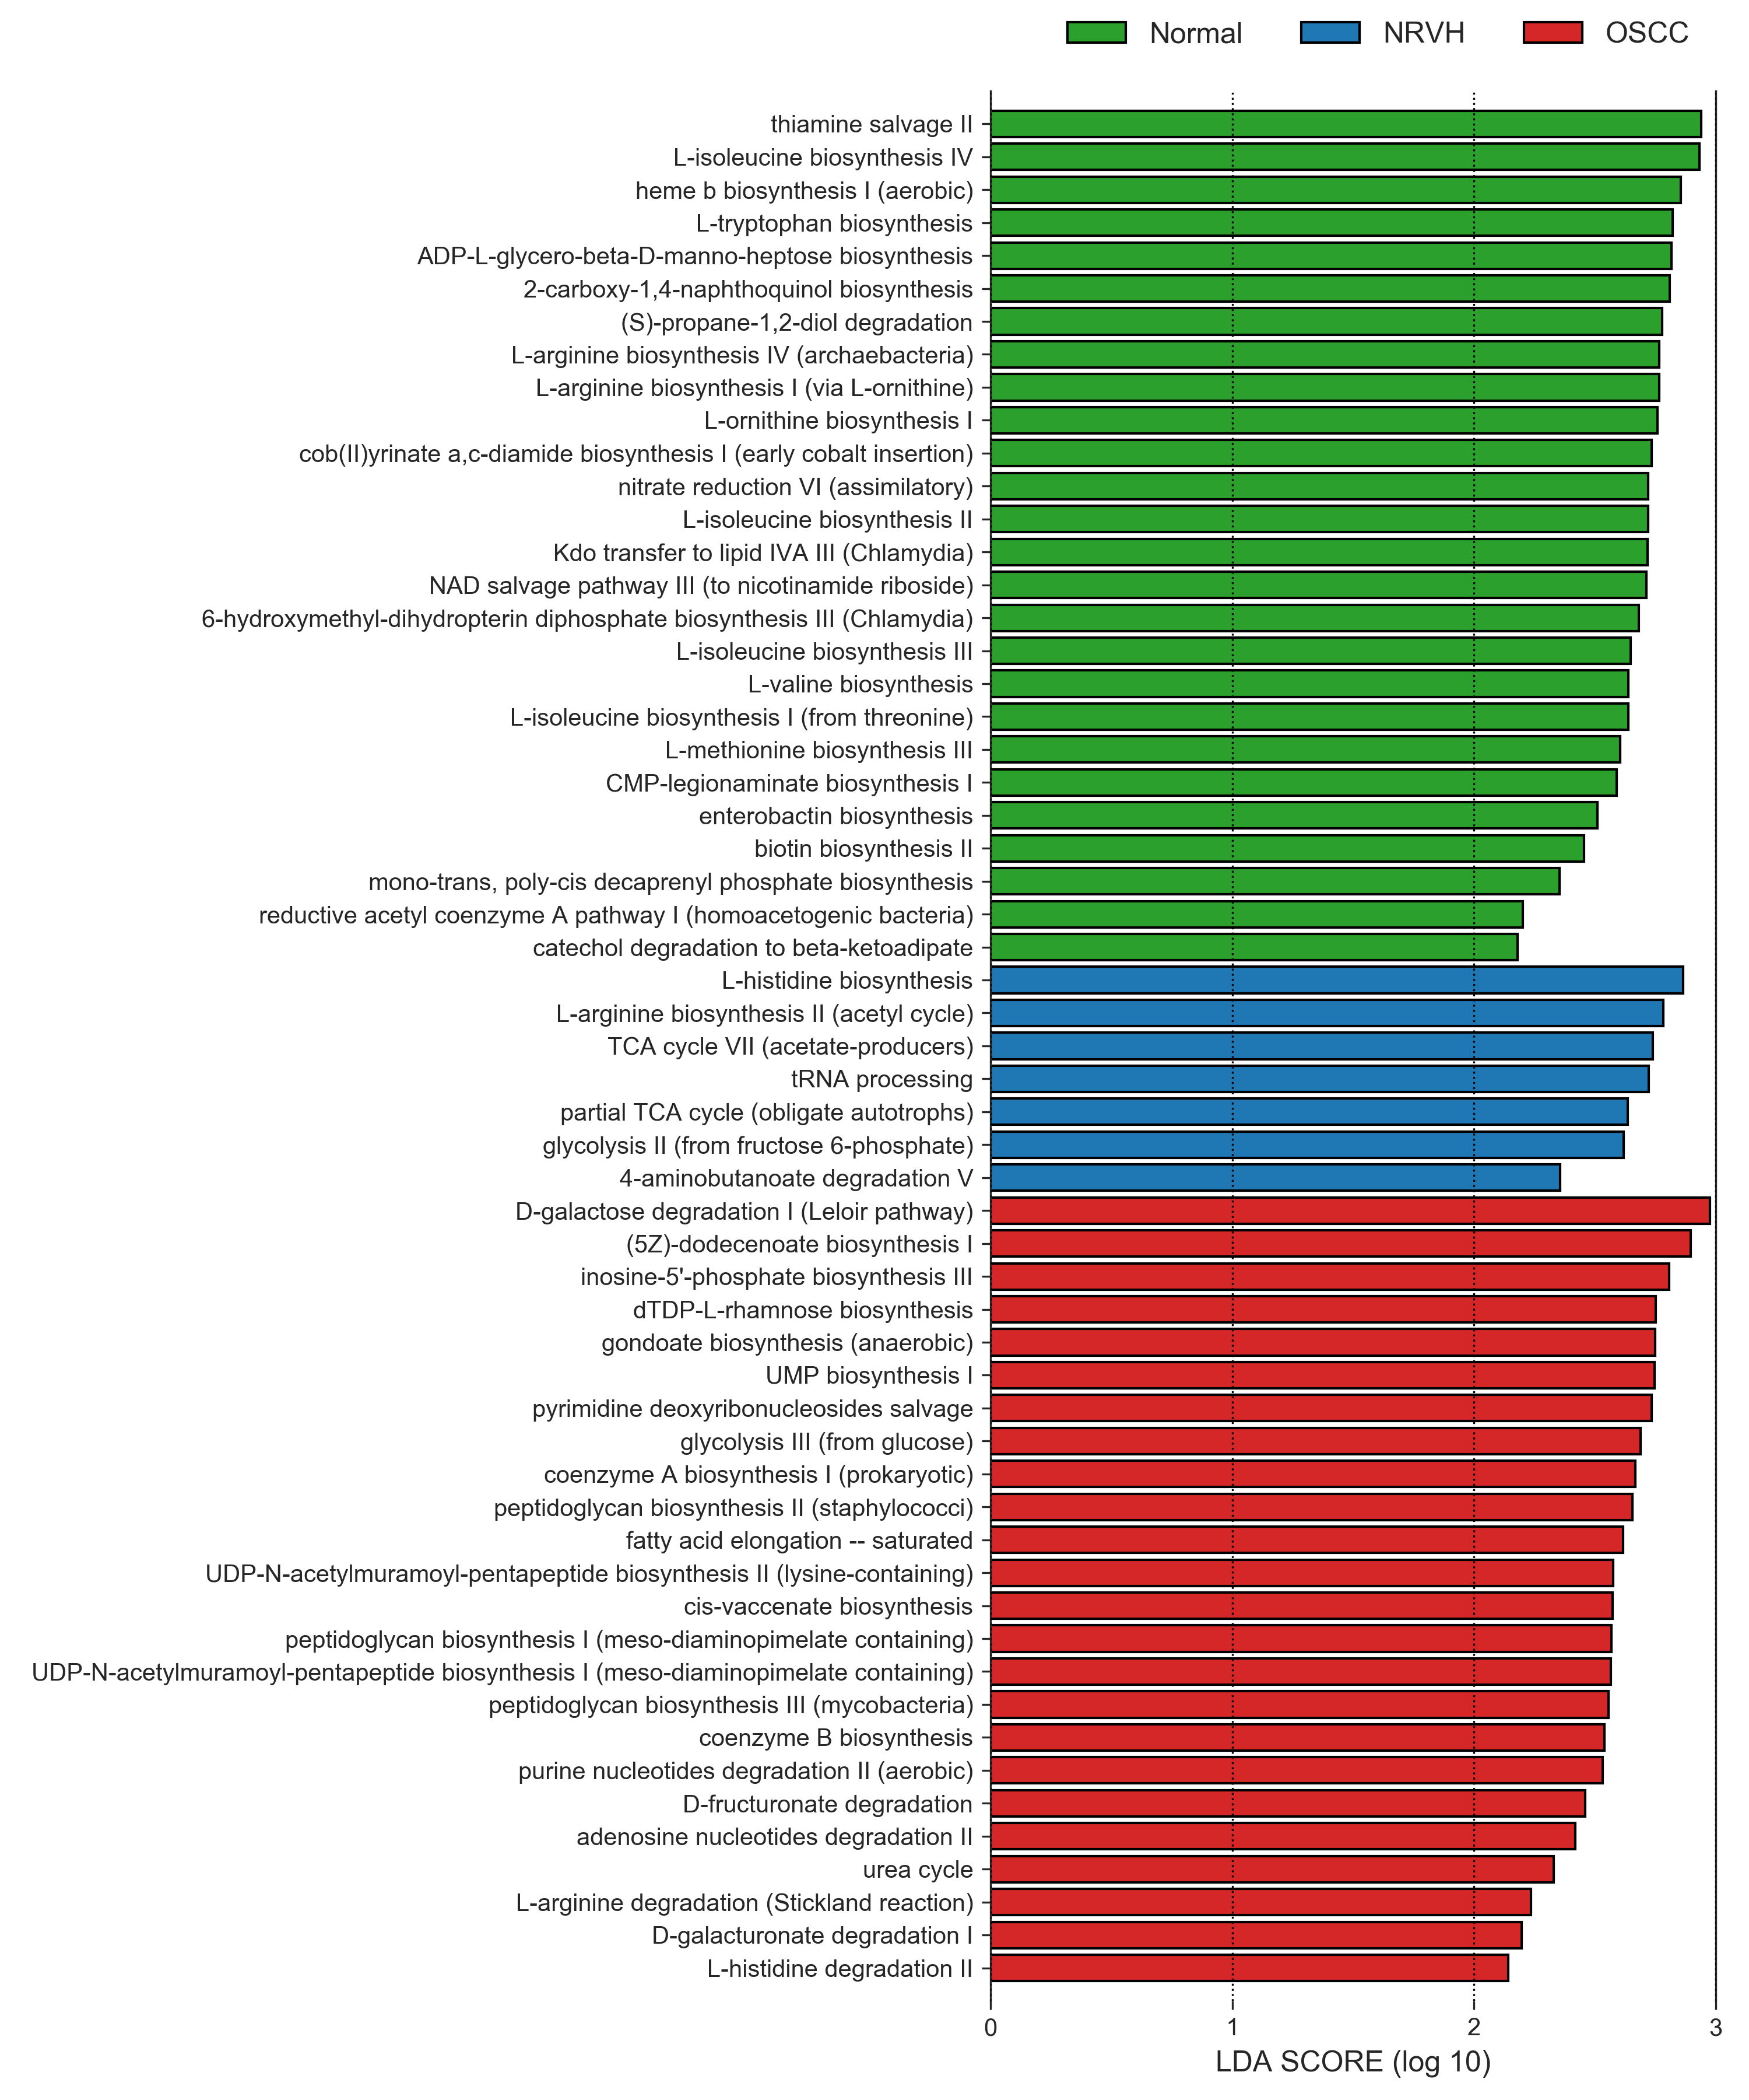
Supplementary Figure S2
A
B
Figure S2. Prediction of metagenome using PICRUSt2. (A) The cumulative relative reads count shows 81.68% of reads with NSTI < 0.15, which indicates high to moderate quality of predicted metagenome. (B) LEfSe revealed significant metabolic pathways among cohorts.

Slide 3
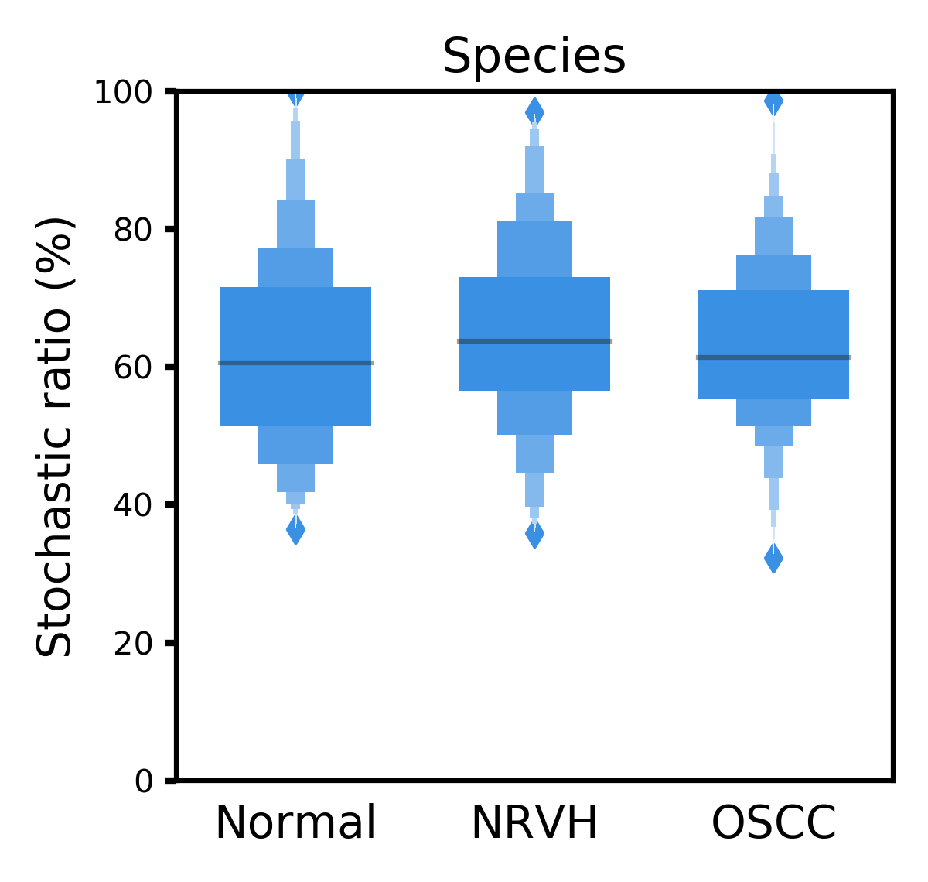
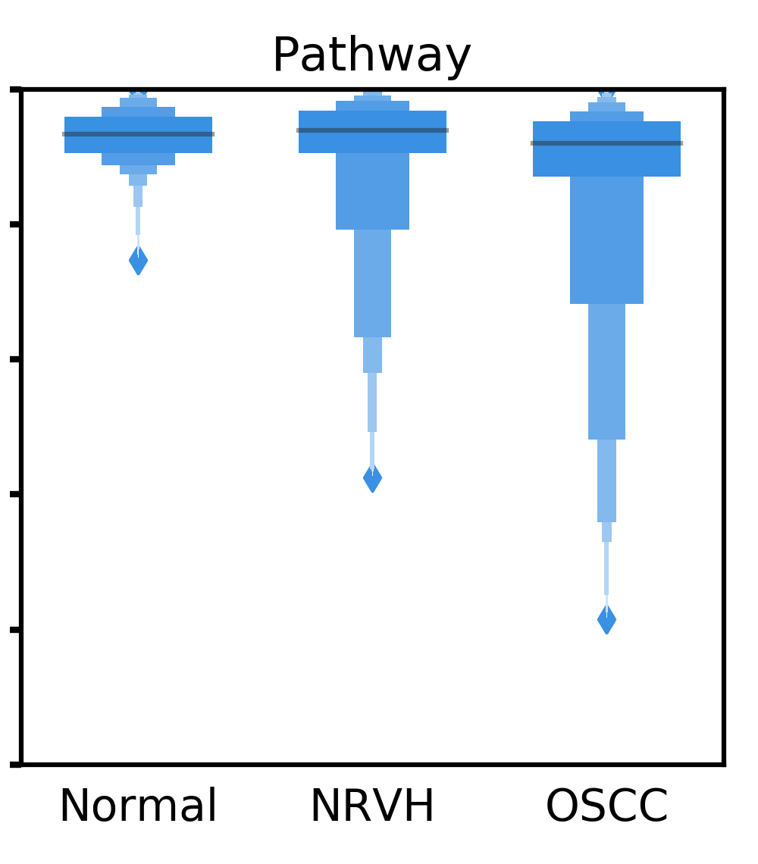
Supplementary Figure S3
Figure S3. Boxenplots illustrate the null-model-based stochastic ratio of microbial taxonomic and functional assembly based on Bray–Curtis dissimilarities. The simulated assembly procedure was repeated 999 times with proportional occurrence frequency and richness.

Slide 4
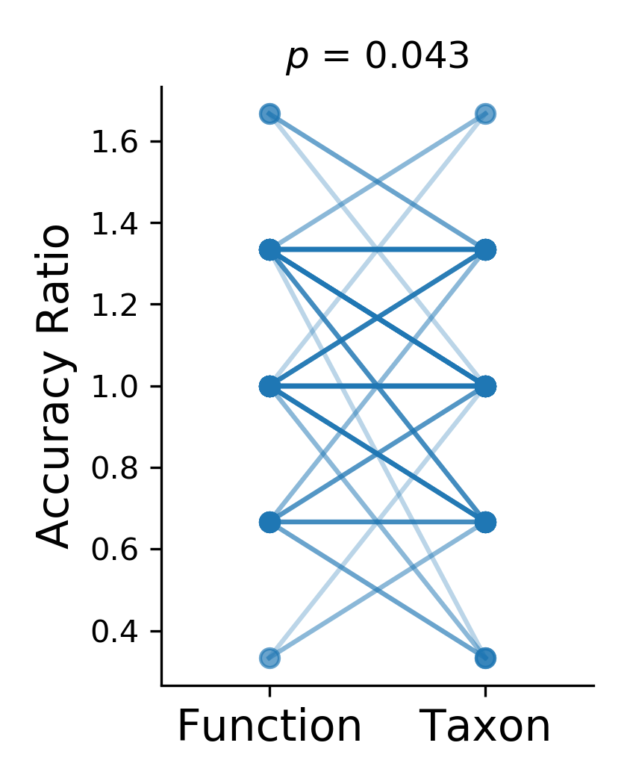
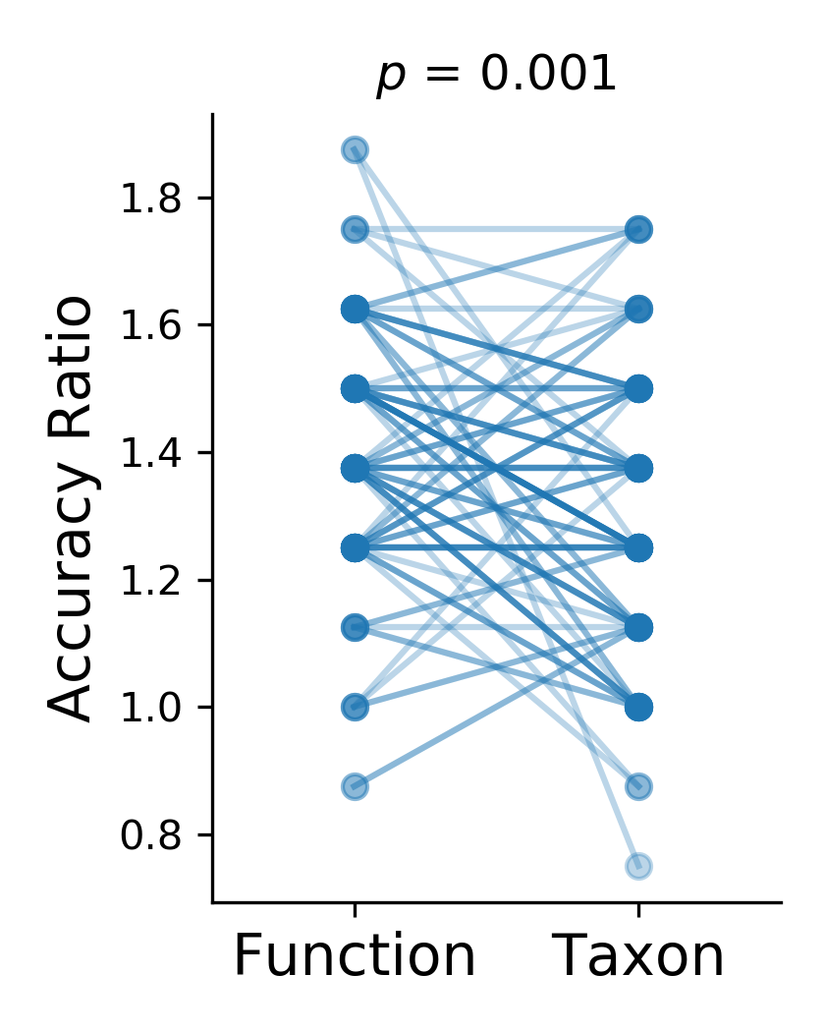
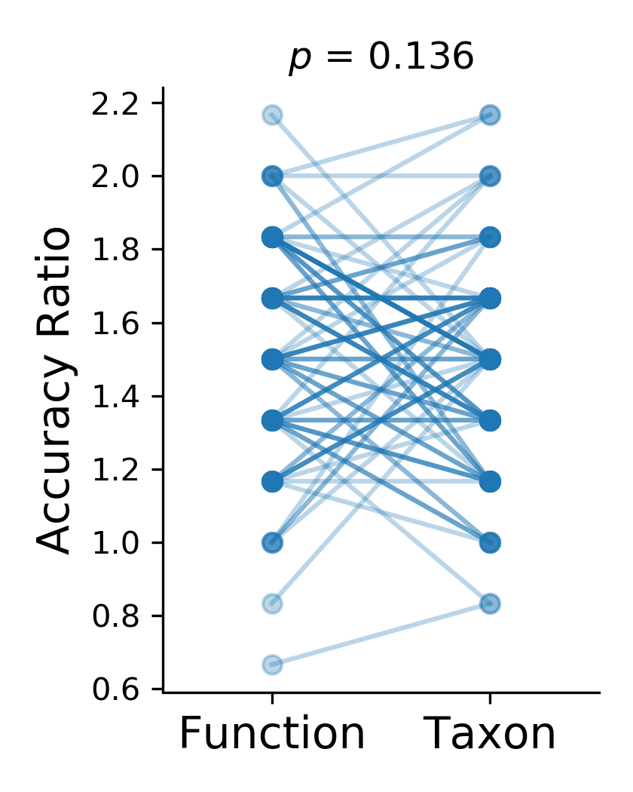
Supplementary Figure S4
Wolf et al.
Zhao et al.
This study
Figure S4. Pairwise comparisons of accuracy ratio between taxonomic and functional profiles. A total of 100 iterations was repeated with different training-testing splits (80%-20%) for each study. Independent t-test was performed to examined the statistical significance.

