Slide 1
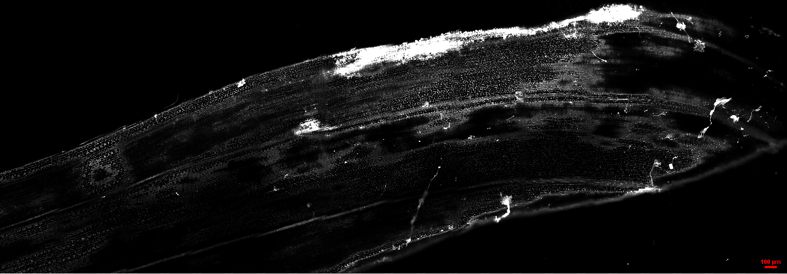
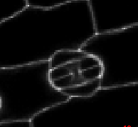
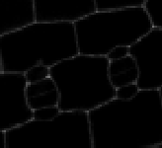
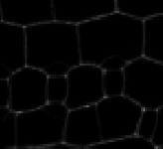
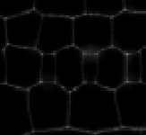
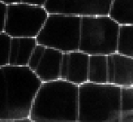
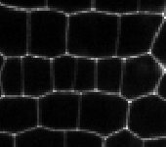
A
~400μm
~350μm
~1600μm
~450μm
~2700μm
100 μm
B
C
D
E
F
G
10 μm
10 μm
10 μm
10 μm
10 μm
10 μm
Stage6: GC maturation
Stage5: GMC symmetric division
Stage4: SMC asymmetric division
Stage3: SMC formation
Stage2: Asymmetric entry division
Stage1:Cell proliferation
Supplementary figure 1. The development pathway of stomata in the second leaf at 7 days after sowing maize seedling
A: Large scale confocal images of maize leaf protoderm.
B-F: Series events of stomata development.

