Slide 1
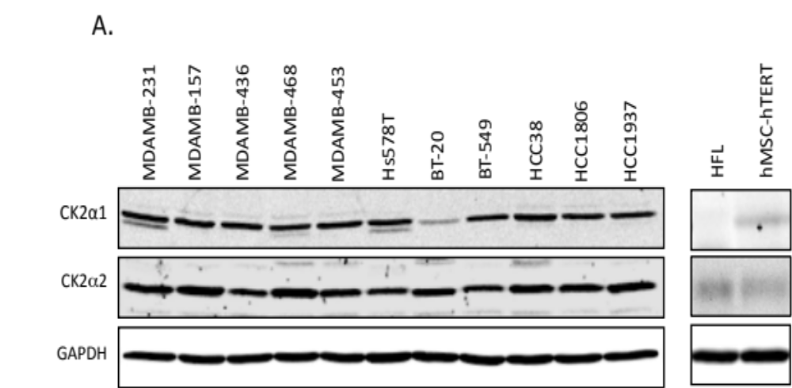



Supplemental Figure 1
Expression of 108600 target kinase in breast cancer and normal cell lines.
MDA-MB-
BT-20
BT-549
Hs578t
468
453
436
157
231
TNIK
CK2α
GAPDH

Slide 2
Supplemental Figure 2
A
B
Non-target
siRNA
siCSNK2A1
siDYRK1A
siTNIK
CK2α
Ratio to Day 0
*
DYRK1A
Days after transfection
Days after transfection
Days after transfection
Non-target siRNA;
siCSNK2A1;
siDYRK1A;
siTNIK;
TNIK
p < 0.01 (Tukey's test)
GAPDH

Slide 3
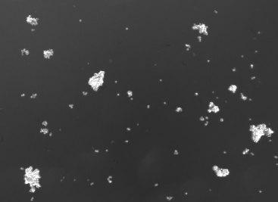
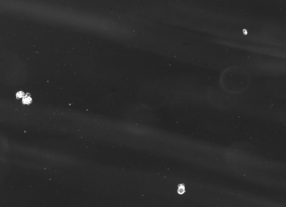
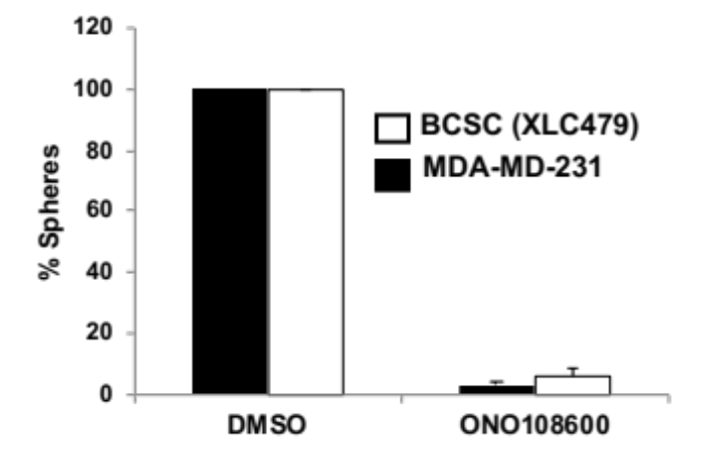
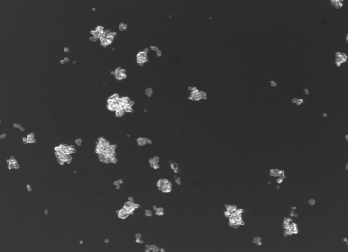
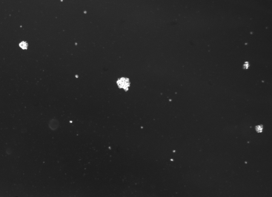
Supplemental Figure 3
Sphere formation assay
Control
108600 200nM
200 µm
BCSC (XLC479)
200 µm
*
*
MDA-MB-231
DMSO
108600

Slide 4
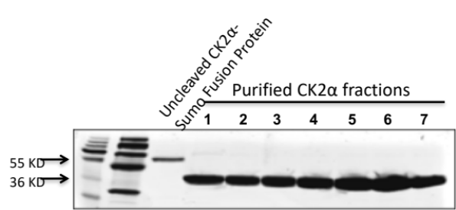
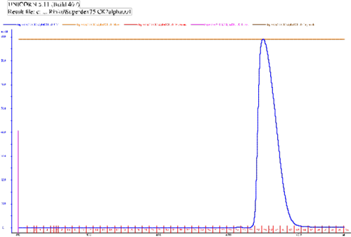
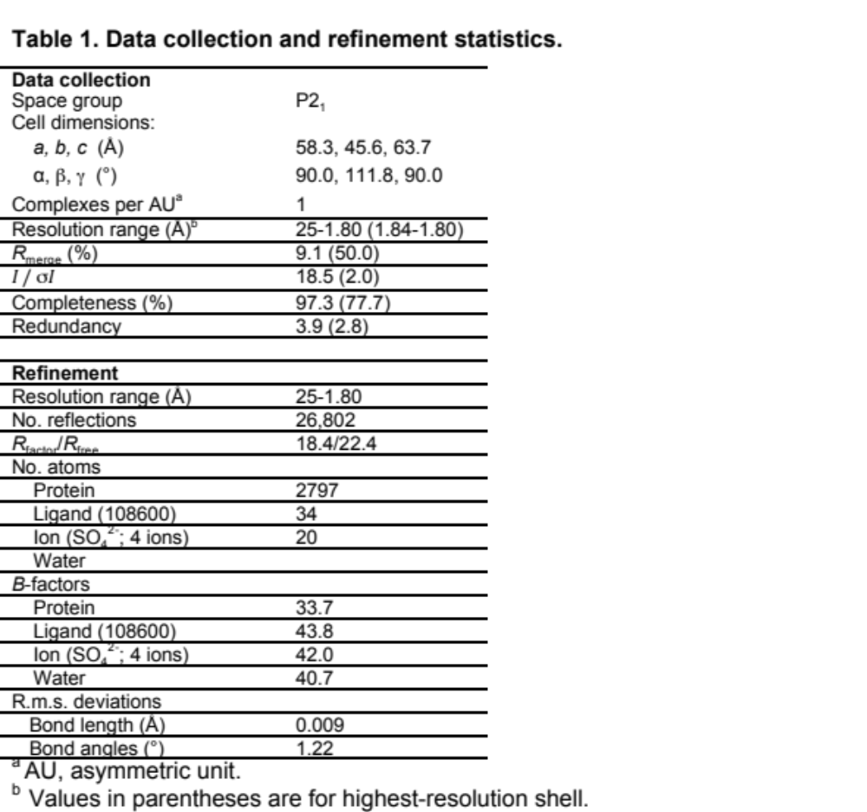
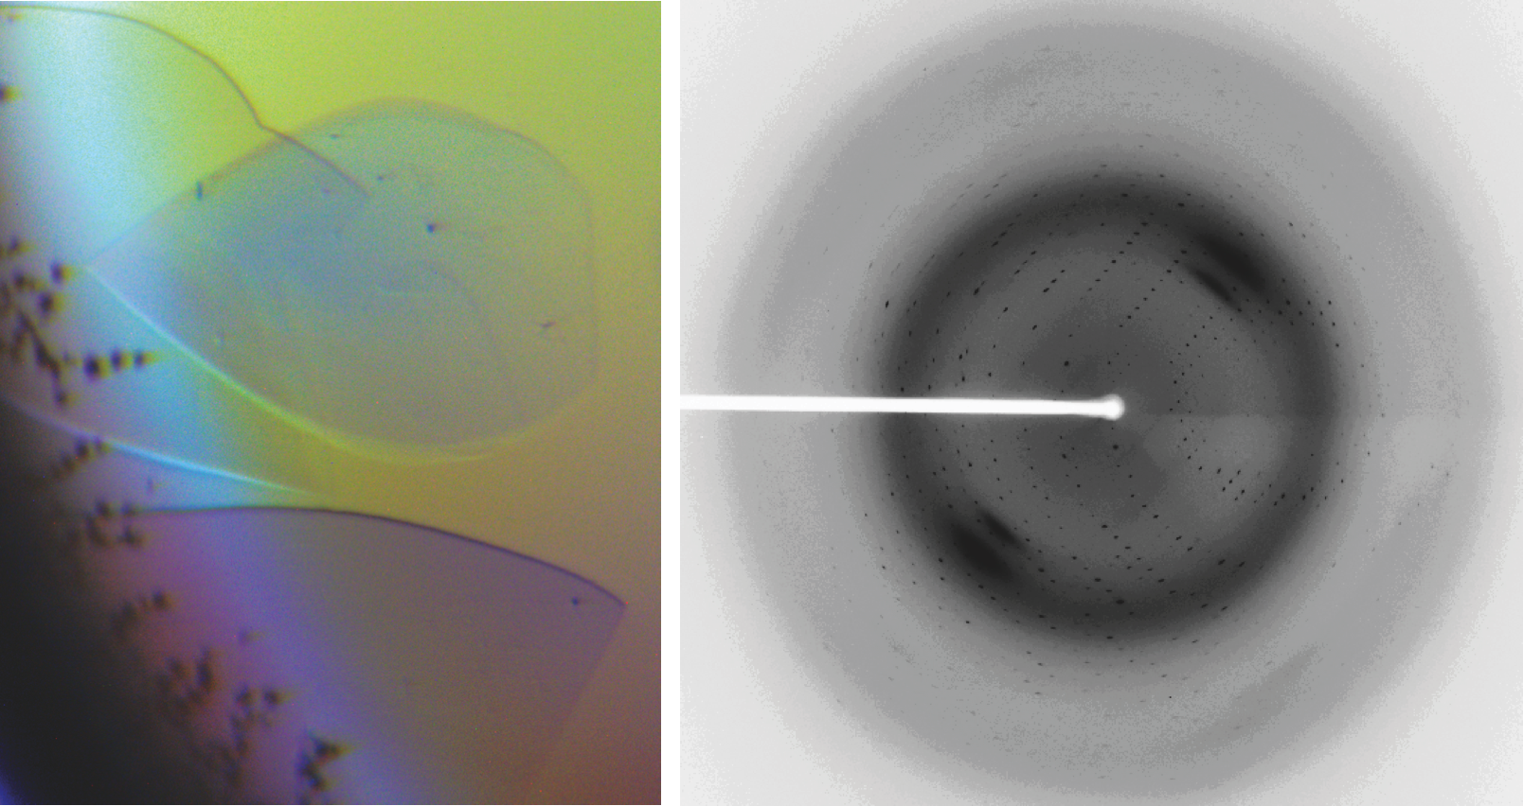
Supplemental Figure 4
Purification and crystallization of CK2α.
A
B
Table S3
C
D
Crystallographic data collection and refinement statistics for the CK2-ON108600 complex.

Slide 5
Supplemental Figure 5
A
MDA-MB-231
B
CTG1883 organoids
100
100
70
S
70
G1
G2M
Cell count
SubG1
Cell count
SubG1
50
50
S
Polyploid
G2M
25
G1
Polyploid
25
0
0
0
6
12
18
24
30
0
6
12
18
24
30
Fluorescence intensity (x10⁴)
Fluorescence intensity (x10⁴)
108600
108600
0.1% DMSO
0.125 µM
0.25 µM
0.5 µM
120
0.1 %DMSO
0.5 µM
100
70
90
12 h
50
24 h
60
25
30
0
0
100
120
70
90
24 h
50
48 h
60
25
30
0
0
100
120
70
90
36 h
50
72 h
60
25
30
0
0
0
6
12
18
24
30
0
6
12
18
24
30
0
6
12
18
24
30
0
6
12
18
24
30
0
6
12
18
24
30
0
6
12
18
24
30

Slide 6
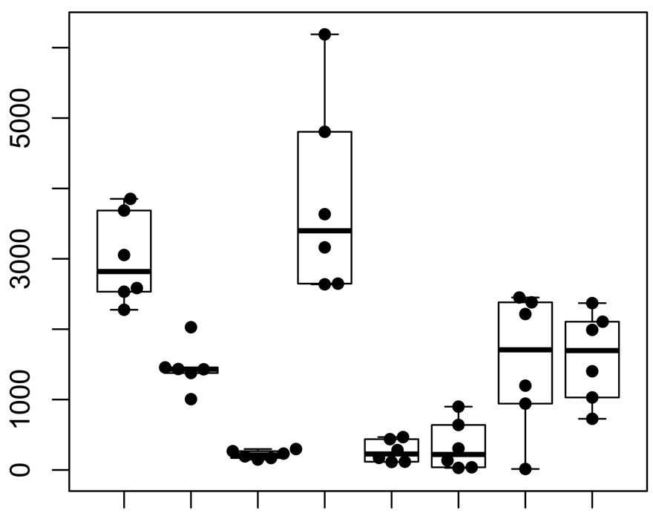
Supplemental Figure 6
B
PDX model
A
Levels of 108600 target kinases
2397
1883
2208
pAKT1
S129
CTG1883
AKT1
CTG2397
Read count
CK2α
CTG2397
CTG1883
CTG2397
CTG1883
CTG1883
GAPDH
CTG2397
TNIK
CSNK2A1
CSNK2A2
CSNK2B
DYRK1A
DYRK2B
TNIK
PTEN
AKT1
DYRK1A
108600 target
Direct substrate
of CK2α
GAPDH

Slide 7
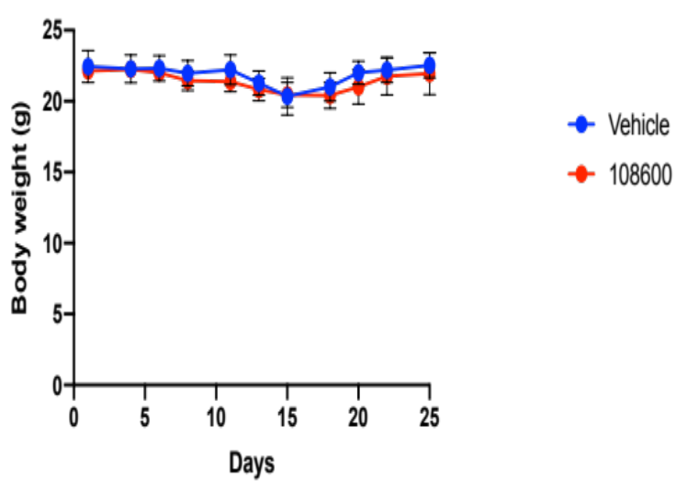
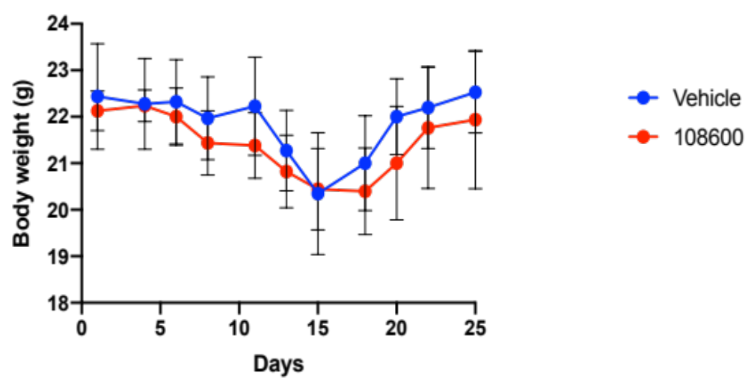
Supplemental Figure 7
Body weight
TM00098
CTG 1883
CTG 2397
Ratio at Day 0
Ratio at Day 0
Days after i.p. injection
Days after i.p. injections
DMSO
PTX
108600
Combination

