Slide 1
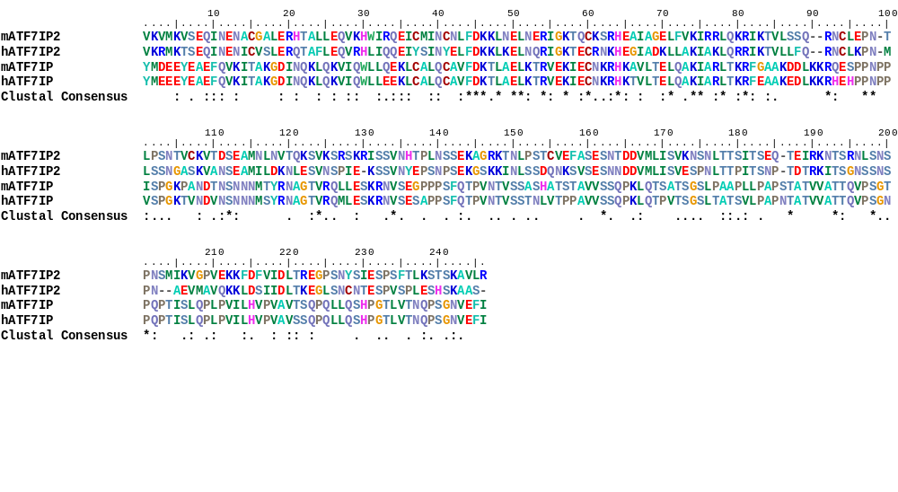
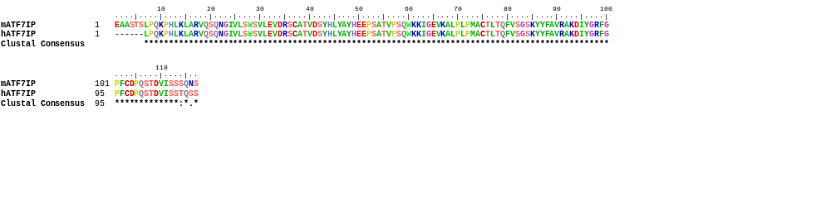
A
region 627-794 (SETDB1 binding)
mATF7IP(606-705):
hATF7IP(572-671):
estimated α-helix
region 627-694 a.a. of mouse ATF7IP
estimated α-helix
B
region 1190-1306 (FN III domain)
mATF7IP(1190-1306):
hATF7IP(1160-1270):
mATF7IP:
hATF7IP:
Figure S1

Slide 2

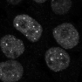
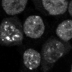

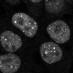
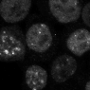

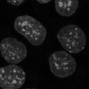
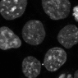

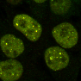
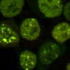

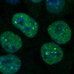
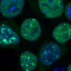
A
Atf7ip KO
Day 5
B
+3xF-ATF7IP
SETDB1
WT
dFNIII
100
80
% intensity
(nucleus/total)
SETDB1
60
40
20
0
FLAG
Atf7ip KO + WT
Atf7ip KO + dFNIII
DAPI
C
ATF7IP
100
80
% intensity
(nucleus/total)
SETDB1
+FLAG
60
40
20
0
SETDB1
+DAPI
Atf7ip KO + WT
10µm
Atf7ip KO + dFNIII
Figure S2

Slide 3
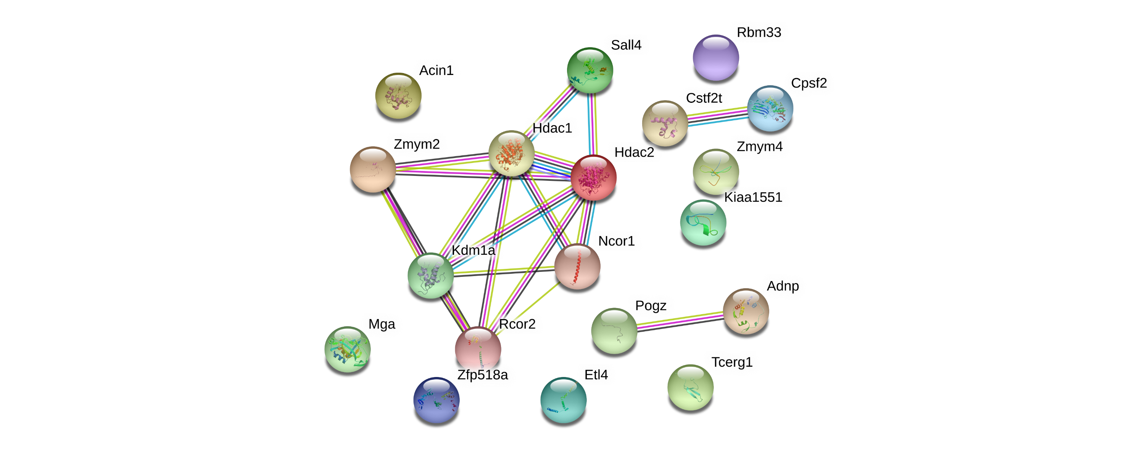
Identified protein network in the top 20 candidate proteins
Figure S3

Slide 4
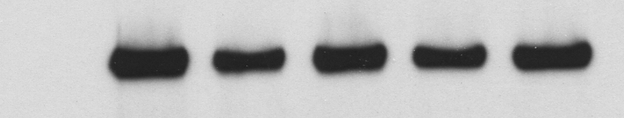
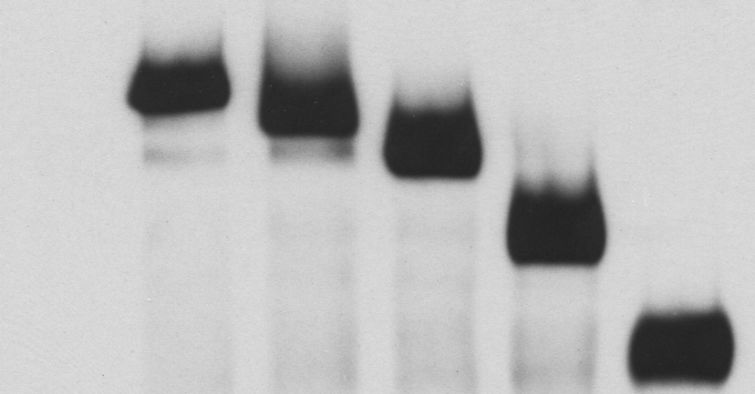
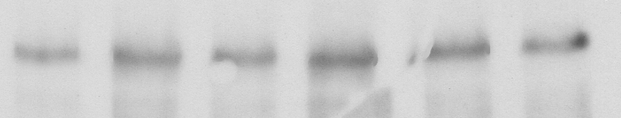
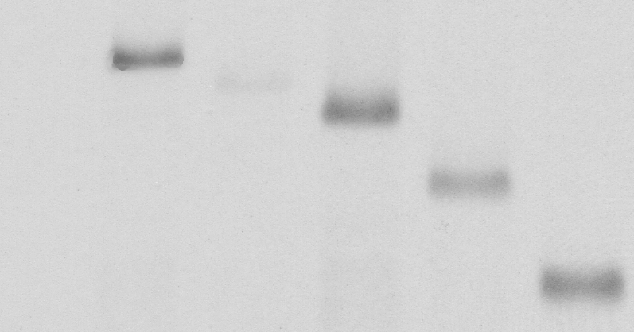
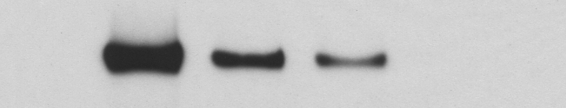
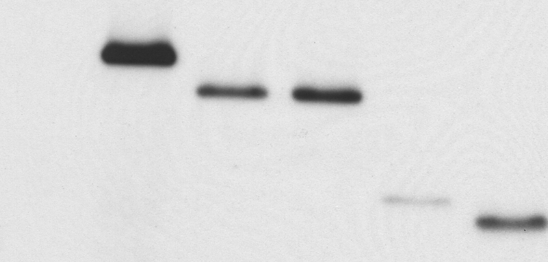
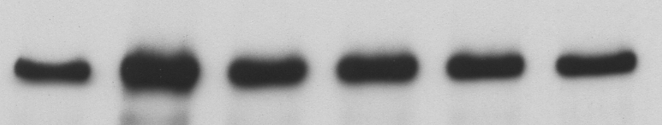
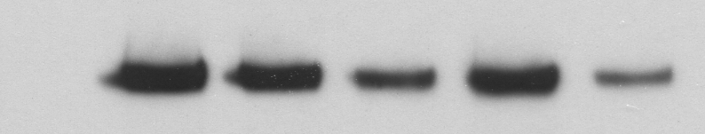
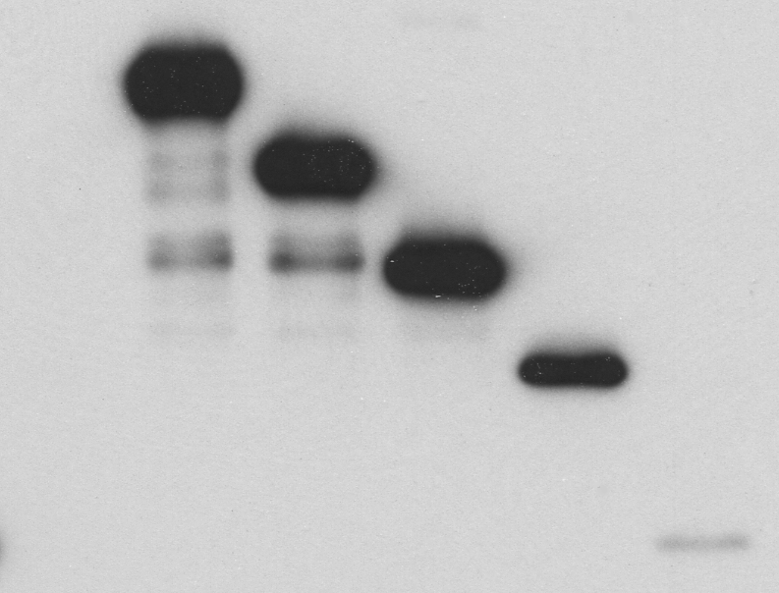
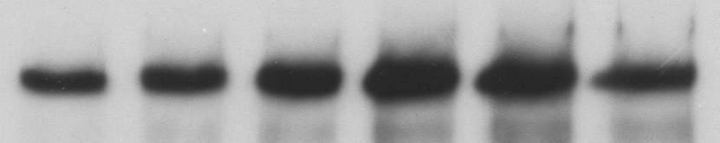
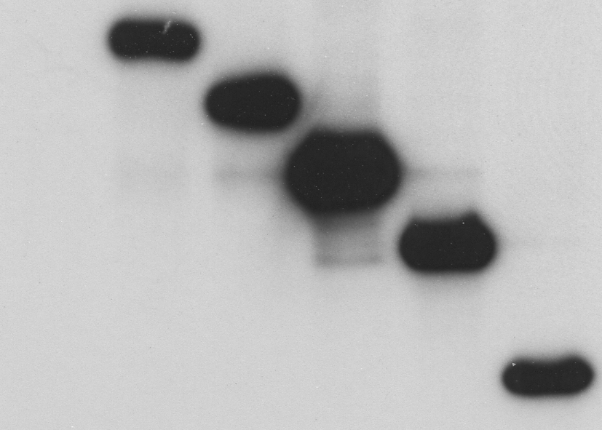
A
FAM1
FAM2
B
Δ2
Δ1
Δ4
FL
Δ3
182 …IQIANVTTLETGVSSVSDGQLESTDGRDMNLMITHVTSL… 220
−
: V5-mZMYM2
+
+
+
+
+
+
(kDa)
: 3xF-mATF7IP WT
250-
α-FLAG
ZMYM2
(mouse)
250-
IP: α-V5
α-V5
1
180
350
780
1376
150-
Mym-domain
LSD1-HDAC
100-
FL (2-1376):
250-
α-FLAG
250-
Δ1 (2-1249):
Input
150-
α-V5
Δ2 (2-1098):
100-
Cells: HEK293T
Δ3 (2-999) :
C
1
2
3
4
5
6
Δ4 (2-811) :
ΔN1
ΔN2
ΔN3
FL
ΔN4
Δ5 (2-603) :
−
: V5-mZMYM2
+
+
+
+
+
+
Δ6 (2-443) :
(kDa)
: 3xF-mATF7IP WT
250-
α-FLAG
Δ7 (2-350) :
250-
IP: α-V5
Δ8 (2-211) :
150-
α-V5
100-
ΔN1 (181-1376) :
250-
α-FLAG
ΔN2 (190-1376) :
250-
Input
ΔN3 (694-1376) :
150-
α-V5
ΔN4 (781-1376) :
100-
Cells: HEK293T
1
2
3
4
5
6
D
Δ6
Δ5
Δ8
Δ4
Δ7
−
: V5-mZMYM2
+
+
+
+
+
+
(kDa)
: 3xF-mATF7IP WT
250-
α-FLAG
100-
75-
IP: α-V5
α-V5
50-
37-
250-
α-FLAG
100-
75-
α-V5
Input
50-
37-
Cells: HEK293T
1
2
3
4
5
6
Figure S4

Slide 5
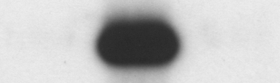
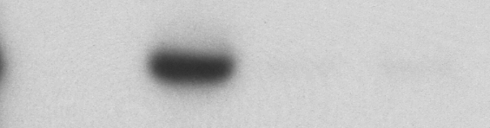
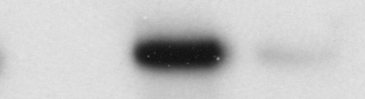
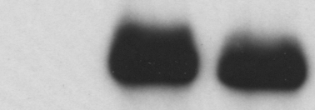
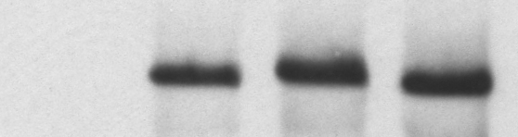
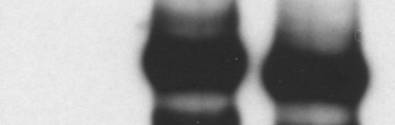
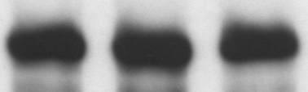
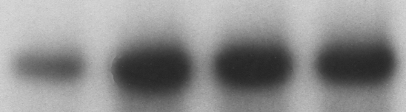
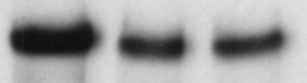
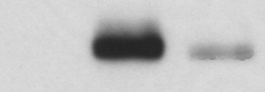
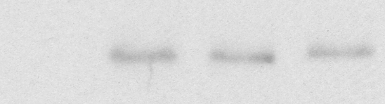
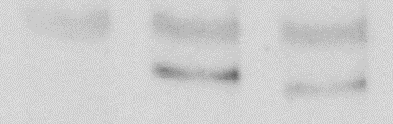
A
FAM Mut
Cells: HEK293T
B
ΔFAM
Cells: HEK293T
C
WT
FAM Mut
FAM Mut
Cells: HEK293T
WT
WT
−
: V5-mMGA C-ter
−
: V5-mZFP518A
+
+
+
+
−
: V5-mZMYM4
+
: 3xF-mATF7IP WT
+
+
(kDa)
(kDa)
: 3xF-mATF7IP WT
+
+
α-FLAG
+
α-FLAG
250-
(kDa)
: 3xF-mATF7IP WT
250-
IP: α-V5
IP: α-V5
α-V5
250-
α-V5
250-
α-FLAG
IP: α-V5
75-
α-FLAG
α-FLAG
250-
α-V5
250-
250-
α-FLAG
Input
α-V5
Input
250-
75-
250-
α-V5
Input
1
2
3
1
2
3
4
250-
α-V5
1
2
3
Figure S5

Slide 6
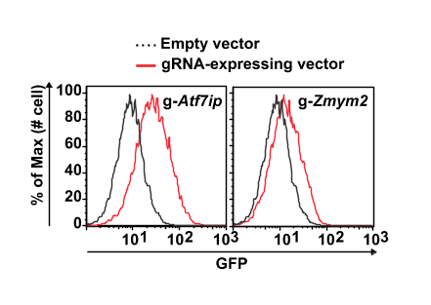
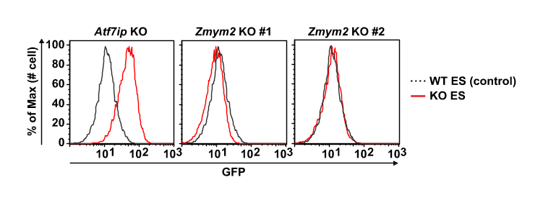
A
B
C
*
**
**
**
NS
NS
NS
NS
**
**
**
**
**
NS
**
**
Figure S6

Slide 7
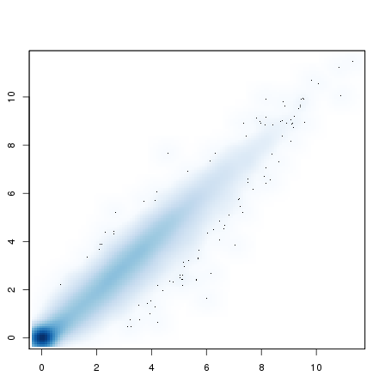
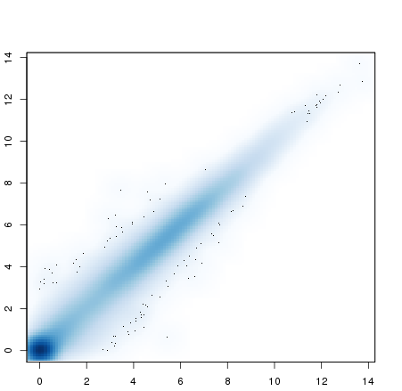
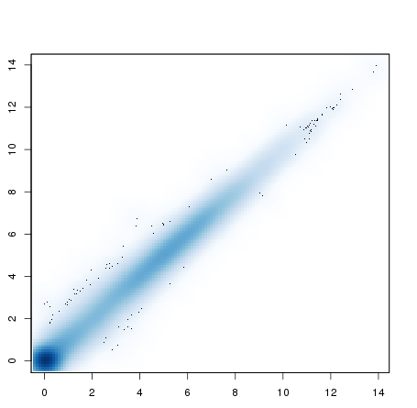


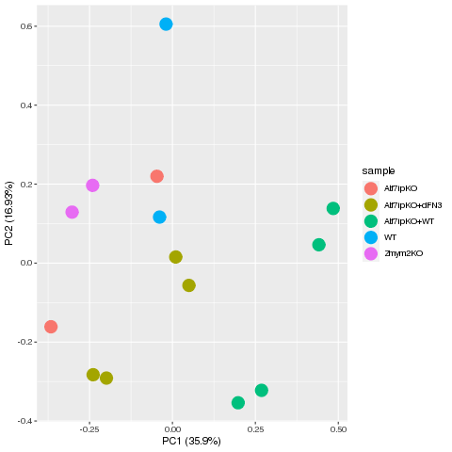
A
RNA-seq sample | Repliacte | Description
WT mESCs | 2 | two replicates from one WT mES cell line
Atf7ip KO | 2 | two cell lines
Atf7ip KO + WT | 4 | two replicates from each cell line
Atf7ip KO + dFNIII | 4 | two replicates from each cell line
Zmym2 KO | 2 | two cell lines
ChIP-seq sample | Repliacte | Description
Flag-ATF7IP | 2 | two replicates from one cell line
Flag-ATF7IP dFNIII | 2 | two replicates from one cell line
B
Correlation between WT replicate
Correlation between Atf7ip KO clones
Correlation between Zmym2 KO clones
Pearson’s r = 0.98
Pearson’s r = 0.99
Pearson’s r = 0.99
WT rep2
Atf7ip KO (TT2-12)
Zmym2 KO #2
WT rep1
Atf7ip KO (TT2-5)
Zmym2 KO #1
Correlation between WT ATF7IP rescue
Correlation between dFNIII ATF7IP rescue
Pearson’s r = 0.99
Pearson’s r = 0.99
Atf7ip KO (TT2-12) +
WT ATF7IP
Atf7ip KO (TT2-12) +
dFNIII ATF7IP
Atf7ip KO (TT2-5) +
WT ATF7IP
Atf7ip KO (TT2-5) +
dFNIII ATF7IP
C
Gene expression
Log2 (RPM+1)
WT
Zmym2 KO
Atf7ip KO (TT2-5)
WT rescue (TT2-5)
WT
Atf7ip KO (TT2-12)
dFNIII rescue (TT2-5)
dFNIII rescue (TT2-12)
WT rescue (TT2-12)
Figure S7

Slide 8
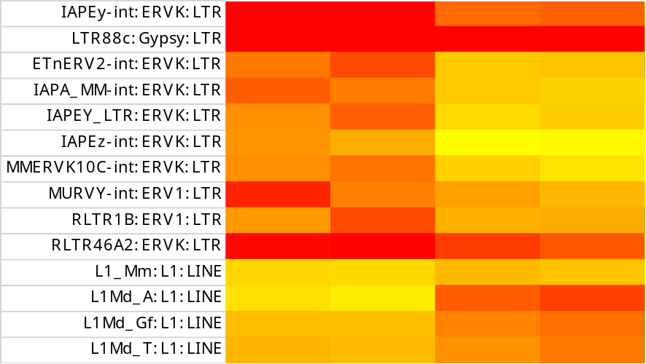
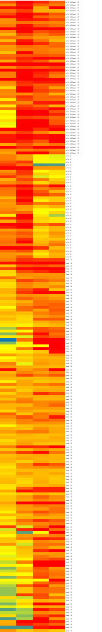
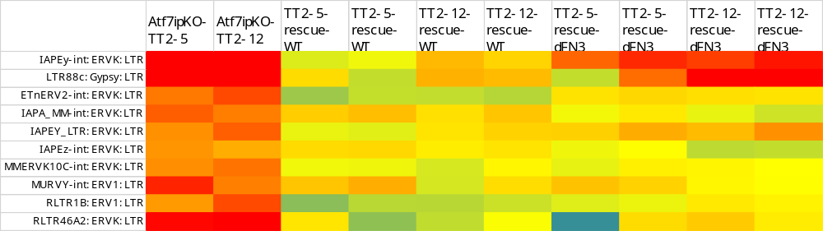
A
C
Atf7ip KO-TT2-5
Atf7ip KO-TT2-12
Zmym2 KO 1
Atf7ip KO
(87)
Zmym2 KO 2
Atf7ip KO
/Zmym2 KO
52
Zmym2 KO
(178)
Atf7ip KO
B
Zmym2 KO
Zmym2 KO 1
Atf7ip KO-TT2-5
Zmym2 KO 2
Atf7ip KO-TT2-12
-4
4
Log2(FC)
Atf7ip KO
/Zmym2 KO
+WT
+dFNIII
KO TT2-12
KO TT2-12
KO TT2-12
KO TT2-12
KO TT2-5
KO TT2-5
KO TT2-12
KO TT2-5
KO TT2-5
KO TT2-5
Atf7ip KO
D
Zmym2 KO
-4
4
Log2(FC)
-4
4
Atf7ip KO/Zmym2 KO
Meiotic cell cycle (Fkbp6/Hormad1/Aurkc/Mael/Stra8/Sycp1/Tdrd12/Tex15)
Spermatogenesis (Fkbp6/Hormad1/Aurkc/Mael/Morc1/Rpl39l/Stra8/Sycp1/Tdrd12/Tdrd15/Uba1y)
DNA methylation involved in gamete generation (Fkbp6/Mael/Morc1/Tdrd12)
Synapsis (Hormad1/Mael/Stra8/Sycp1/Tex15)
Spermatid development (Xlr3a/Xlr3b/Xlr5a/Xlr5b/Xlr5c)
Log2(FC)
Figure S8

Slide 9
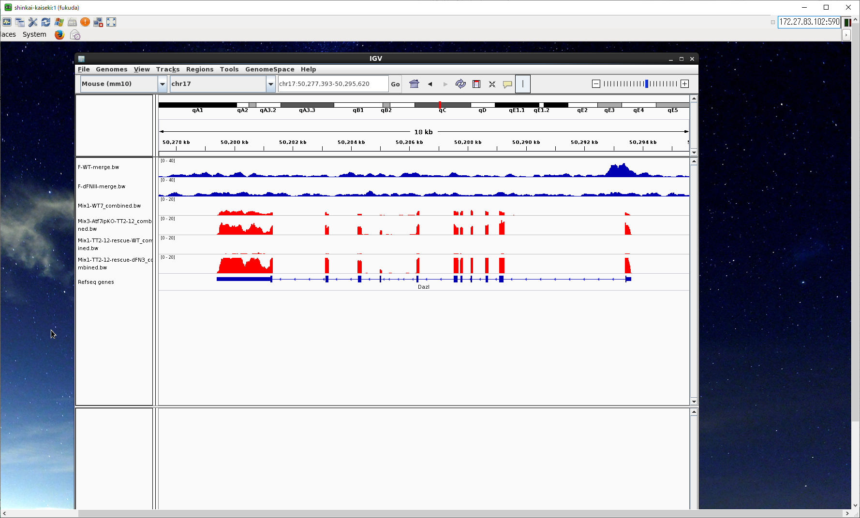
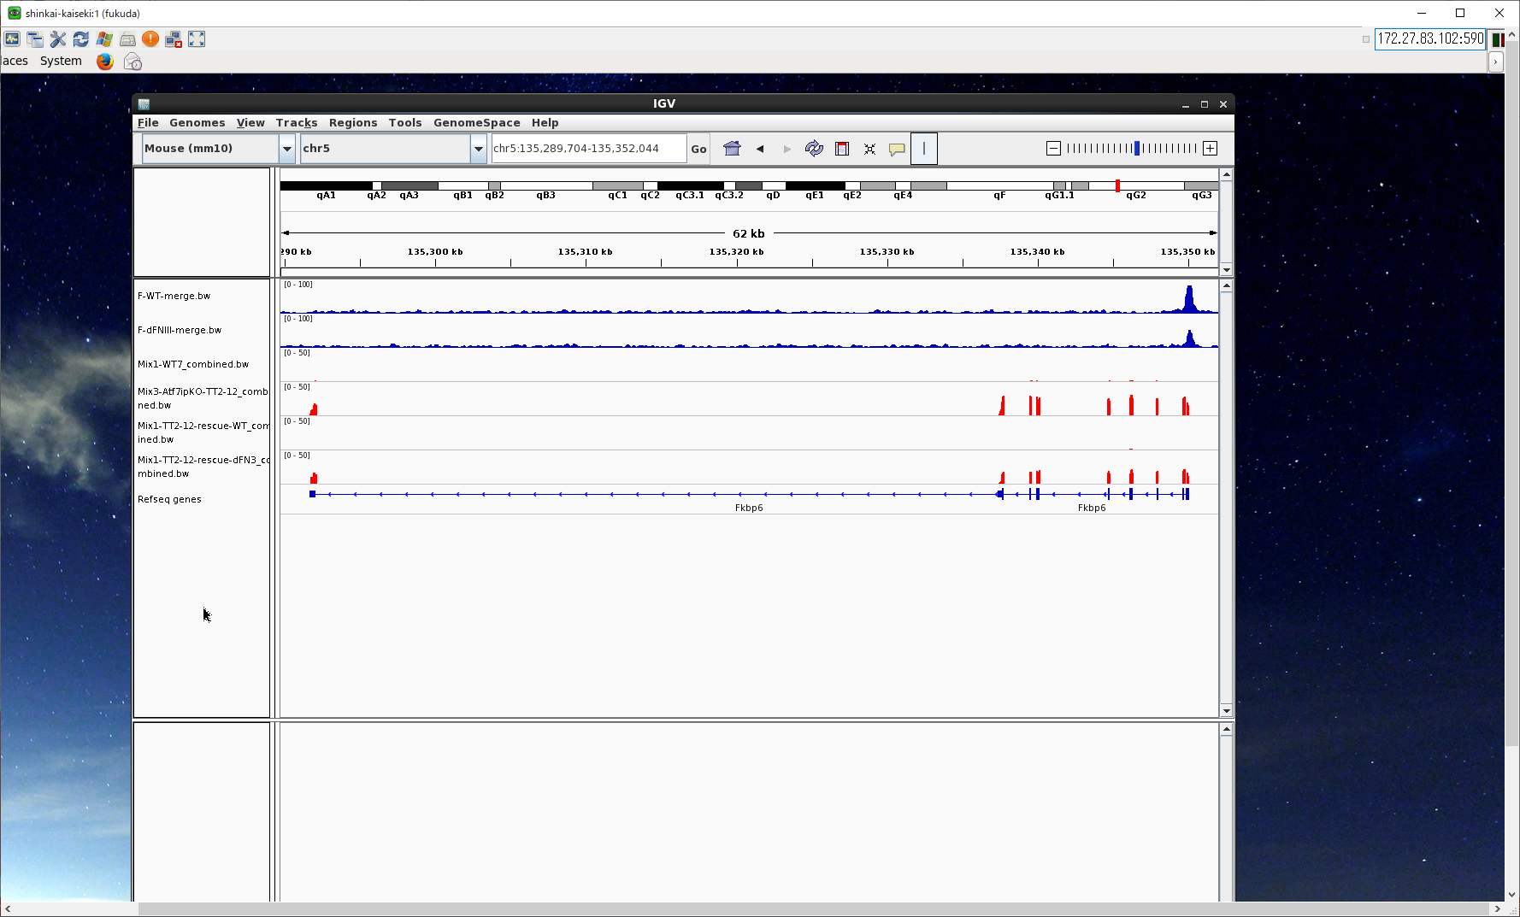
A
WT: rep1+2
6537
dFNIII:
3376
3177
3177/3376=94.1%
B
ChIP
Flag-ATF7IP
Flag-ATF7IP dFNIII
WT mESCs
Atf7ip KO mESCs
RNA
Atf7ip KO + WT
Atf7ip KO + dFNIII
Dazl
ChIP
Flag-ATF7IP
Flag-ATF7IP dFNIII
WT mESCs
Atf7ip KO mESCs
RNA
Atf7ip KO + WT
Atf7ip KO + dFNIII
Fkbp6
Figure S9

