Slide 1
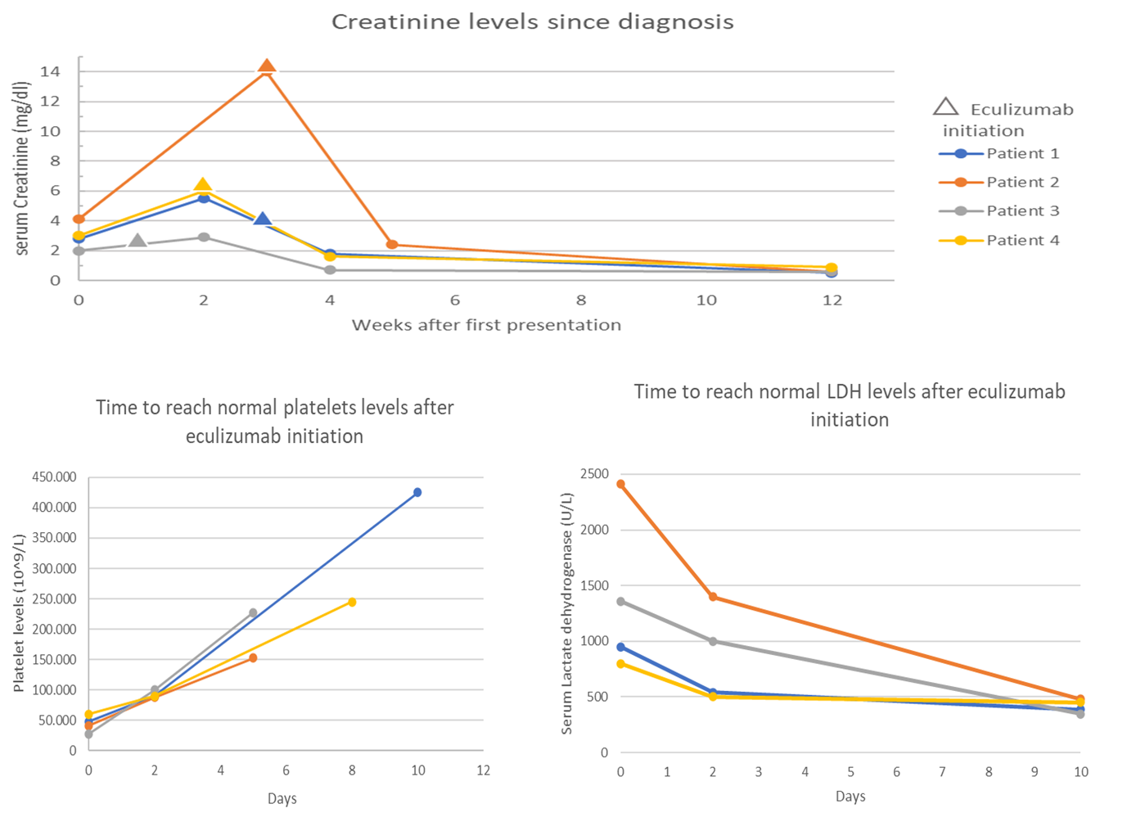
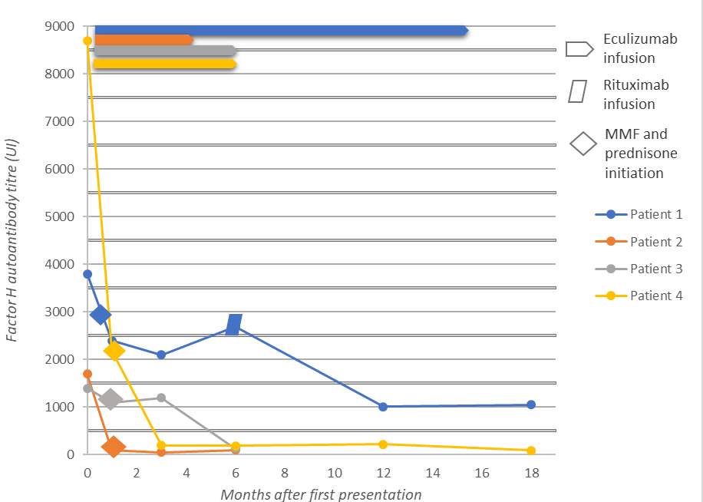
Eculizumab as first line treatment for patients with severe
presentation of Complement Factor H antibodies mediated Hemolytic Uremic Syndrome
Aim: to report four children with Complement Factor H (CFH) antibodies mediated Hemolytic Uremic Syndrome (HUS)managed with Eculizumab plus immunosuppression as first line therapy.
Evolution of factor H autoantibody levels according to treatment
DESIGN & OUTCOMES:
4 patients with CFH antibodies mediated HUS
3 boys. Aged 6-11 years old.
CFH antibody titers ranged from 1000-8500 UA/ml.
3 patients had homozygous CFHR1/CFHR3 deletions.
Dialysis was necessary for 30-60 days in 3 patients.
Eculizumab was administered 5-23 days after onset.
None of them received plasmapheresis.
During a mean 12-month follow-up (range 6-24), no relapses were recorded.
All patients ended with normal GFR.
Conclusions: a short course of 6 months of C5 inhibitor might be sufficient to reverse TMA symptoms and improve kidney function in severe patients with CFH antibodies mediated HUS. Immunosuppressive agents might reduce the risk of relapse and allow cessation of C5 inhibition in a shorter period of time.
Coccia et al. 2024

