Slide 1
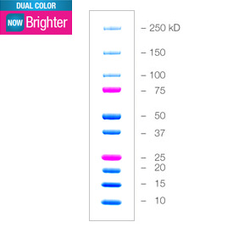
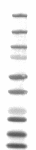
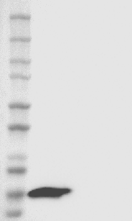
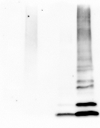
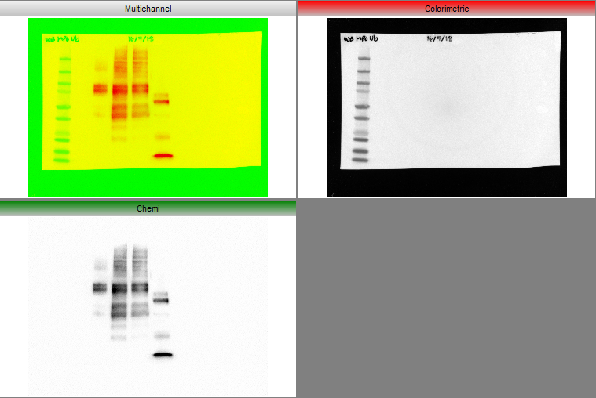
MPOUb Ctl Neg
HEK293 cell lysate
ISG15 lysate
Supplementary 1
HeLa
MPOUbIV
MPM
MPM
MPOrh
A)
B)
MPOUb
α-ISG15
18kDa
α-UbP4D1
ISG15
α-MPO
80kDa
Notes:
Supplementary 1. Western Blot of total anti-ubiquitin and controls used for anti-ISG15 antibody. A lysate of HeLa cells, recombinant human MPO (rhMPO) are observed, both without the presence of ubiquitin and MPO with ubiquitin as negative controls of the reaction (since all the substrates necessary for the enzymatic reaction are added except ATP); in the last lane the product of the complete in vitro ubiquitylation reaction of the MPO (Panel A). A lysate of transfected human HEK293T cells that overexpressed ISG15 used as a positive control and empty vector transfected control cell lysate (HEK293) as a negative control for Western Blot experiments of the figure 2 (Panel B).

Slide 2
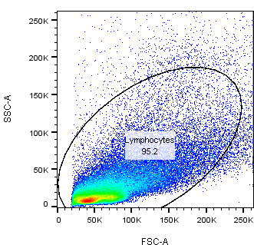
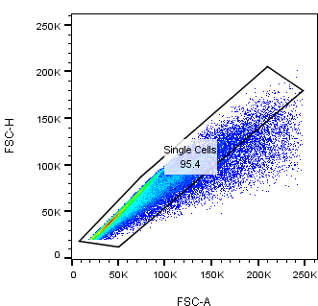
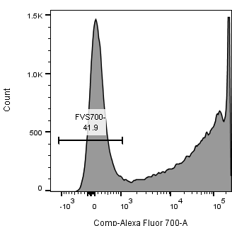
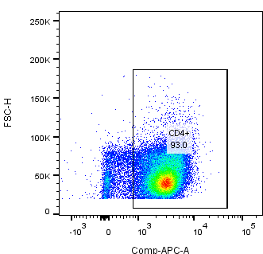
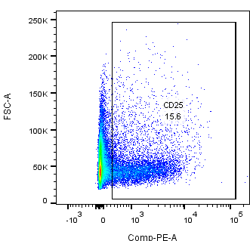
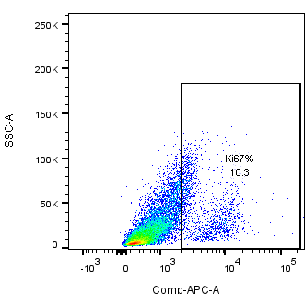
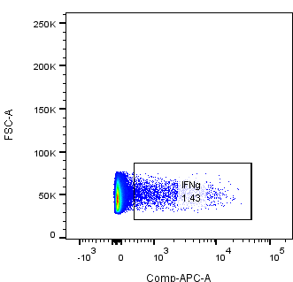
A)
B)
Supplementary 2
C)
D)
FVS700
CD4+
E)
F)
G)
CD25+
Ki67+
IFNγ+
Notes:
Supplementary 2. Representative dot plot of the gating strategy for the determination of the percentage of CD25, Ki67, IFNγ. The lymphocyte population was selected from a graph of size and complexity (Panel A). Then the singlettes were obtained by comparing area granularity against height granularity (Panel B). Viable cells were determined using FVS700 exclusion staining (Panel C). This subpopulation of lymphocytes was determined by CD4 + staining (Panel D). Subsequently, activation markers were determined in this subpopulation (CD25+ in Panel E), proliferation (Ki67+ in Panel F) and polarization through the production of cytokines (IFNγ+ in panel G).

Slide 3
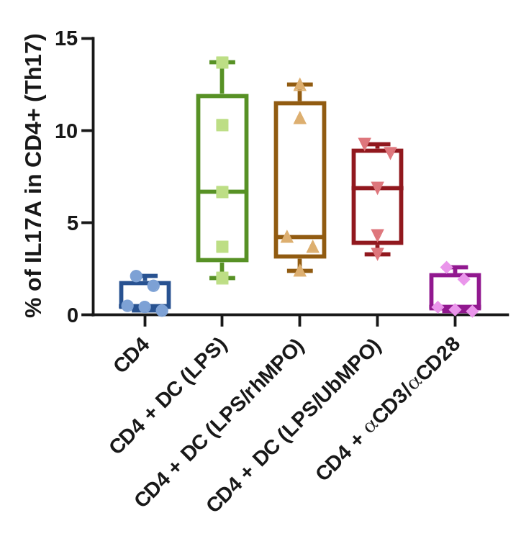
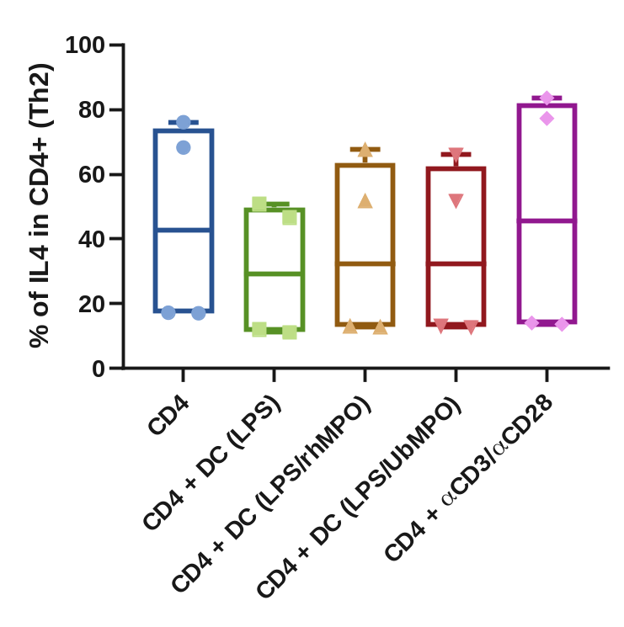
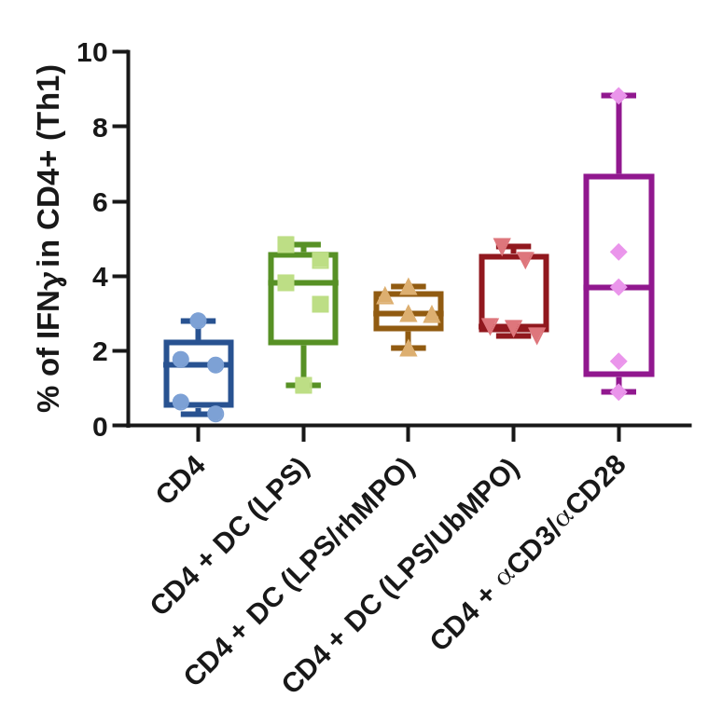
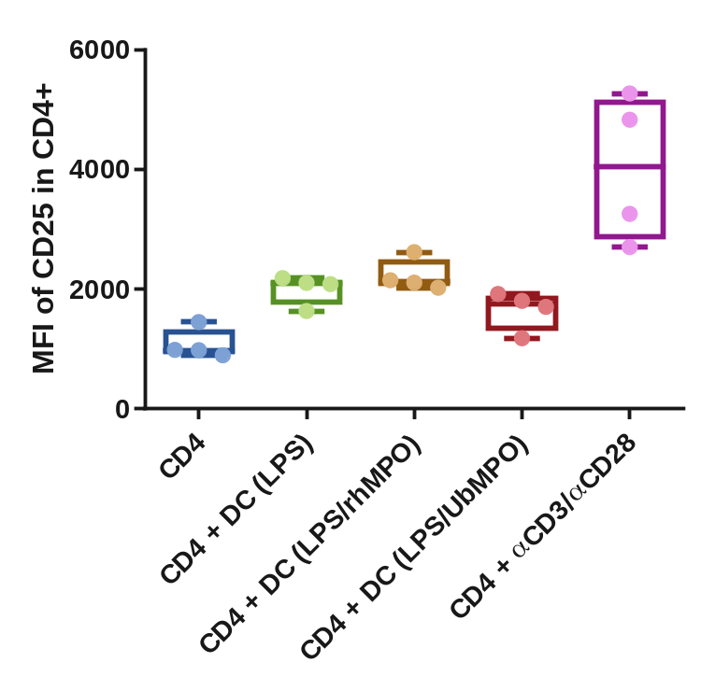
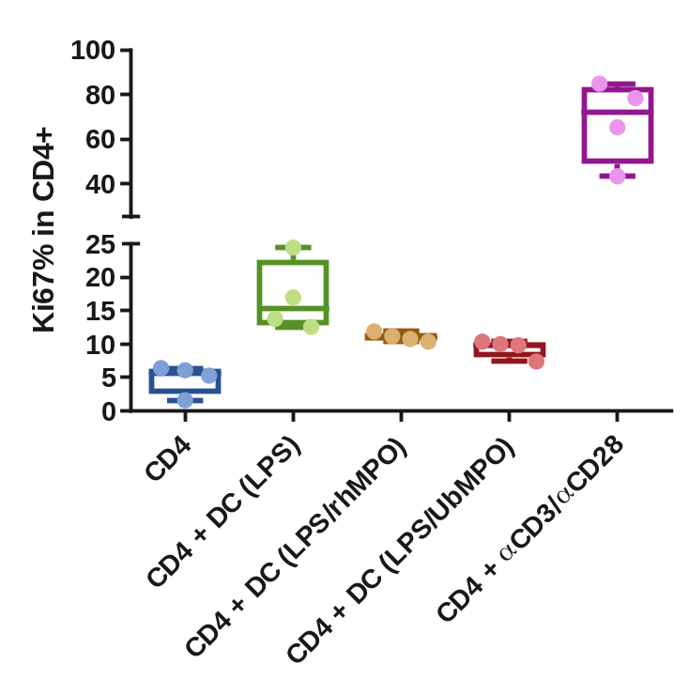
B)
p= NS
C)
Supplementary 3
p= NS
A)
p= NS
D)
E)
*
*
*
*
Notes:
Supplementary 3. UbMPO diminish CD4⁺ lymphocyte activation and proliferation of healthy controls were cocultured with LPS activated DCs with UbMPO. No differences were found in the production of cytokines among groups of interest (A-C). However, lower activation of healthy control determined by CD25 expression in CD4⁺ lymphocytes upon UbMPO stimulation was found compared with rhMPO (D). Decreased proliferation from healthy controls towards UbMPO stimulation (E) . * p<0.05.

Slide 4
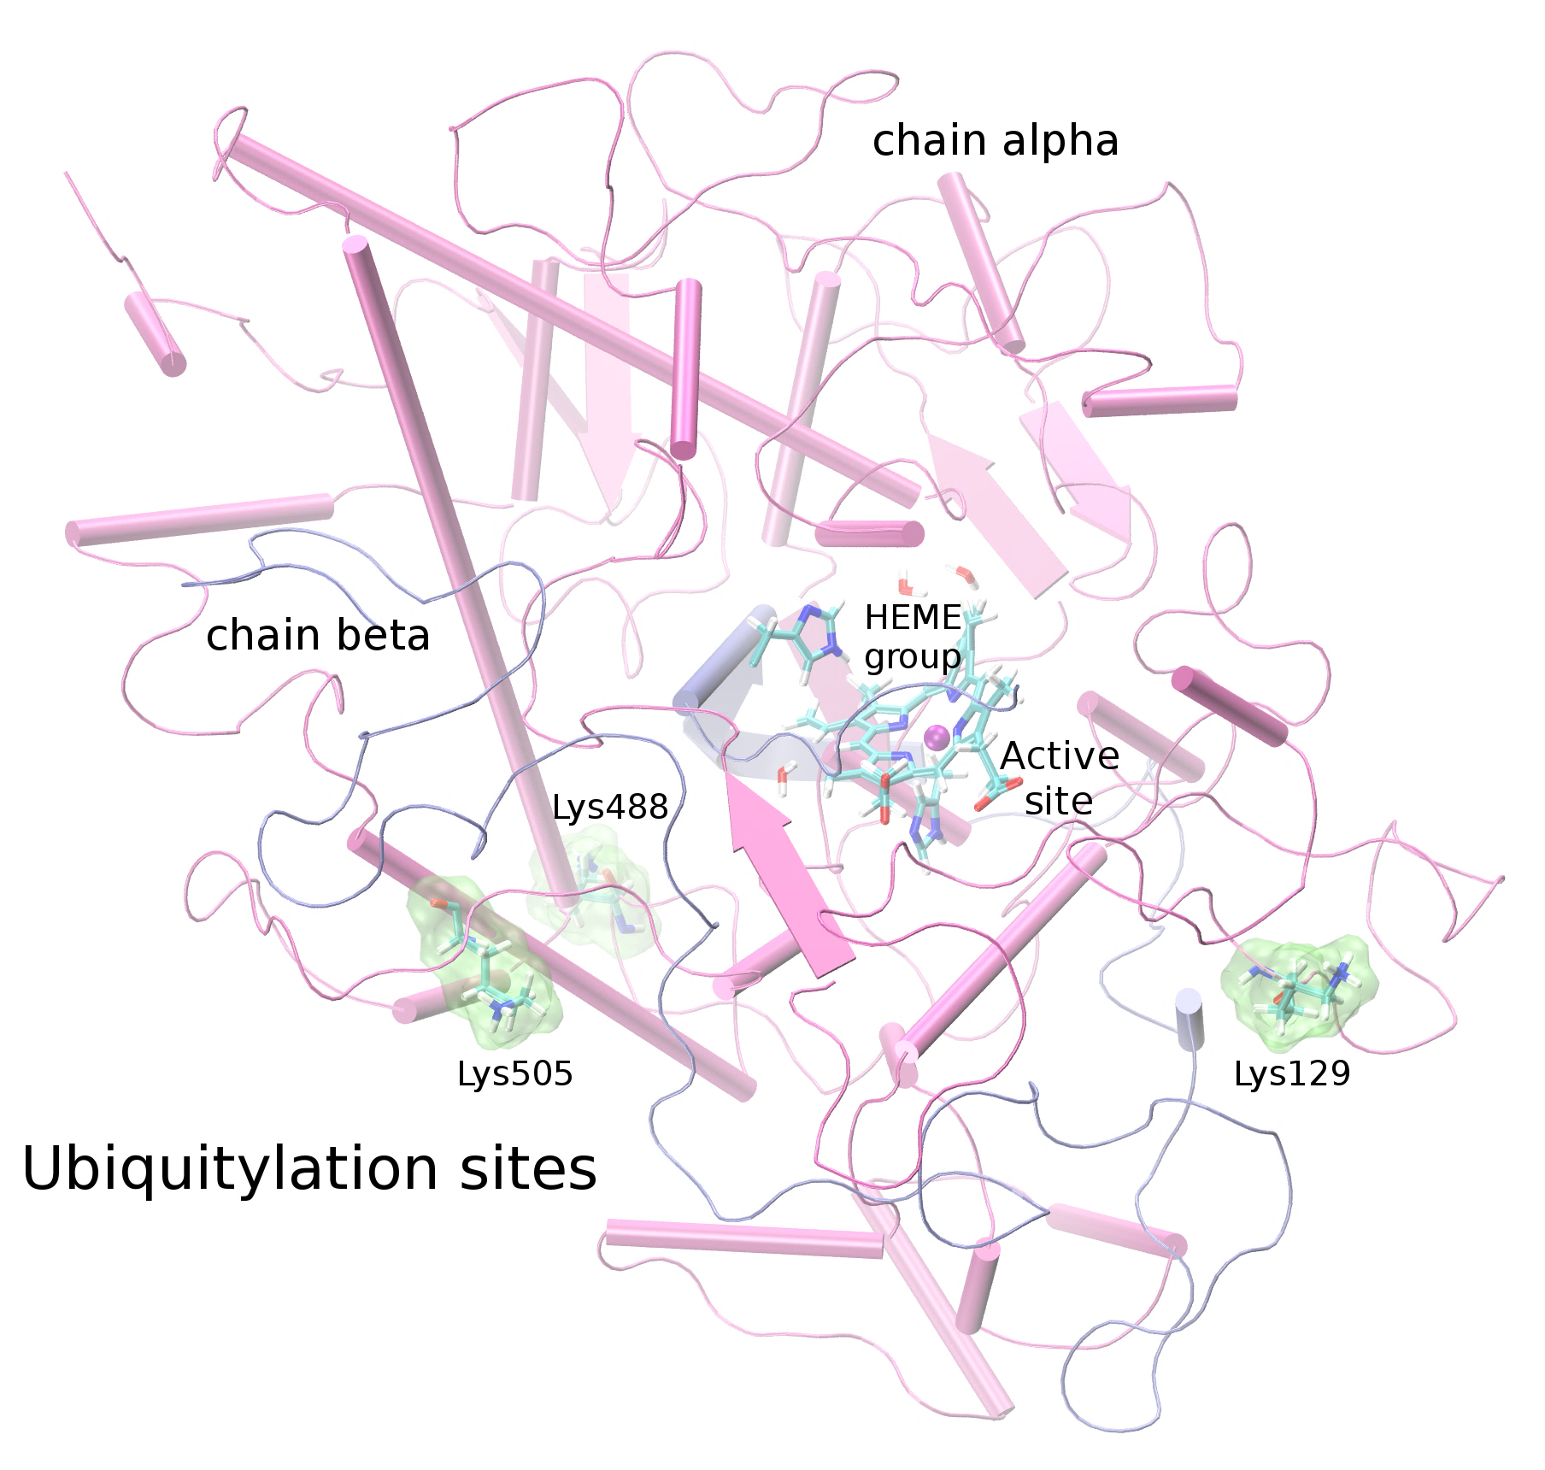
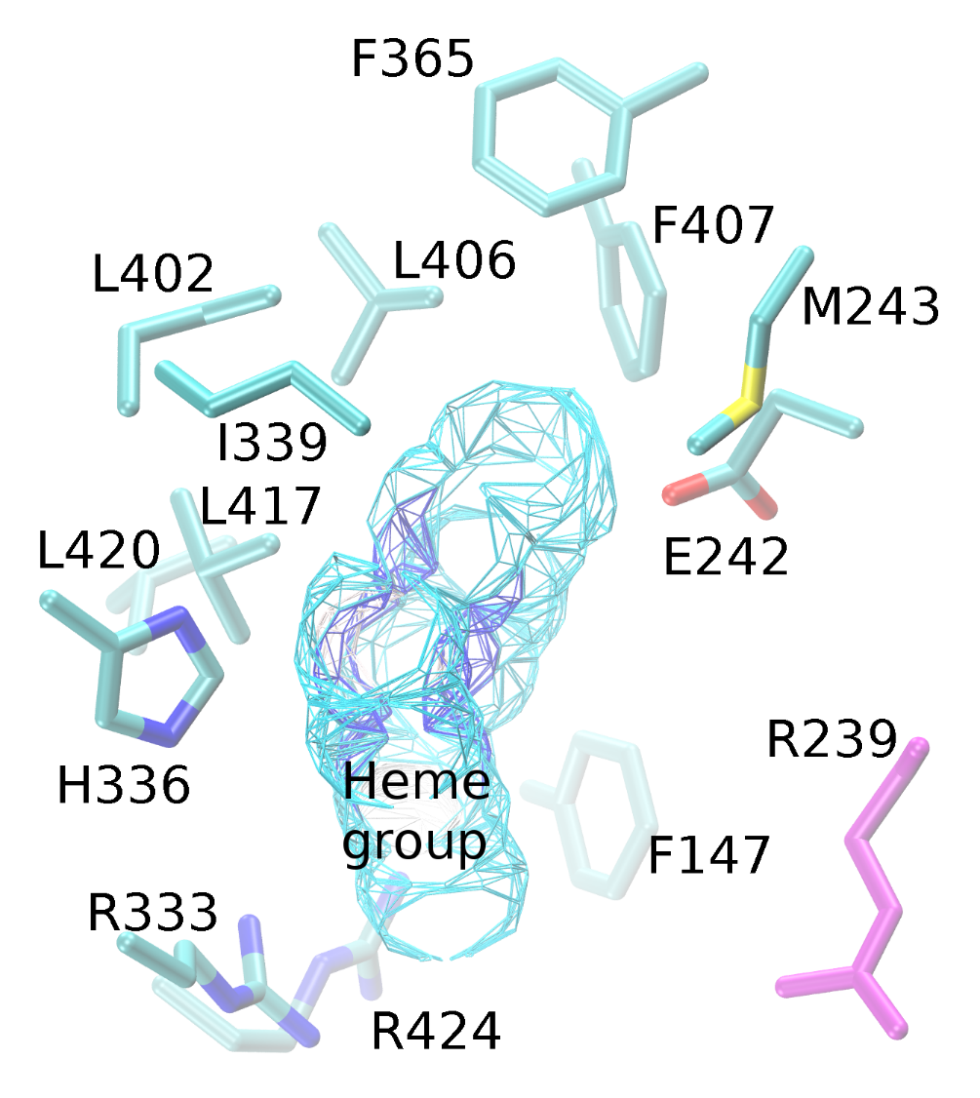
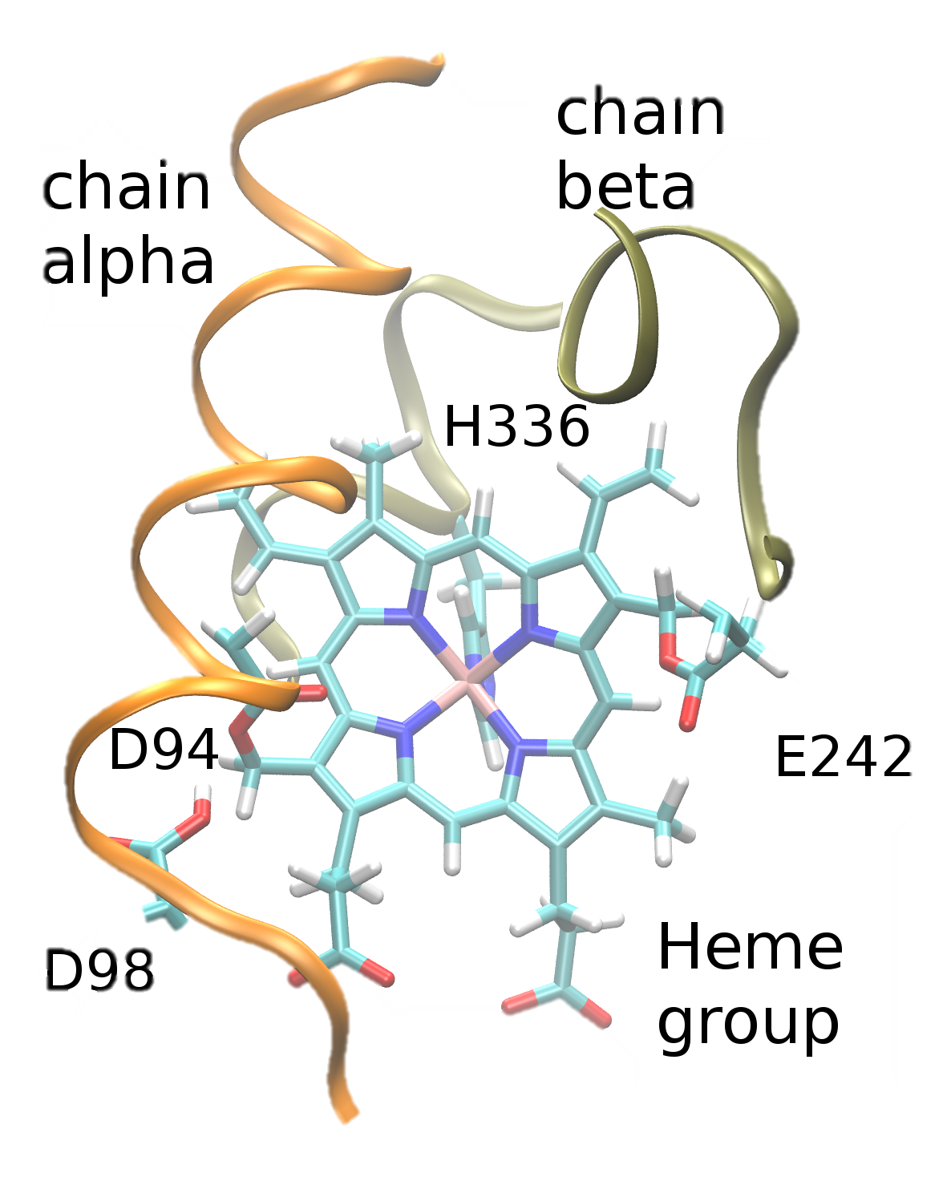
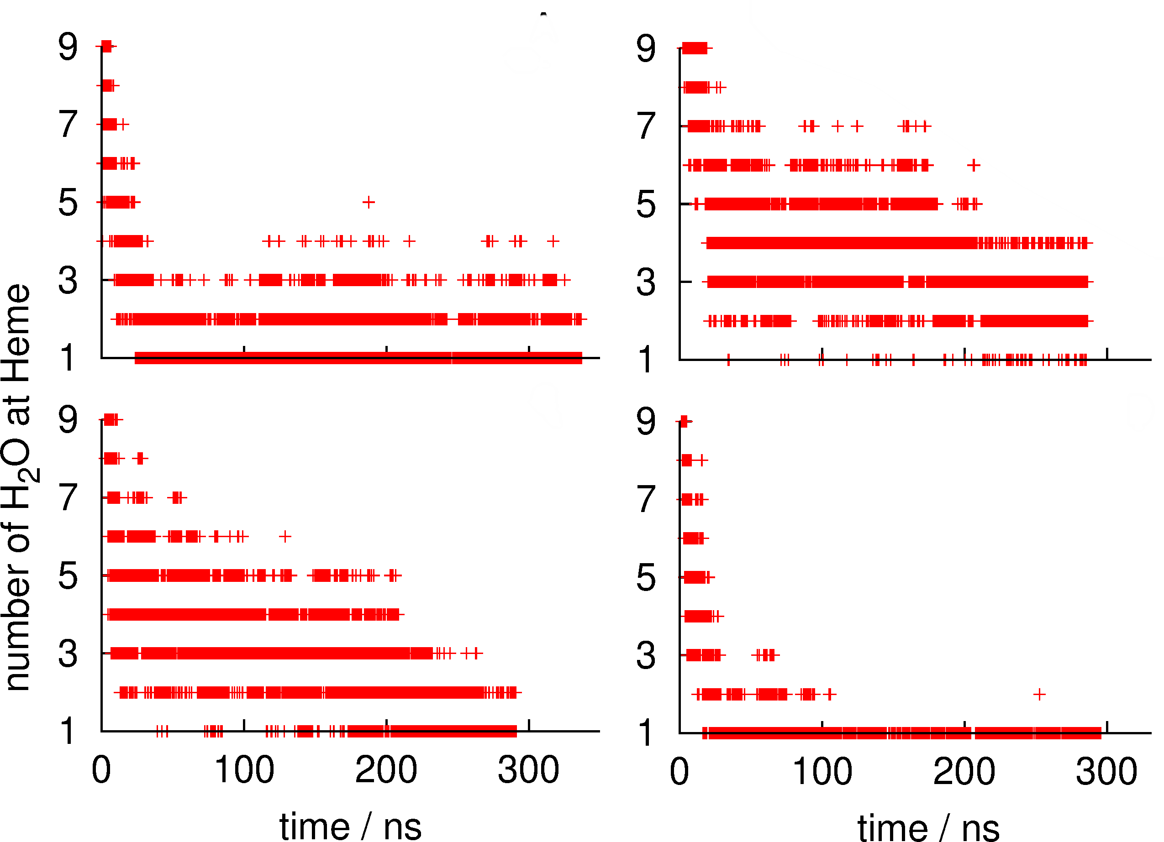
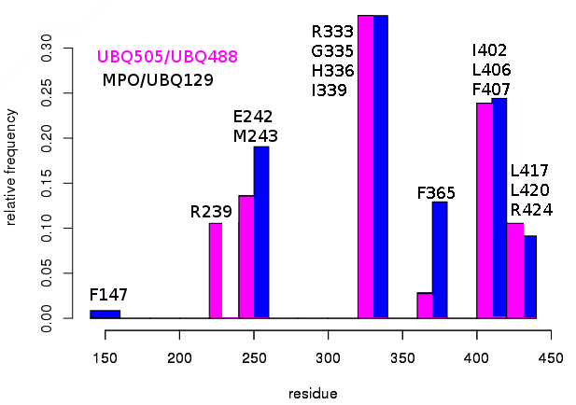
Supplementary 4
A)
B)
C)
E)
F)
D)
G)
H)
Notes:
Supplementary 4. Molecular dynamics simulations
MPO active site and ubiquitylation sites. Close-up of the HEME group in the native MPO active site showing ester bonds of the D94, E292 side chains and the methyls at position 3 and 13 of the HEME group (A). Representation in licorice. Fragments of chain a and chain b are shown in orange and ochre ribbons as context of the active site, as well as H. Structure of the native MPO in cartoons representation (B), chain a in magenta and chain b in ice blue. In licorice representation the HEME group, axial histidine, lysines 129, 488 and 505, and three water molecules in the active site. Color code: Color code C, cyan, O, red, H, white N, blue, Fe, pink.
Visual representation of the residues near the HEME. R239 was found close to the active site only when ubiquitin was conjugated to K505 or K488 (C). Contact map of the residues of the MPO in close contact with the HEME group, highlights the differential profile when the ubiquitin is found in K505 or K488 over R239 (D).
Number of water molecules in the active site as a function of simulation time. In the crystal structure, there are 3.5 water molecules in this region of the protein. Compared to the native MPO (E), ubiquitylation at K129 (F) or K488 (G) the number of water molecules increases by 1 to 3 molecules; in K505 (H) the amount of water in the active decreases up to 1. The hydration level at the active site was sensitive to the ubiquitylation site.

Slide 5
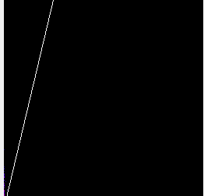
Supplementary 5
40x
SLE5 S
40x
SLE5 S
ISG15
DNA
ISG15
40x
40x
LL37
Pearson's R value (no threshold): 0.40
Costes P-Value: 1.00
DNA
ISG-15
LL37
LL37
50 μm
Notes:
Supplementary 5. Colocalization of LL37 with ISG15 in lupus NETs. ISG15 and known proteins expressed in NETs such as LL37, was assessed in spontaneous NETs from SLE patient by indirect immunofluorescence (40X) and confocal microscopy. In a representative SLE patient, ISG15 and LL37 colocalized inside NETs with a lower Pearson (R= 0.40) and Costes p value (1.0 ), compared with colocalization of ISG15 and H2B (Figure 4). Blue (DNA), red (ISG15) and green (LL37).

Slide 6
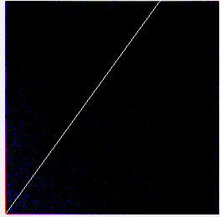
Supplementary 6
40x
SLE5 S
40x
SLE5 S
DNA
ISG15
ISG15
40x
40x
HMGB1
Pearson's R value (no threshold): 0.57
Costes P-Value: 1.00
DNA
ISG15
HMGB1
HMGB1
50 μm
Notes:
Supplementary 6. Colocalization of HMGB1 with ISG15 in lupus NETs. ISG15 and known proteins expressed in NETs such as HMGB1, was assessed in spontaneous NETs from SLE patient by indirect immunofluorescence (40X) and confocal microscopy. In a representative SLE patient, ISG15 and HMGB1 colocalized inside NETs with a lower Pearson (R= 0.57) and Costes p value (1.0 ), compared with colocalization of ISG15 and H2B (Figure 4). Blue (DNA), red (ISG15) and green (HMGB1).

Slide 7
Supplementary
table 1
 | SLE (n=5)
 | CD4 | CD4/DCs (LPS) | CD4/DCs (LPS + rhMPO) | CD4/DCs (LPS + UbMPO) | CD4 + αCD3/αCD28 | p value
CD25+ MFI (IQR) | 371.5 (358-586) | 658 (405.5-1065) | 656.0 (436-927) | 750 (468-1077) | 1342 (906.8-1669) | 0.6857
CD4/CD25/FoxP3+ % (IQR) | 5.7 (4.39-6.36) | 3.9 (2.55-4.83) | 4.5 (2.57-10.33) | 4.26 (2.6-10.33) | 4.06 (1.56-7.31) | 0.8857
CD83+ % (IQR) | 4.4 (1.73-8.6) | 1.5 (1.1-12.8) | 2.8 (0.58-15.28) | 1.7 (0.9-3.2) | 17.82 (6.1-38.6) | 0.8857
HLA-DR % (IQR) | 9.1 (4.5-15.6) | 9.92 (7.5-20.4) | 9.32 (6.75-20) | 9.9 (6.7-13.2) | 9.9 (9.4-18.28) | >0.9999
Ki67 % (IQR) | 2.1(1.65-2.70) | 3.8 (2.9-7.09) | 3.2(1.4-8.1) | 8 (5.3-12.1) | 61.5 (50.28-75.5) | 0.1143
IFNγ % (IQR) | 3.17(1.8-5.6) | 3.6(3-4.5) | 10.5(7-12.13) | 6.820(5.8-8.42) | 23.75(11-24.98) | 0.0286
IL17A % (IQR) | 2.650(2.2-3.2) | 2.7(2.3-2.76) | 4.9(4-6.1) | 4.6(3.3-6.5) | 2.68(1.8-3.6) | 0.0286
IL4 % (IQR) | 27.15 (13.88-38) | 30.5(15.25-41.2) | 32.8(20.4-33.8) | 28.6(23.4-38) | 49.75(37.4-69.2) | 0.8857
 | Healthy controls (n=5)
 | CD4 | CD4/DCs (LPS) | CD4/DCs (LPS + rhMPO) | CD4/DCs (LPS + UbMPO) | CD4 + αCD3/αCD28 | p value
CD25+ MFI (IQR) | 979.5 (913.5-1331) | 2091(1743-2160) | 2127(2042-2501) | 1751(1308-1889) | 4045(2840-5162) | 0.0286
CD4/CD25/FoxP3+ % (IQR) | 1.39 (1.1-1.48) | 1.48 (1.08-2.25) | 0.9 (0.78-2.66) | 1.53 (1.08-1.9) | 0.85 (0.29-1.2) | >0.9999
CD83+ % (IQR) | 2.87 (1.62-3.45) | 2.85 (2.3-4.6) | 3.08 (2.6-3.8) | 2.9(2.2-3.3) | 63.2 (24-83.1) | 0.8857
HLA-DR % (IQR) | 6.9 (3.86-8.8) | 4.9 (4.5-9.7) | 5.4 (4.8-9.9) | 8.5 (3.7-9.1) | 8.5 (5.8-15.8) | 0.6905
Ki67 % (IQR) | 5.7 (2.53-6.32) | 15.4 (12.9-22.6) | 11 (10.5-11.73) | 9.93 (8-10.3) | 71.95(48.8-83.3) | 0.0421
IFNγ % (IQR) | 1.63 (0.48-2.3) | 3.83(2.1-4.6) | 3 (2.5-3.6) | 2.66 (2.5-4.61) | 3.7 (1.3-6.7) | 0.7381
IL17A % (IQR) | 0.49(0.33-1.84) | 6.6(2.8-12) | 4.24(3-11.6) | 6.8(3.8-9) | 0.42(0.23-2.25) | >0.9999
IL4 % (IQR) | 42.75(17-74.1) | 29.3(11.3-49.7) | 32.4(12.8-63.6) | 32.4(12.7-62.4) | 45.6(13.7-82) | 0.3429

