Slide 1
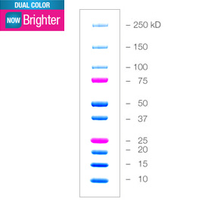
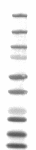
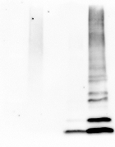
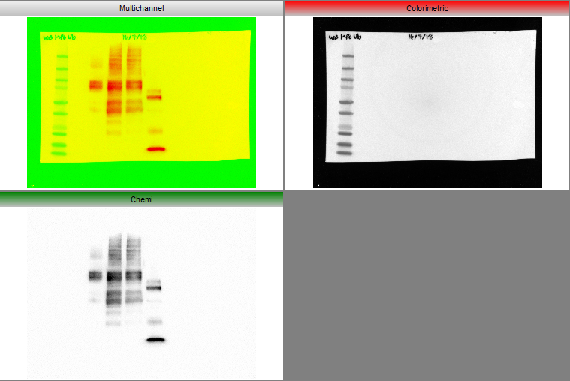
MPOUb Ctl Neg
Supplementary 1
HeLa
MPOUbIV
MPM
MPOrh
MPOUb
α-UbP4D1
α-MPO
80kDa
Notes:
Supplementary 1. Western Blot total anti-ubiquitin. A lysate of HeLa cells, recombinant human MPO (MPOrh) are observed, both without the presence of ubiquitin and MPO with ubiquitin as negative controls of the reaction (since all the substrates necessary for the enzymatic reaction are added except ATP); in the last lane the product of the complete in vitro ubiquitylation reaction of the MPO.

Slide 2
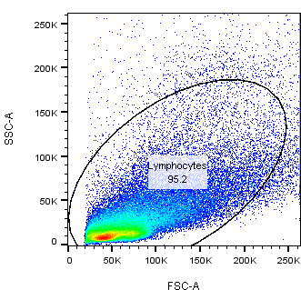
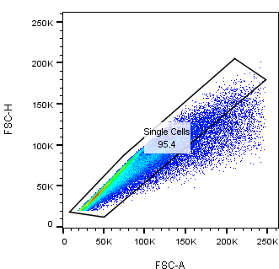
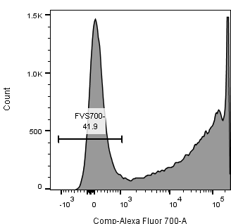
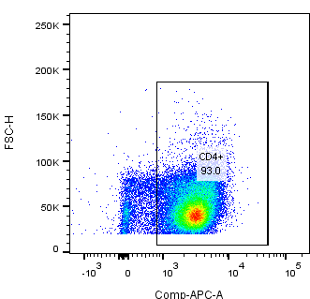
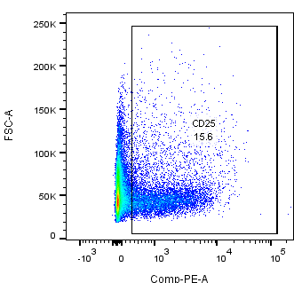
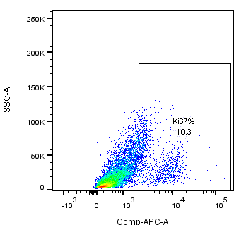
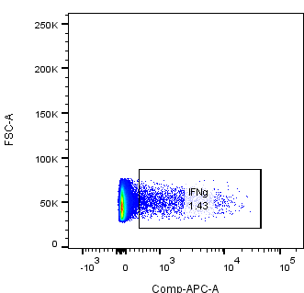
A)
B)
Supplementary 2
C)
D)
FVS700
CD4+
E)
F)
G)
CD25+
Ki67+
IFNγ+
Notes:
Supplementary 2. Representative dot plot of the gating strategy for the determination of the percentage of CD25, Ki67, IFNγ. The lymphocyte population was selected from a graph of size and complexity (Panel A). Then the singlettes were obtained by comparing area granularity against height granularity (Panel B). Viable cells were determined using FVS700 exclusion staining (Panel C). This subpopulation of lymphocytes was determined by CD4 + staining (Panel D). Subsequently, activation markers were determined in this subpopulation (CD25+ in Panel E), proliferation (Ki67+ in Panel F) and polarization through the production of cytokines (IFNγ+ in panel G).

Slide 3
Supplementary
table 1
 | SLE (n=5)
 | CD4 | CD4/DCs (LPS) | CD4/DCs (LPS + rhMPO) | CD4/DCs (LPS + UbMPO) | CD4 + αCD3/αCD28 | p value
CD25+ MFI (IQR) | 371.5 (358-586) | 658 (405.5-1065) | 656.0 (436-927) | 750 (468-1077) | 1342 (906.8-1669) | 0.6857
CD4/CD25/FoxP3+ % (IQR) | 5.7 (4.39-6.36) | 3.9 (2.55-4.83) | 4.5 (2.57-10.33) | 4.26 (2.6-10.33) | 4.06 (1.56-7.31) | 0.8857
CD83+ % (IQR) | 4.4 (1.73-8.6) | 1.5 (1.1-12.8) | 2.8 (0.58-15.28) | 1.7 (0.9-3.2) | 17.82 (6.1-38.6) | 0.8857
HLA-DR % (IQR) | 9.1 (4.5-15.6) | 9.92 (7.5-20.4) | 9.32 (6.75-20) | 9.9 (6.7-13.2) | 9.9 (9.4-18.28) | >0.9999
Ki67 % (IQR) | 2.1(1.65-2.70) | 3.8 (2.9-7.09) | 3.2(1.4-8.1) | 8 (5.3-12.1) | 61.5 (50.28-75.5) | 0.1143
IFNγ % (IQR) | 3.17(1.8-5.6) | 3.6(3-4.5) | 10.5(7-12.13) | 6.820(5.8-8.42) | 23.75(11-24.98) | 0.0286
IL17A % (IQR) | 2.650(2.2-3.2) | 2.7(2.3-2.76) | 4.9(4-6.1) | 4.6(3.3-6.5) | 2.68(1.8-3.6) | 0.0286
IL4 % (IQR) | 42.75(17-74.1) | 29.3(11.3-49.7) | 32.4(12.8-63.6) | 32.4(12.7-62.4) | 45.6(13.7-82) | 0.3429
 | Healthy controls (n=5)
 | CD4 | CD4/DCs (LPS) | CD4/DCs (LPS + rhMPO) | CD4/DCs (LPS + UbMPO) | CD4 + αCD3/αCD28 | p value
CD25+ MFI (IQR) | 979.5 (913.5-1331) | 2091(1743-2160) | 2127(2042-2501) | 1751(1308-1889) | 4045(2840-5162) | 0.0286
CD4/CD25/FoxP3+ % (IQR) | 1.39 (1.1-1.48) | 1.48 (1.08-2.25) | 0.9 (0.78-2.66) | 1.53 (1.08-1.9) | 0.85 (0.29-1.2) | >0.9999
CD83+ % (IQR) | 2.87 (1.62-3.45) | 2.85 (2.3-4.6) | 3.08 (2.6-3.8) | 2.9(2.2-3.3) | 63.2 (24-83.1) | 0.8857
HLA-DR % (IQR) | 6.9 (3.86-8.8) | 4.9 (4.5-9.7) | 5.4 (4.8-9.9) | 8.5 (3.7-9.1) | 8.5 (5.8-15.8) | 0.6905
Ki67 % (IQR) | 5.7 (2.53-6.32) | 15.4 (12.9-22.6) | 11 (10.5-11.73) | 9.93 (8-10.3) | 71.95(48.8-83.3) | 0.0421
IFNγ % (IQR) | 1.63 (0.48-2.3) | 3.83(2.1-4.6) | 3 (2.5-3.6) | 2.66 (2.5-4.61) | 3.7 (1.3-6.7) | 0.7381
IL17A % (IQR) | 0.49(0.33-1.84) | 6.6(2.8-12) | 4.24(3-11.6) | 6.8(3.8-9) | 0.42(0.23-2.25) | >0.9999
IL4 % (IQR) | 27.15 (13.88-38) | 30.5(15.25-41.2) | 32.8(20.4-33.8) | 28.6(23.4-38) | 49.75(37.4-69.2) | 0.8857

