Slide 1
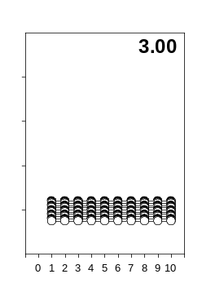
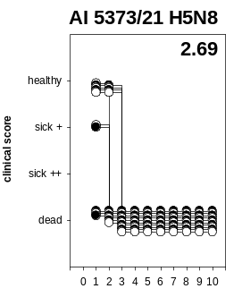
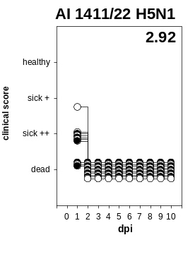
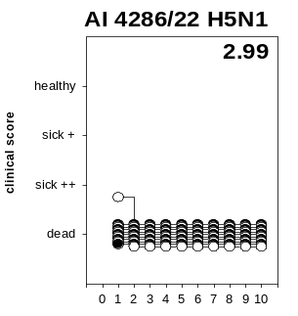
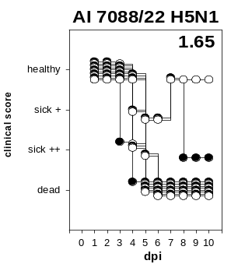
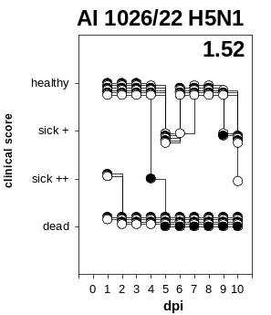
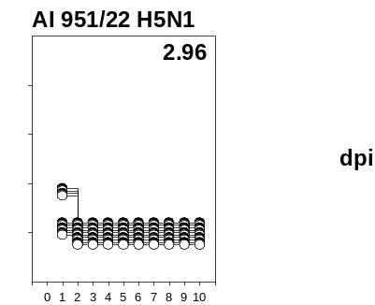
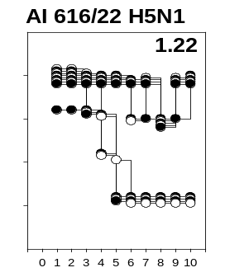
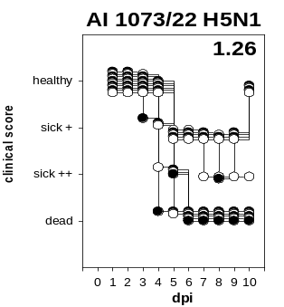
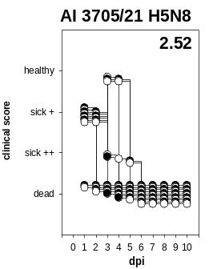
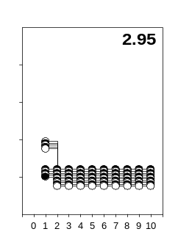
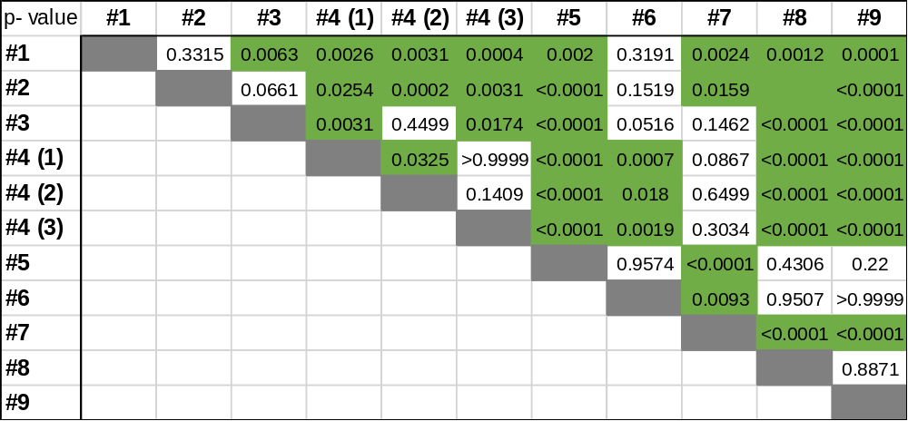
genotype #4
(1)
genotype #2
genotype #3
genotype #5
genotype #6
genotype #7
genotype #8
genotype #9
(3)
genotype #1
dpi
(2)
dpi
dpi
dpi
dpi
dpi
dpi
dpi
Supplemental Figure 1
Statistical significance was determined by applying appropriate Mann- Whitney- U tests. n = 10 per group.
P- value below < 0.05
Notes:
The clinical course of ducklings after infection with HPAIV H5N1 and H5N8 genotype 2.3.4.4b viruses is shown. One- week-old ducklings were inoculated intramuscularly (i.m.) with 0.1 ml of the respective diluted viruses. The numbers in the figures indicate the clinical score for each group according to the IMPI scoring system.
Statistically significant differences between groups are indicated with letters to the right of the corresponding graphs. Statistical significance was determined by applying appropriate Kruskal-Wallis tests using GraphPad Prism version 8.0.1.
Statistik- Auswertung:
unabhängiger, beidseitiger, Mann- Whitney- U- Test
Independent, Nonparametric, Unpaired, Two- tailed
Signifikanter Unterschied einer Gruppe nachgewiesen zu Gruppen (Buchstaben):
A- signifikanter Unterschied gegenüber Gruppe E-K
B- C, E-K
C- B, F-K
D- F-K
E- A, B; F, H, I, K
F- A-E; J,K
G- A-D
H- A-E; J, K
I- A-E; J, K
J- A-D: F; H,I
K- A-F; H,I
H5N1 Genotypes
Ger 10-21 N1.5
In addition to the older H5N8 genotypes prevalent in 2020 and 2021, our interest in this experiment was particularly on the H5N1 genotype Ger 10-21 N1.5, which ended the H5N8 dominance in Germany around October 2021 and since then has consistently spread across many parts of Germany, including others, simultaneously occurring genotypes as far as possible. In our experiment, different virus isolates of this genotype from diverse locations, target species and variable detection dates were tested. After infection with HPAIV H5N1; A/ herring gull/DE-Buesum/ AI 01196/2022 Ger 10-21 N 1.5, a virus isolate from February 2022, a 100% mortality rate appeared in less then 24 hours with ducklings dying peracutely without showing any severly symptoms of disease leading to an IMPI score of 3.00. The second virus isolate of genotype Ger 10- 21 N1.5 tested here, namely HPAIV H5N1; A/ brent goose/DE-Reußenkoege/ AI 02407/2022 Ger 10-21 N 1.5 from April 2022, did show similar properties by leading to peracute death of 5 animals in less then 24 hours. Four of the remaining inoculated ducklings were found moribund after 24 hours of infection why we decided to euthanize them as well as the last remaining bird which appeared calm and dull. These findings resulted in an IMPI score of 2.95. The third virus isolate belonging to genotype Ger 10-21 N 1.5 was HPAIV H5N1; A/ chicken/DE-NI/ AI 04286/2022 Ger 10-21 N 1.5 out of July 2022. Inoculation of 10 ducklings with this virus again led to 100% mortality rate in less then 24 hours with 9 peracutely deceased birds and one moribund one which was then euthanized. IMPI score of this virus was drawn to be 2.99.
Ger 12-21 N 1.3
Inoculation of the next group with a virus isolate of genotype Ger 12-21 N1.3, namely HPAIV H5N1; A/ pigeon/DE-NW/ AI 00951/2022 as well resulted in 100 % mortality within 24 hours after infection with 6 dead birds and 4 severely sick birds found that then were taken out of the experiment, resulting in an IMPI of 2.96.
Ger 10-21 N1.2
The next competitor genotype that circulated simultaneously as the beforementioned successful Ger 10-21 N1.5 in our trial was Ger- 10-21 N1.2. Inoculation of another group of 10 ducklings with the promising virus isolate HPAIV H5N1; A/ European herring gull/DE-MV/AI01411/2022 also resulted in mortality in all of the animals 24 hours after infection with 3 animals already found to be dead, 6 animals with sick and apathetic behavior and one animal breaking down why we decided to take all of the animals out of the trial. Infection of this group resulted in an IMPI of 2.92.
Ger 11- 21 N1.1
A slightly milder course was caused by the virus named A/hering gull/Germany-Buesum/AI 7088/22 of genotype Ger 11-21 N1.1. Signs of infection were not seen until 3 days after inoculation when one bird was found dead. On day 4, however, the virus unleashed its highly virulent capacity, with another animal found moribund and 2 more animals showing clear central nervous symptoms. These were removed from the experiment. While 2 others showed a slightly reduced general condition, the remaining 4 animals were without clinical abnormalities. The general clinical picture worsened on day 5 with 2 animals found dead and 2 others moribund. The 2 remaining animals appeared calm. While the two remaining animals also showed a reduced general condition on day 6 and 7 pi, one of them developed slight Torticollis on day 8 which remained the case until the end of the experiment. The clinical outcome of this group resulted in an IMPI of 1.65.
Ger 12- 21 N1.2Two dead, as well as 2 moribund, motionless animals with Torticollis and head shaking were the result of infection with A/chicken/Germany/AI 1026/22 belonging to genotype Ger 12-21 N1.2 on day one after infection. On the following 2 days, no clinical signs were observed in the remaining 6 animals. It was not until day 4 pi that another animal was found to have severe central nervous symptoms. Between day 5 and day 8 pi, again no signs of disease occurred in the animals. Only on day 9, two more animals were found with slightly reduced general condition. On the last day of the experiment, the condition of one animal worsened into recumbency and dullness, while the other 4 animals showed a slightly reduced general condition. This development resulted in an IMPI of 1.52.
Ger 12- 21 N1.5
Another group was infected with virus A/black headed gull/Germany/AI 1073/22 from genotype Ger 12-21 N1.5, where infection resulted in one animal with reluctance to move only on day 3 pi and resulted in one dead animal and one with severe central nervous symptoms on the following day, which was subsequently withdrawn from the experiment. While 2 other animals showed a slightly reduced general condition, the 6 remaining animals were clinically unremarkable. Three more animals were found moribund on day 5, the other five ducklings were reduced in general condition, which was repeated on the next day. On day 7, one animal was found with a slight head tilt, which maintained until day 10. The other 4 animals were clinically unremarkable until the end, leading to an IMPI of 1.26.
Ger 12- 21 N1.4
Another group of ducklings got inoculated with a virus of genotype Ger 12-21 N1.4, namely HPAIV H5N1; A/ Knutt/DE-SH/ AI 00616/2022. Other than in the previous groups, ducklings here did not come up with high mortality within a short time but only with one slightly sick bird on day one after inoculation and the following day. On day 3 pi one duckling came up with Torticollis while two others appeared with oval shaped eyes making a slightly sick impression. The next day one bird came up showing heavy Opisthotonus why it then was taken off the experiment. Another duckling came up with head shaking, remaining on its position all the time why it was taken out as well. Two further birds appeared slightly sick while the remaining birds did not show any clinical issues. On day 5 after inoculation one duckling was found dead and one duckling came up being heavy atactic why it was decided to take it off the trial. All remaining birds showed up with reduced general conditions that day. On day 6 after inoculation all remaining birds behaved attentive with 2 of them remained seeted. Clinical signs improved the next day with only one slightly atactic bird next to all the others without any signs of disease. On day 8 after inoculation there was this one slighty atactic bird again which as well as the other ducklings did not show high interest in food and water intake that day which was not the case the next day anymore. On day 10 which was the last day of the trial all remaining birds appeared clinically symptom- free and recovered.
The clinical course of group Ger 12-21 N1.4 HPAIV H5N1; A/ Knutt/DE-SH/ AI 00616/2022 allowed both organ material and serum samples to be obtained from the 5 animals remaining on day 10, while the animals from the same group that had died on the previous days were sampled by choana and cloacal swabs only. Analysis of the swab samples revealed findings of viral RNA both in choana and cloaca of all ducklings with higher titers in the choanal swabs.
Organ analysis of brains, lungs, duodenum/ pancreas, kidneys, livers and heart of the ducklings sacrificed on day 10 revealed viral RNA with especially high titers in the brains of all animals while there were only slight findings on the lungs, duodenums and hearts of only some animals.
We also collected serum samples of the 5 remaining ducklings from day 10. Those were indicative for successful seroconversion on the day we ended the experiment.
Bitte Text kürzen: Focus auf IMPI score
Überleiten auf neuen Abschnitt: Verteilung der Isolate: Analyse des lokalen Geschehens von
21 N1.5 drei versch. Isolate getestet)

Slide 2
genotype #4 (3), 3 dpi, o.n.
genotype #8, 5-6 dpi, o.n.
genotype #8, 21 dpi, o.n.
Supplemental Figure 2

Slide 3
genotype #4 (3), 3 dpi, o.n.
genotype #8, 5-6 dpi, o.n.
genotype #8, 21 dpi, o.n.
Supplemental Figure 3

Slide 4
genotype #4 (3), 3 dpi, o.n.
Supplemental Figure 3.1

Slide 5
genotype #4, 3 dpi, o.n.
genotype #8, 5-6 dpi, o.n.
genotype #8, 21 dpi, o.n.
Supplemental Figure 4.

