Slide 1
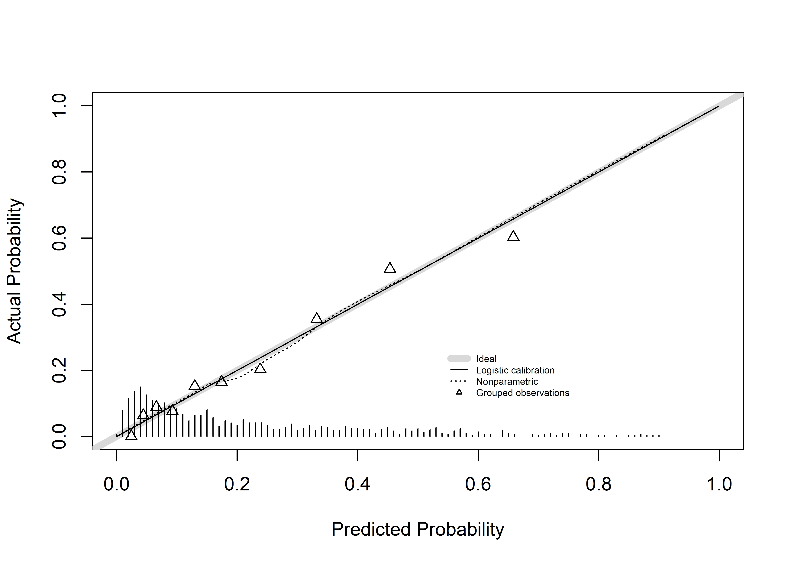
Supplementary Fig. S1 Calibration plot for (a) BRCA1/2, (b) BRCA1, (c) and BRCA2 in the development group.
a

Slide 2
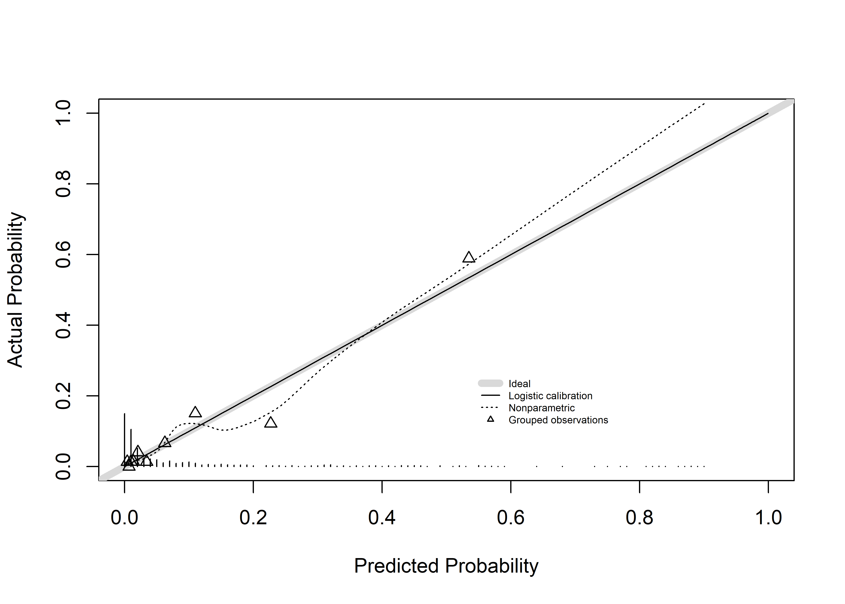
b

Slide 3
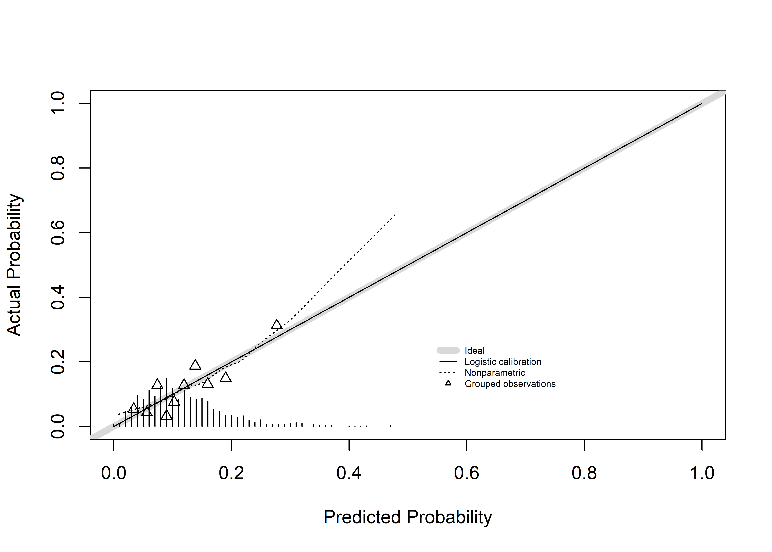
c

