Slide 1
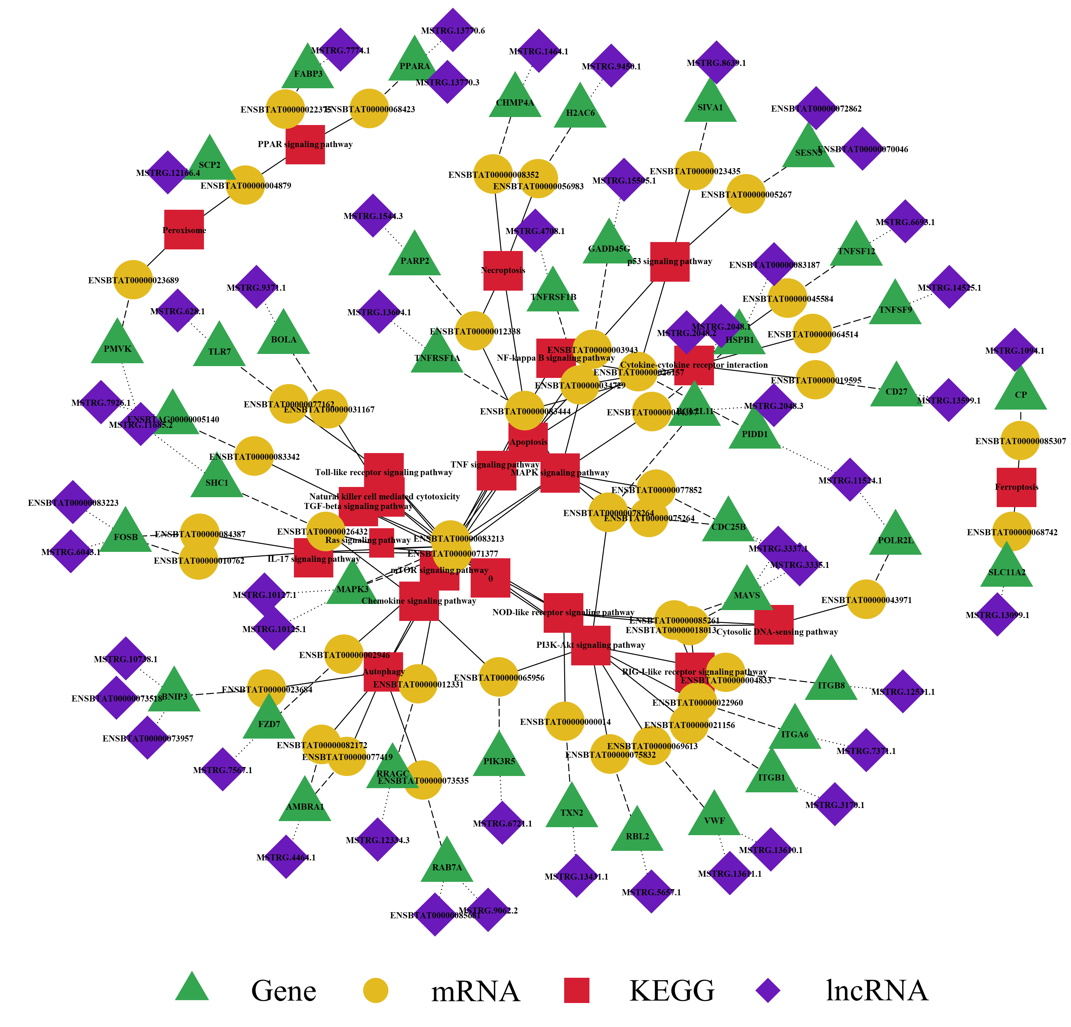
Notes:
Fig. S1. Network of co-expression relationships and KEGG pathways at 24 hpi
This network was constructed using 22 pathways associated with cell proliferation, death, and immunity, which may play a role in infection.

