Slide 1
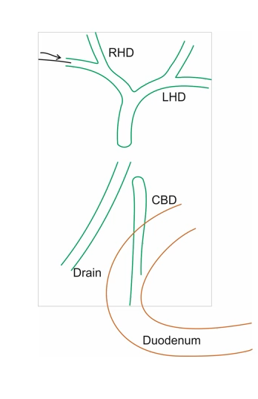
DRAIN LOOP TECHNIQUE

