Slide 1
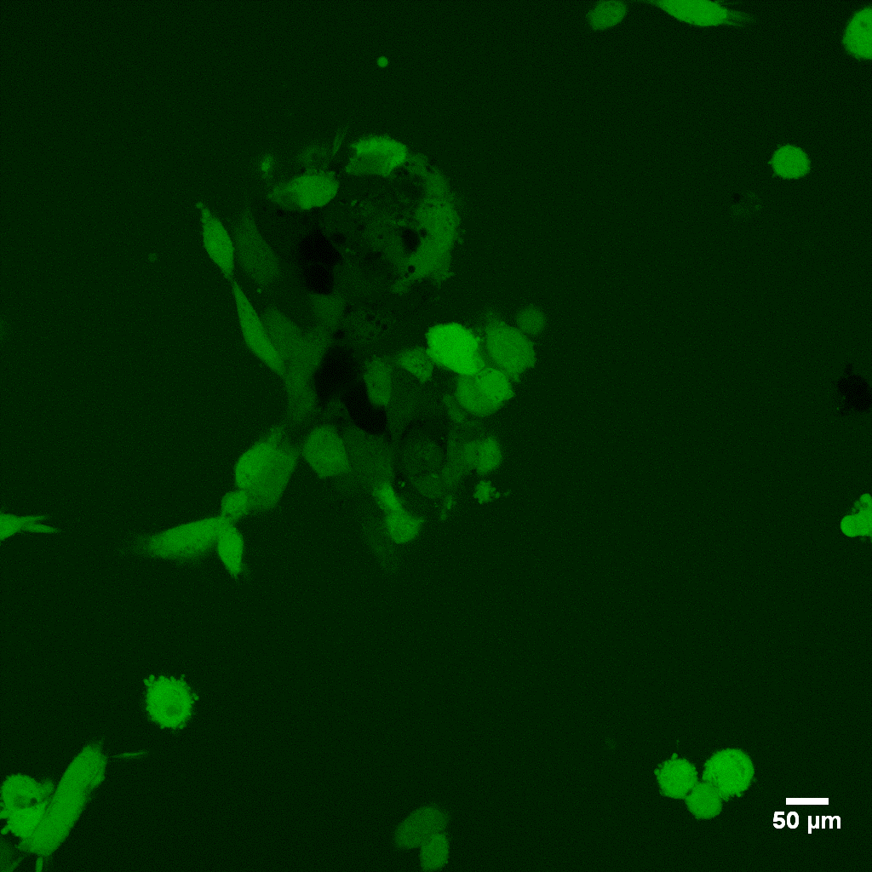
A
CON
AngⅡ
Ad-GFP+Ang II
Ad-ndufb10 +Ang II
MPTP
ROS

Slide 2
B
CON
Ang II
Ad-GFP+Ang II
Ad-ndufb1 +Ang II
JC-1
Aggregate
Jc-1
Monomer
Merge

Slide 3
C

Slide 4
D
CON
AngII
Ad-GFP+AngII
Ad-ndufb10 +Ang II
Tunel

Slide 5








E
Ad-ndufb10 +Ang II
Ad-GFP++AngII
CON
AngII
CASPASE9
BAX
CYTOCHROME C
GAPDH

