Slide 1
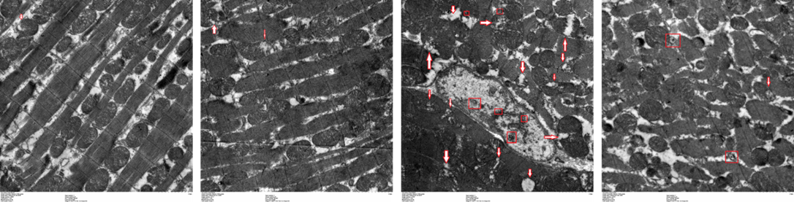
A
CN
sham
SC
SE

Slide 2
B

Slide 3
























C
CN
Sham
SC
SE
MFN1
LC3Ⅱ
PINK1
PARKIN
NIX
BNIP3
GAPDH

