Slide 1
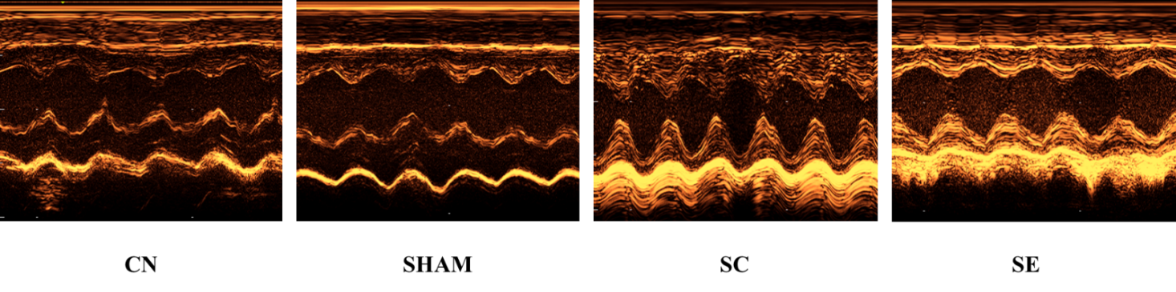
A
CN
sham
SC
SE

Slide 2
B

Slide 3
C

Slide 4
D

Slide 5
E

Slide 6
F

Slide 7
G

Slide 8
H

Slide 9
I

Slide 10
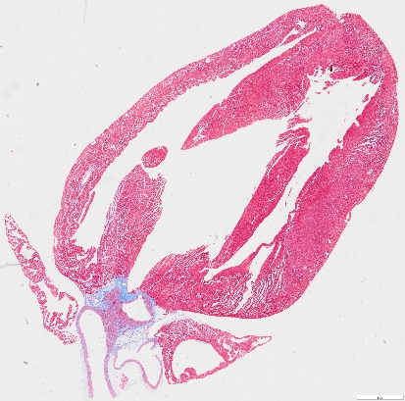
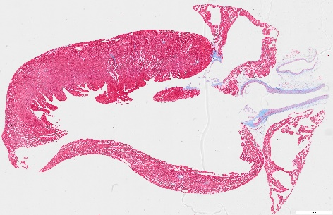
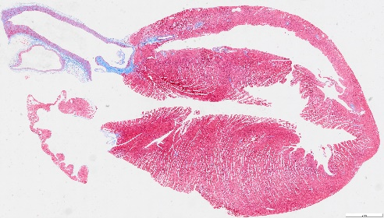
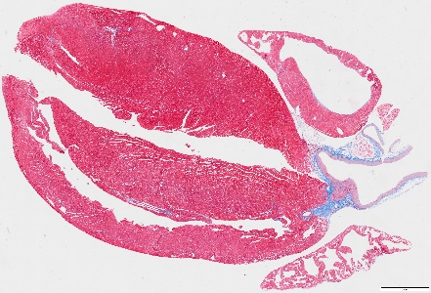
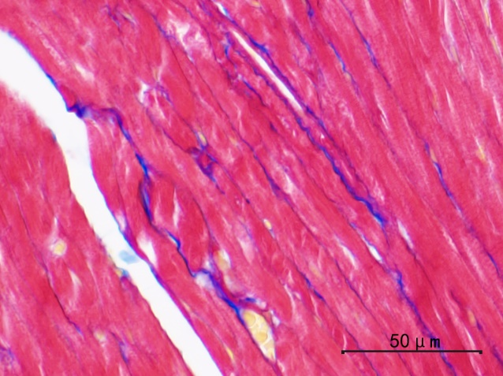
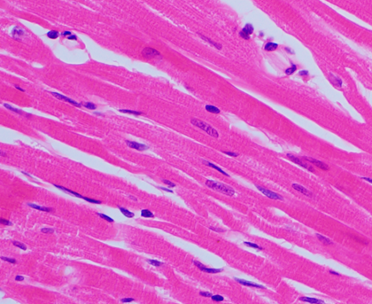
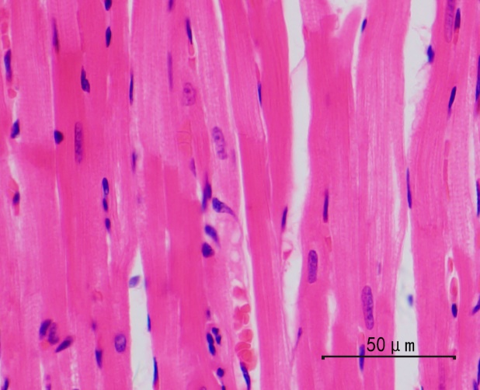
J
CN
sham
SC
SE
Masson staining
HE staining

Slide 11
K

Slide 12
L

Slide 13




M
CN
Sham
SC
SE
ANP
BNP
GAPDH

