Slide 1
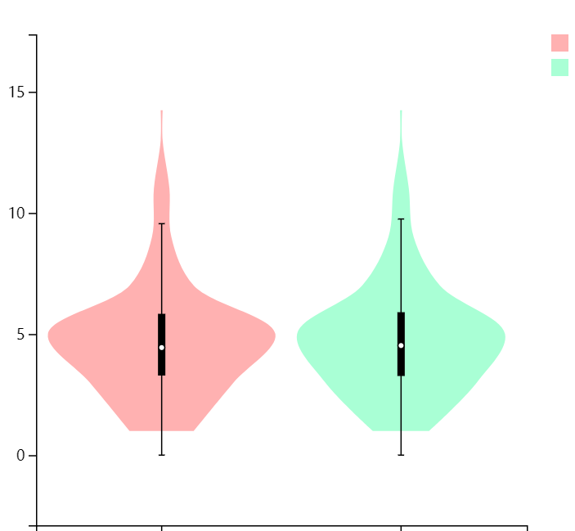
A
SC
SE
Log2（FPKM+1）
SC
SE

Slide 2
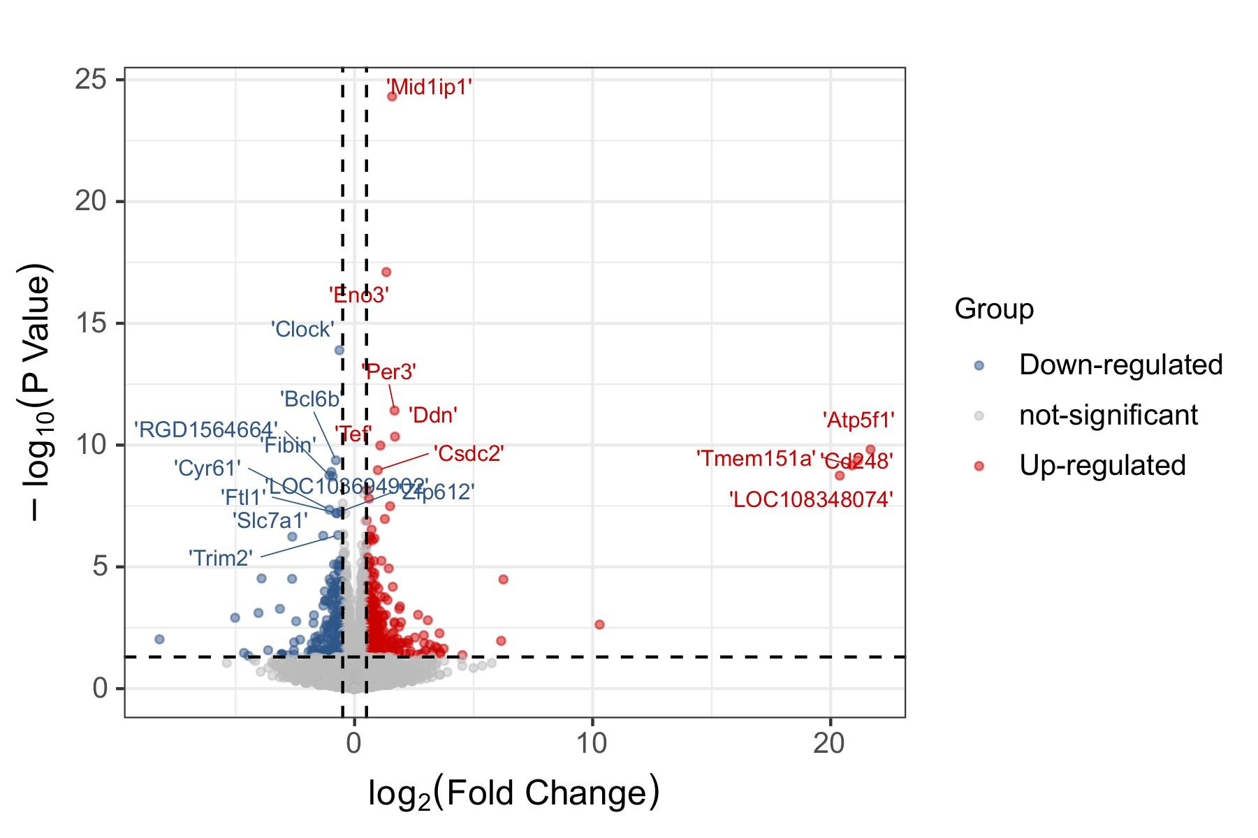
B

Slide 3
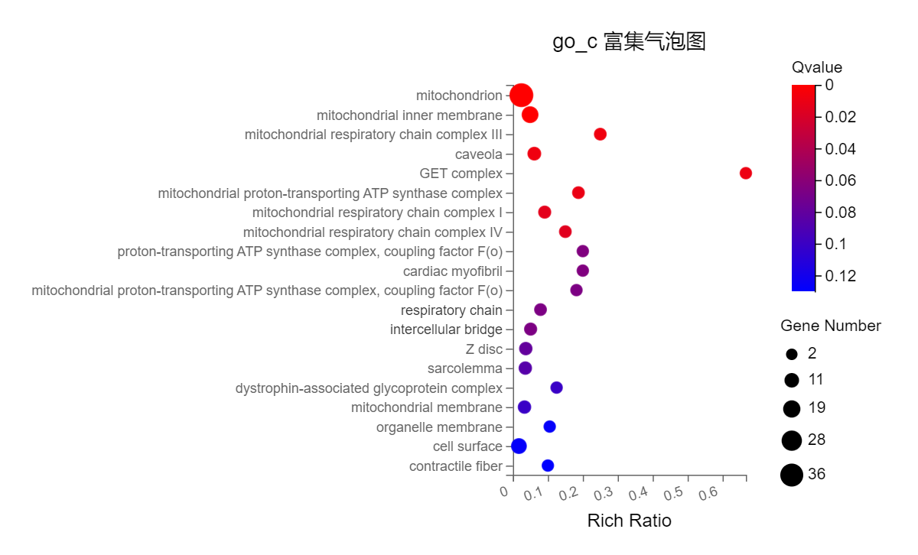
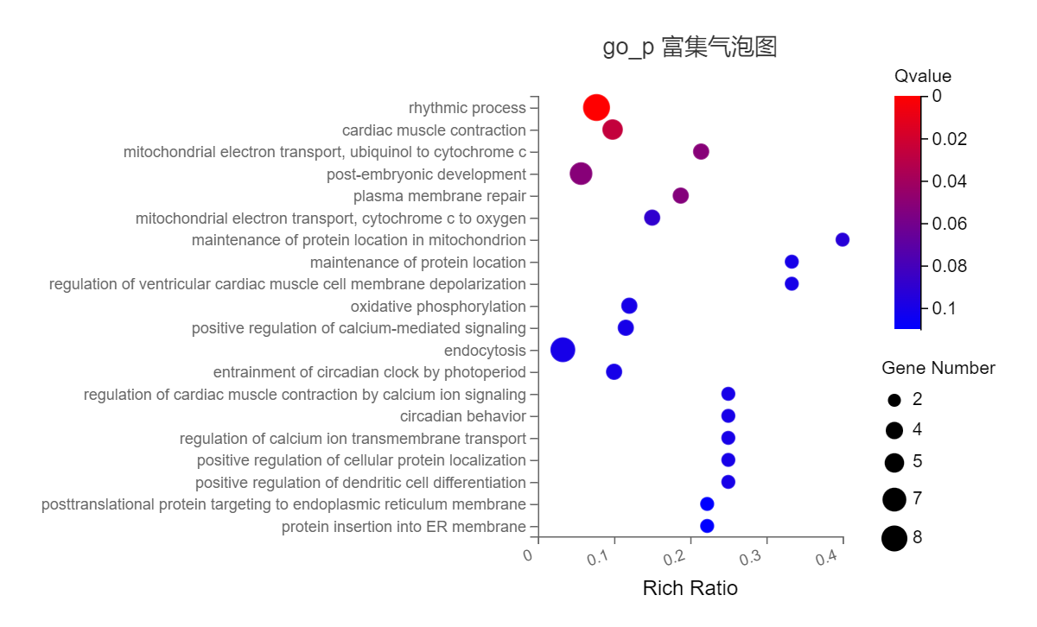
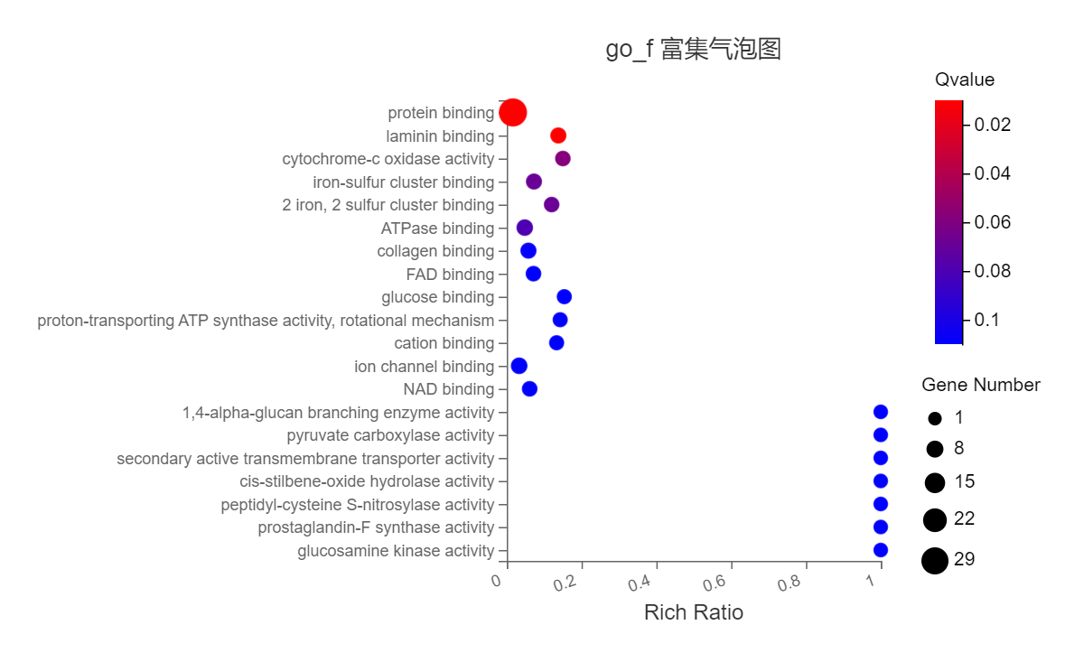
C
Cellular Component
Biological Process
Molecular Function

Slide 4
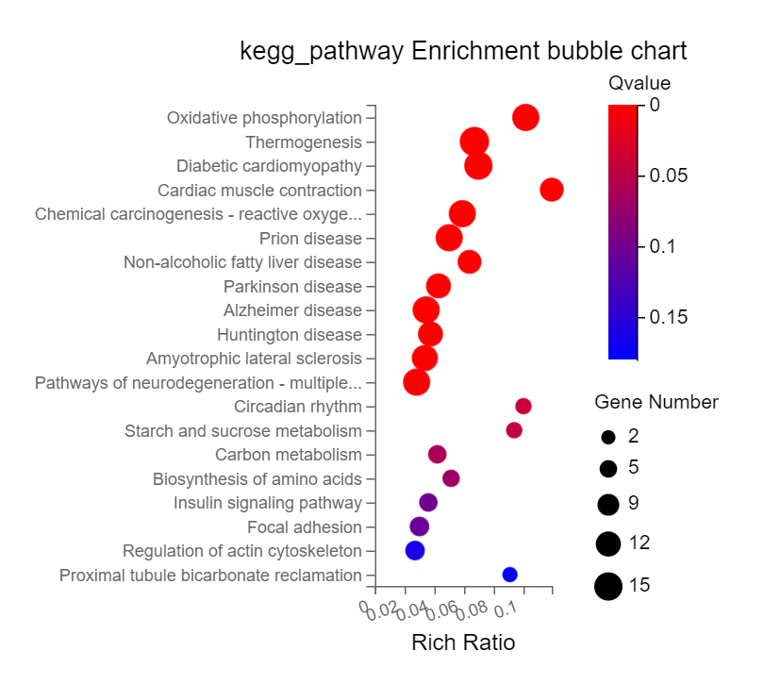
D

Slide 5
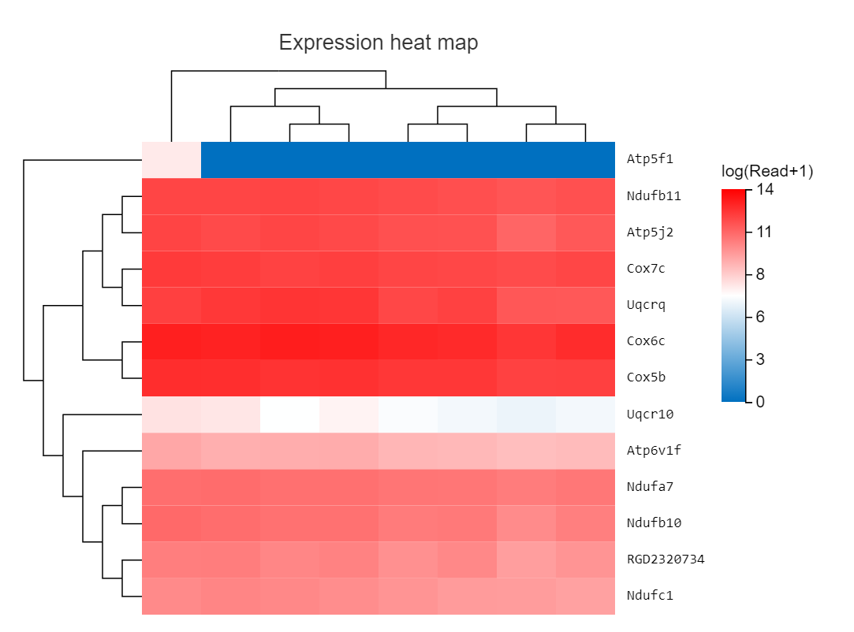
E
SC1
SC2
SC3
SC4
SE1
SE2
SE3
SE4

Slide 6
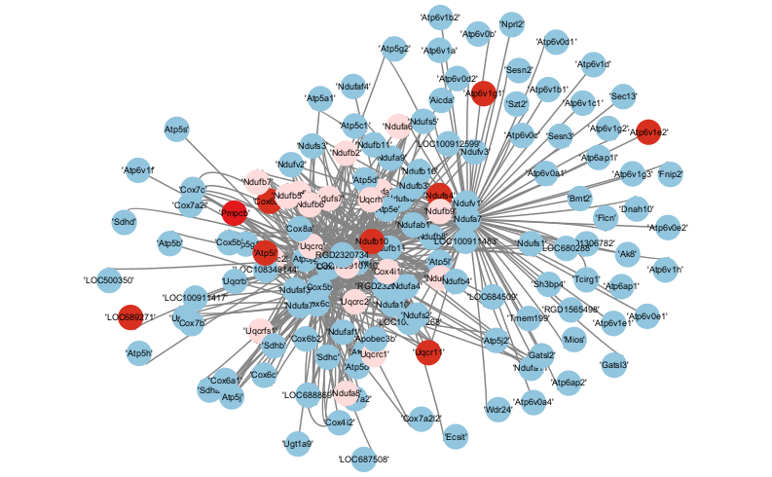
F

Slide 7
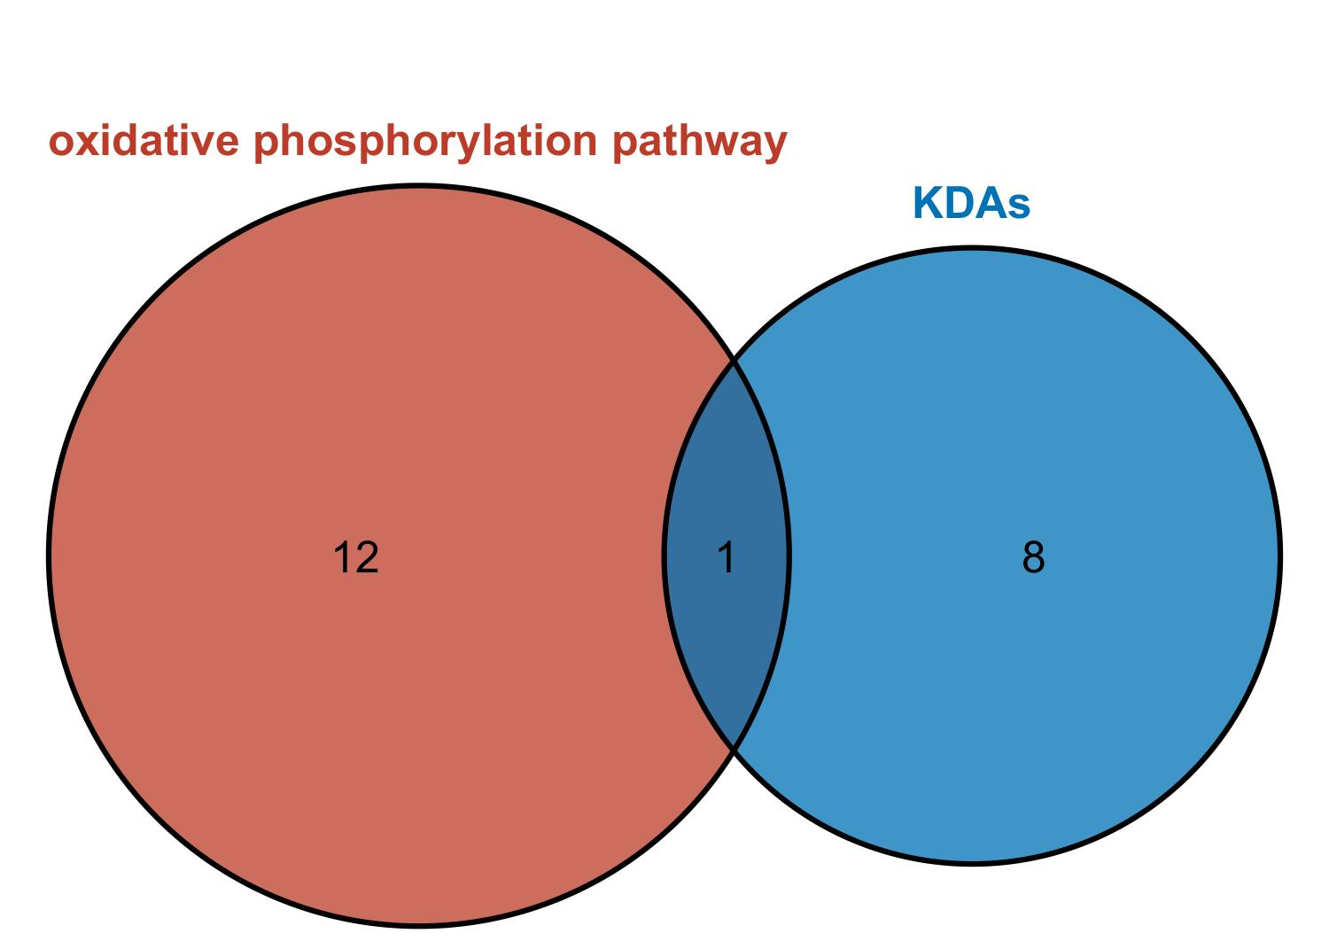
G

Slide 8





H
CN
sham
SC
SE
NDUFB10
GAPDH

