Slide 1
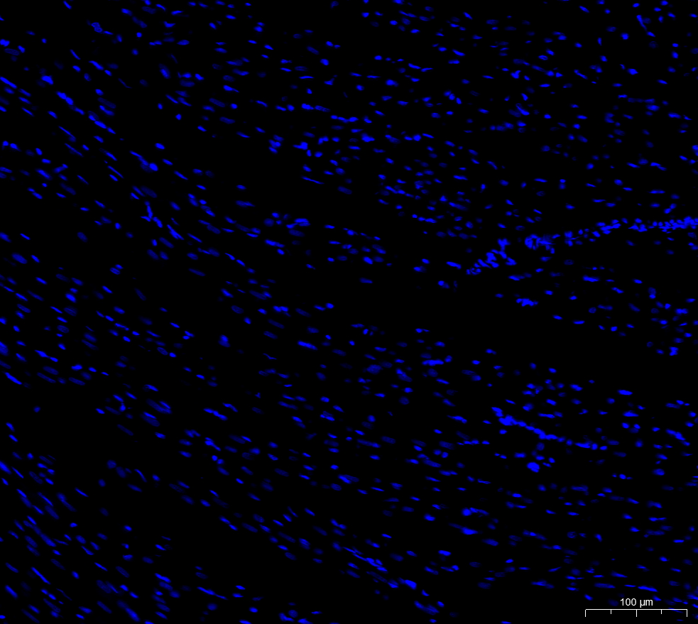

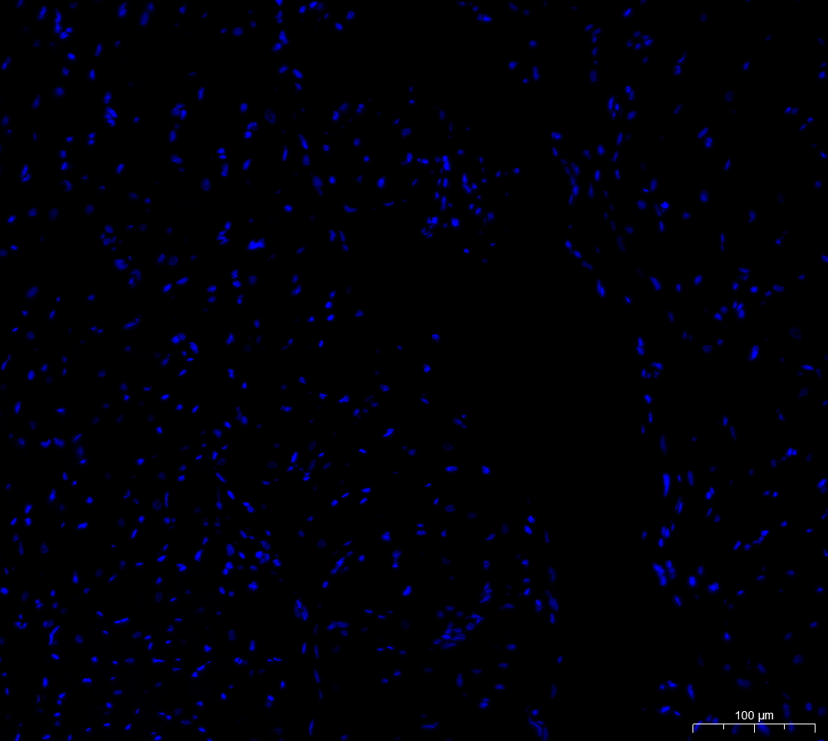





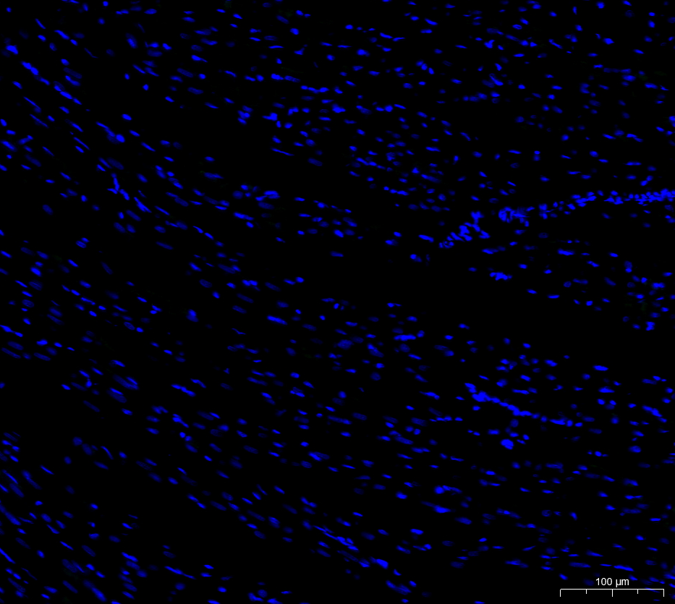
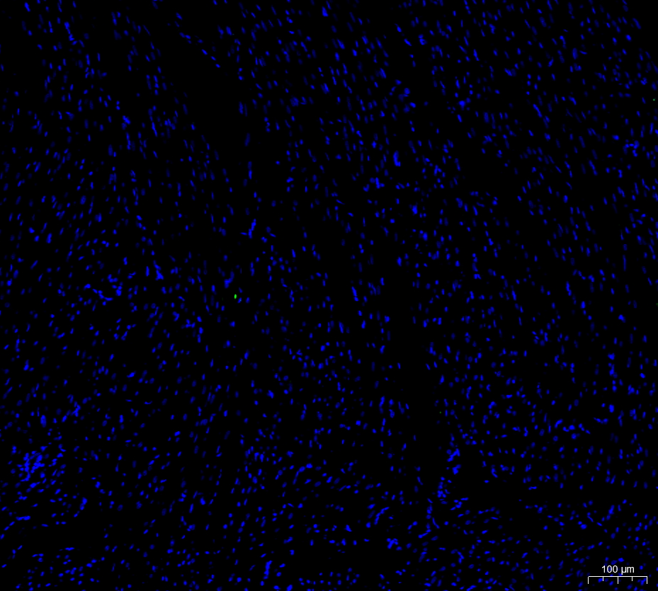
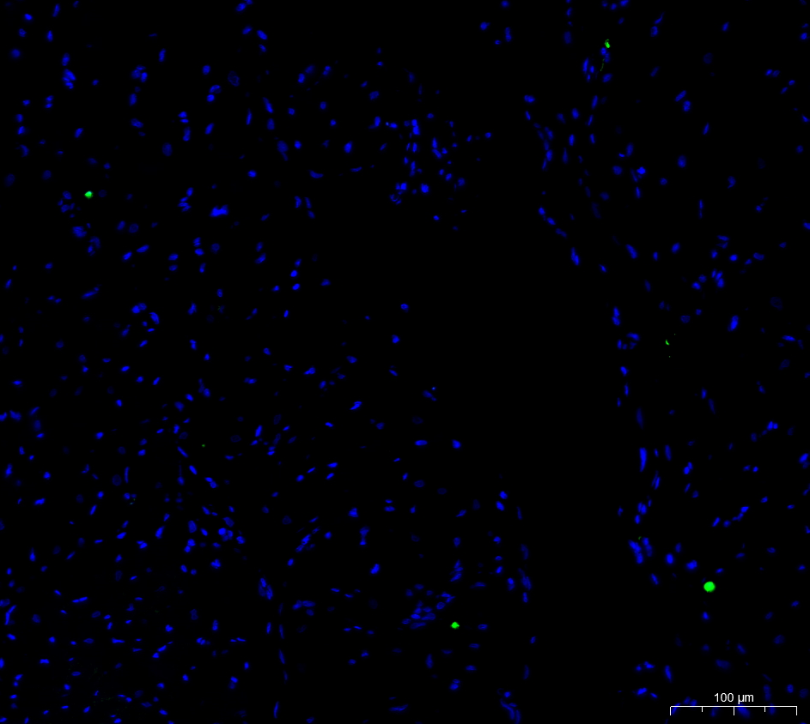
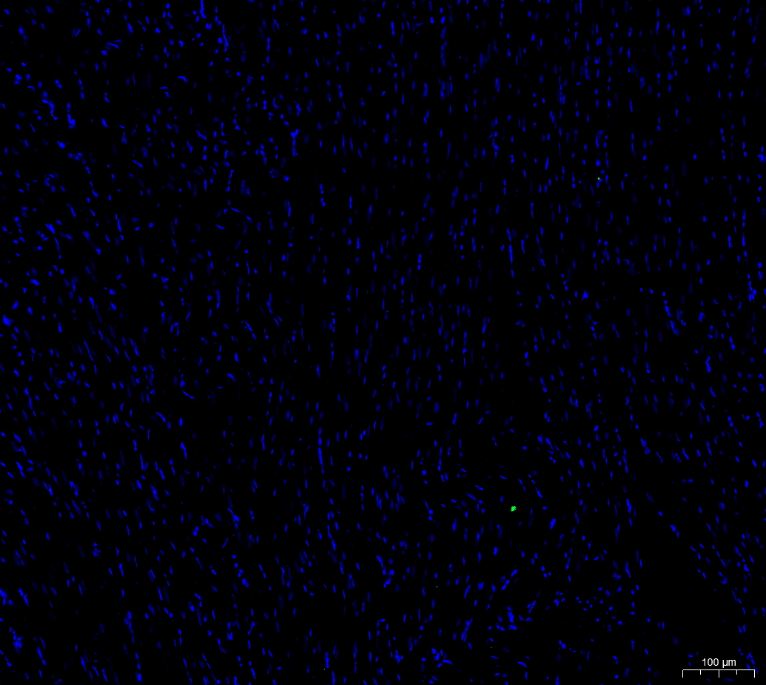
A
CN
sham
SC
SE
DAPI
FITE
Merge

Slide 2
B

Slide 3










C
CN
Sham
SC
SE
CASPASE3
CASPASE9
BAX
BCL-2
GAPDH

