Slide 1
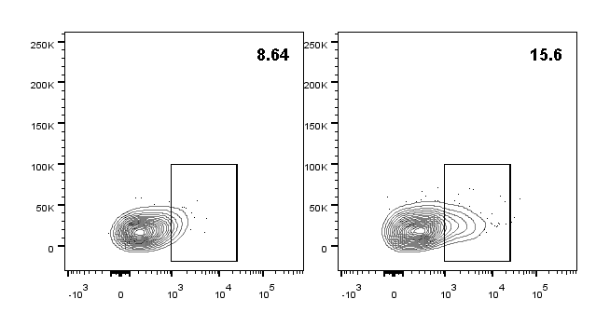
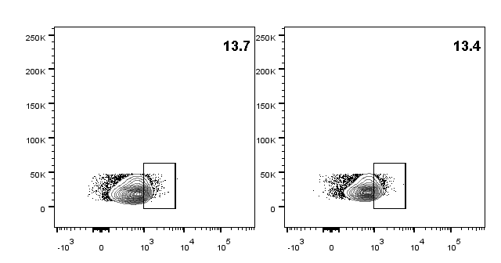
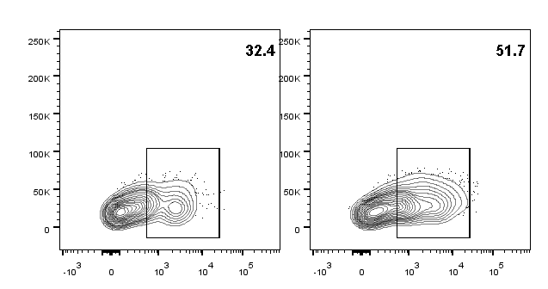
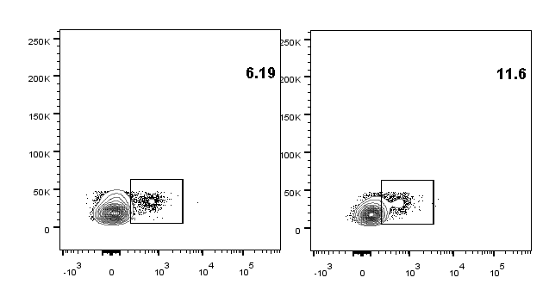
Fig. S1
A
B
CTRL
Tumor
NAC
CTRL
SLN
NAC
PD1
Gated on CD45+CD4+
SSC
PD1
Gated on CD45+CD8+
A. Body weight of mice in the experiment, corresponding to Fig. 1B
B. Representative cell flow plots of PD1 expression in CD45+CD8+ and CD45+CD4+ cells in colorectal cancer tumor tissues, corresponding to Fig. 1J

Slide 2
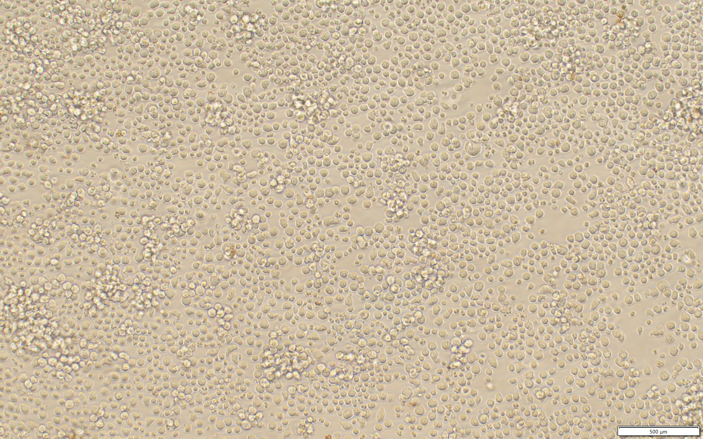
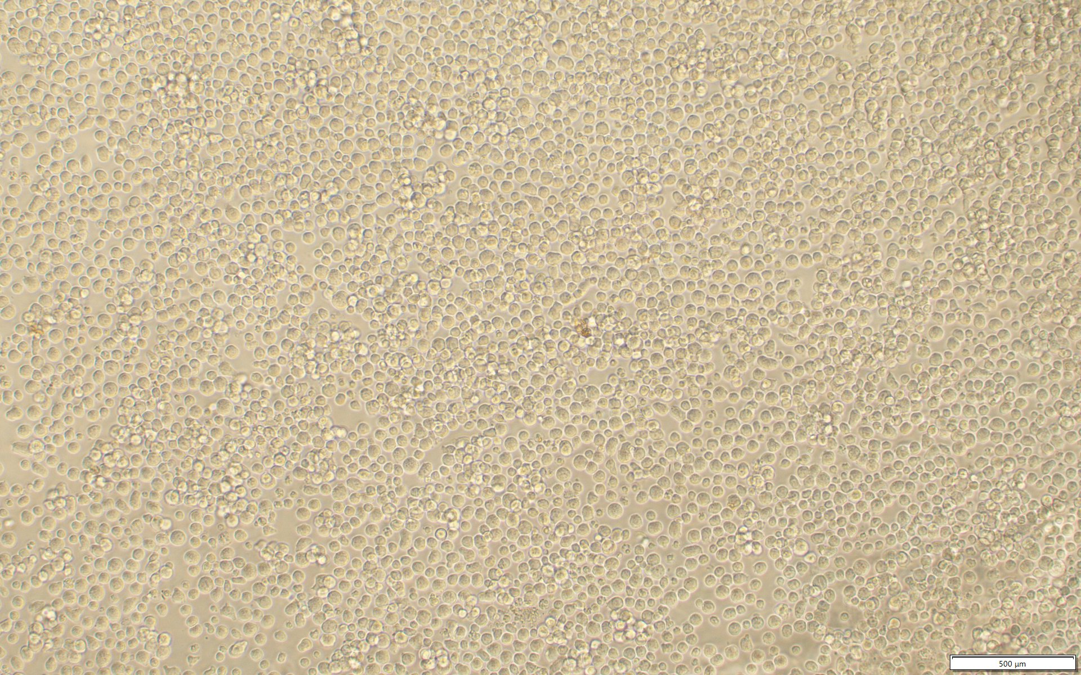
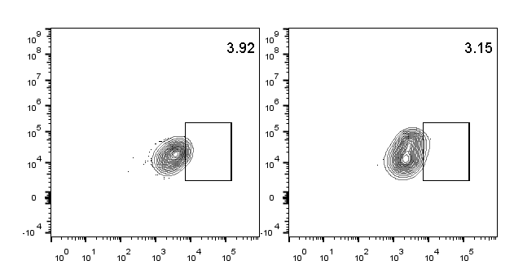
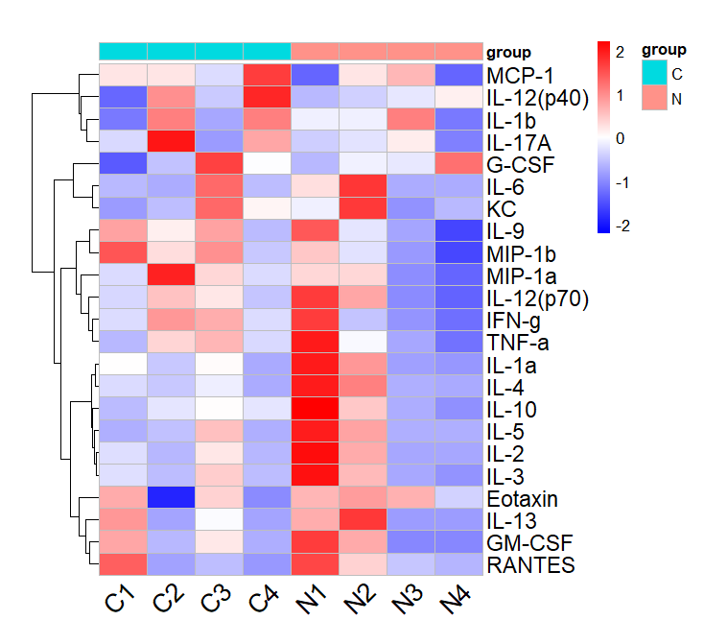
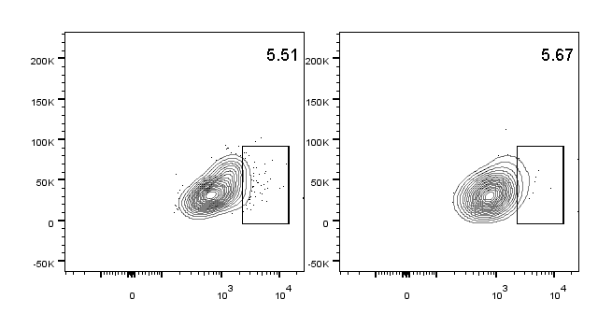
Fig. S2
A
CTRL
NAC
A. Counting of CD8+ T cells cultured in vitro
B
Ctrl
NAC
C
GzmB
SSC
IFN-γ
Gated on CD45+CD8+
B. Cell flow analysis of IFN-γ and Granzmy B in CD45+CD8+ cells of mouse tumor tissues.
C. Luminex liquid suspension microarray experiments on the serum of mice with colorectal cancer

Slide 3
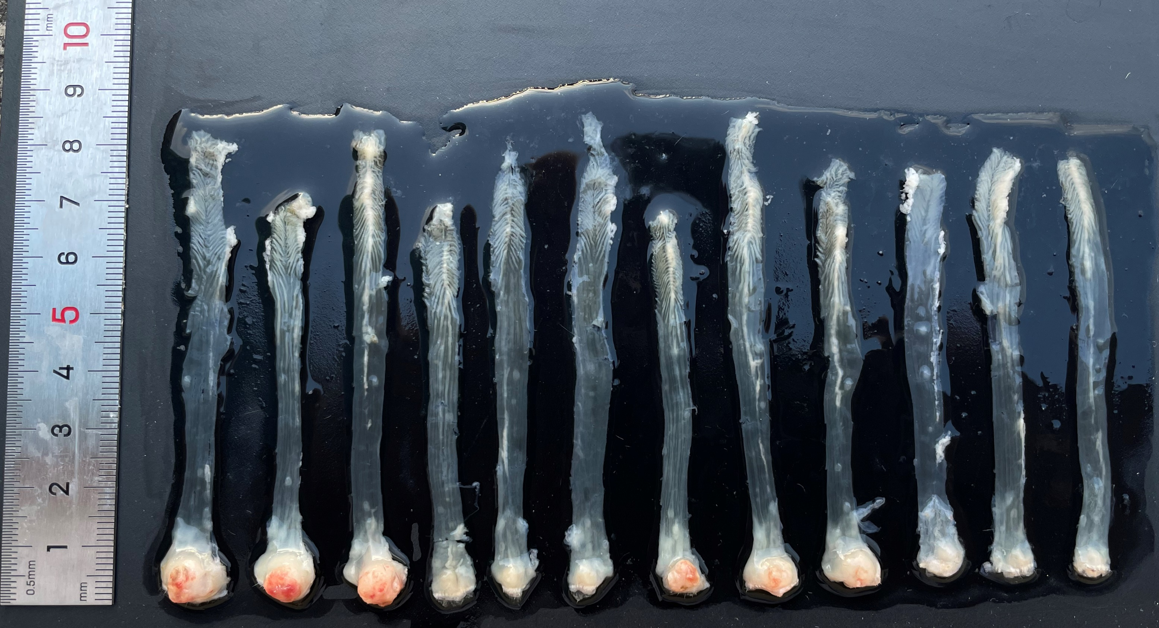
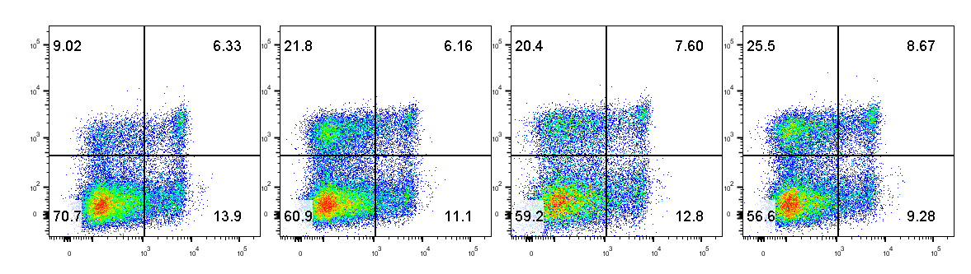
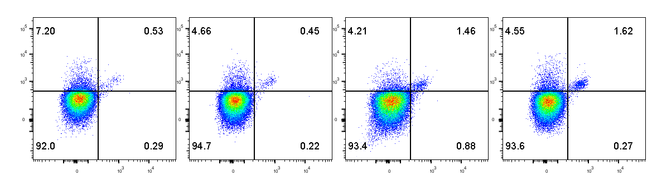
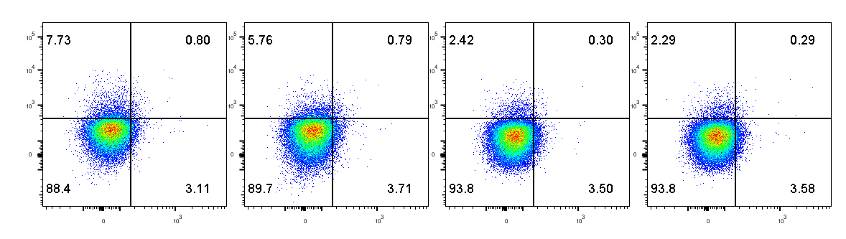
Fig. S3
A
B
CTRL
Anti-PD-1
NAC
NAC+Anti-PD-1
C
SLN
NAC+Anti-PD1
CTRL
Anti-PD1
NAC
CD62L
CD44
Gated on CD45+CD8+
PD1
TCF1
Gated on CD45+CD8+
PD1
Tim3
Gated on CD45+CD8+
A. Statistical analysis of Fig. 4D
B. Images of mouse tumors of Fig. 4E, F, G
C. Cell flow analysis of lymph nodes, corresponding to Fig. 4E, F, G

Slide 4
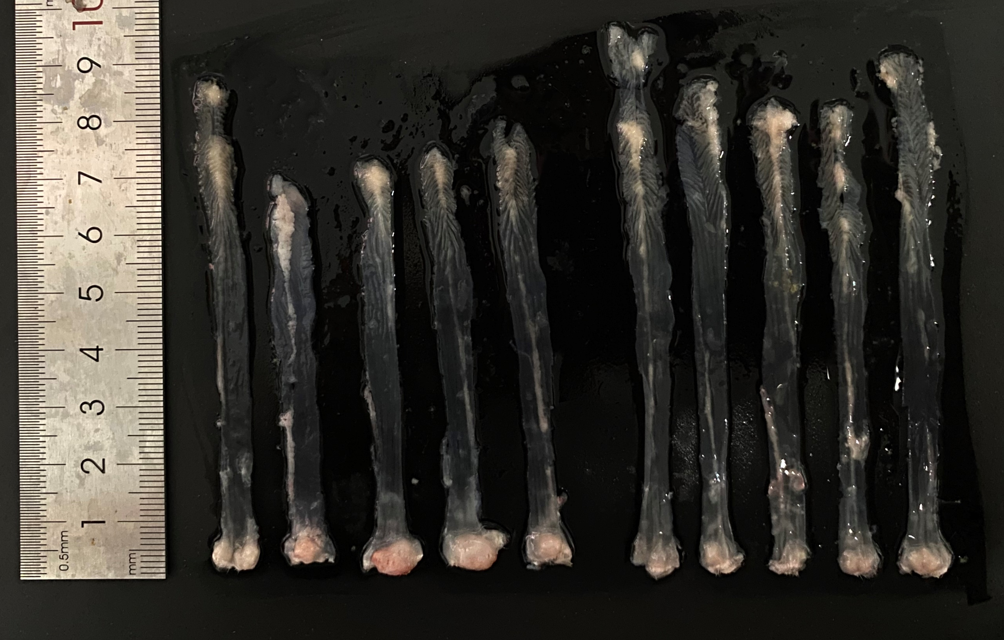
Fig. S4
A
Ctrl
NAC
B
C
A. Images of mouse tumors of Fig. 6A
B. Statistical analysis of Fig. 6C
C. Statistical analysis of Fig. 6D

Slide 5
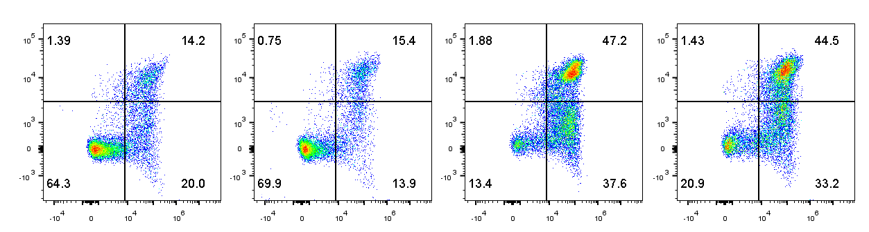
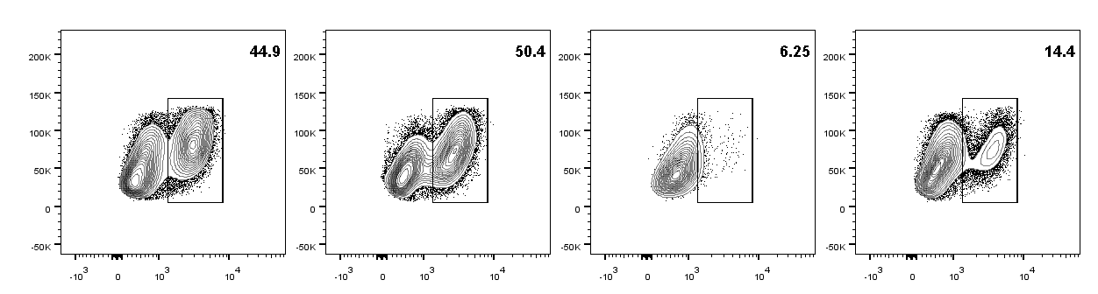

Fig. S5
A
CTRL
NAC
Akt-IN
NAC+Akt-IN
Ctrl
NAC
Akt-IN
NAC+Akt-IN
PI
Annexin V
B
SSC
Ki 67
C
PD1
TCF1
A, B, C Representative cell flow analysis plots corresponding to Fig. 7H, I, J

Slide 6
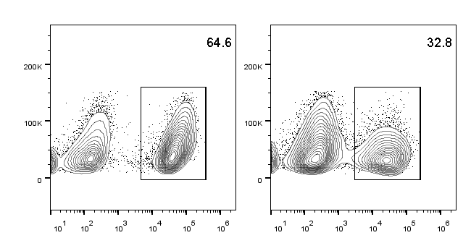
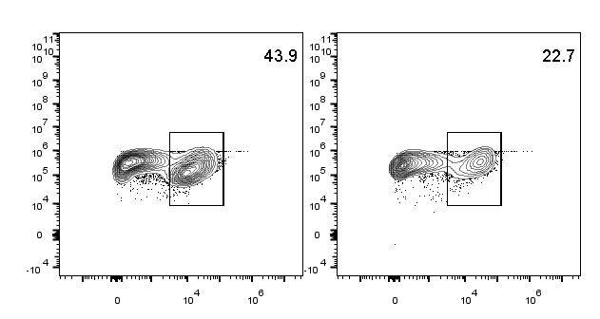
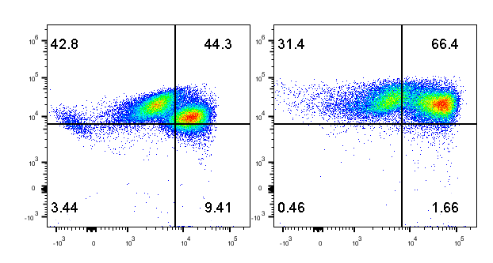
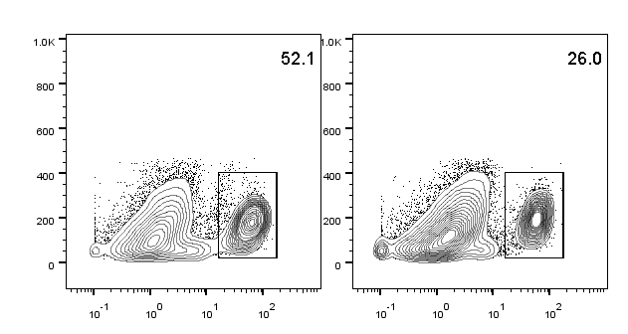
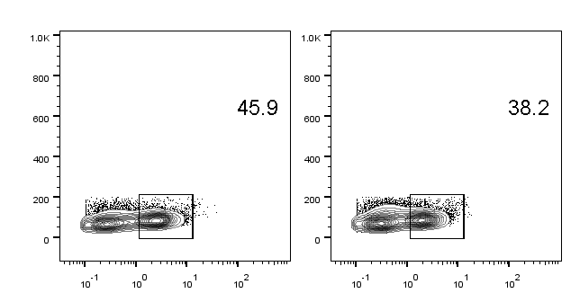
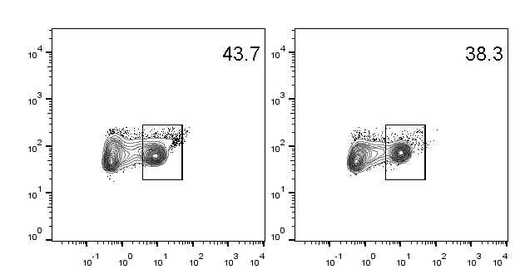
Fig. S6
A
Ctrl
NAC
SSC
ROS
Ctrl
NAC
B
CD8
mtROS
C
Ctrl
NAC
MT st red
MT green
D
Tumor
SLN
Spleen
Ctrl
NAC
Ctrl
NAC
Ctrl
NAC
SSC
ROS
A. Representative cell flow analysis plots of ROS+CD8+ T cells in vitro
B. Representative cell flow analysis plots of mtROS+CD8+ T cells in vitro
C. Representative cell flow analysis plots of mitochondria-damaged CD8+ T cells in vitro
D. Representative cell flow analysis plots of ROS+CD8+ T cells on colorectal mouse

Slide 7
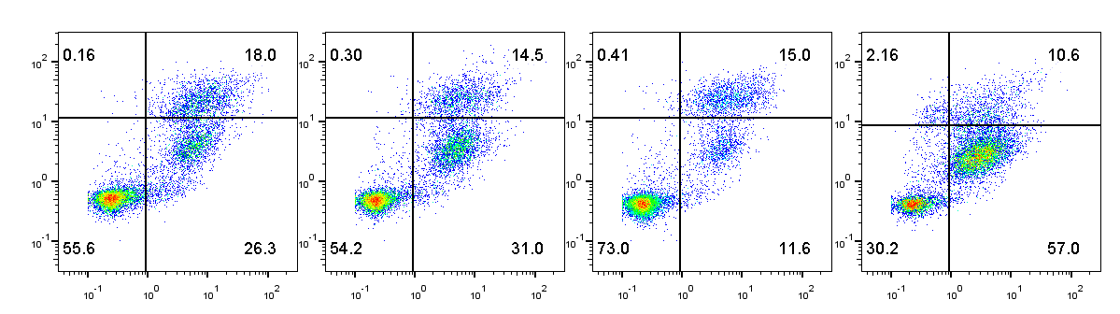
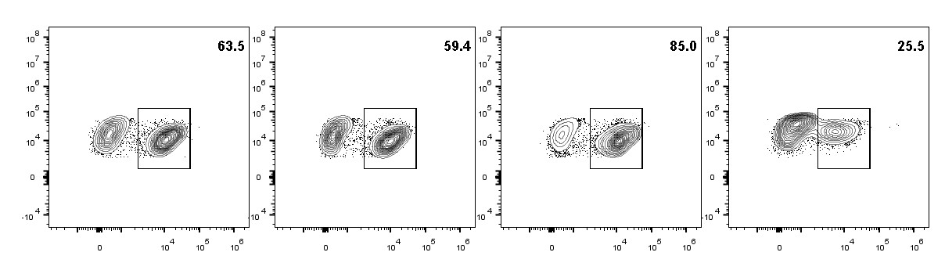
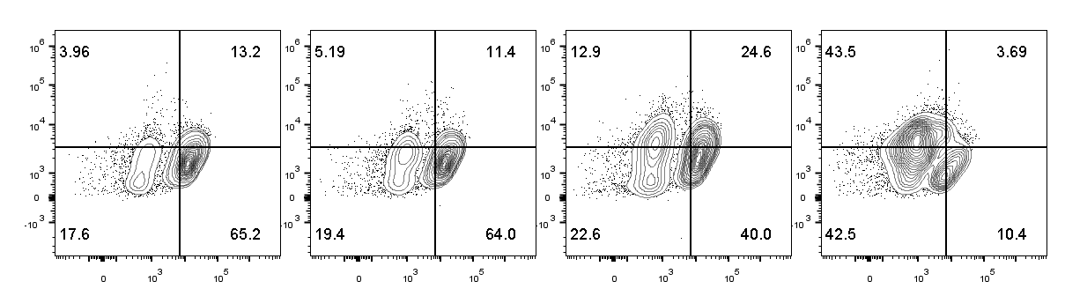
Fig. S7
A
CTRL
Vector
NAC+Vector
NAC+shGlut4
PI
Annexin V
B
CD8
Ki 67
C
PD1
TCF1
A, B, C Representative cell flow analysis plots corresponding to Fig. 8F, G, H

