Slide 1
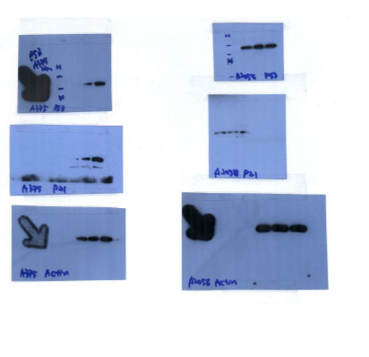
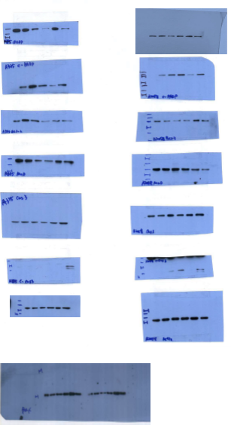
A375
A2058
A375
A2058
p53
p53
Full PARP
Full PARP
Cleaved PARP
Cleaved PARP
p21
p21
Bcl-2
Bcl-2
β-Actin
β-Actin
MuD
MuD
Full Caspase3
Full Caspase3
Cleaved Caspase3
Cleaved Caspase3
β-Actin
β-Actin
A2058
A375
Bax

