Slide 1
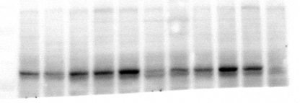
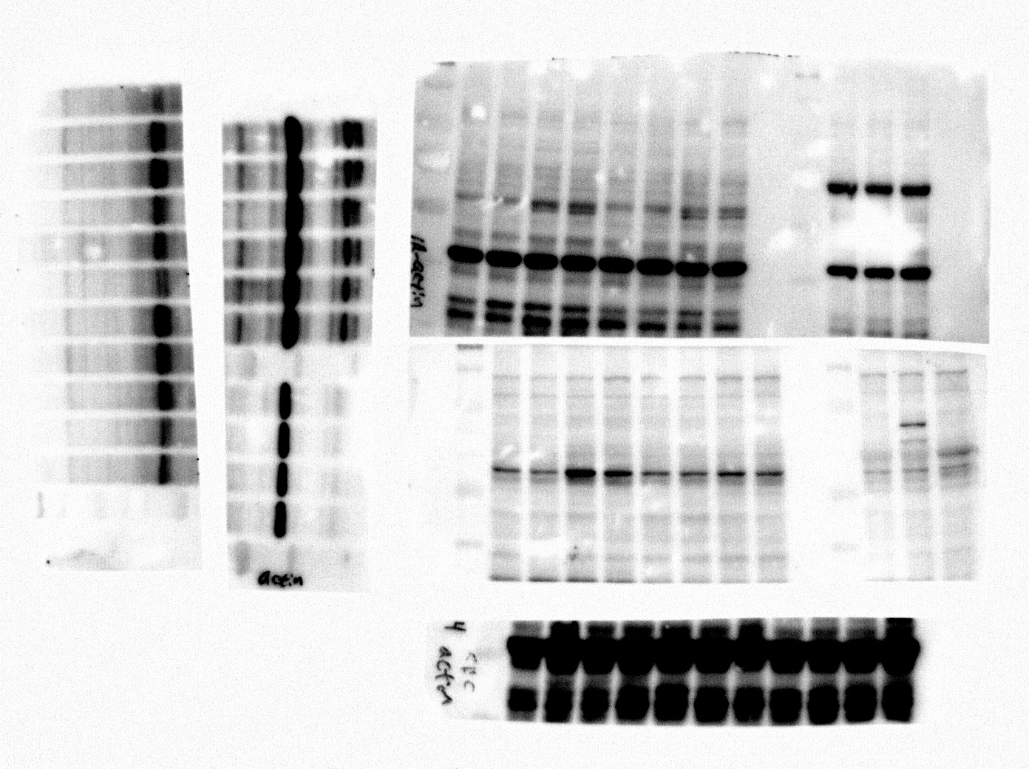
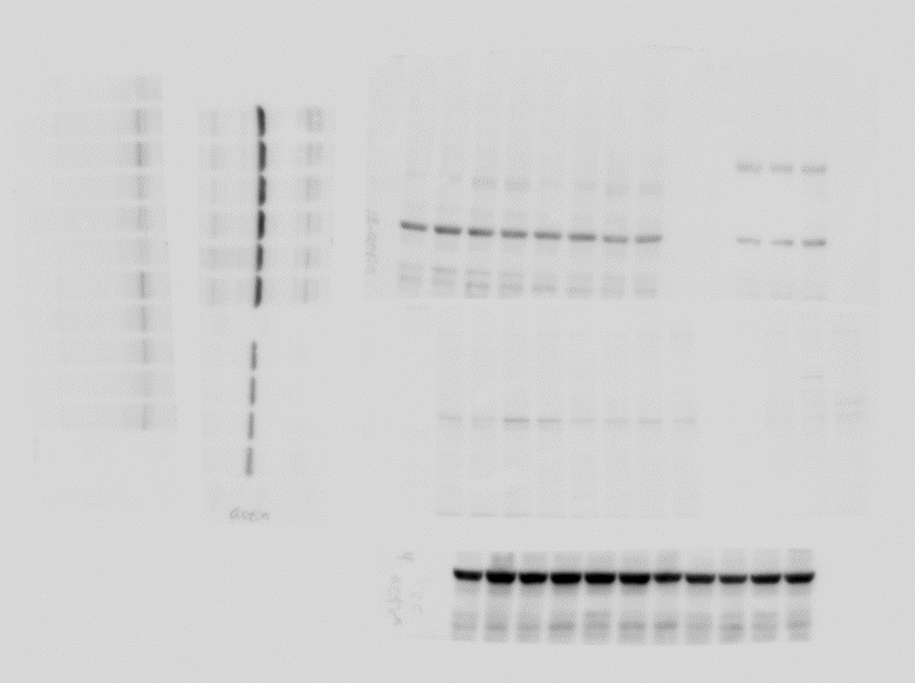
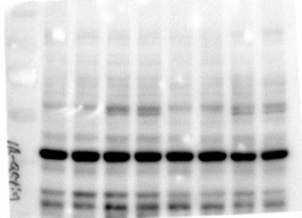
Fig. 1a
IR-SW620
IR-SW480
SW480
SW620
HT29
RKO
HCT116
LS174T
KM12SM
IR-HT29
IR-RKO
SW480
KM12C
Caco2
SW620
RKO
HT29
DLD1
Lovo
70
CRMP4
70
CRMP4
β-actin
55
40
40
β-actin

Slide 2
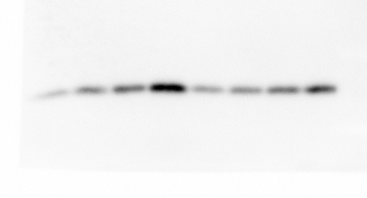
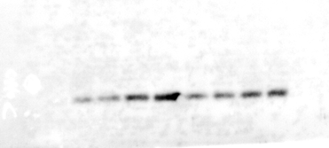
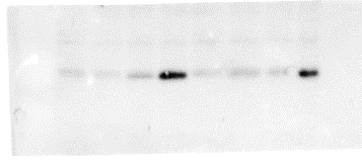

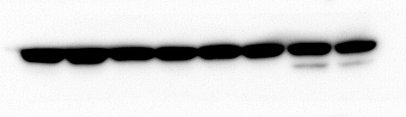
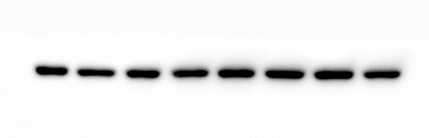
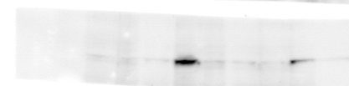
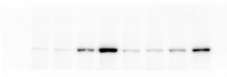

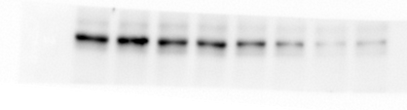


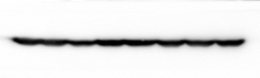

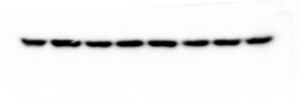
Fig. 3a
Fig. 3b
SW620
RKO
SW620
IR-SW620
shControl shCRMP4
shControl shCRMP4
0
(hr, 5 Gy)
24
48
72
0
0
24
48
72
24
48
72
0
0
48
0
(hr, 5 Gy)
24
48
72
24
72
24
48
72
25
25
CytC
CytC
β-actin
40
β-actin
40
100
C-PARP
100
C-PARP
55
CRMP4
CRMP4
55
40
β-actin
40
β-actin

Slide 3
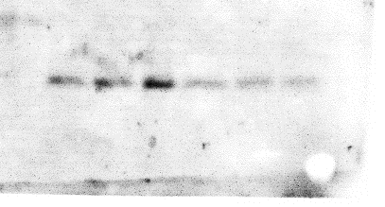
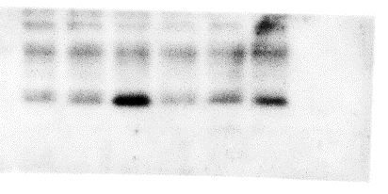
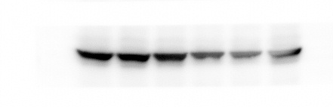
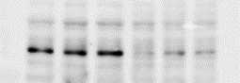


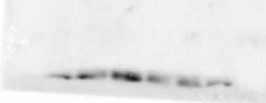
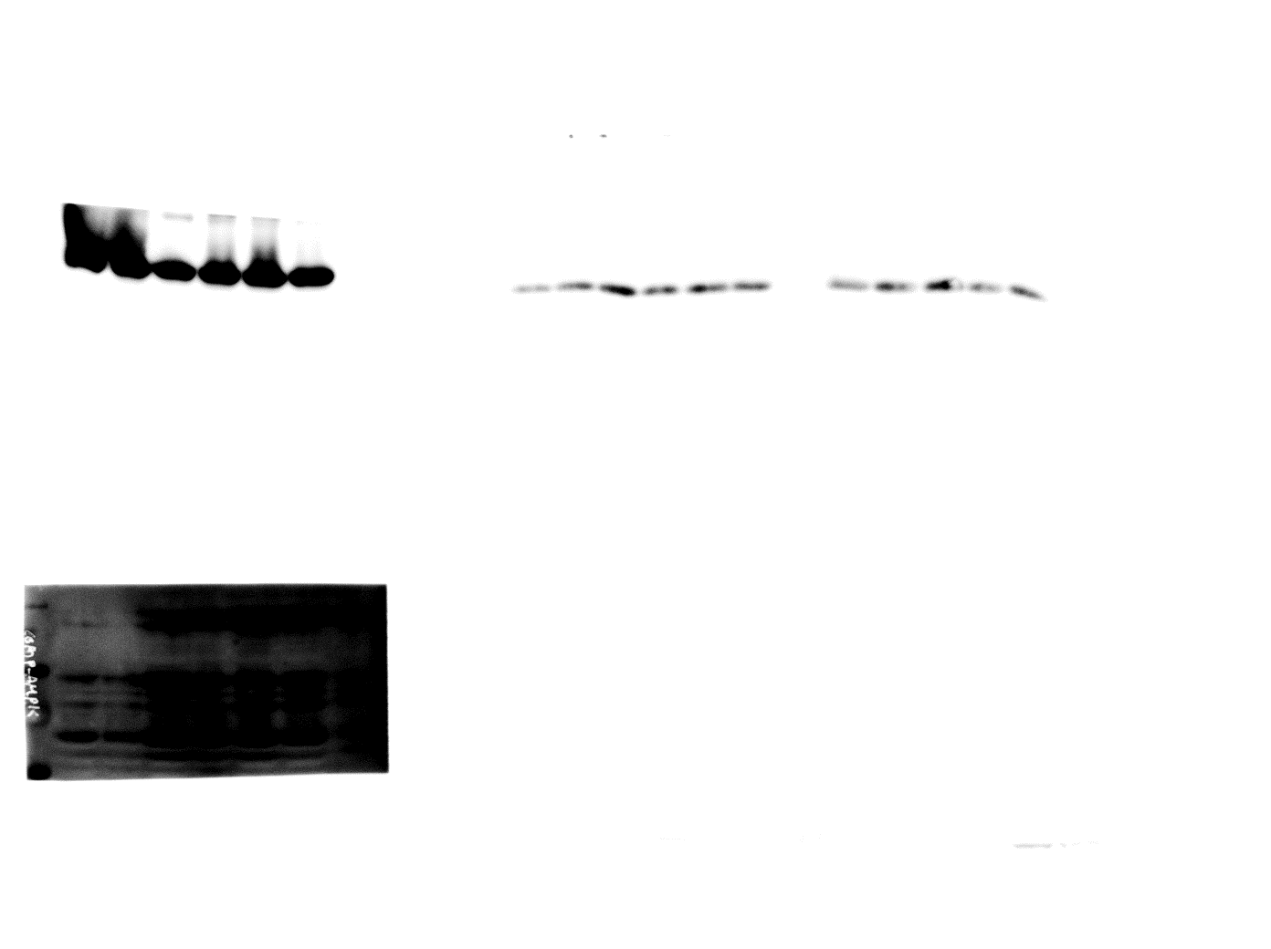
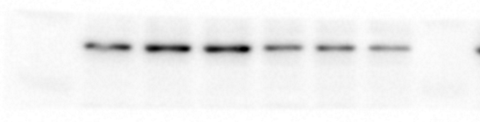
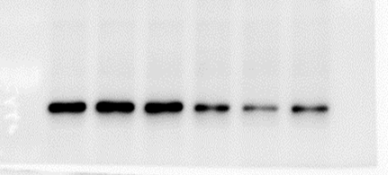
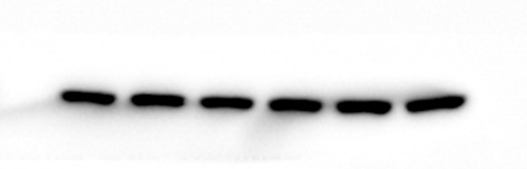
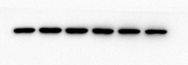
Fig. 4d
shContr. shCRMP4
parent IR-resistant
0
1
2
0
0
1
2 (μM, A23187)
1
2
0
1
2
(μM, A23187)
25
25
CytC
CytC
70
CRMP4
70
CRMP4
55
β-actin
β-actin
40
40
25
25
CytC
CytC
55
CRMP4
70
CRMP4
β-actin
40
40
β-actin

Slide 4
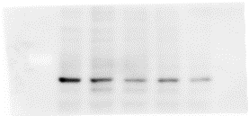
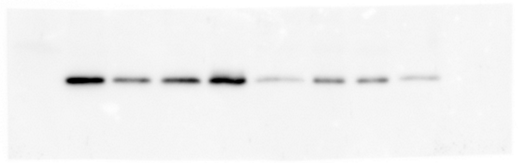
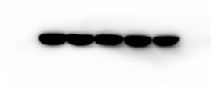
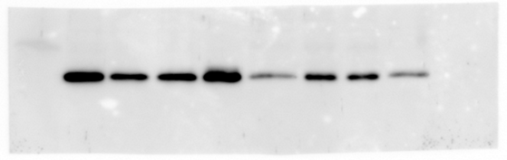
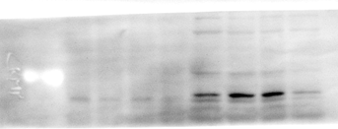
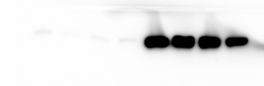

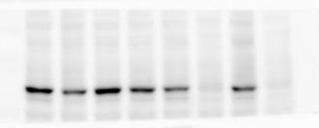
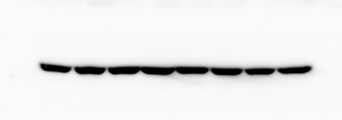
Fig. 5a
Fig. 5b
BAPTA-AM (μM)
Mitochondrial
fraction
Cytosolic
fraction
0 2.5 5 10 20
A23187
−
+
++
++
−
+
++
++
−
−
−
+
−
−
−
+
BAPTA-AM (5μM)
25
70
CytC
CRMP4
25
CytC
40
β-actin
Fig. 5c
70
CRMP4
SW620
IR-SW620
−
−
+
+
−
−
+
+
5 Gy
−
+
−
+
−
+
−
+
BAPTA-AM (5μM)
40
β-actin
100
C-PARP
70
CRMP4
40
β-actin

Slide 5
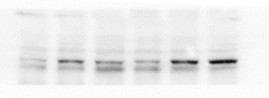
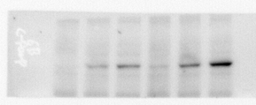
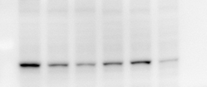

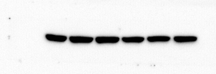

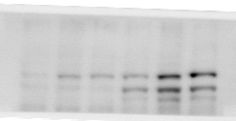
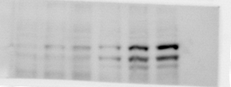
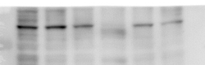


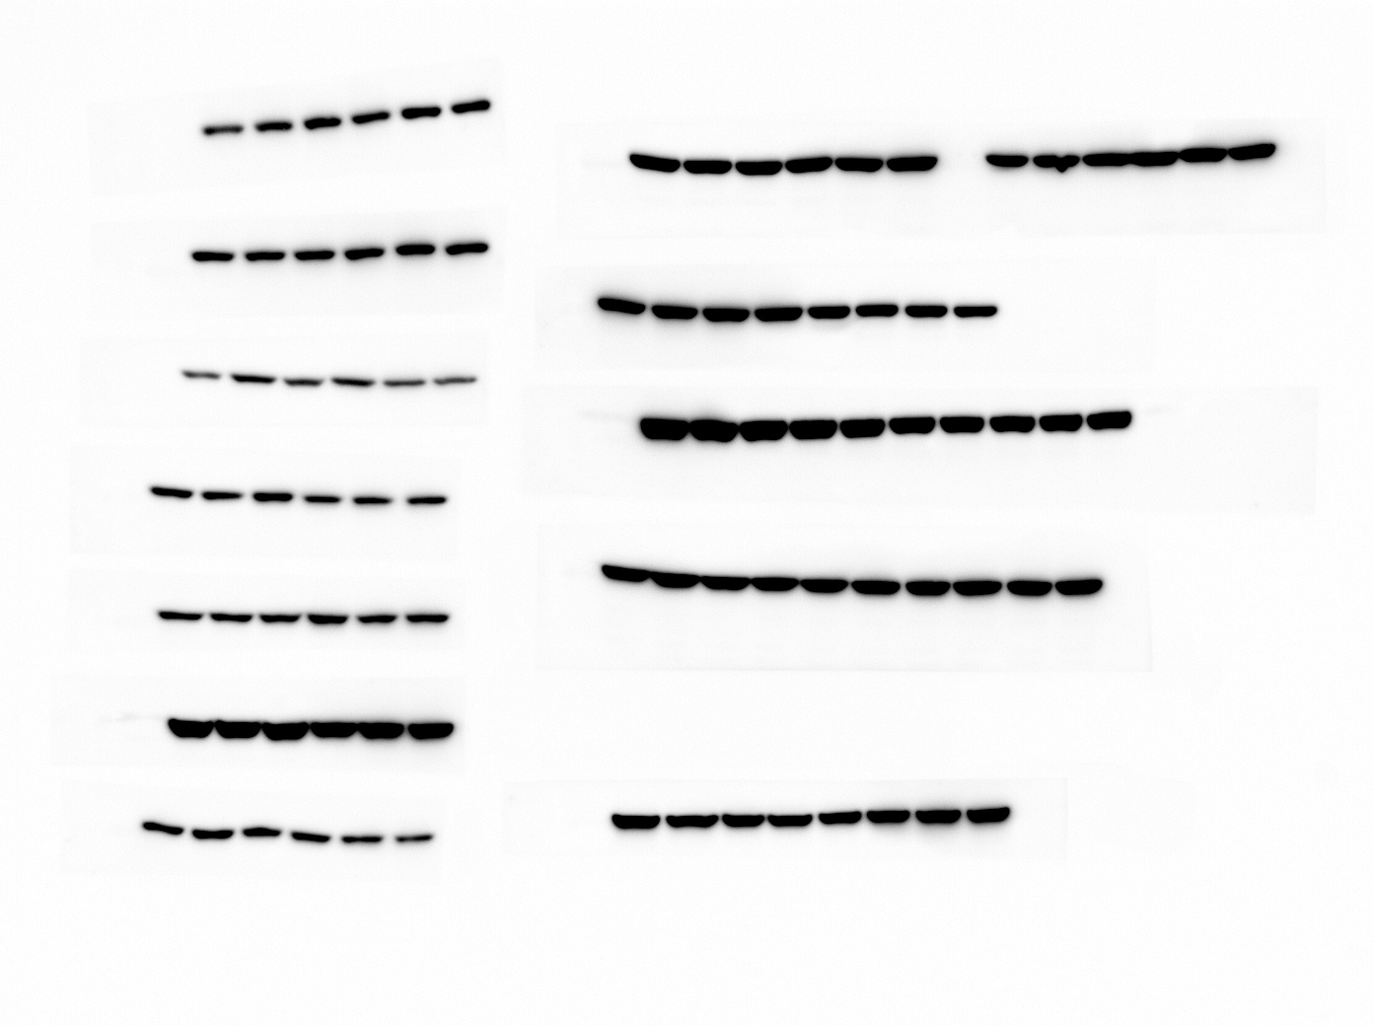
Fig. 6c
BAPTA-AM (μM)
BAPTA-AM (μM)
0
10
20
0
10
20
0
10
20
0
10
20
100
C-PARP
100
C-PARP
SW620
70
CRMP4
70
CRMP4
β-actin
β-actin
40
40
100
C-PARP
100
C-PARP
RKO
CRMP4
70
55
CRMP4
40
β-actin
40
β-actin

