Slide 1
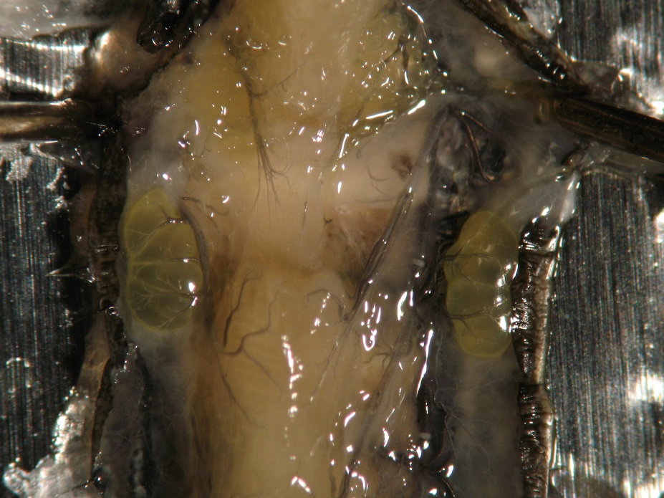
a
5th instar larval testis
b
Prophase of meiosis
Mitosis
c
Prophase of meiosis

