Slide 1
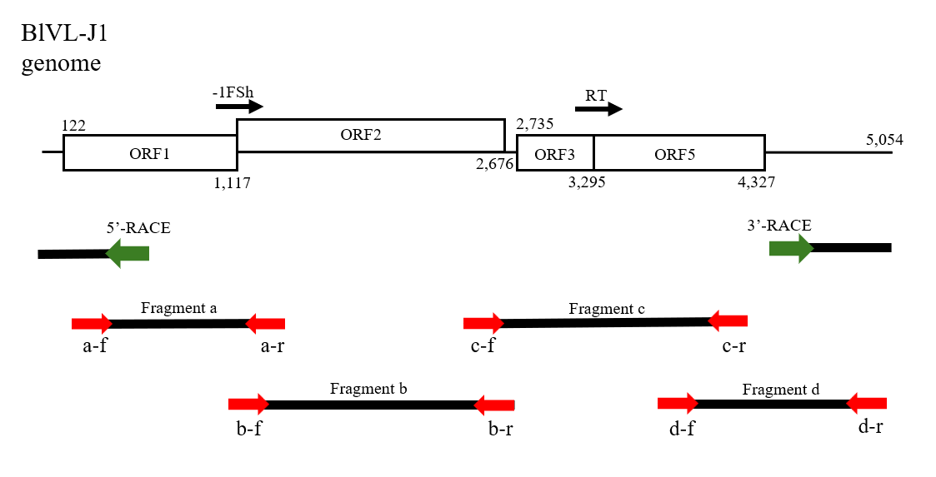
Supplementary Fig. S1. Primer position for cloning and sequence of the BlVL-J1 genome. Primers indicated by red arrows were used for PCR amplification of fragments a–d. Green arrows indicate the primer used to amplify the 5′ and 3′ terminal regions using the SMARTer RACE Kit.

