Slide 1
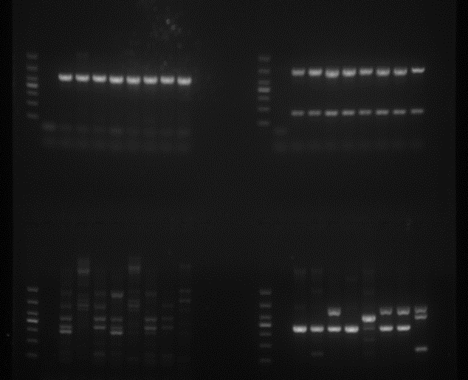
virulence gene identified
magA-fimA-uge-iutA
wabG-rmpA-cnf-ycf
magA-fimA-uge-iutA
wabG-rmpA-cnf-ycf
M - 24 45 74 77 X25 X41 X46 E28 M - 24 45 74 77 X25 X41 X46 E28
M - 24 45 74 77 X25 X41 X46 E28 M - 24 45 74 77 X25 X41 X46 E28
1000
700
500
400
300
200
100
hly-iroN-K2a-mrkD
kpn-allS-entB-wcaG
M - 24 45 74 77 X25 X41 X46 E28 M - 24 45 74 77 X25 X41 X46 E28
1000
700
500
400
300
200
100

Slide 2
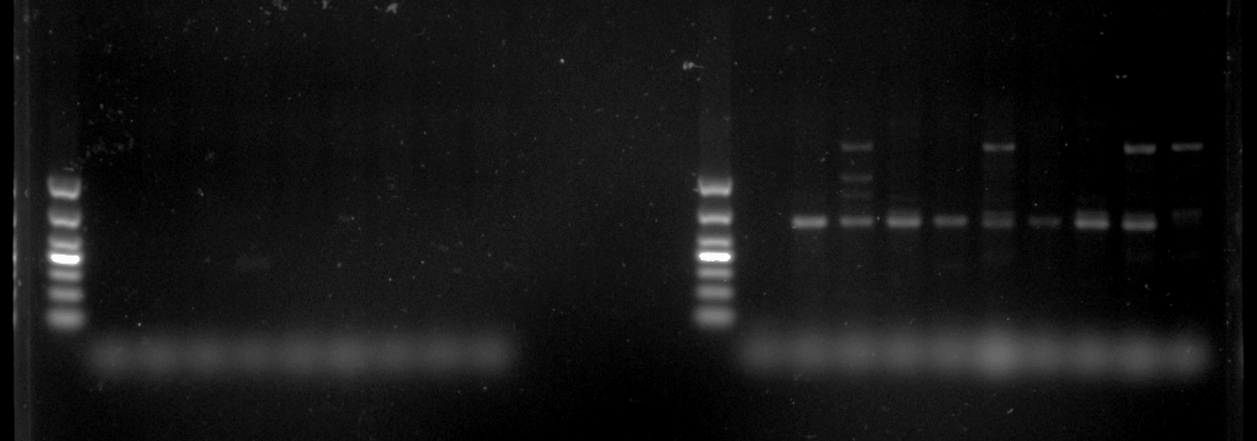
MGEs In2, traF identified
In2
traF
M - 24 45 74 77 X25 X41 X46 E28 M - 24 45 74 77 X25 X41 X46 E28
1000
700
500
400
300
200
100

Slide 3
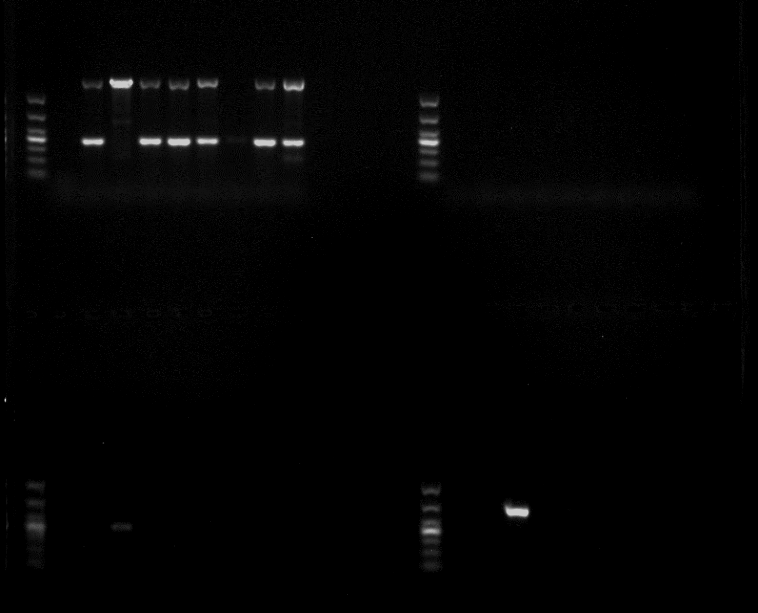
tnpU
intI2
M - 24 45 74 77 X25 X41 X46 E28 M - 24 45 74 77 X25 X41 X46 E28
MGEs tnpU, intI2,intI3,ISI133 identified
1000
700
500
400
300
200
100
intI3
ISI133
M - 24 45 74 77 X25 X41 X46 E28 M - 24 45 74 77 X25 X41 X46 E28
1000
700
500
400
300
200
100

Slide 4
MGEs tnpA/Tn21, tnsA
, tnp513, ISCR3/14 identified
tnpA/Tn21
tnsA
M - 24 45 74 77 X25 X41 X46 E28 M - 24 45 74 77 X25 X41 X46 E28
1000
700
500
400
300
200
100
tnp513
ISCR3/14
M - 24 45 74 77 X25 X41 X46 E28 M - 24 45 74 77 X25 X41 X46 E28
1000
700
500
400
300
200
100

Slide 5
MGEs merA
, ISkpn7
, IS903
, ISEcp1
identified
merA
ISkpn7
M - 24 45 74 77 X25 X41 X46 E28 M - 24 45 74 77 X25 X41 X46 E28
1000
700
500
400
300
200
100
IS903
ISEcp1
M - 24 45 74 77 X25 X41 X46 E28 M - 24 45 74 77 X25 X41 X46 E28
1000
700
500
400
300
200
100

Slide 6
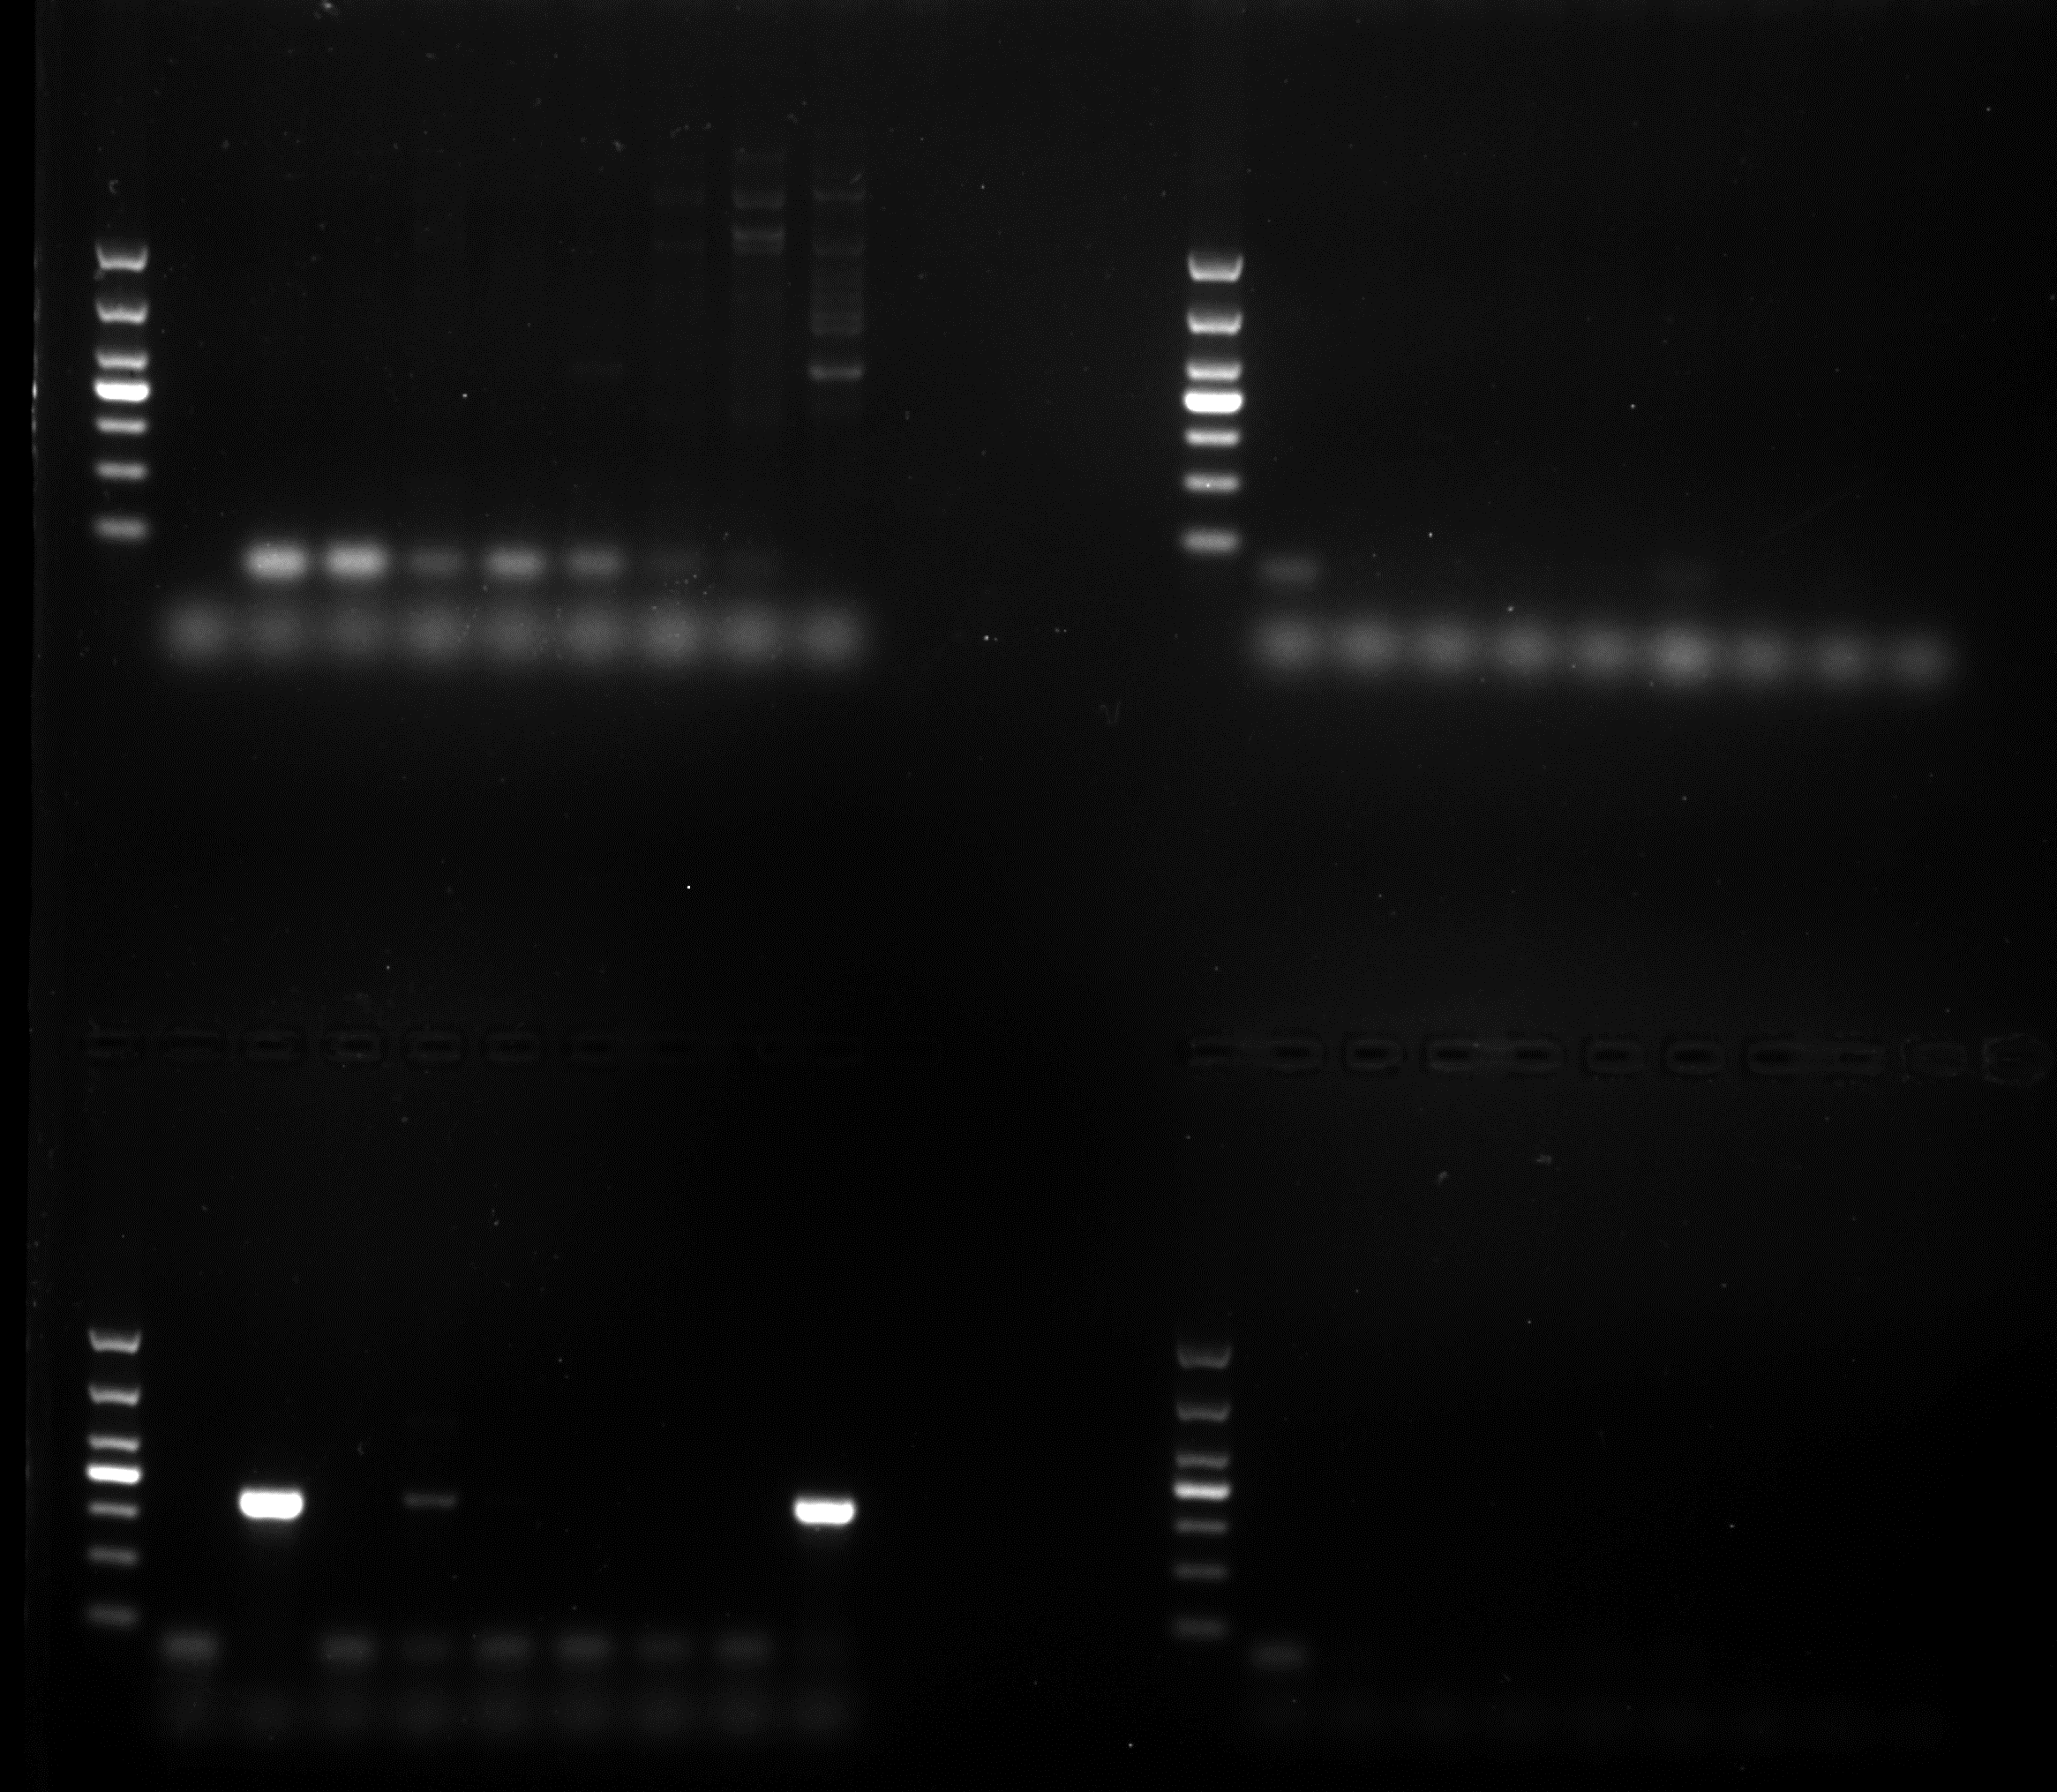
MGEs ISCR3/14
, ISpa7, IS26, ISkpn6 identified
ISCR3/14
ISpa7
M - 24 45 74 77 X25 X41 X46 E28 M - 24 45 74 77 X25 X41 X46 E28
1000
700
500
400
300
200
100
IS26
ISkpn6
M - 24 45 74 77 X25 X41 X46 E28 M - 24 45 74 77 X25 X41 X46 E28
1000
700
500
400
300
200
100

Slide 7
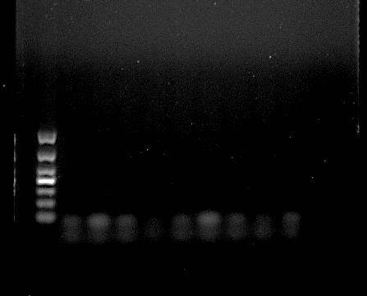
MGEs ISaba1 identified
ISaba1
M - 24 45 74 77 X25 X41 X46 E28
1000
700
500
400
300
200
100

Slide 8
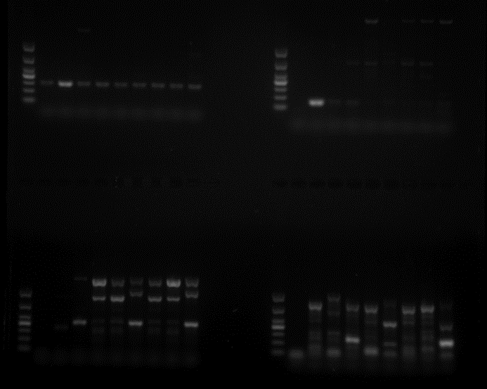
intI1
In1
MGEs intI1,In1,traA,tbrC identified
1000
M - 24 45 74 77 X25 X41 X46 E28 M - 24 45 74 77 X25 X41 X46 E28
700
500
400
300
200
100
traA
tbrC
M - 24 45 74 77 X25 X41 X46 E28 M - 24 45 74 77 X25 X41 X46 E28

Slide 9
C 24 45 74 C 77 X25 X41 C
Note:”C” control strain Salmonella serotupe Braenderup strain H9812

Slide 10
C X41 X46 E28 C
Note:”C” control strain Salmonella serotupe Braenderup strain H9812

