Slide 1
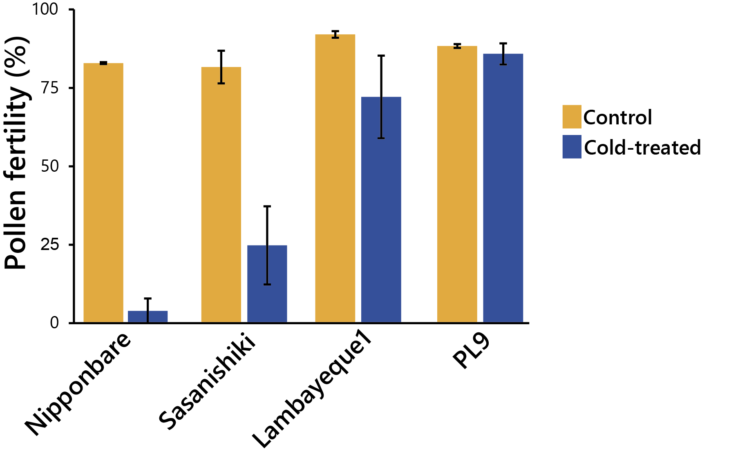
Supplemental Fig. S1. Evaluation of pollen fertility in four rice lines.
Pollen fertility of control and cold-treated plants from the four selected lines. Values are means ± standard error of the mean (SEM).

Slide 2
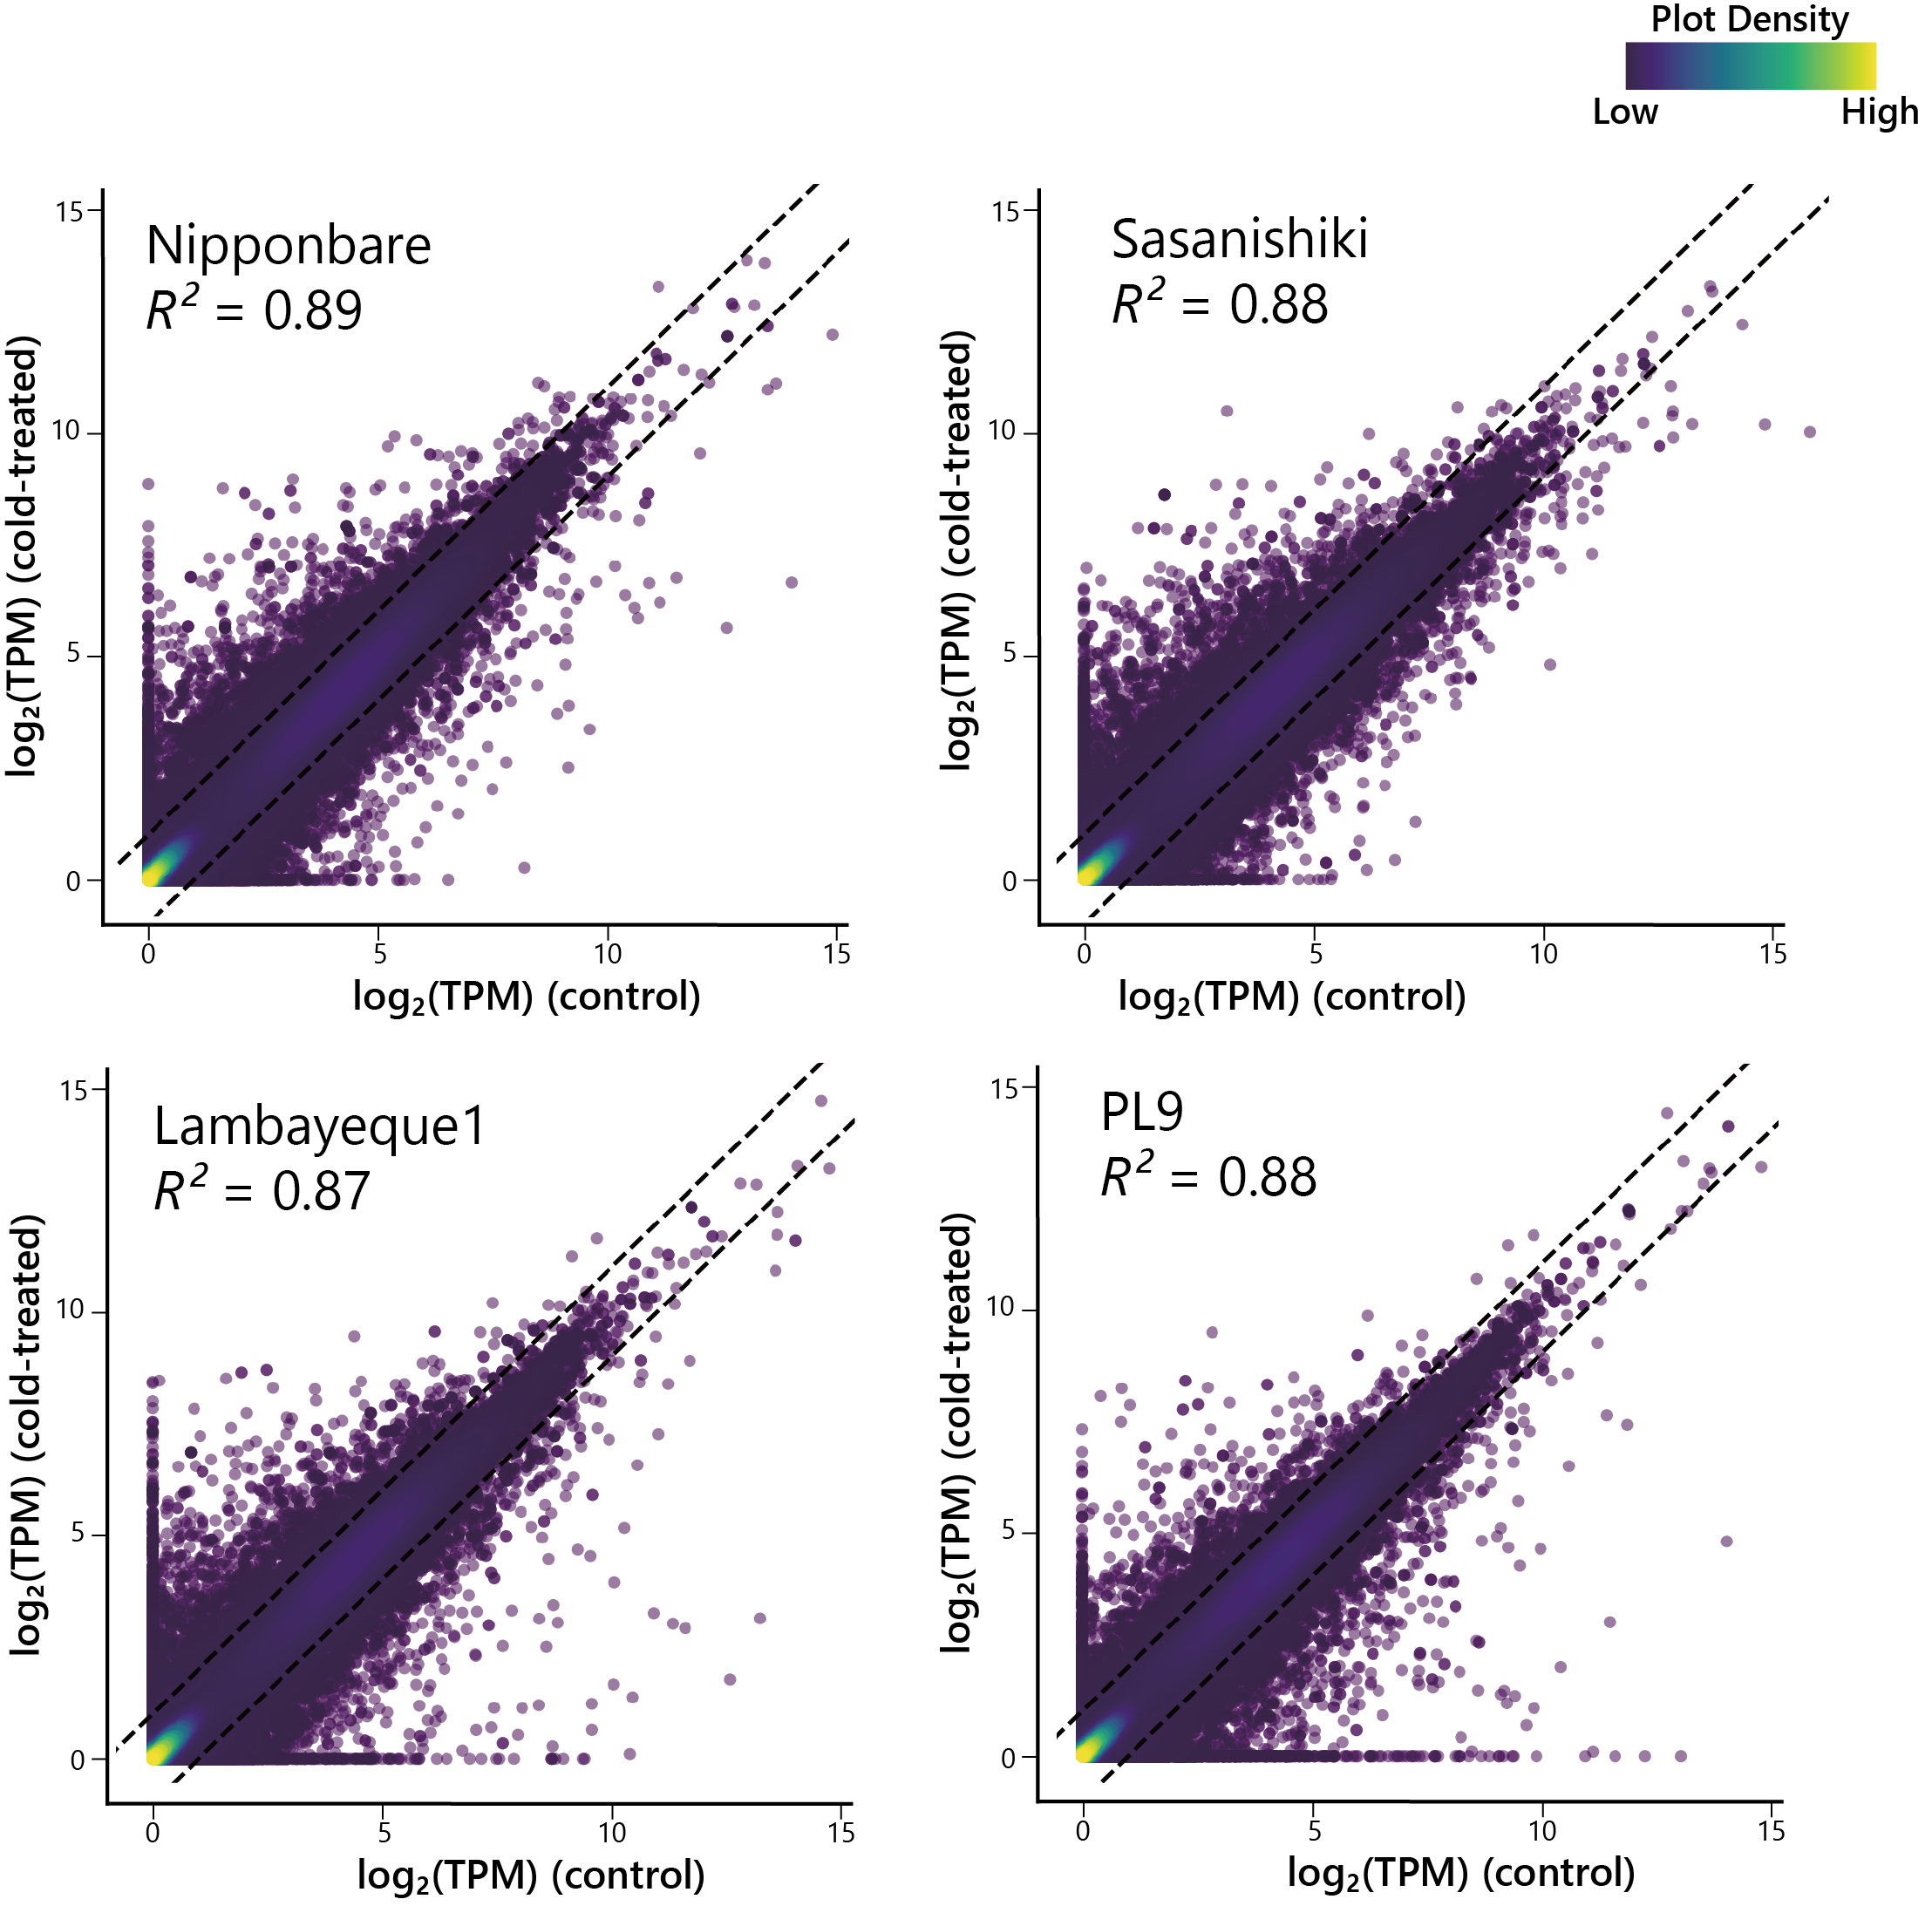
Supplemental Fig. S2. Scatterplots of the anther RNA-seq data for the four rice lines in response to cold treatment.
Plants from the cultivars Nipponbare, Sasanishiki, Lambayeque1, and PL9 were grown under control conditions or subjected to a 12℃ low-temperature treatment. For each line, the x-axis shows the log₂-normalized expression values as transcripts per million (TPM) from control plants; the y-axis shows the log₂-normalized expression values as TPM from cold-treated plants. The coefficient of determination (R²) value in each plot indicates the degree of similarity between the anther transcriptomes from the cold-treated and control plants. The dotted lines indicate y = x ± 1.

Slide 3
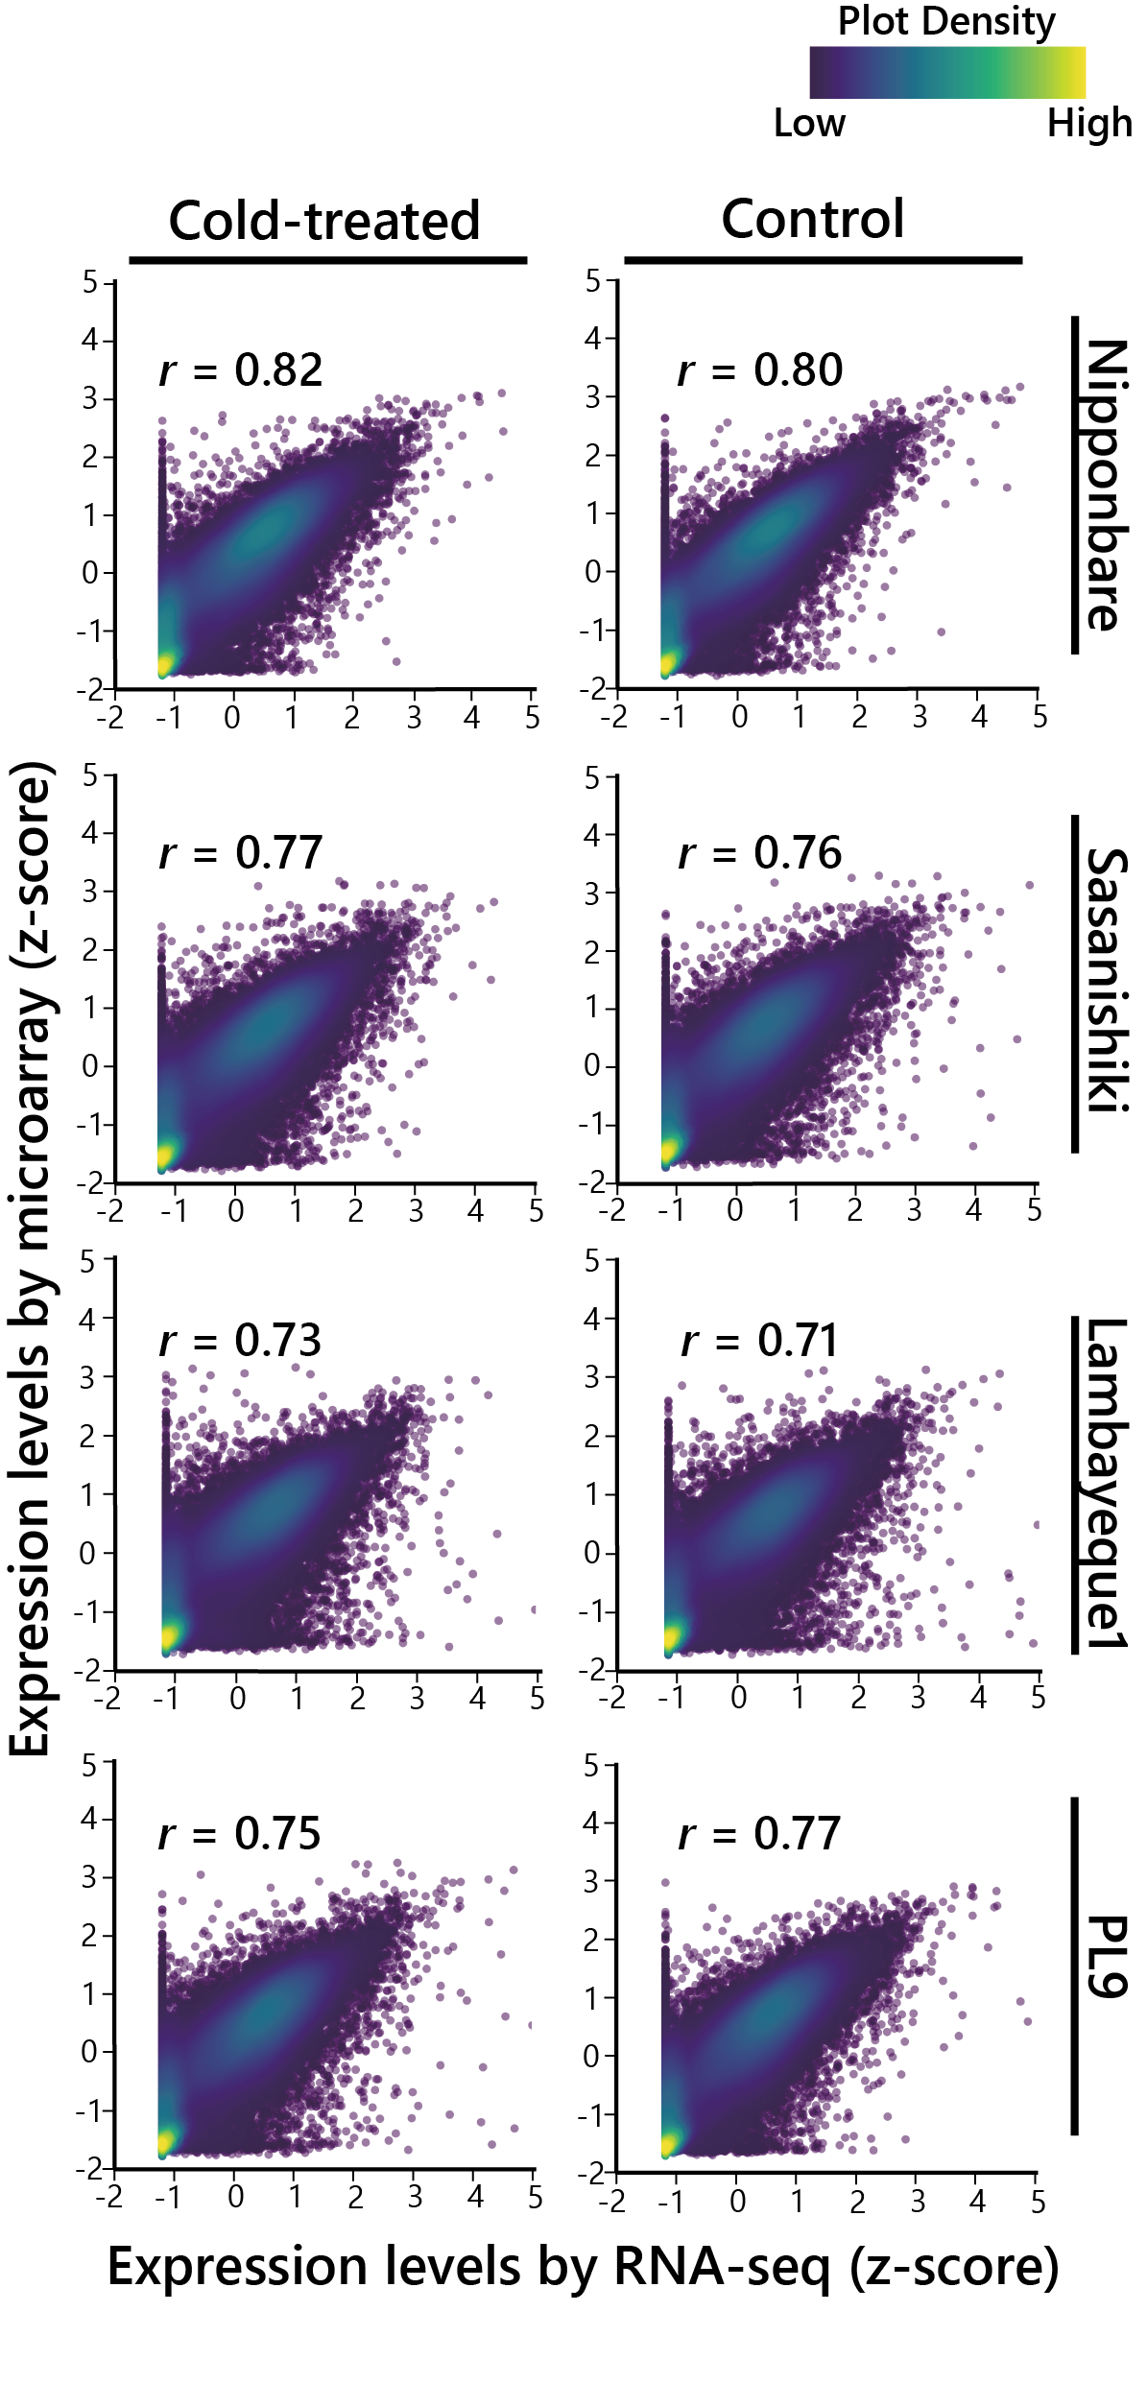
Supplemental Fig. S3. Equivalency between expression levels estimated by RNA-seq and microarrays in the four lines Nipponbare, Sasanishiki, Lambayeque1, and PL9.
The expression levels from the RNA-seq (x-axis) and microarrays (y-axis) are shown as z-score normalized values. The r-values in each plot are the Pearson’s correlation coefficient values. Left column, cold-treated plants; right column, control plants.

Slide 4
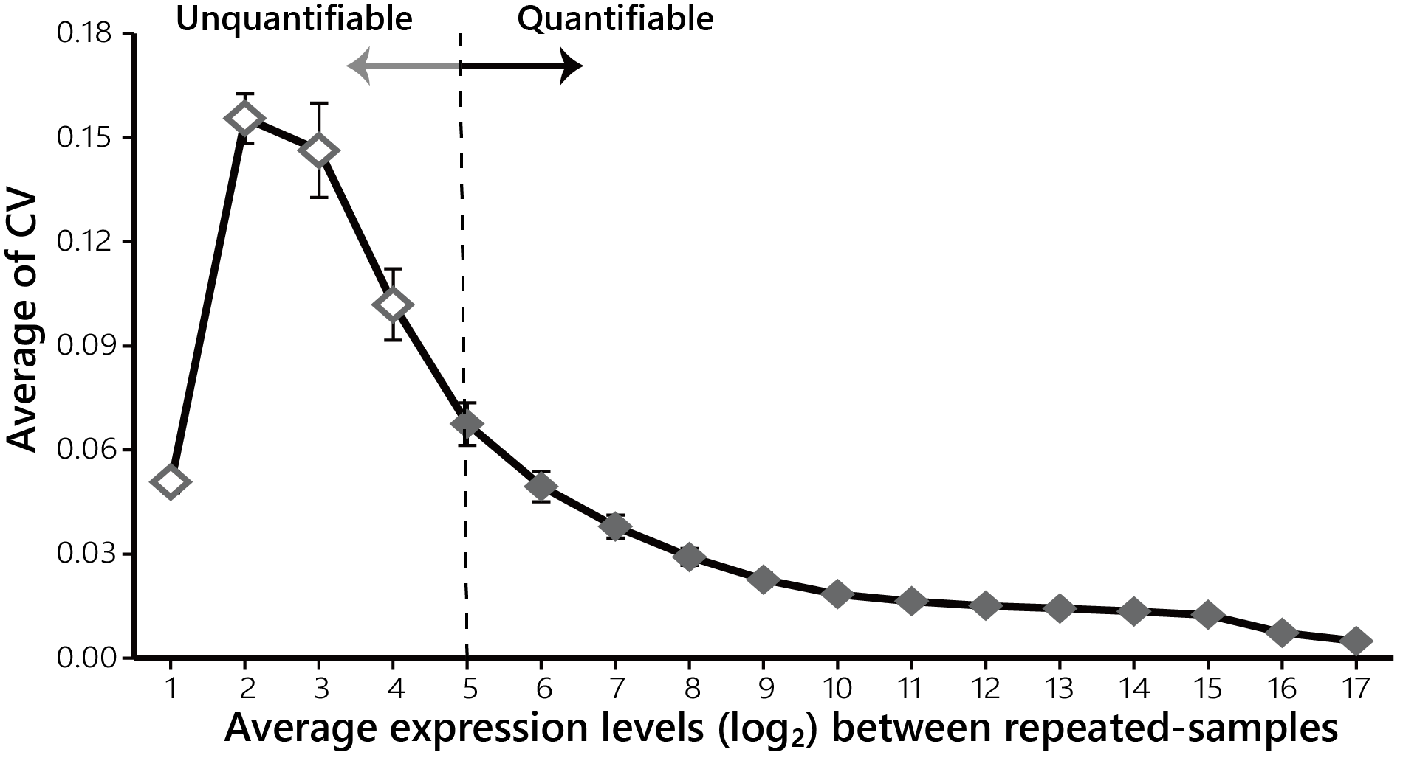
Supplemental Fig. S4. Assessment of the threshold above which gene expression can be quantified by microarrays.
The coefficient of variation (CV) was calculated for the expression levels of each probe between biological replicates in each line and plotted against the average expression levels across biological replicates. Probes with log₂-normalized expression levels below 5 (dashed line) have larger CV values, indicating their highly variable expression levels between biological replicates. Values are means ± SEM.

Slide 5
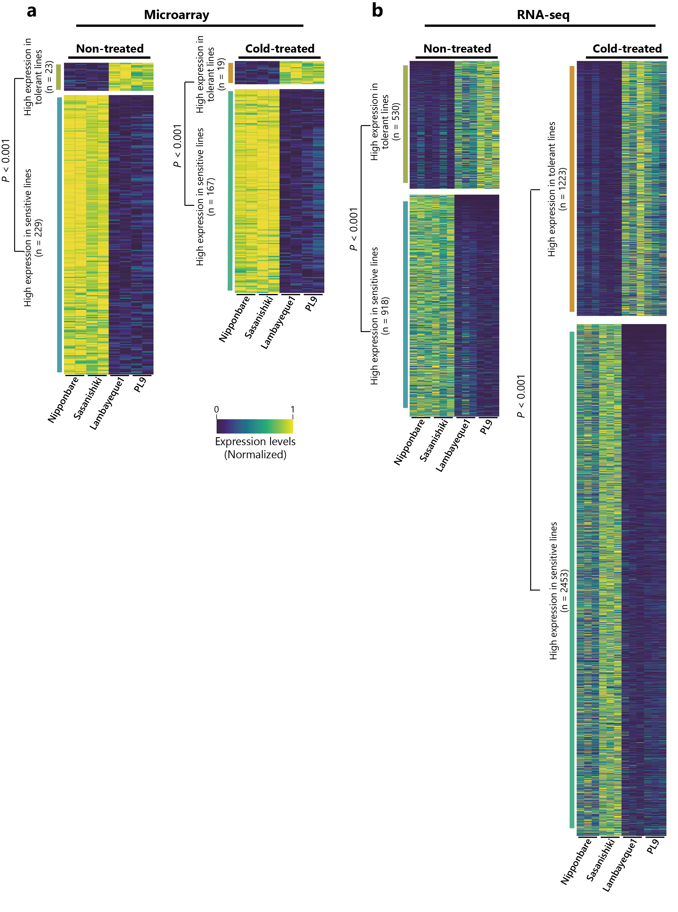
Supplemental Fig. S5 Comparison of gene expression data obtained by microarrays and RNA-seq.
Heatmap representations of gene expression levels for differentially expressed genes identified by microarrays (A) or RNA-seq (B) for genes with an over 2-fold (FDR < 0.05) difference between the tolerant lines (Lambayeque1 and PL9) and the sensitive lines (Nipponbare and Sasanishiki). The P-value was calculated by Fisher's test.

Slide 6
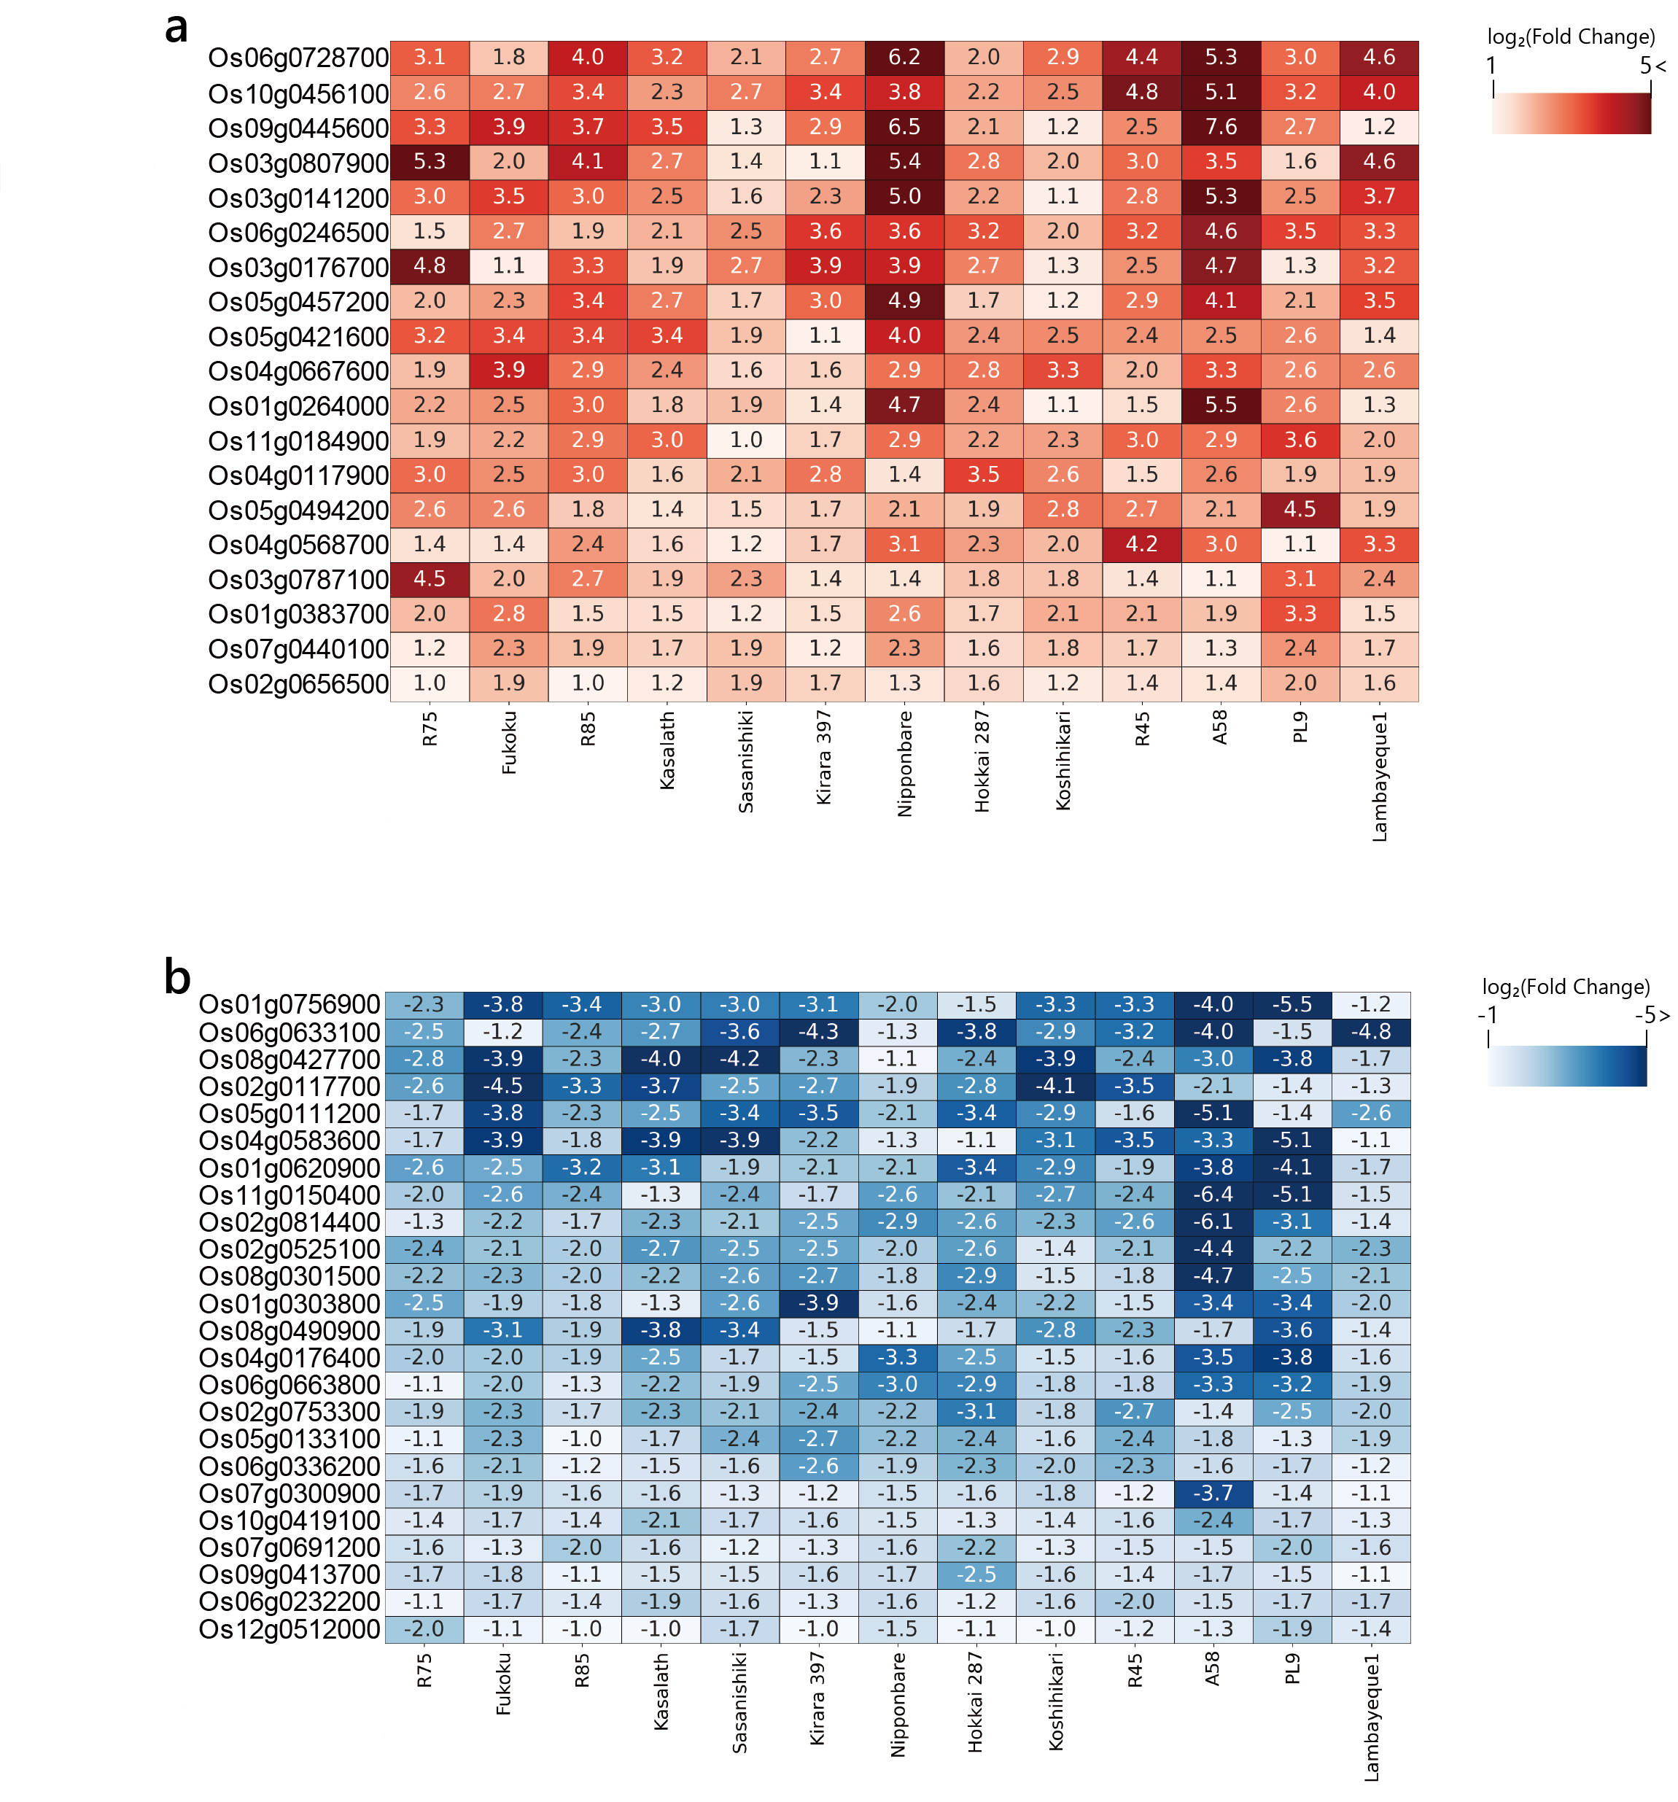
Supplemental Fig. S6. The expression changes of genes up- or down-regulated at least 2-fold in the 13 lines upon cold treatment.
Heatmaps representation of expression change (log₂[FC]) in each line between cold treatment and control conditions. (A) The genes up-regulated in the 13 lines. (B) The genes down-regulated in the 13 lines. The genes are sorted from highest (A) or lowest (B) average log₂(FC) across the 13 lines.

Slide 7
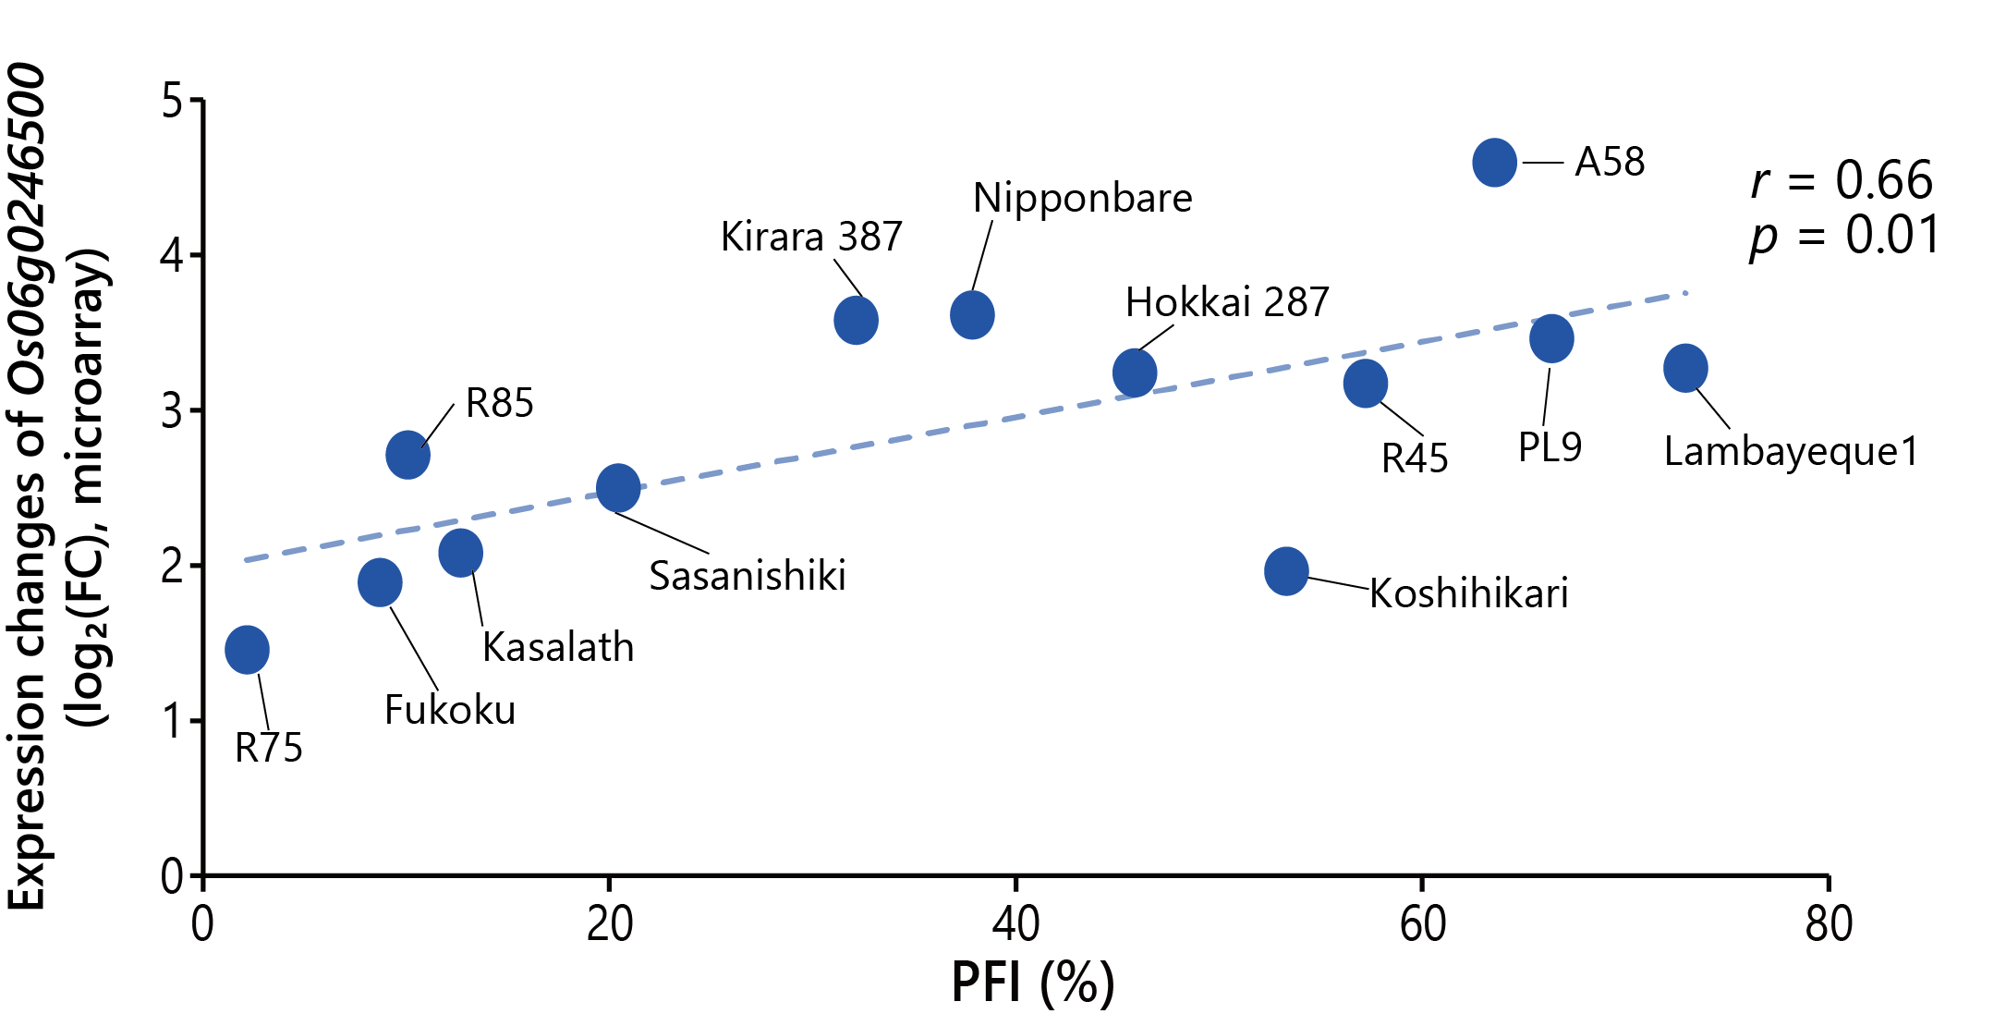
Supplemental Fig. S7. Correlation between the expression changes of Os06g0246500 based on microarray analysis and the pollen fertility index (PFI) across the 13 lines.

Slide 8
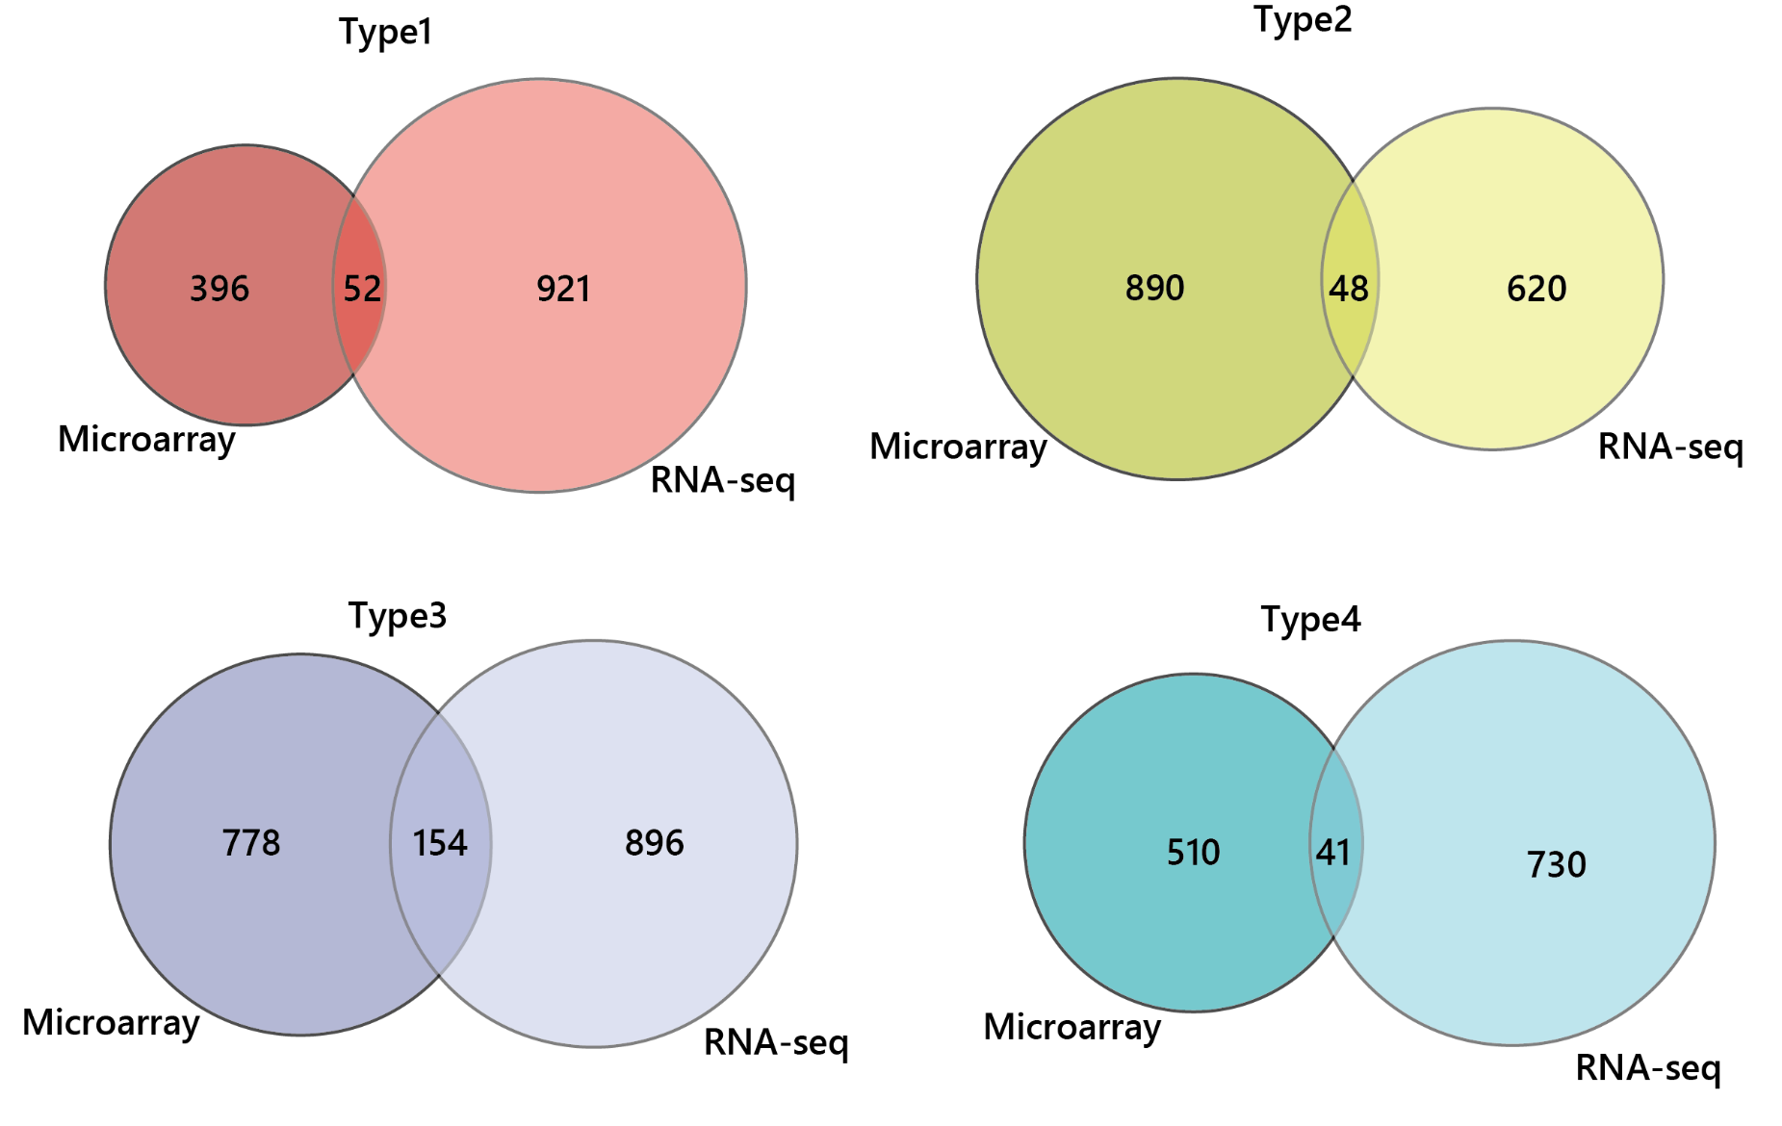
Supplemental Fig. S8. Identification of shared genes between the microarray and RNA-seq data for Types 1–4.
The genes obtained from the RNA-seq analysis for the two cold-tolerant (PL9 and Lambayeque1) and two cold-sensitive (Nipponbare and Sasanishiki) lines were selected as described in Fig. 6. Venn diagrams show the extent of overlap between differentially expressed genes from each type obtained by RNA-seq or microarrays.

Slide 9
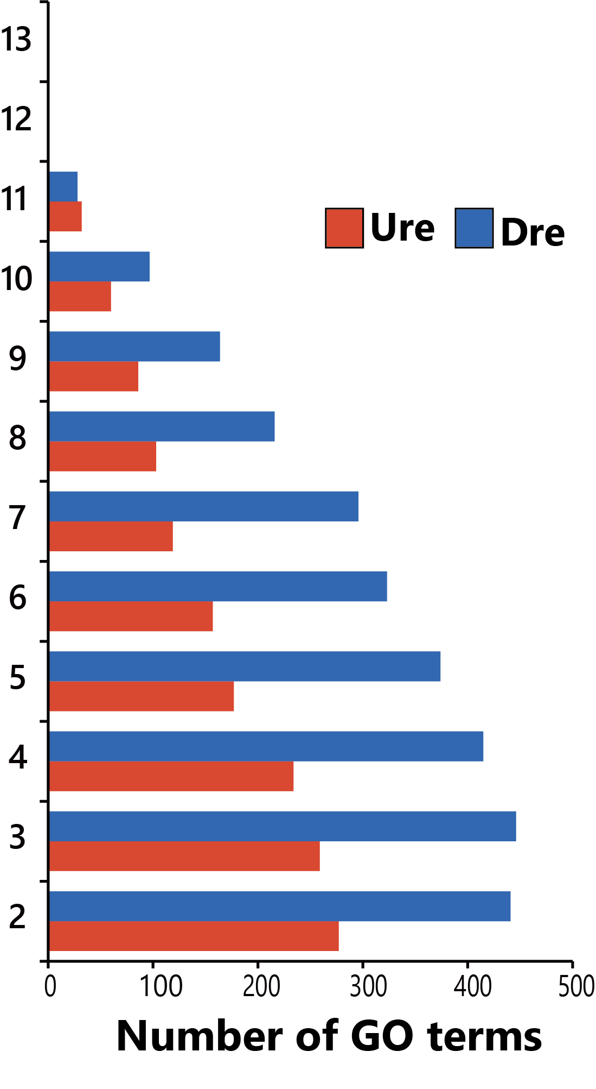
Supplemental Fig. S9. Numbers of GO terms detected among differentially expressed genes shared by two or more lines.
Ure, up-regulated differentially expressed gene; Dre, down-regulated differentially expressed gene.

Slide 10
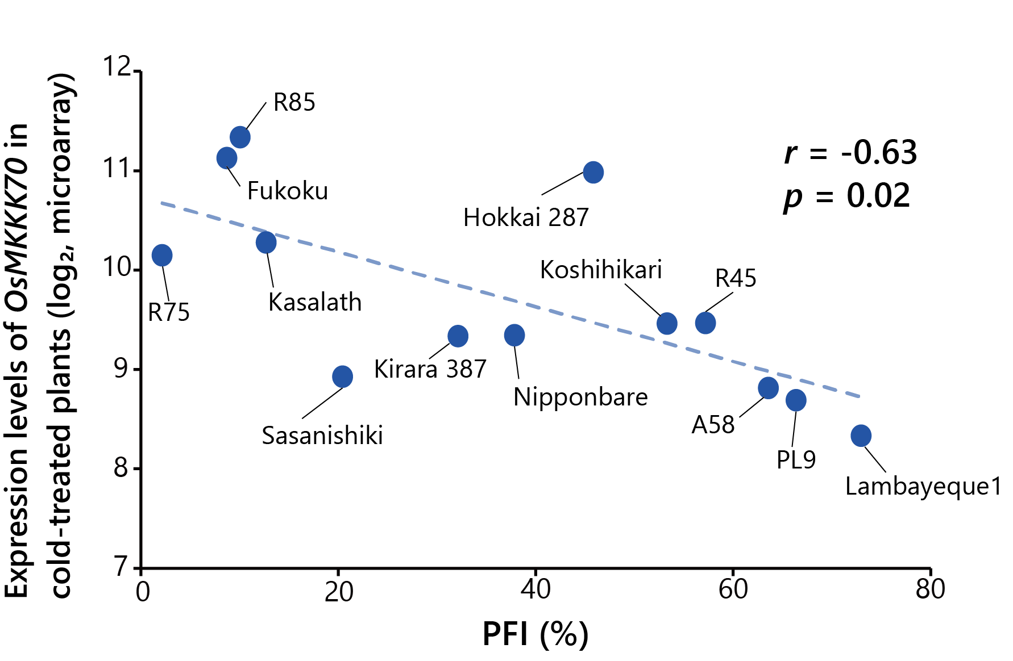
Supplemental Fig. S10. Correlation between the expression levels of OsMKKK70 in cold-treated plants based on the microarray analysis and the pollen fertility index (PFI) of the 13 lines.

