Slide 1
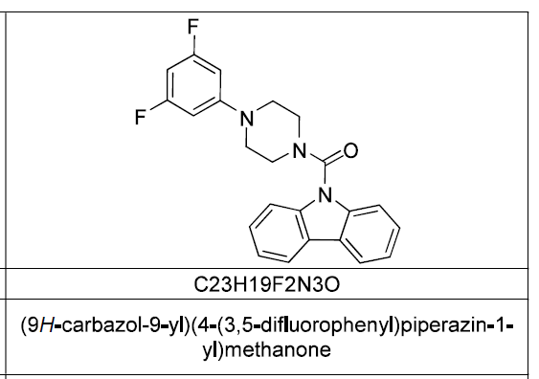
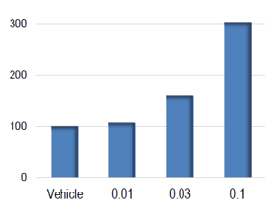
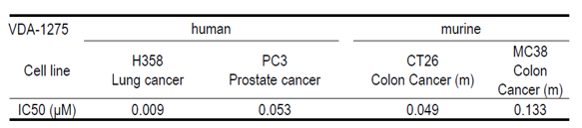
A
B
Caspase 3/7 activity (%)
µM
C

Slide 2
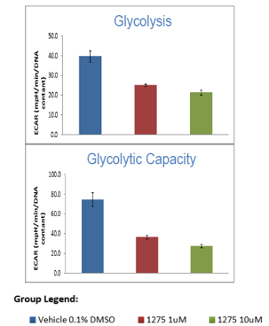
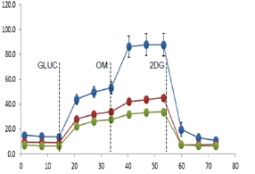
ECAR (mpH/min/DNA content)
Time (min)

Slide 3
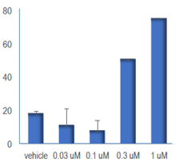
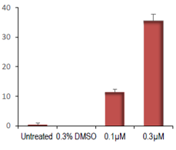
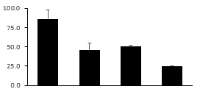
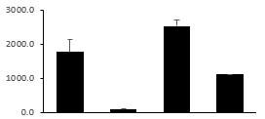
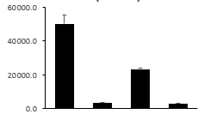
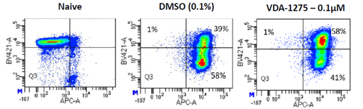
A
IL-1ß
IL-18
Vehicle
0.03
0.1
0.3
1.0
UT
0.3%
DMSO
0.1 µM
0.3 µM
VDA-1275 (µM)
VDA-1275 (µM)
B
Relative Fold Change
Cdh-1
Ym1
Fizz1
Vehicle
2-DG
0.3%
DMSO
VDA-1275
0.3µM
Vehicle
2-DG
0.3%
DMSO
VDA-1275
0.3µM
Vehicle
2-DG
0.3%
DMSO
VDA-1275
0.3µM
C
CD62L (CM)
CD44+ (Activation)

Slide 4
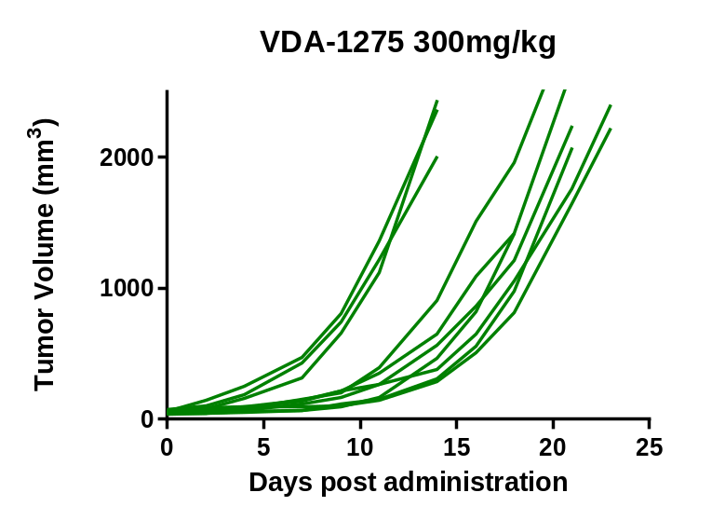
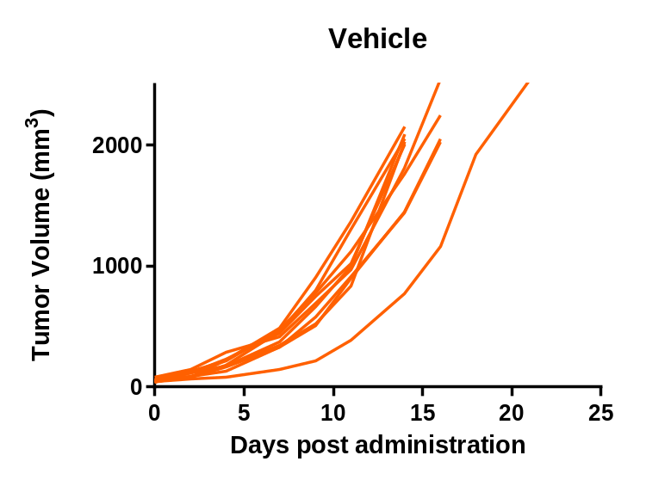
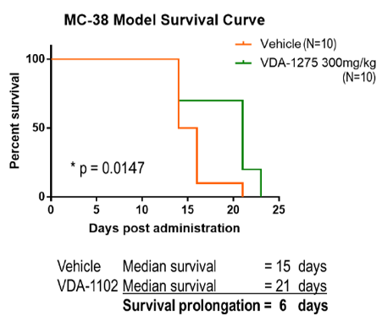
A
B

Slide 5
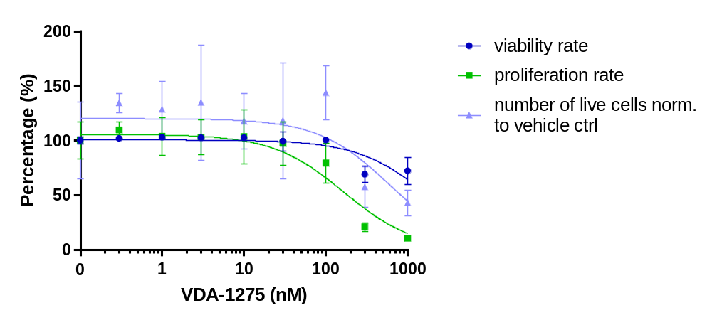
A
B
Viability
Rate (%)
# of Live
Cells

