Slide 1
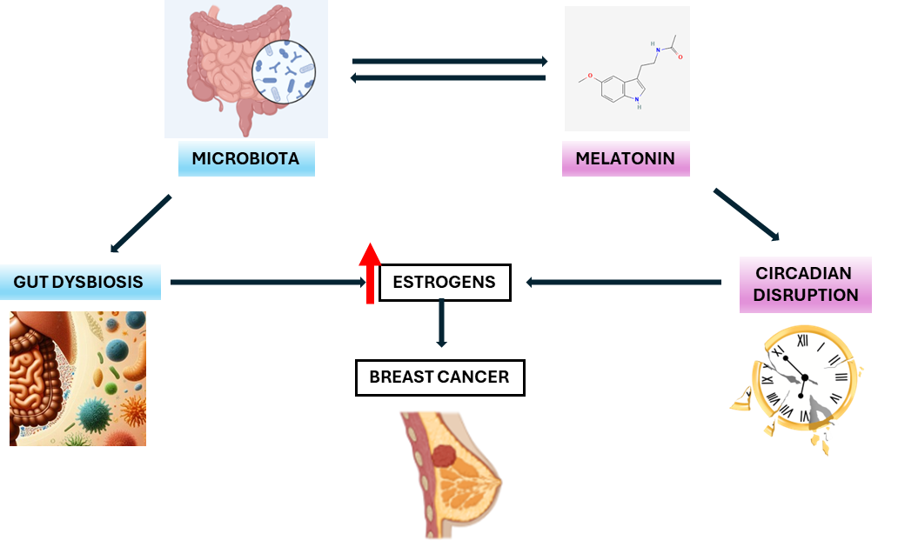

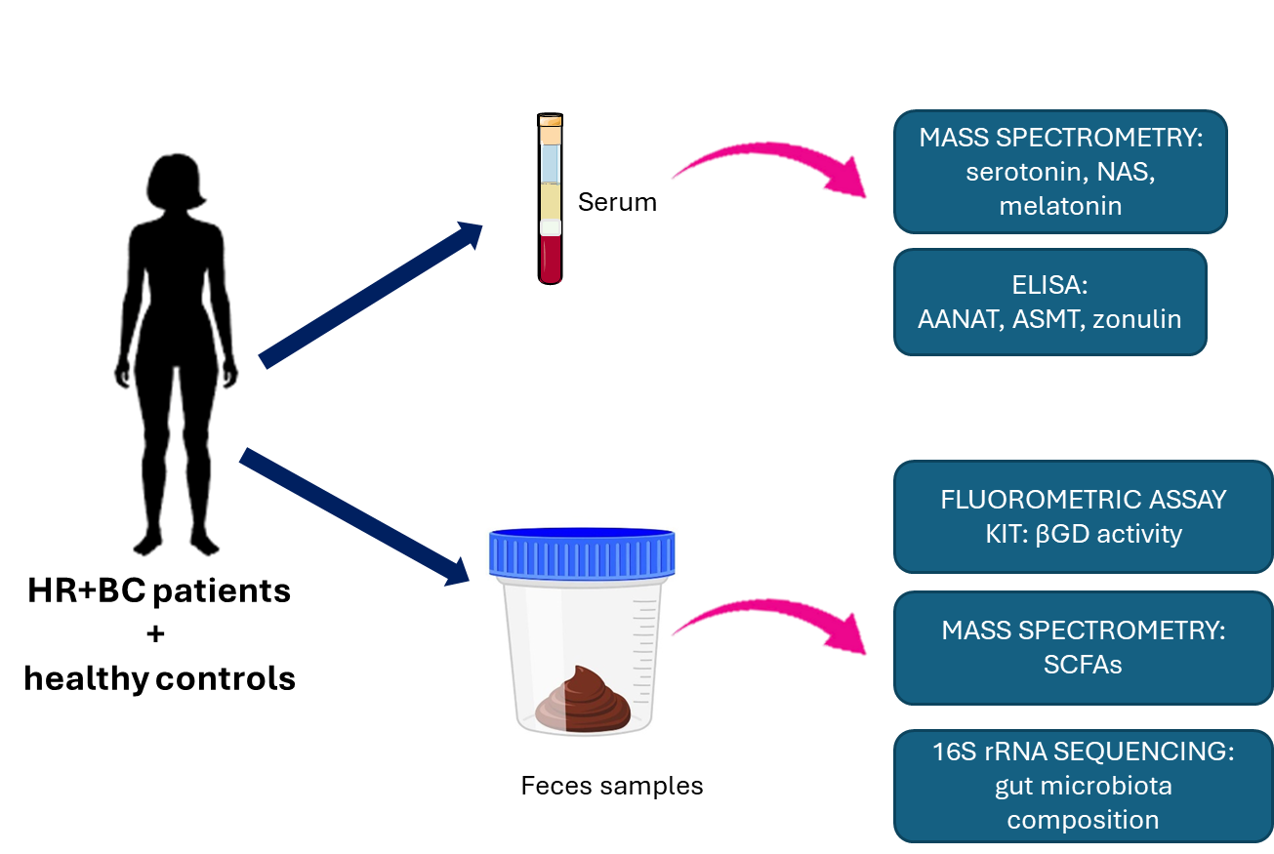

Dysbiosis and circadian disruption play roles in hormonal receptor-positive breast cancer development and may serve as therapeutic targets and biomarkers for predicting the disease
Interplay between gut microbial composition and the melatonergic pathway: implications for hormonal receptor-positive breast cancer development
OBJECTIVE
MATERIAL & METHODS
Investigate the relationship between gut microbiota, melatonin production, and hormonal receptor-positive breast cancer (BC) patients, focusing on alterations in microbial composition, the melatonergic pathway, and their implications in BC development.
RESULTS
Alterations in melatonergic pathway:
Changes in gut microbiota:
Correlations:
Serotonin and NAS levels
Beta-glucuronidase activity
Bacteroides
eggerthii
HR+BC patients:
Melatonin levels
IBA and zonulin (permeability)
Bifidobacterium
longum
Ratio NAS/melatonin
Enrichment of Bacteroides spp.
and depletion of Bifidobacterium spp.
Melatonin
Fecal βGD
Intercenter Medical Oncology Clinical Management Unit, Regional and Virgen de la Victoria University Hospitals, Málaga Biomedical Research Institute (IBIMA) BIONAND Platform-CIMES; University of Malaga
Laborda-Illanes A, Boutriq S, Aranega-Martín L, Sánchez-Alcoholado L, Plaza-Andrades I, Peralta-Linero J, Alba E, Fernández-García JC, González-González A* and Queipo-Ortuño MI
Visual Abstract by Alicia González-González

