Slide 1
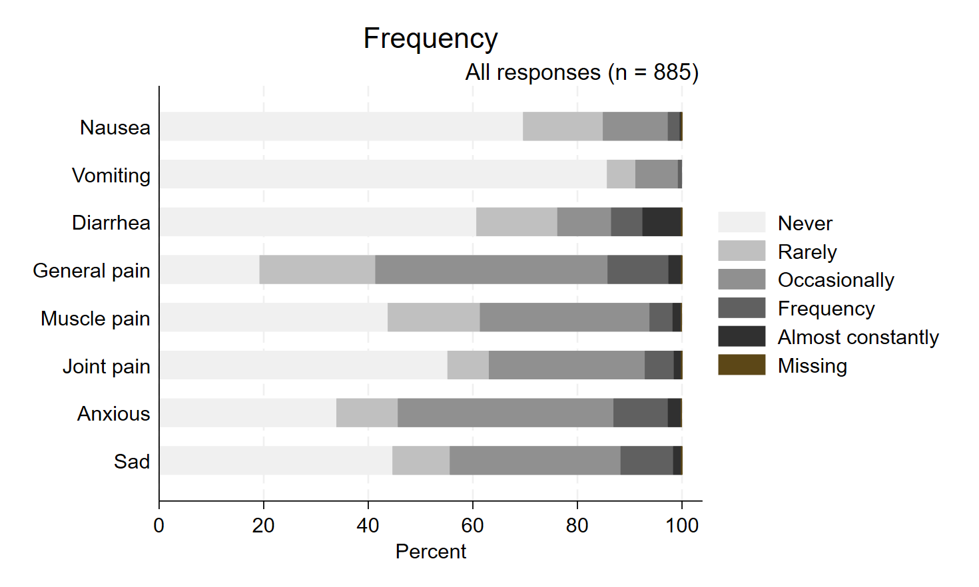
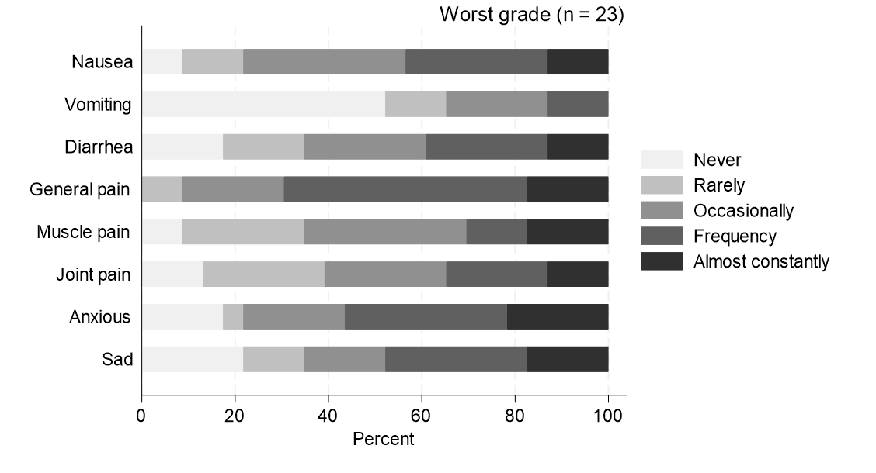
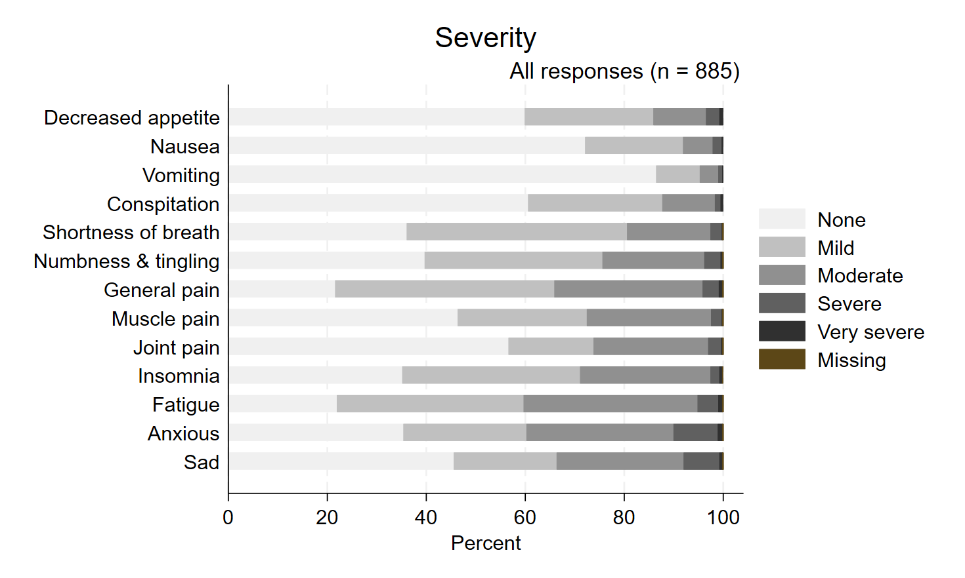
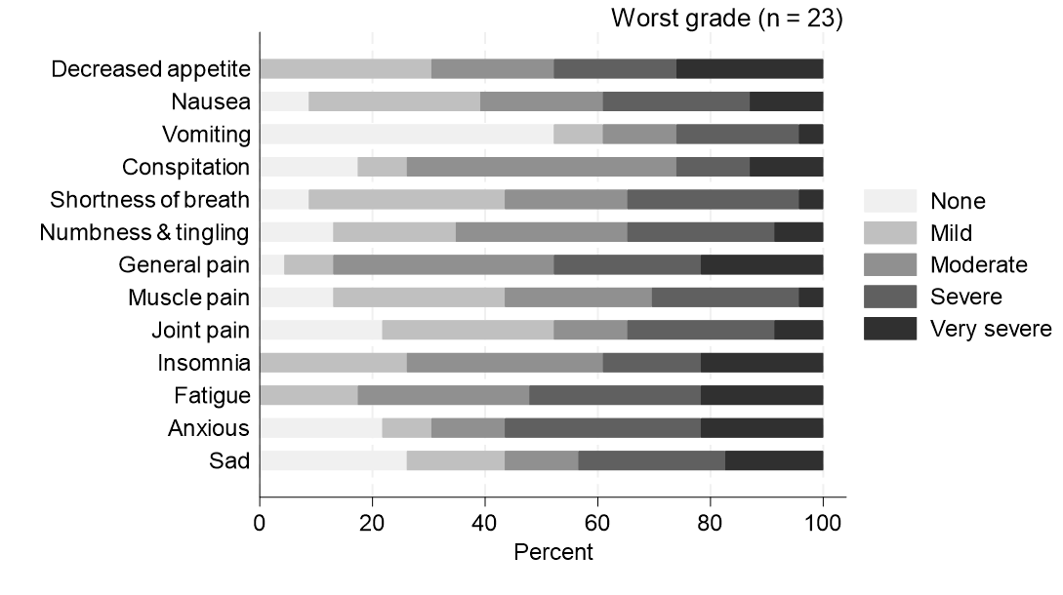
(A)
PRO-CTCAE frequency
(B)
PRO-CTCAE frequency
 | Never |  | Rarely |  | Occasionally |  | Frequency |  | Almost constantly |  | Missing
 | N | % | N | % | N | % | N | % | N | % | N | %
Nausea | 616 | 69.6 | 135 | 15.3 | 110 | 12.4 | 20 | 2.3 | 3 | 0.3 | 1 | 0.1
Vomiting | 758 | 85.6 | 48 | 5.4 | 72 | 8.1 | 7 | 0.8 | 0 | 0 | 0 | 0
Diarrhea | 537 | 60.7 | 137 | 15.5 | 91 | 10.3 | 53 | 6.0 | 66 | 7.5 | 1 | 0.1
General pain | 170 | 19.2 | 196 | 22.1 | 393 | 44.4 | 103 | 11.6 | 22 | 2.5 | 1 | 0.1
Muscle pain | 387 | 43.7 | 156 | 17.6 | 287 | 32.4 | 39 | 4.4 | 14 | 1.6 | 2 | 0.2
Joint pain | 488 | 55.1 | 70 | 7.9 | 264 | 29.8 | 49 | 5.5 | 13 | 1.5 | 1 | 0.1
Anxious | 300 | 33.9 | 104 | 11.8 | 365 | 41.2 | 92 | 10.4 | 22 | 2.5 | 2 | 0.2
Sad | 395 | 44.6 | 97 | 11.0 | 289 | 32.7 | 89 | 10.1 | 14 | 1.6 | 1 | 0.1
 | Never |  | Rarely |  | Occasionally |  | Frequency |  | Almost constantly
 | N | % | N | % | N | % | N | % | N | %
Nausea | 2 | 8.7 | 3 | 13.0 | 8 | 34.8 | 7 | 30.4 | 3 | 13.0
Vomiting | 12 | 52.2 | 3 | 13.0 | 5 | 21.7 | 3 | 13.0 | 0 | 0
Diarrhea | 4 | 17.4 | 4 | 17.4 | 6 | 26.1 | 6 | 26.1 | 3 | 13.0
General pain | 0 | 0 | 2 | 8.7 | 5 | 21.7 | 12 | 52.2 | 4 | 17.4
Muscle pain | 2 | 8.7 | 6 | 26.1 | 8 | 34.8 | 3 | 13.0 | 4 | 17.4
Joint pain | 3 | 13.0 | 6 | 26.1 | 6 | 26.1 | 5 | 21.7 | 3 | 13.0
Anxious | 4 | 17.4 | 1 | 4.3 | 5 | 21.7 | 8 | 34.8 | 5 | 21.7
Sad | 5 | 21.7 | 3 | 13.0 | 4 | 17.4 | 7 | 30.4 | 4 | 17.4
(C)
PRO-CTCAE severity
(D)
PRO-CTCAE severity
 | None |  | Mild |  | Moderate |  | Severe |  | Very severe |  | Missing
 | N | % | N | % | N | % | N | % | N | % | N | %
Decreased appetite | 530 | 59.9 | 230 | 26.0 | 94 | 10.6 | 24 | 2.7 | 7 | 0.8 | 0 | 0
Nausea | 638 | 72.1 | 175 | 19.8 | 53 | 6.0 | 16 | 1.8 | 3 | 0.3 | 0 | 0
Vomiting | 765 | 86.4 | 78 | 8.8 | 33 | 3.7 | 7 | 0.8 | 2 | 0.2 | 0 | 0
Conspitation | 536 | 60.6 | 240 | 27.1 | 94 | 10.6 | 10 | 1.1 | 5 | 0.6 | 0 | 0
Shortness of breath | 319 | 36.0 | 394 | 44.5 | 149 | 16.8 | 21 | 2.4 | 1 | 0.1 | 1 | 0.1
Numbness & tingling | 351 | 39.7 | 318 | 35.9 | 182 | 20.6 | 29 | 3.3 | 4 | 0.5 | 1 | 0.1
General pain | 191 | 21.6 | 392 | 44.3 | 265 | 29.9 | 29 | 3.3 | 7 | 0.8 | 1 | 0.1
Muscle pain | 410 | 46.3 | 231 | 26.1 | 222 | 25.1 | 19 | 2.1 | 2 | 0.2 | 1 | 0.1
Joint pain | 501 | 56.6 | 152 | 17.2 | 205 | 23.2 | 23 | 2.6 | 3 | 0.3 | 1 | 0.1
Insomnia | 311 | 35.1 | 318 | 35.9 | 233 | 26.3 | 16 | 1.8 | 5 | 0.6 | 2 | 0.2
Fatigue | 194 | 21.9 | 334 | 37.7 | 311 | 35.1 | 37 | 4.2 | 8 | 0.9 | 1 | 0.1
Anxious | 313 | 35.4 | 220 | 24.9 | 263 | 29.7 | 79 | 8.9 | 9 | 1.0 | 1 | 0.1
Sad | 403 | 45.5 | 184 | 20.8 | 227 | 25.6 | 64 | 7.2 | 6 | 0.7 | 1 | 0.1
 | None |  | Mild |  | Moderate |  | Severe |  | Very severe
 | N | % | N | % | N | % | N | % | N | %
Decreased appetite | 0 | 0 | 7 | 30.4 | 5 | 21.7 | 5 | 21.7 | 6 | 26.1
Nausea | 2 | 8.7 | 7 | 30.4 | 5 | 21.7 | 6 | 26.1 | 3 | 13.0
Vomiting | 12 | 52.2 | 2 | 8.7 | 3 | 13.0 | 5 | 21.7 | 1 | 4.3
Conspitation | 4 | 17.4 | 2 | 8.7 | 11 | 47.8 | 3 | 13.0 | 3 | 13.0
Shortness of breath | 2 | 8.7 | 8 | 34.8 | 5 | 21.7 | 7 | 30.4 | 1 | 4.3
Numbness & tingling | 3 | 13.0 | 5 | 21.7 | 7 | 30.4 | 6 | 26.1 | 2 | 8.7
General pain | 1 | 4.3 | 2 | 8.7 | 9 | 39.1 | 6 | 26.1 | 5 | 21.7
Muscle pain | 3 | 13.0 | 7 | 30.4 | 6 | 26.1 | 6 | 26.1 | 1 | 4.3
Joint pain | 5 | 21.7 | 7 | 30.4 | 3 | 13.0 | 6 | 26.1 | 2 | 8.7
Insomnia | 0 | 0 | 6 | 26.1 | 8 | 34.8 | 4 | 17.4 | 5 | 21.7
Fatigue | 0 | 0 | 4 | 17.4 | 7 | 30.4 | 7 | 30.4 | 5 | 21.7
Anxious | 5 | 21.7 | 2 | 8.7 | 3 | 13.0 | 8 | 34.8 | 5 | 21.7
Sad | 6 | 26.1 | 4 | 17.4 | 3 | 13.0 | 6 | 26.1 | 4 | 17.4

