Slide 1
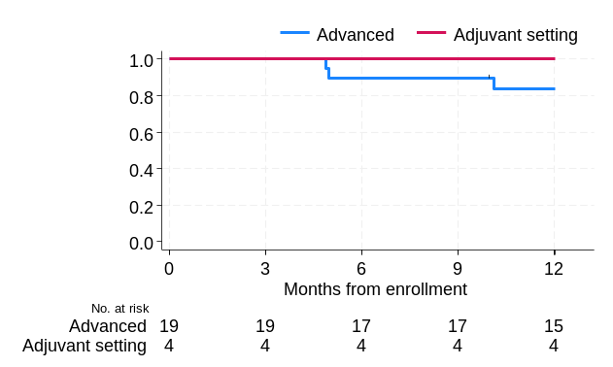
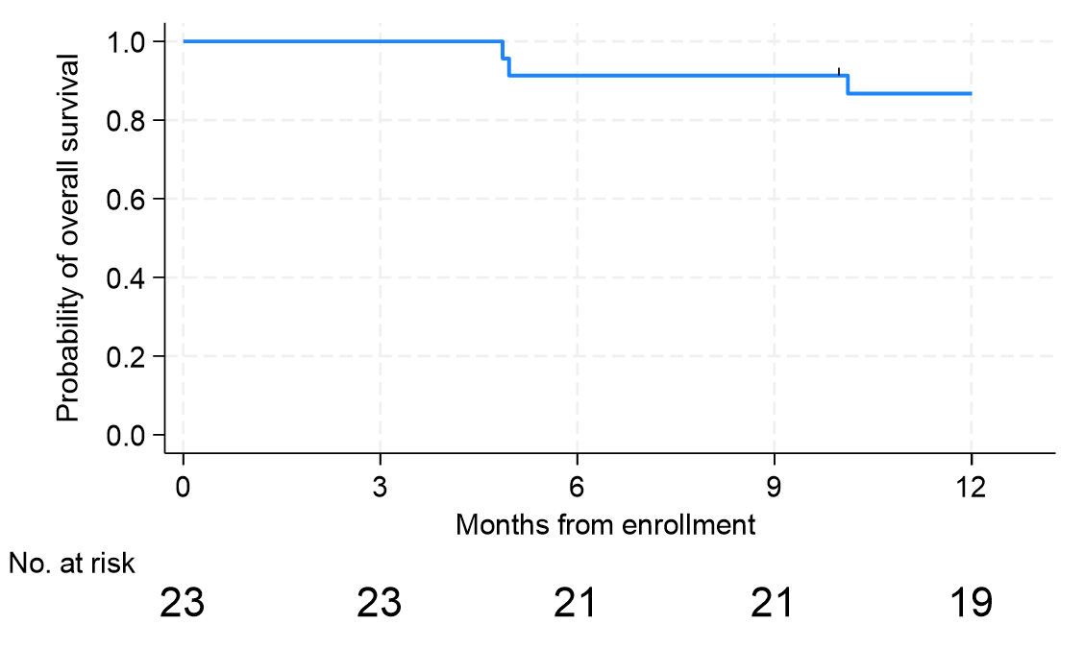
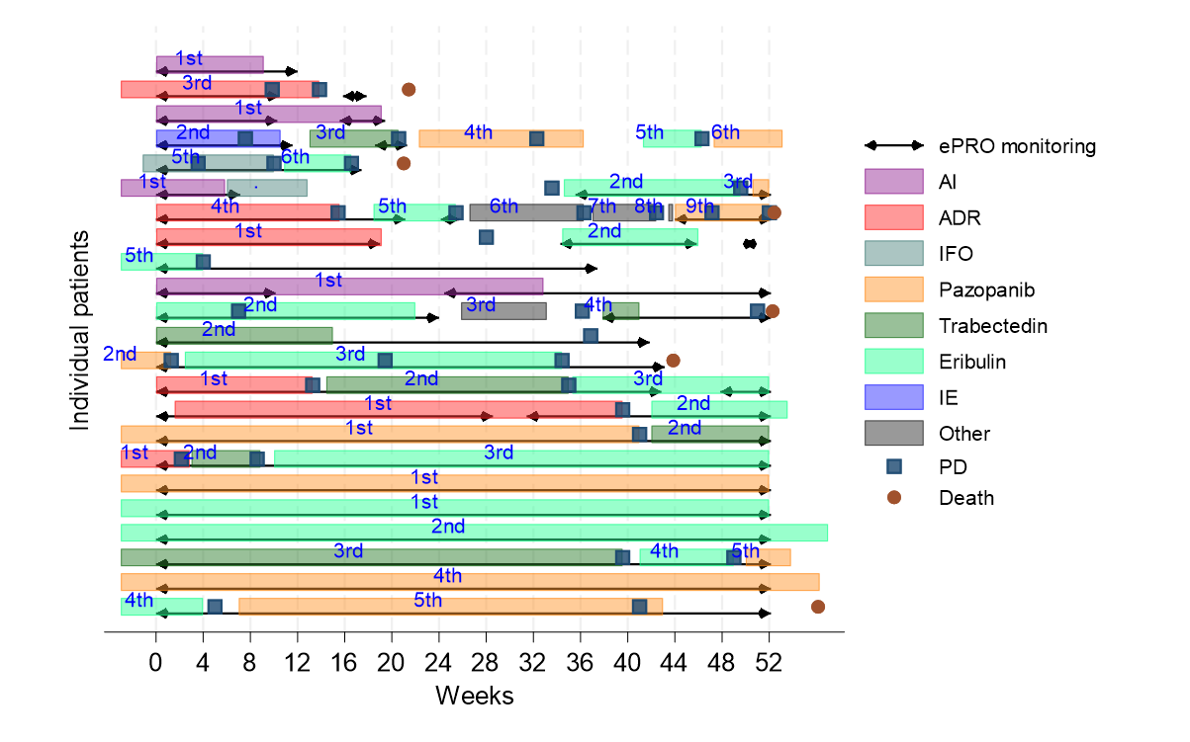
(A)
(B)
1-year rate (%): 86.7 (95%CI: 64.3–95.5)
1-year rate (%): 83.9 (95%CI: 57.9–94.5)
(C)

