Slide 1
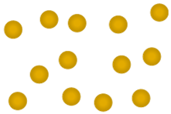

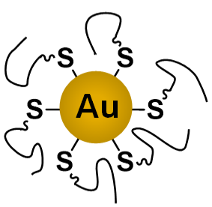
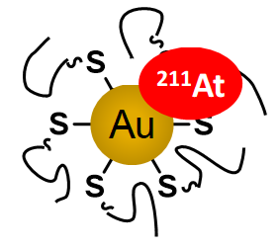
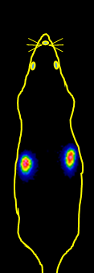
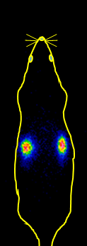
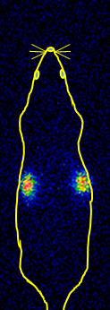

Au
mm³
AuNP
AuNP-S-mPEG
²¹¹At-AuNP-S-mPEG
days
Systemic distributions by scintigraphy
Tumor growth suppression
Intratumoral administration
4 hours
19 hours
42 hours

