Slide 1
Supplementary Figures

Slide 2
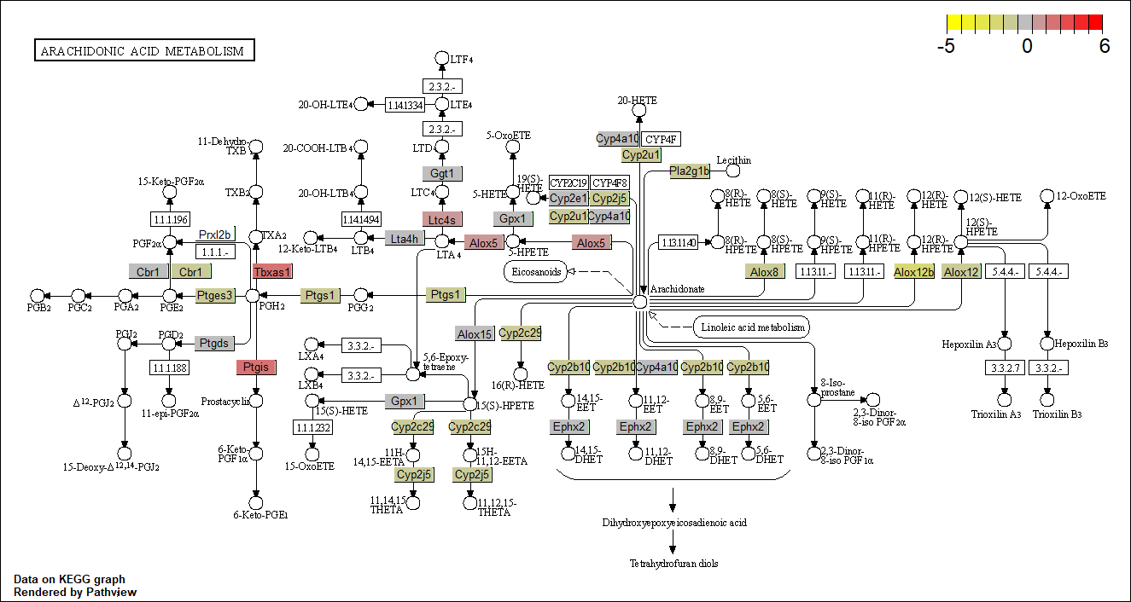
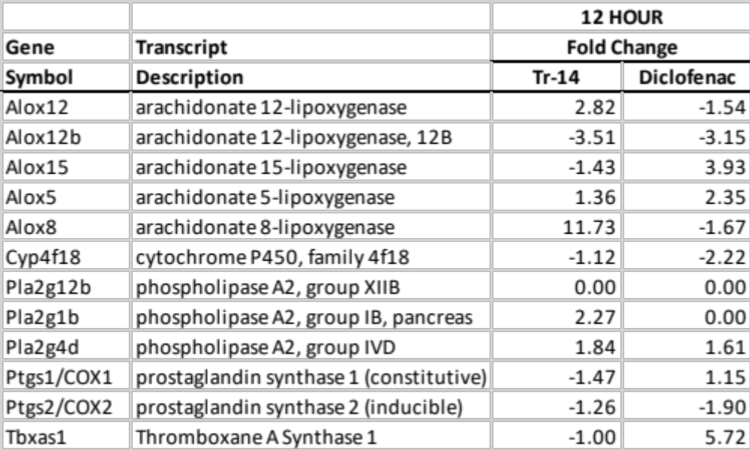
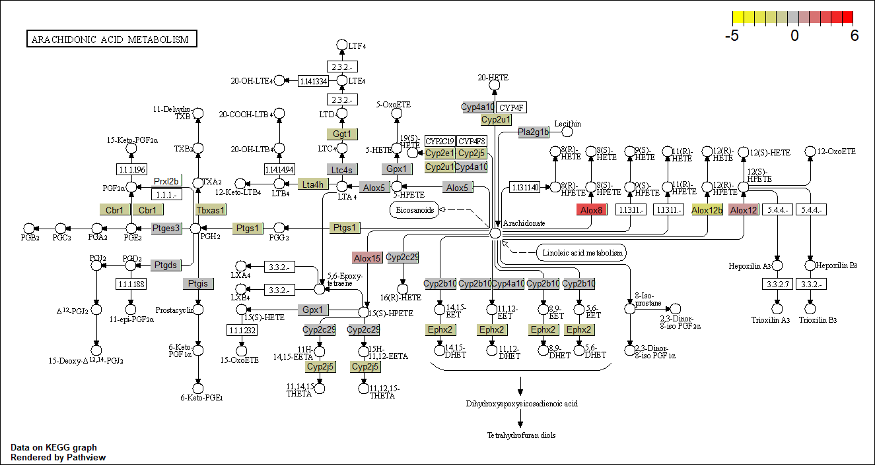
Diclofenac
Tr14-Traumeel
Supplemental Figure 1. Arachadonic Acid/prostaglandin/leukotriene pathway analysis of treatment-induced signaling changes at the 12H timepoint.

Slide 3
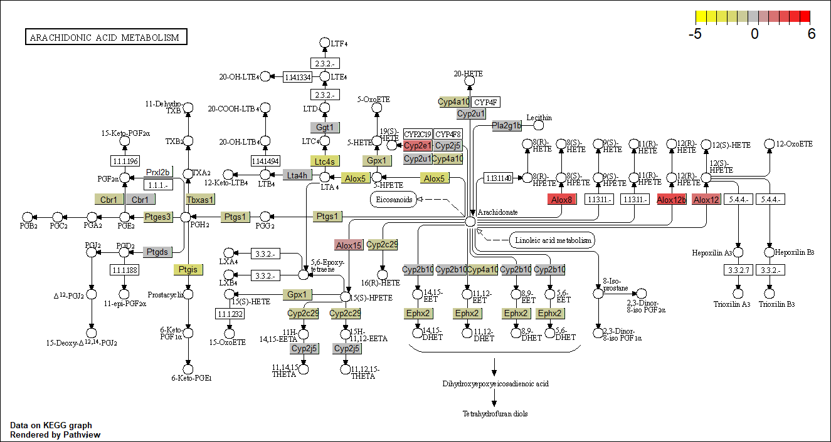
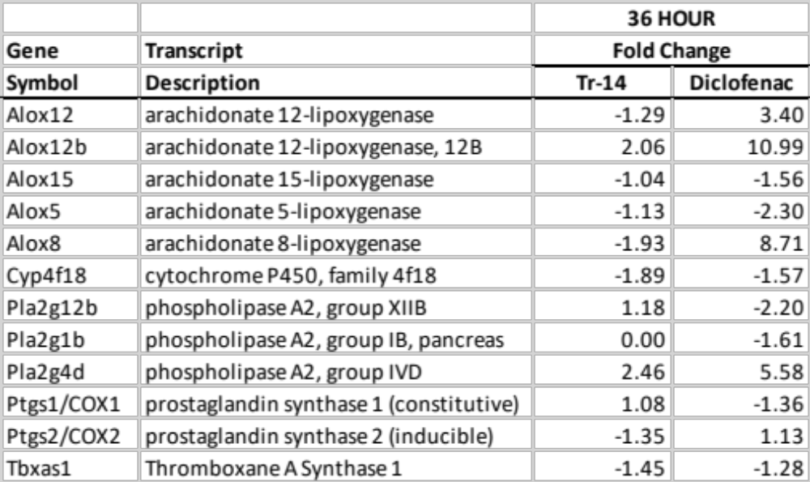
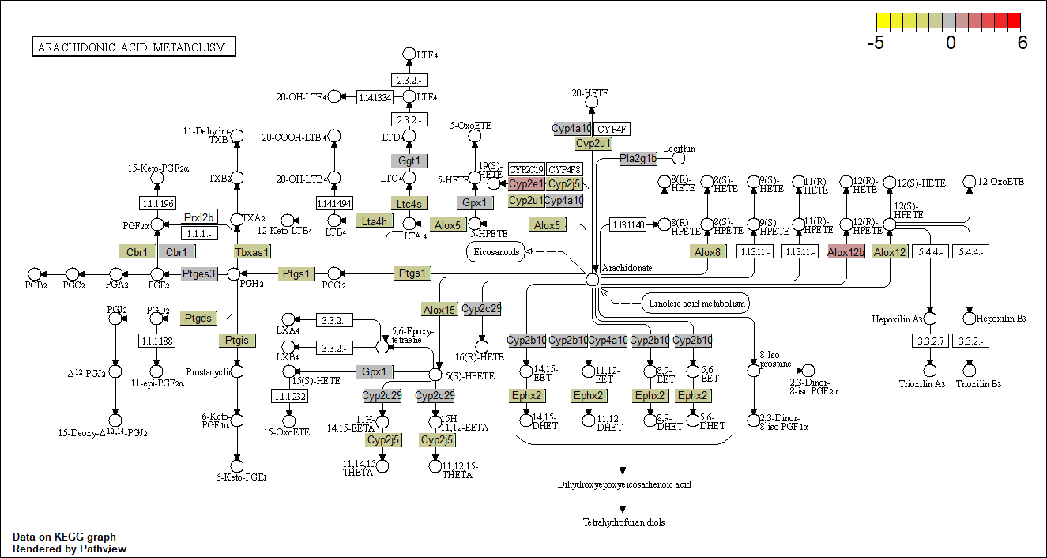
Diclofenac
Tr14-Traumeel
Supplemental Figure 2. Arachadonic Acid/prostaglandin/leukotriene pathway analysis of treatment-induced signaling changes at the 36 H timepoint.

Slide 4
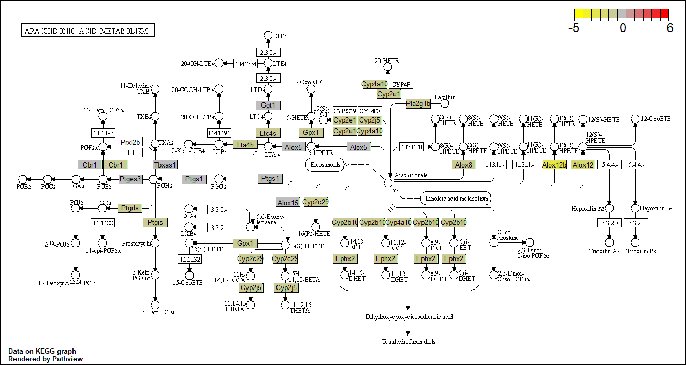

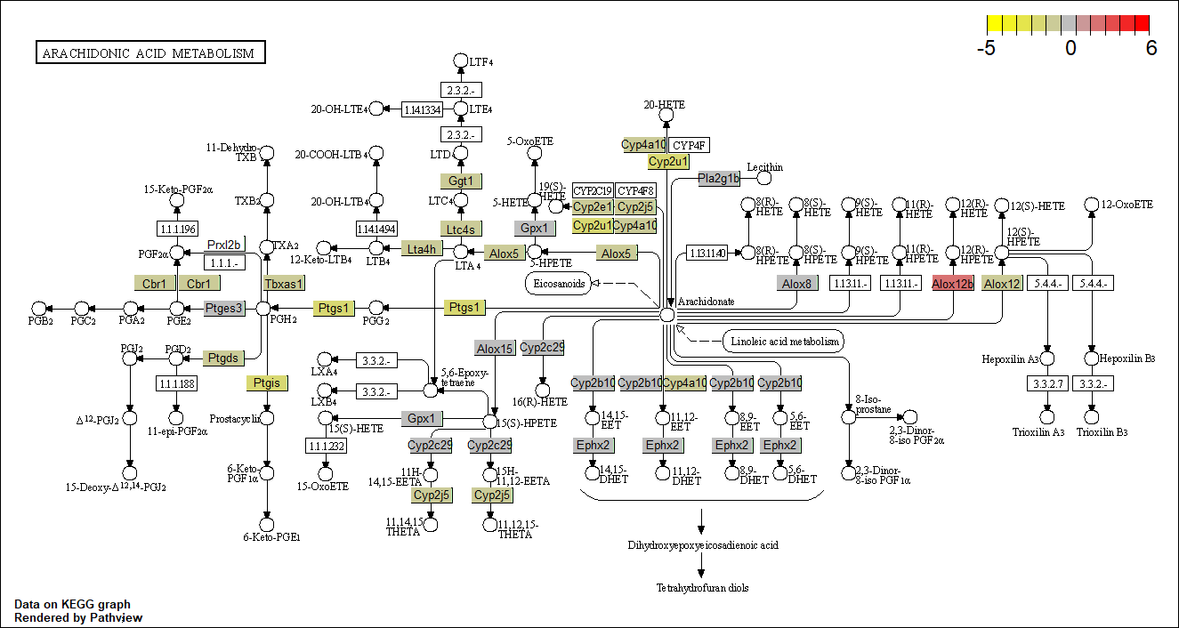
Diclofenac
Tr14-Traumeel
Supplemental Figure 3. Arachadonic Acid/prostaglandin/leukotriene pathway analysis of treatment-induced signaling changes at the 72H timepoint.

Slide 5
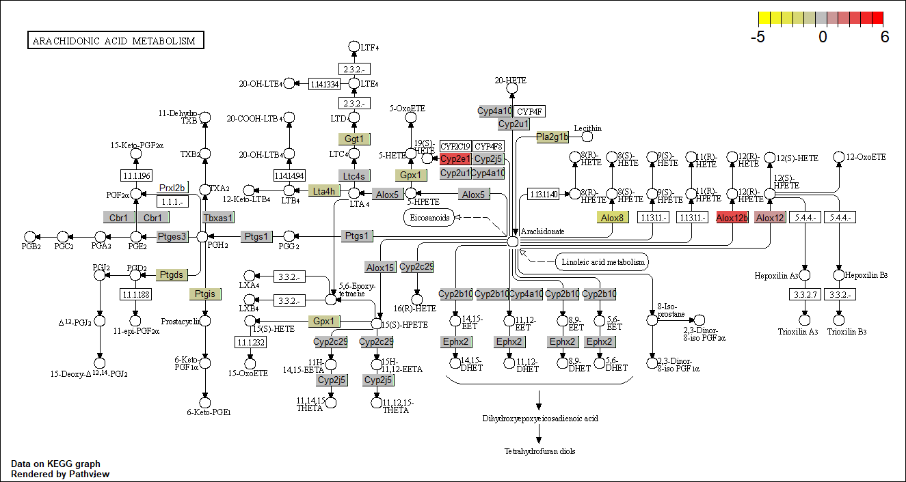

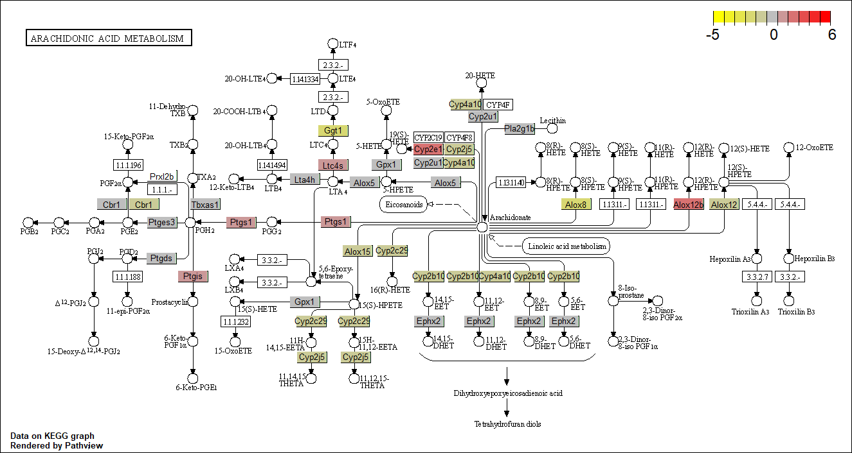
Diclofenac
Tr14-Traumeel
Supplemental Figure 4. Arachadonic Acid/prostaglandin/leukotriene pathway analysis of treatment-induced signaling changes at the 96 H timepoint.

Slide 6
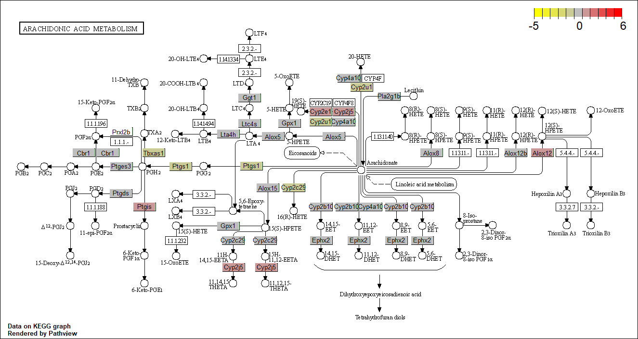
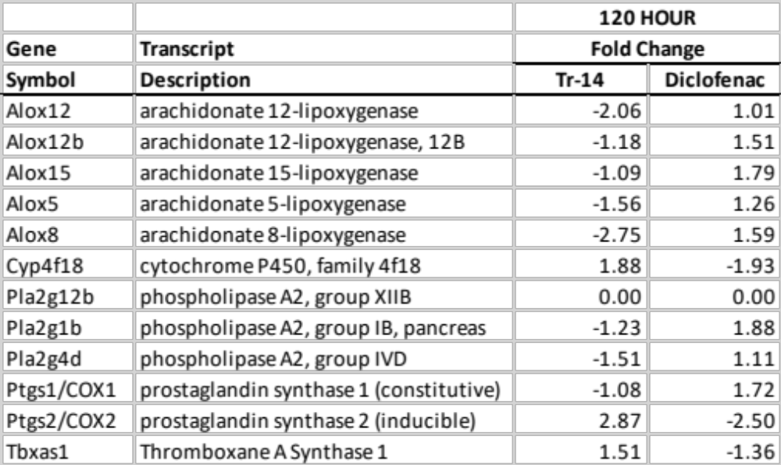

Diclofenac
Tr14-Traumeel
Supplemental Figure 5. Arachadonic Acid/prostaglandin/leukotriene pathway analysis of treatment-induced signaling changes at the 120 H timepoint.

Slide 7
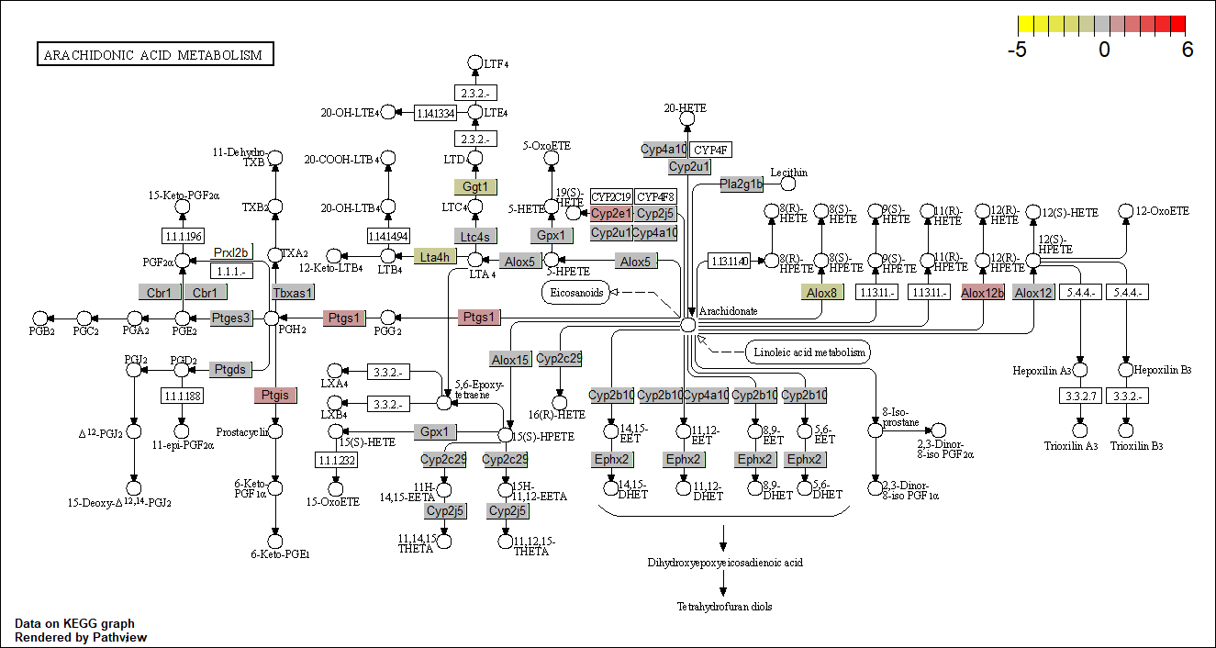
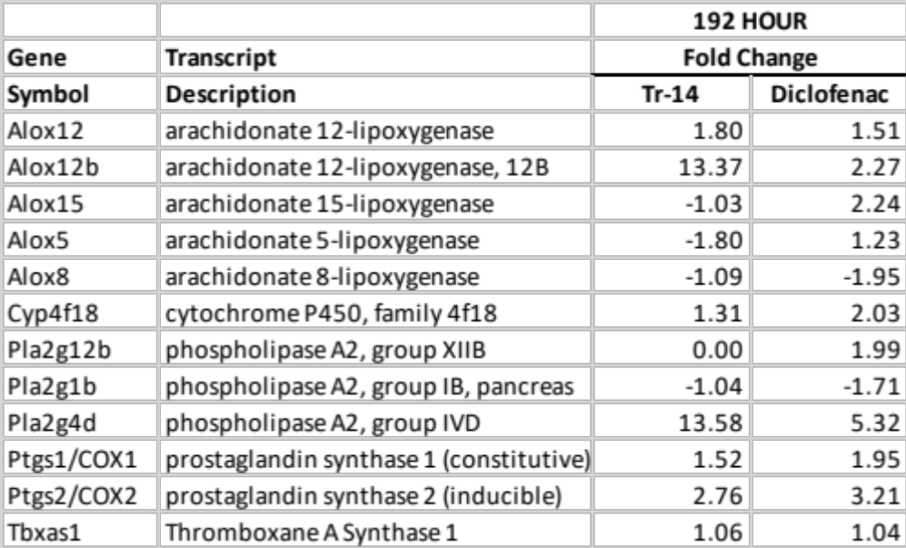
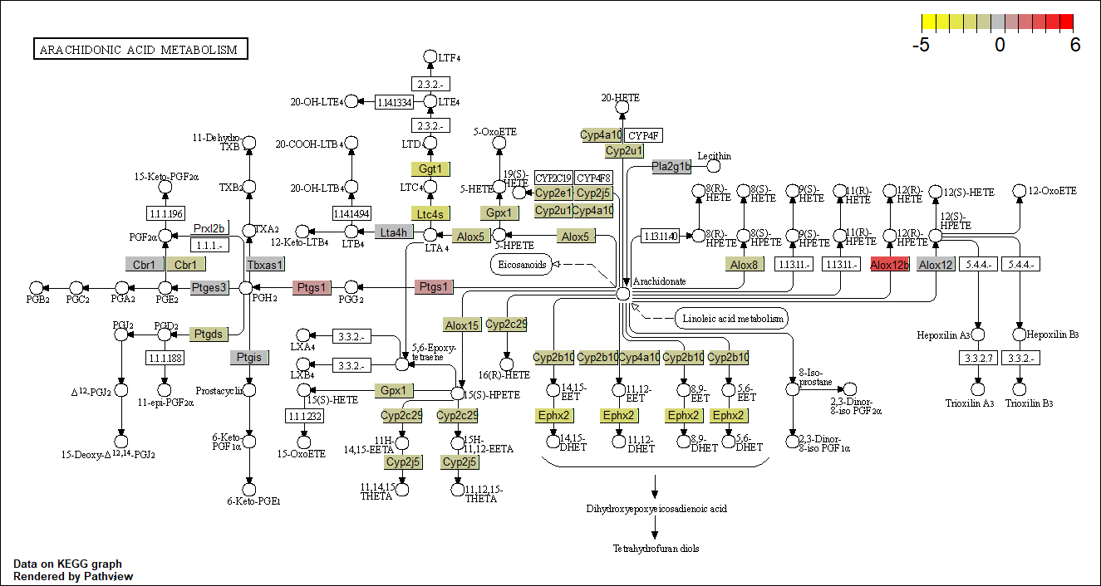
Diclofenac
Tr14-Traumeel
Supplemental Figure 6. Arachadonic Acid/prostaglandin/leukotriene pathway analysis of treatment-induced signaling changes at the 192 H timepoint.

