Slide 1
Supplementary Data

Slide 2
Table S1. Adverse events reported during the study. No grade 4 or 5 toxicities were observed.
Toxicity | Control n=21 |  | Experimental n=37
 | G1-2 | G3 | G1-2 | G3
Hematoma secondary to breast biopsy | 2 (9.5%) | 0 | 3 (8.1%) | 0
Bone pain | 0 | 0 | 10 (27.03%) | 0
Pain in the site of denosumab infusion | 0 | 0 | 3 (8.1%) | 0
Asthenia | 0 | 0 | 4 (10.81%) | 0
Chill | 0 | 0 | 2 (5.41%) | 0
Tooth infection | 0 | 0 | 1 (2.70)* | 0
* Outside the study follow-up period, at 11 months after denosumab infusion, the same patient presented osteonecrosis of the jaw (ONJ) requiring surgery. This was reported as a possible late adverse event related to denosumab, ONJ was classified as grade 3.
pg/ml
Figure S1. Serum biomarker carboxy-terminal collagen crosslinks (CTX): Levels of CTX in serum from patients collected at the time of biopsy (Serum A) and surgery (Serum B) in the control and experimental arms. p value T-test for comparison between experimental and control arm is shown in the upper left corner and p value T-test for paired samples is shown for each treatment group. N indicates the number of samples analyzed. Denosumab did not associate with a reduction in the serum levels of CTX .

Slide 3
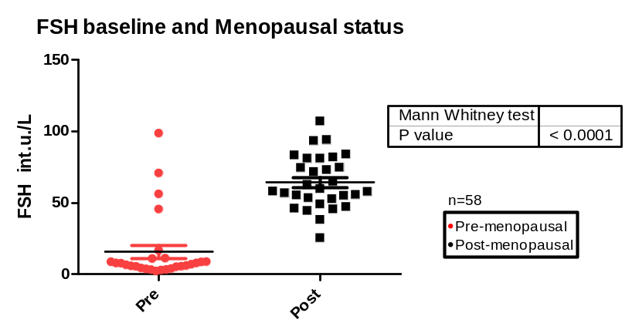
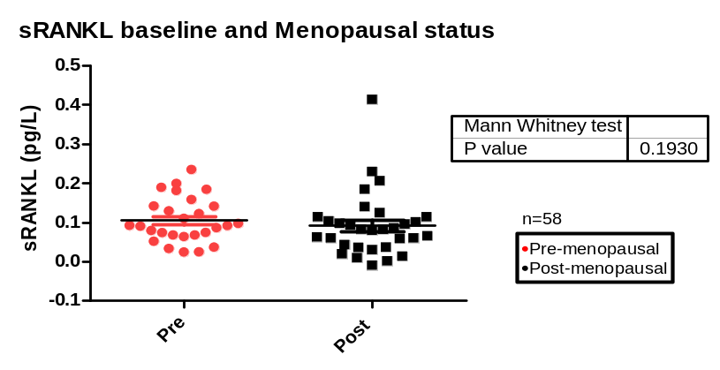
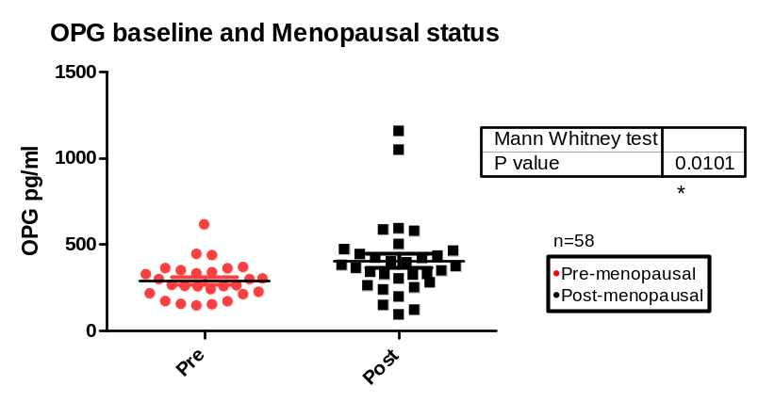
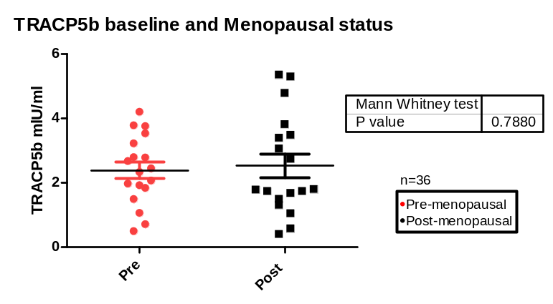
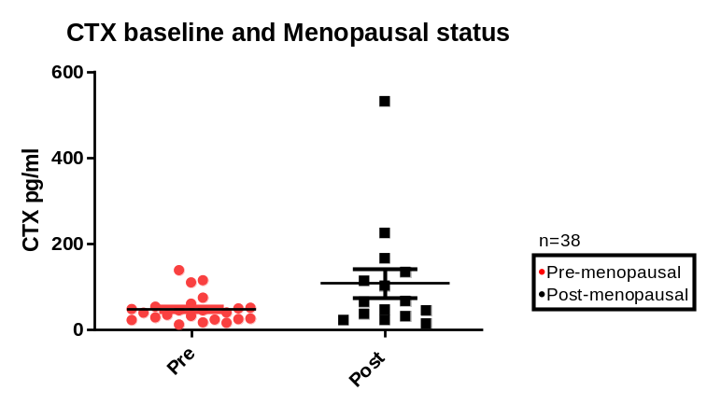
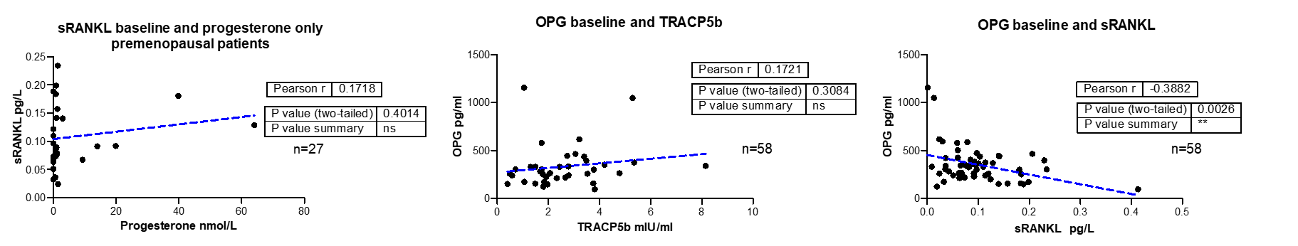
A
B
n=37
Figure S2. Baseline levels and correlations of serum follitropin (FSH), sRANKL, OPG, TRACP5b and CTX and menopausal status. A) Levels of FSH, sRANKL, OPG, TRACP-5b and CTX detected by ELISA, in serum from patients collected at the time of biopsy, attending to the menopausal status. Postmenopausal patients had higher FSH and OPG levels, while sRANKL and TRACP5b levels were comparable between pre- and post-menopausal women. Mann Whitney test p values are shown B) Correlations between levels of indicated markers in serum. Two tailed p values and Pearson r are shown, and n indicates total number of samples. There were no discernible associations observed between progesterone levels and sRANKL in premenopausal patients, and between OPG and TRACP5b. However, it is noteworthy that sRANKL levels exhibited an inverse relationship with OPG levels.

Slide 4
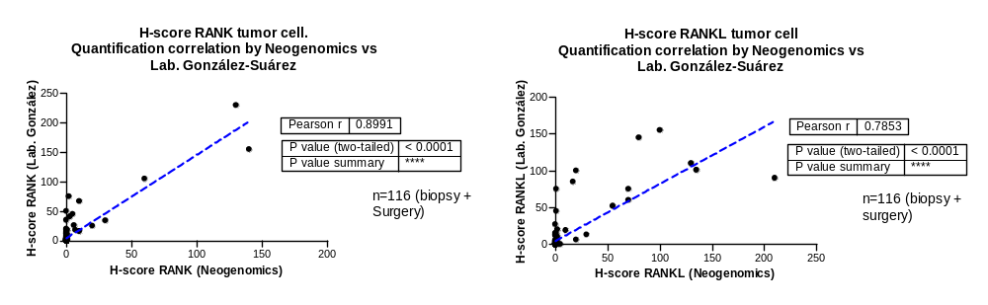
Table S2. Analysis by surrogate molecular subtype.
 | Luminal A-like (N=27) |  |  |  |  |  |  | Luminal B-like (N=21) |  |  |  |  |  |  | TNBC (N=10)
 | Control (N=8) |  |  | Experimental (N=19) |  |  | p-inter* | Control (N=9) |  |  | Experimental (N=12) |  |  | p-inter* | Control (N=4) |  |  | Experimental (N=6) |  |  | p-inter*
 | Biopsy | Surgery | p-value | Biopsy | Surgery | p-value |  | Biopsy | Surgery | p-value | Biopsy | Surgery | p-value |  | Biopsy | Surgery | p-value | Biopsy | Surgery | p-value
KI 67 (%) | 16.25 | 21.88 | 0.125 | 11.58 | 14.84 | 0.126 | 0.547 | 25.89 | 30.33 | 0.254 | 30.67 | 34.92 | 0.350 | 0.973 | 38.00 | 41.25 | 0.517 | 28.67 | 40.17 | 0.025 | 0.197
Cleaved Caspase- 3 (H-score) | 1.77 | 2.55 | 0.252 | 1.26 | 0.96 | 0.346 | 0.152 | 1.19 | 1.42 | 0.254 | 3.79 | 2.48 | 0.348 | 0.275 | 2.48 | 3.43 | 0.350 | 4.52 | 4.66 | 0.694 | 0.434
sRANKL (pg/L) | 0.10 | 0.11 | 0.775 | 0.10 | 0.00 | 0.000 | 0.004 | 0.08 | 0.12 | 0.069 | 0.10 | 0.00 | 0.000 | 0.000 | 0.14 | 0.11 | 0.282 | 0.08 | 0.00 | 0.028 | 0.118
OPG (pg/ml) | 327.35 | 320.48 | 0.556 | 308.15 | 311.54 | 0.690 | 0.472 | 384.57 | 326.29 | 0.135 | 301.32 | 311.78 | 0.468 | 0.097 | 570.52 | 472.91 | 0.286 | 440.48 | 497.97 | 0.061 | 0.129
TRACP5b (mlU/ml) | 2.39 | 2.98 | 0.342 | 1.63 | 2.34 | 0.102 | 0.870 | 3.23 | 3.48 | 0.680 | 2.70 | 2.58 | 0.223 | 0.546 | 2.75 | 1.97 | 0.034 | 3.40 | 2.95 | 0.316 | 0.437
*T-test for non-paired samples used for comparison between the experimental and control arms.
Table S3. Analysis by menopausal status only in luminal tumors
 | ER+ Pre-menopausal (N=26) |  |  |  |  |  |  | ER+ Post-menopausal (N=22)
 | Control (N=10) |  |  | Experimental (N=16) |  |  | p-inter* | Control (N=7) |  |  | Experimental (N=15) |  |  | p-inter*
 | Biopsy | Surgery | p-value | Biopsy | Surgery | p-value |  | Biopsy | Surgery | p-value | Biopsy | Surgery | p-value
KI 67 (%) | 20.50 | 29.40 | 0.031 | 18.69 | 22.81 | 0.244 | 0.338 | 22.57 | 22.00 | 0.668 | 19.27 | 22.40 | 0.199 | 0.177
Cleaved Caspase- 3 (H-score) | 1.47 | 2.33 | 0.109 | 3.15 | 1.71 | 0.169 | 0.050 | 1.45 | 1.42 | 0.898 | 1.26 | 1.38 | 0.689 | 0.686
sRANKL (pg/L) | 0.09 | 0.14 | 0.070 | 0.11 | 0.00 | 0.000 | 0.000 | 0.09 | 0.08 | 0.803 | 0.09 | 0.00 | 0.000 | 0.002
OPG (pg/ml) | 318.40 | 293.82 | 0.107 | 281.63 | 288.42 | 0.561 | 0.095 | 413.70 | 366.02 | 0.337 | 330.98 | 336.38 | 0.573 | 0.295
TRACP5b (mlU/ml) | 3.09 | 3.64 | 0.256 | 2.18 | 2.23 | 0.677 | 0.312 | 2.47 | 2.59 | 0.889 | 2.15 | 2.76 | 0.239 | 0.628
*T-test for non-paired samples used for comparison between the experimental and control arms.
Biopsy
Figure S3. Correlations between quantifications of RANK and RANKL expression in tumor cells (H-score). Quantifications were performed by Negenomics Laboratory (outsourced) and by Dr. González-Suárez's Laboratory. Pearson r and two tailed p value are indicated. Similar results observed in both quantifications.

Slide 5
A
B
C
D
Figure S4. Correlation analysis between RANK/RANKL expression in tumor (A,B) or stroma (C,D) and clinicopathological parameters exclusively in luminal tumors using Pearson's correlation coefficient. RANK expression in stroma cells positively correlates with high Ki67 levels, and a positive correlation between RANKL expression in the stroma and TILs was observed.

Slide 6
A
B
H-Score
H-Score
C
D
H-Score
H-Score
Figure S5: RANK and RANKL expression (H–scores) in tumor and stroma. RANK and RANKL expression (H-Score) detected by IHC in tumor cells and stroma at the diagnostic biopsy (biopsy) and in the surgical specimen (surgery) in the control and experimental arm. p value T-test for comparison between experimental and treatment arm is shown in the upper left corner and p value T-test for paired samples is shown for each treatment group. N indicates the number of samples analyzed. No significant changes in the expression of RANK and RANKL were observed between biopsy and surgery.

