Slide 1
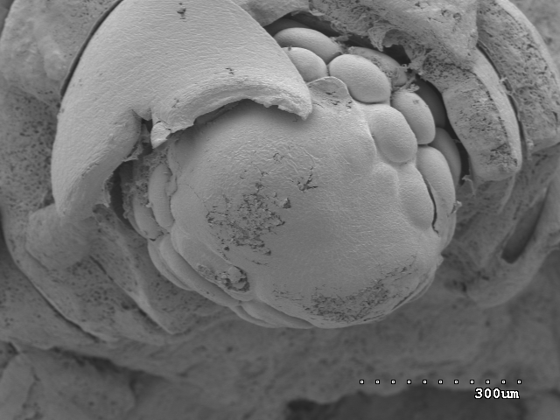
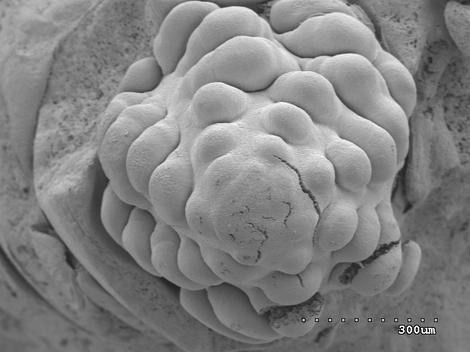
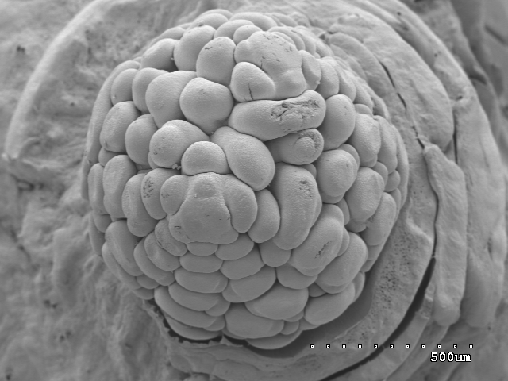
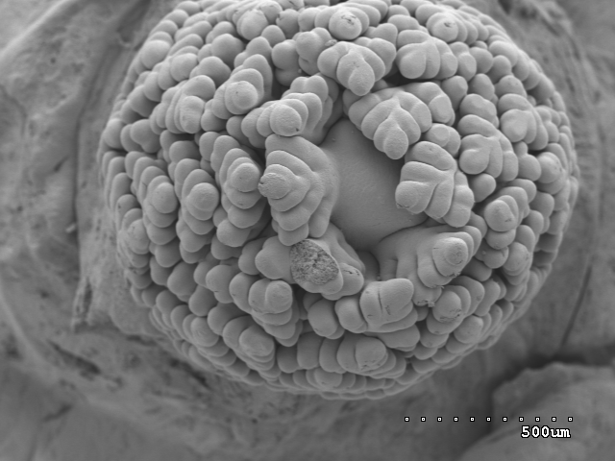
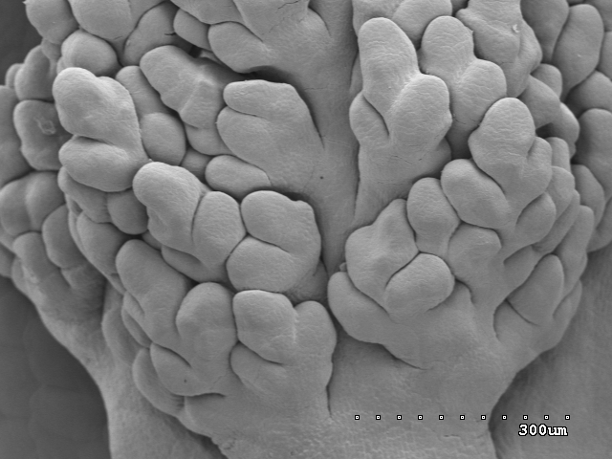
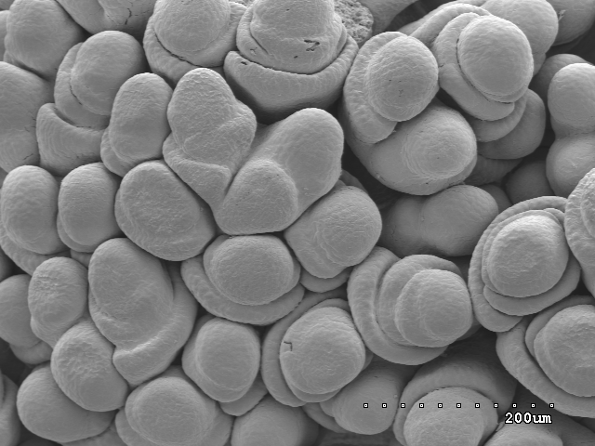
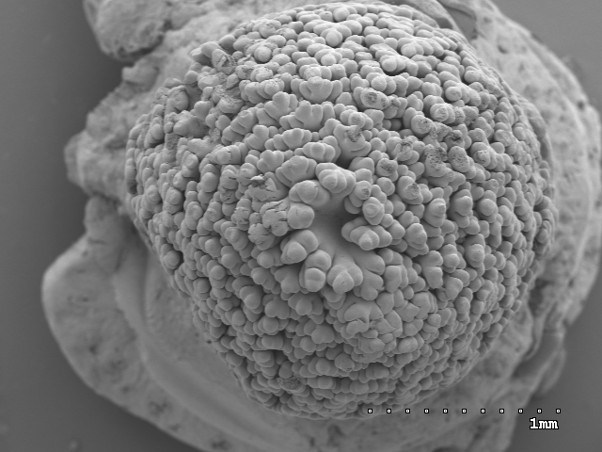
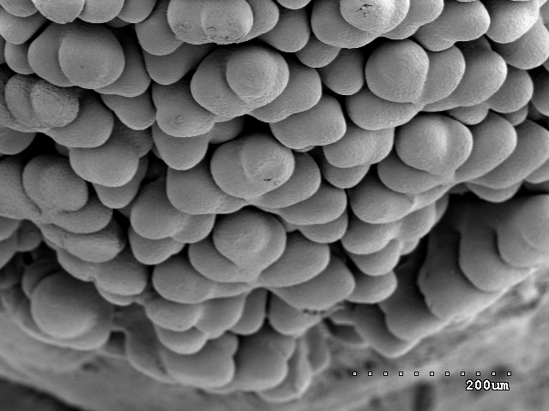
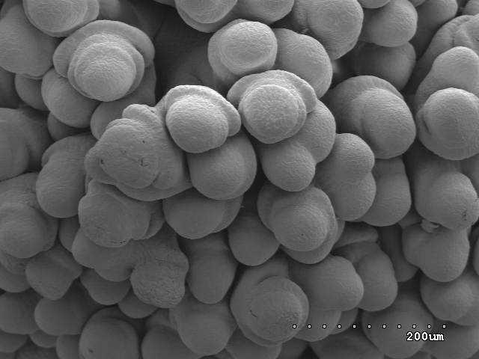
a
b
c
fb
im
fb
im
sb
Dgs
Dgs
Dgs
d
e
f
l
sb
ig
og
sm
fb
ig
tb
og
Dgs
Dgs
sb
Dgs
g
h
fb
i
og
sm
Jin5
Jin5
Jin5
Fig. S1 Scanning electron micrographs of branch differentiation and spikelet differentiation in Dgs and Jin5. a-b, first branch differentiation in Dgs; c, the initiation of second branch differentiate from base to top in Dgs; d and g, second branch differentiated from base to top in Dgs (d) and in Jin5 (g); e and h, third branch differentiated in Dgs (e) and in Jin5 (h); f and i, spikelet differentiated in Dgs (f) and in Jin5 (i). fb, first branch; sb, second branch; tb, third branch; im, inflorescence meristem; sm, spikelet meristem; og, out glume; ig, inner glume; l, lemma primordium. Scale bars= 200 μm (f, h, i), 300 μm (a-b, e), 500 μm (c, d) and 1mm (g).

Slide 2
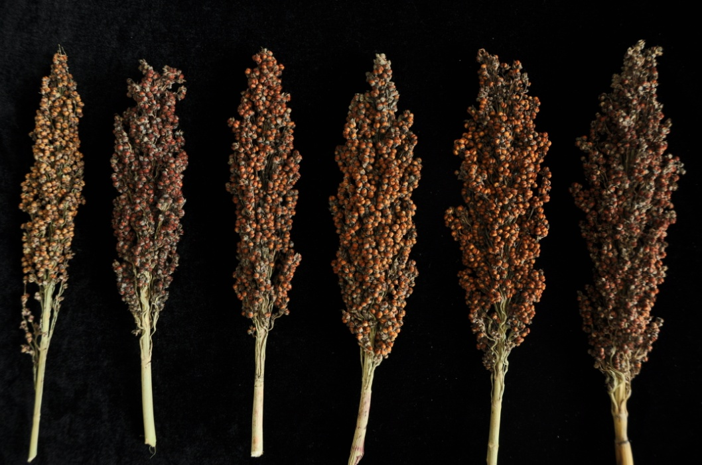
Individual panicles from F₁ population derived from Jin5ｘDgs
Fig. S2 The typical phenotype of panicles from F₁ population derived from Jin5 ｘDgs at mature stage

