Slide 1
Supplemental Data 1. Patient characteristics
Characteristics | All patients (n = 99)
Age, median (range) | 70 (40–88)
Male/female, n (%) | 72 (72.7)/27 (27.3)
Most recent cancer stage, n (%)
I ª | 7 (7.1)
II ª | 8 (8.1)
IIIA ª | 7 (7.1)
IIIB | 9 (9.1)
IIIC | 1 (1.0)
IVA | 33 (33.3)
IVB | 34 (34.3)
Histology at diagnosis, n (%)
Adenocarcinoma | 65 (65.7)
Squamous cell carcinoma | 21 (21.2)
Pleomorphic carcinoma | 3 (3.0)
Large cell carcinoma | 1 (1.0)
Non-small cell lung carcinoma | 4 (4.0)
Not specified | 5 (5.1)
PD-L1 status, n (%)
TPS < 1 % | 39 (39.4)
TPS 1–49 % | 22 (22.2)
TPS ≥ 50 % | 34 (34.3)
Unknown | 4 (4.0)
Line of therapy, n (%)
1 | 70 (70.7)
2 | 18 (18.2)
≥3 | 11 (11.1)
Regimen, n (%)
ICI+Chemotherapy | 43 (43.4)
ICI | 26 (26.3)
Chemotherapy | 30 (30.3)
Driver mutation, n (%)
EGFR | 10 (10.1)
ALK | 0 (0.0)
ROS-1 | 2 (2.0)
BRAF | 2 (2.0)
Negative/Unknown | 85 (85.9)
Abbreviations: PD-L1, programmed cell death/programmed cell death ligand-1; TPS, tumor proportion score; ICI, immune checkpoint inhibitor; EGFR, epidermal growth factor receptor; ALK, anaplastic lymphoma kinase.
ª Patients were enrolled after post-operative recurrence.

Slide 2
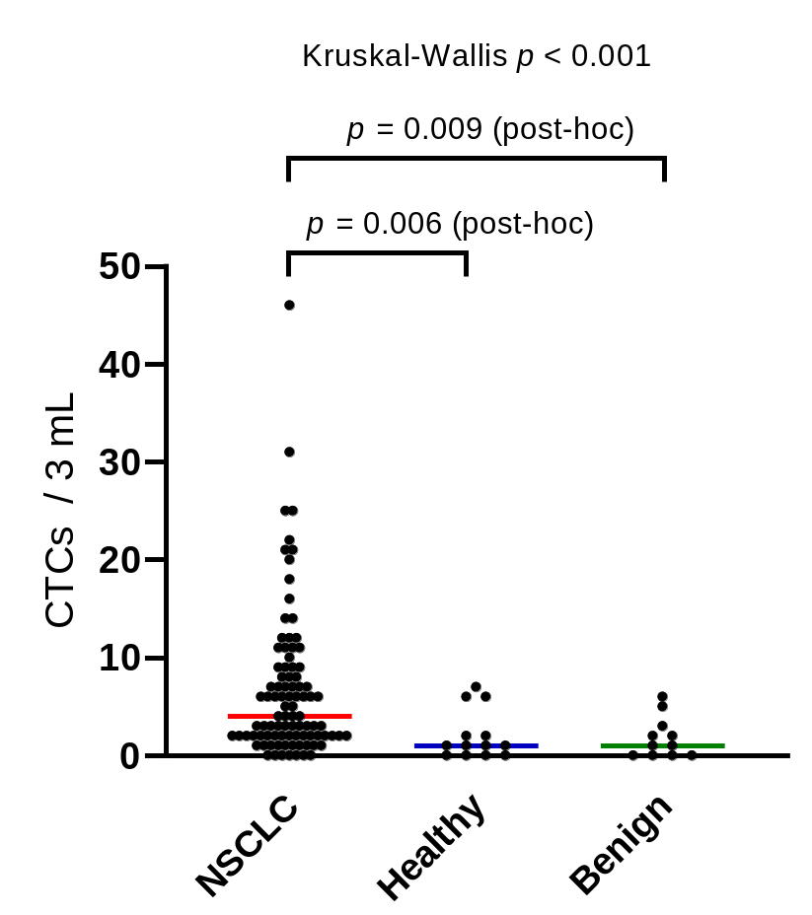
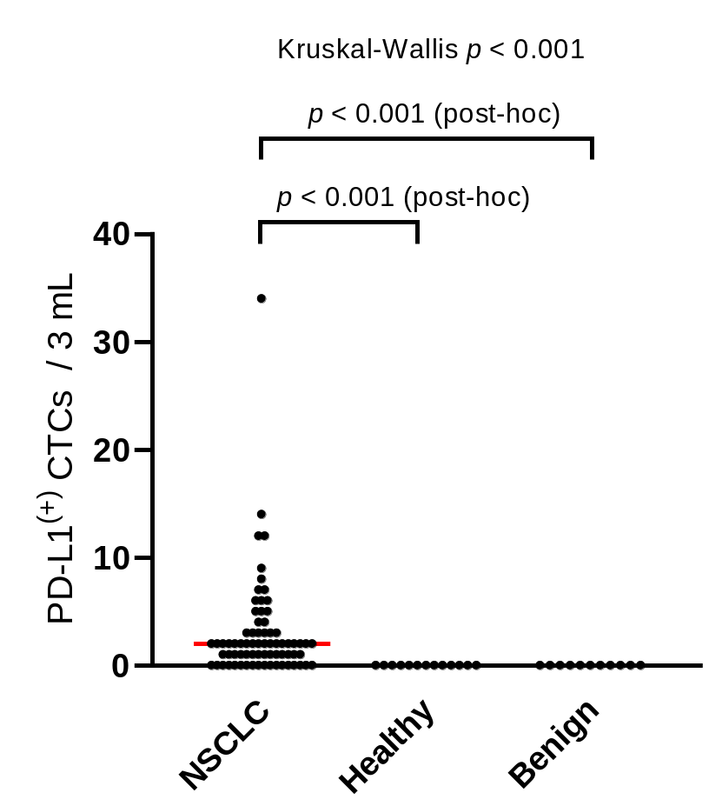
A)
B)
Supplemental Data 2. Comparison of circulating tumor cells (CTCs) between non-small-cell lung cancer (NSCLC) patients and control individuals.
The total CTC counts (A) and programmed death-ligand 1 (PD-L1)(+) CTC counts (B) of patients with NSCLC were significantly higher than those of healthy individuals and patients with non-carcinomatous lung disease. P-values were calculated using the Kruskal–Wallis test and post-hoc analysis (Dunn–Bonferroni test).

Slide 3
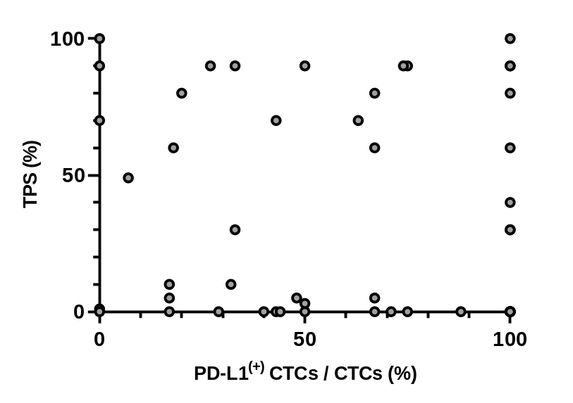
Rs = -0.003
p = 0.982
Supplemental Data 3. Concordance between programmed death-ligand 1 (PD-L1) expression in tumor biopsy and circulating tumor cells (CTCs).
To calculate %tumor proportion scores (%TPS), PD-L1 expression levels in lung tumor tissues were routinely evaluated by using the FDA-approved Dako PD-L1 immunohistochemistry 22C3 pharmDx assay. The x-axis reveals the %TPS of individual tumor biopsy samples, and the y-axis shows the corresponding %PD-L1(+) CTC among all CTC counts. Rs and p-values were calculated using the Spearman correlation coefficient.

Slide 4
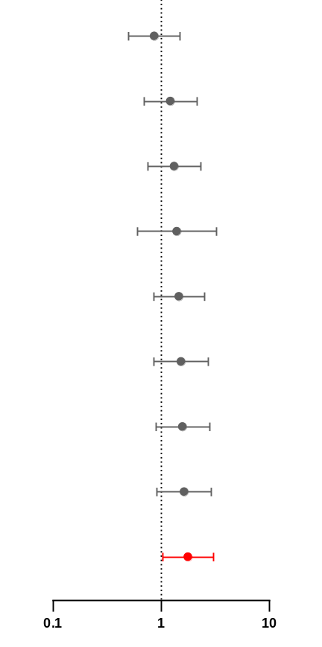
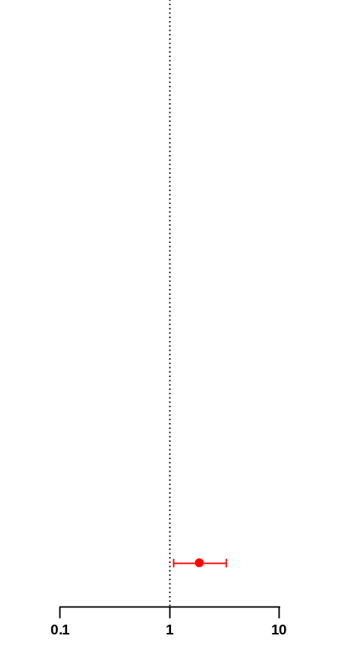
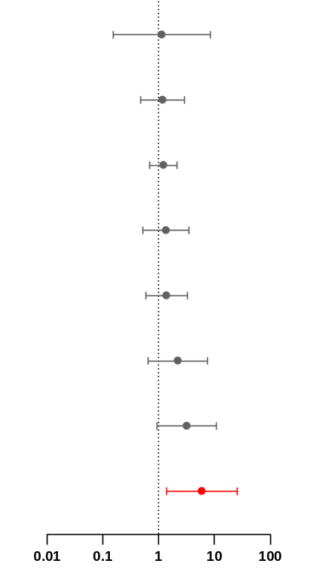
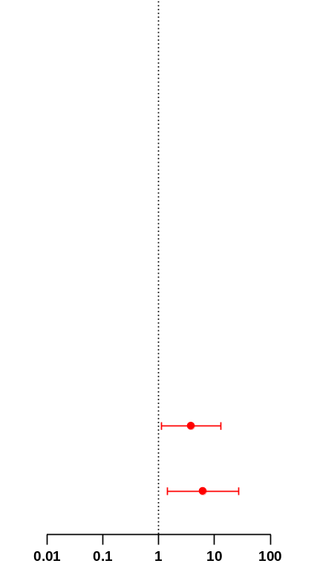
A)
 |  | Univariate analysis ª
Characteristics | Patient (n) | HR (95%CI) | P value
Histology at diagnosis
Adenocarcinoma | 61
Squamous cell carcinoma/Others | 31 | 0.867 (0.500-1.502) | 0.609
Regimen
ICI+Chemotherapy / ICI | 65
Chemotherapy | 27 | 1.221 (0.694-2.150) | 0.488
PD-L1 status
TPS ≥ 50% | 30
TPS < 50% | 59 | 1.326 (0.753-2.334) | 0.328
Driver mutation
EGFR / ALK / ROS-1 / BRAF | 12
Negative / Unknown | 80 | 1.400 (0.601-3.260) | 0.435
Line of therapy
1 | 64
≥2 | 28 | 1.465 (0.856-2.507) | 0.164
Stage
I, II, III | 30
IV | 62 | 1.533 (0.856-2.744) | 0.151
Age
<65 | 25
≥65 | 67 | 1.580 (0.892-2.799) | 0.117
Sex
Female | 25
Male | 67 | 1.632 (0.909-2.929) | 0.101
CTC
≤2 | 34
≥3 | 58 | 1.778 (1.034-3.057) | 0.038
Forest plot
Multivariate analysis ^{b}
HR (95%CI) | P value
1.879 (1.080-3.271) | 0.026
Forest plot
B)
 |  | Univariate analysis ª
Characteristics | Patient (n) | HR (95%CI) | P value
Driver mutation
EGFR / ALK / ROS-1 / BRAF | 4
Negative / Unknown | 60 | 1.143 (0.153-8.567) | 0.896
Stage
I, II, III | 25
IV | 39 | 1.182 (0.475-2.940) | 0.719
Regimen
ICI+Chemotherapy / ICI | 65
Chemotherapy | 27 | 1.221 (0.694-2.150) | 0.334
PD-L1 status
TPS ≥ 50 % | 20
TPS < 50 % | 42 | 1.354 (0.524-3.499) | 0.532
Histology at diagnosis
Adenocarcinoma | 40
Squamous cell carcinoma / Others | 24 | 1.383 (0.582-3.279) | 0.463
Age (years)
<65 | 17
≥65 | 47 | 2.222 (0.651-7.582) | 0.202
Sex
Female | 20
Male | 42 | 3.202 (0.932-11.00) | 0.065
CTC
≤2 | 25
≥3 | 39 | 5.961 (1.375-25.85) | 0.017
Forest plot
Multivariate analysis ^{b}
HR (95%CI) | P value
3.829 (1.114-13.17) | 0.033
6.244 (1.436-27.16) | 0.015
Forest plot
Supplemental Data 4. Prognostic outcome of circulating tumor cells (CTCs) measurement evaluated by Cox proportional hazards model.
Multivariate analysis revealed that the baseline CTC count (≥3 cells) was an independent prognostic factor for A. progression-free survival (hazard ratio (HR) 1.879, 95 % confidence interval (CI) 1.080–3.271, p = 0.026) and B. overall survival (HR 6.244, 95% CI 1.436–27.16, p = 0.015). HR, hazard ratio; CI, confidence interval
ª Univariate analyses were performed using the Cox proportional hazard model.
^{b} Multivariate analyses were performed using the Cox proportional hazard model (forward stepwise).

Slide 5
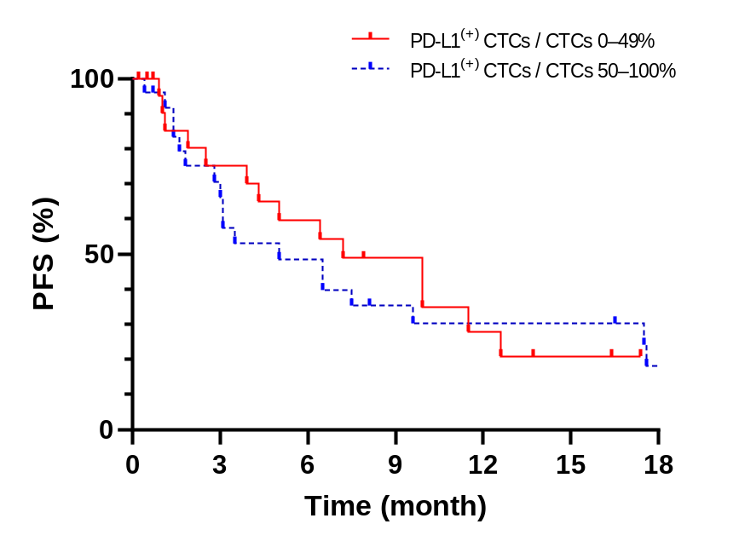
p = 0.842
HR 1.075 (0.524-2.207)
PD-L1⁽⁺⁾ CTCs / CTCs 0%–49%
PD-L1⁽⁺⁾ CTCs / CTCs 50%–100%
No. at risk
24 15 11 7 4 2 0
25 16 11 7 6 6 3
Supplemental Data 5. Association of programmed death-ligand 1 (PD-L1) positive ratio of circulating tumor cells (CTCs) with PFS in patients treated with regimens, including immune checkpoint inhibitors (ICIs).
High PD-L1 expression ratio of CTCs (≥50 %) was not associated with prolonged PFS in patients treated with regimens including ICIs. P-values were calculated using the log-rank test. Hazard ratios (HRs) were calculated using the Cox proportional hazards model.

Slide 6
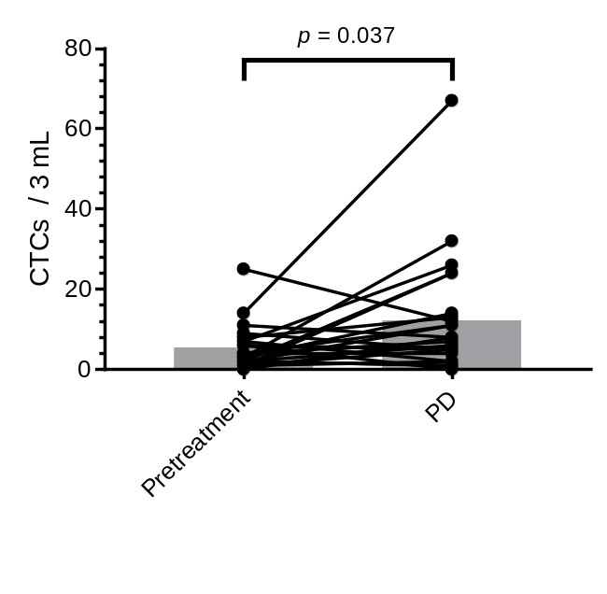
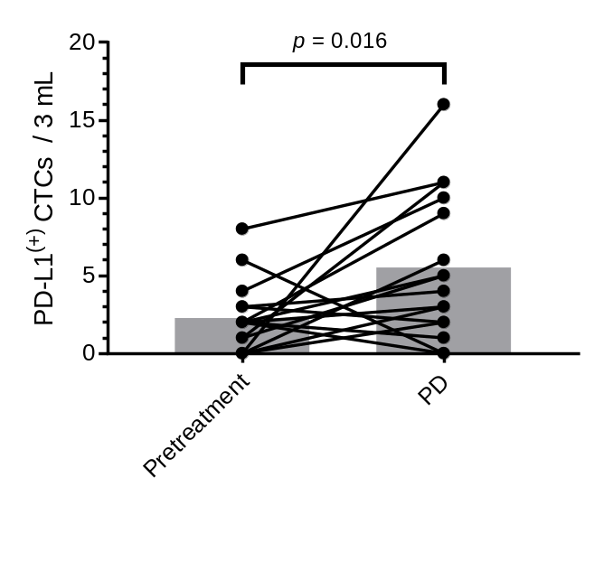
A)
B)
Supplemental Data 6. Dynamic monitoring of circulating tumor cell (CTC) counts until progressive disease.
A: CTC counts and B: programmed death-ligand 1 (PD-L1)(+) CTC counts before and after disease progression. P-values were calculated using the Wilcoxon signed-rank test.

