Slide 1
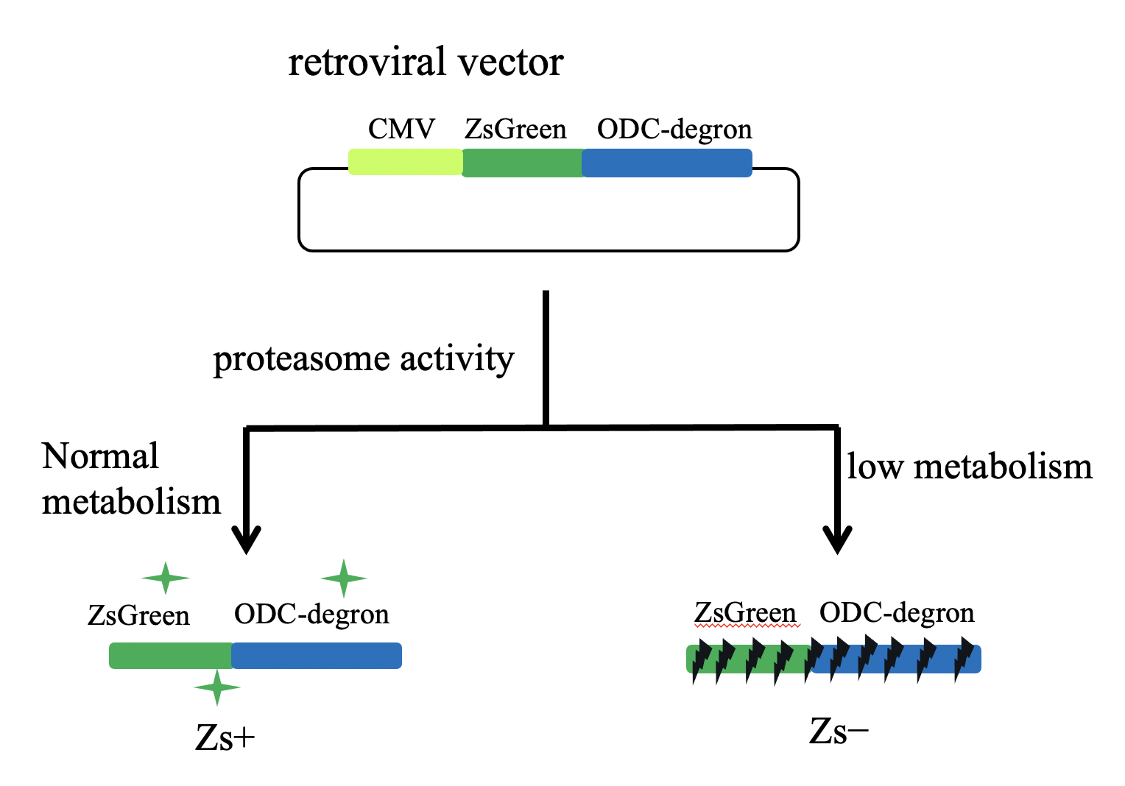
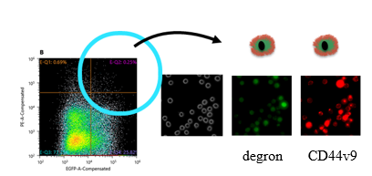
Supplement Fig. 1
A
B

Slide 2
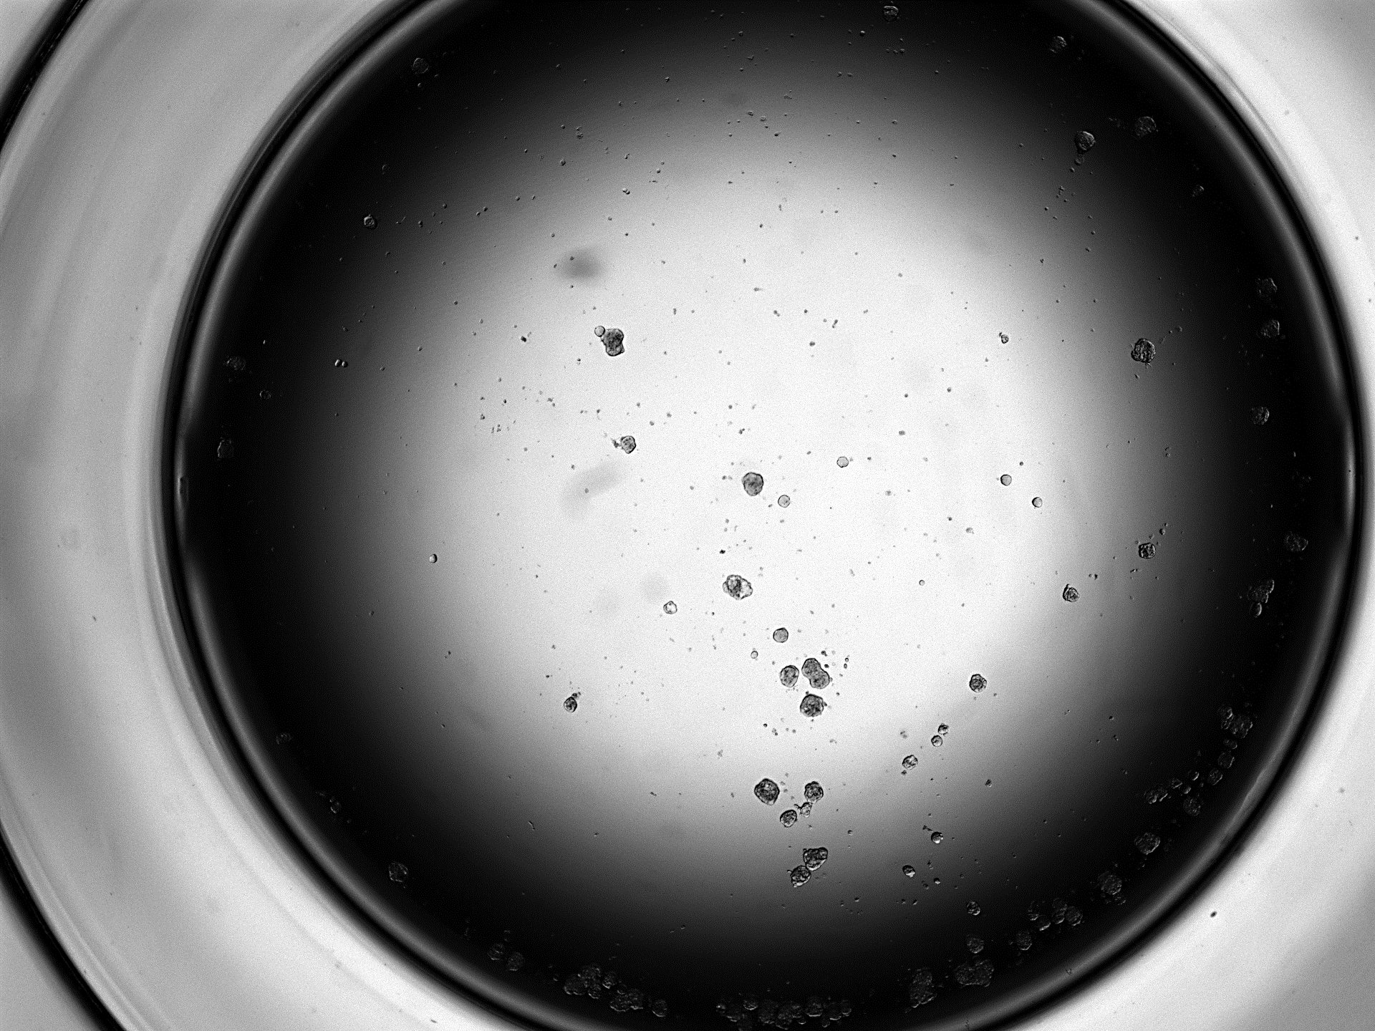
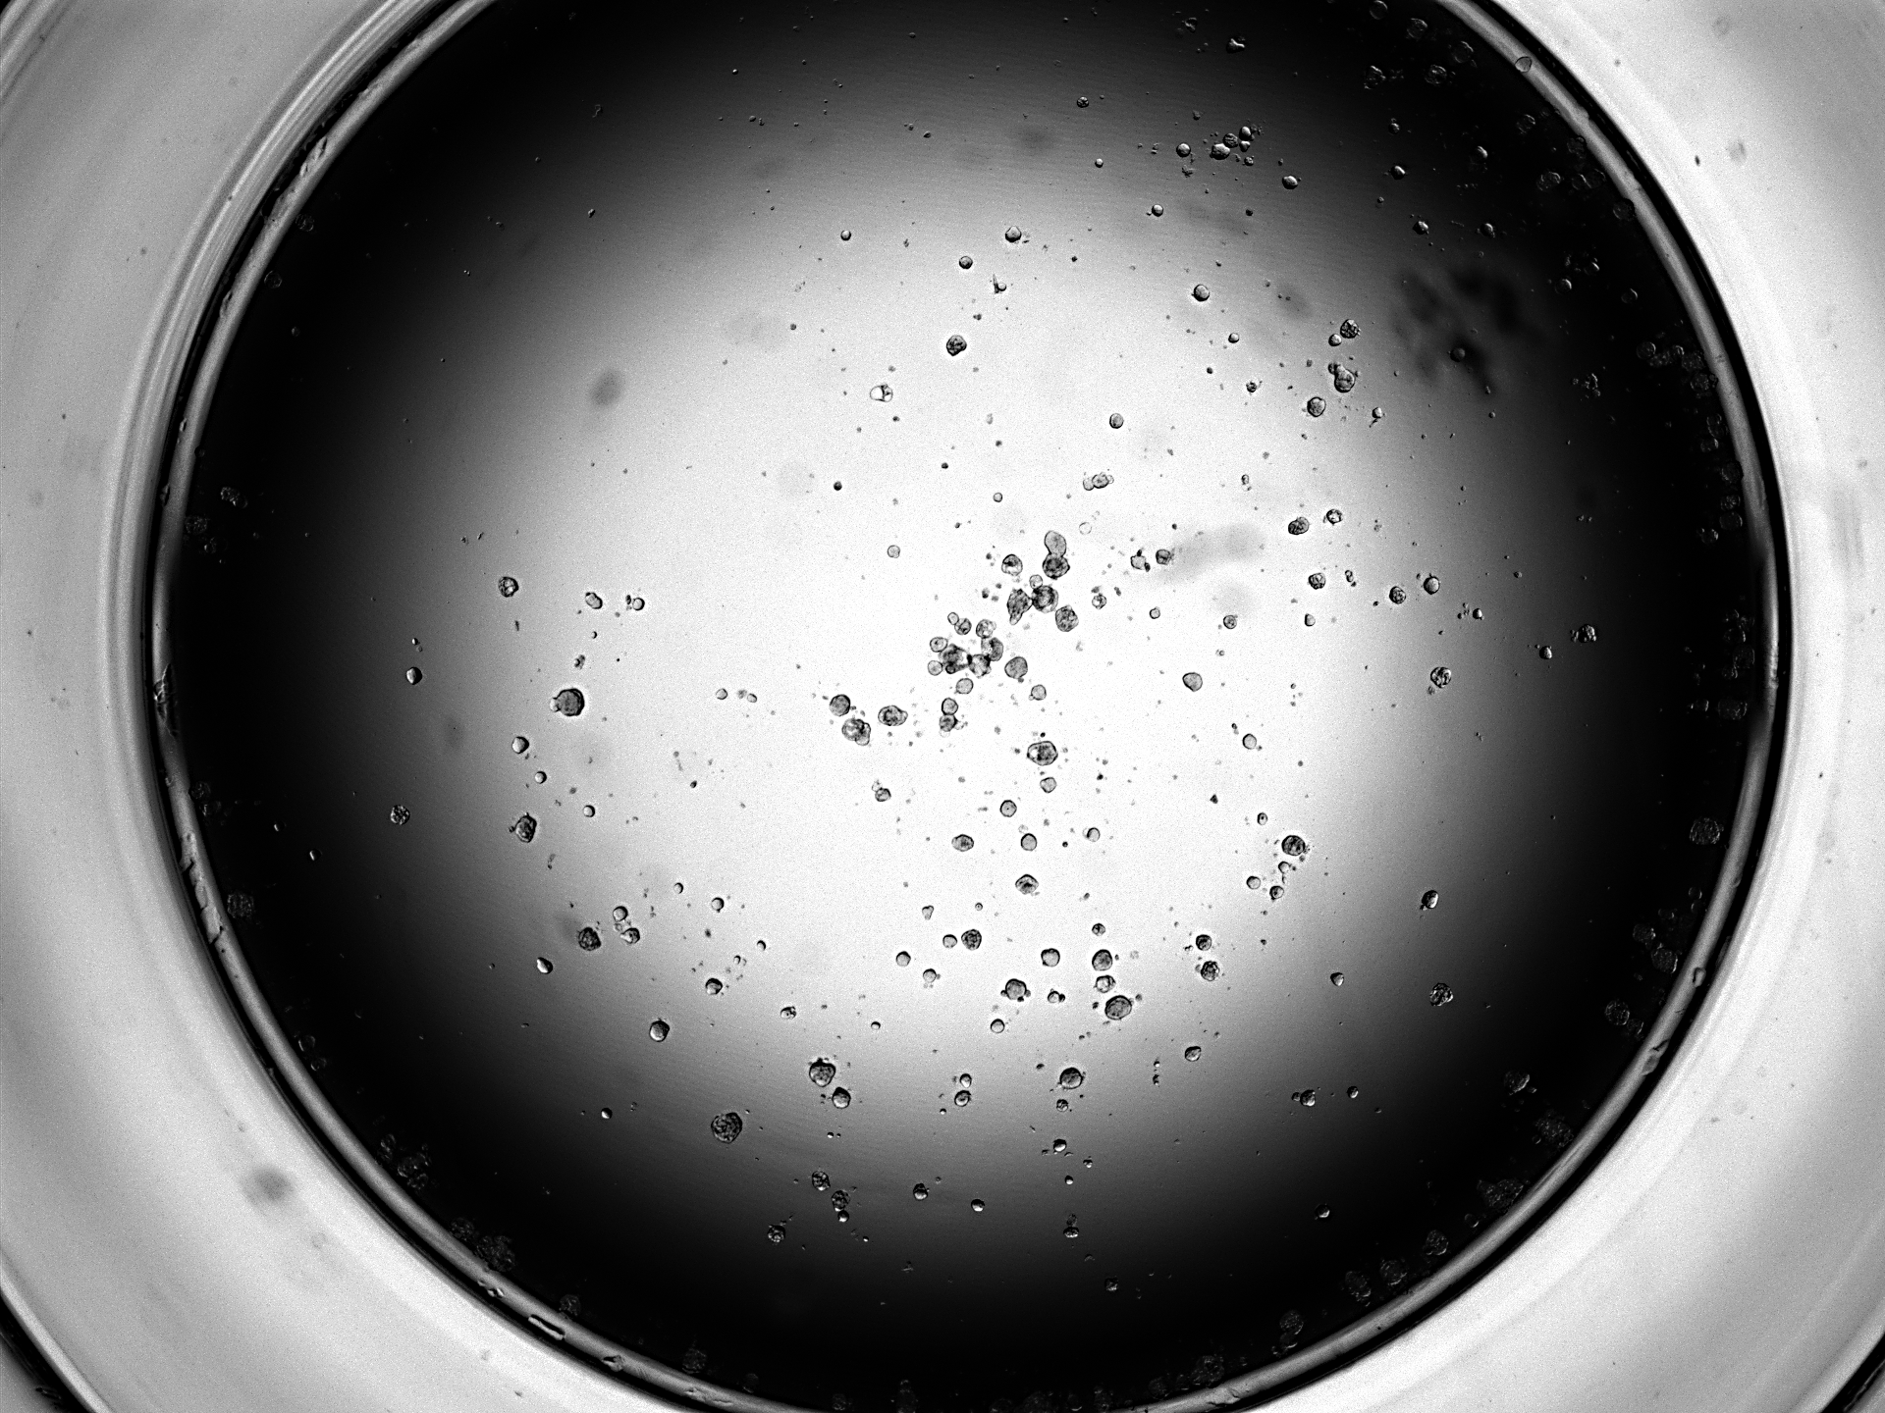
Supplement Fig. 2
Number of spheroids (>100μm)
*
A
Parent
LP/CD44⁺
B
* *
* *
CD24 (normalized to GAPDH)
CD133 (normalized to GAPDH)
* *
CXCR4 (normalized to GAPDH)
C
Oxaliplatin
Gemcitabine
Cell viability (% of control)
Cell viability (% of control)
*
*
**
*
(μM)
(ng/mL)

Slide 3
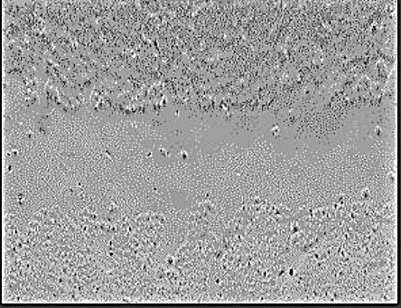
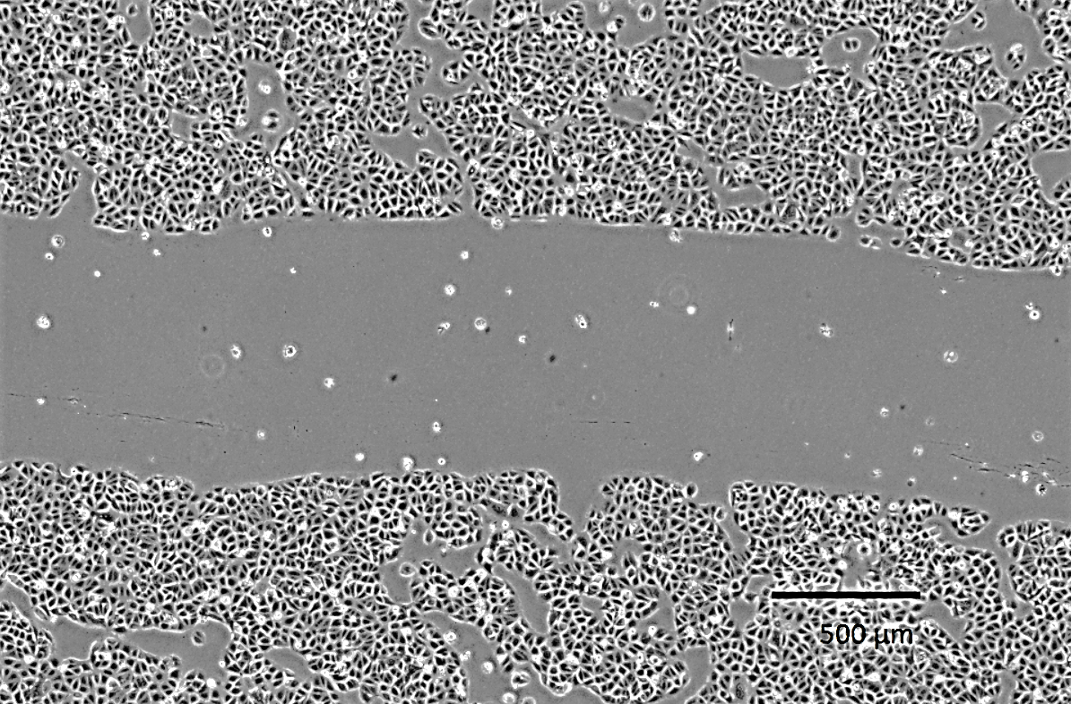
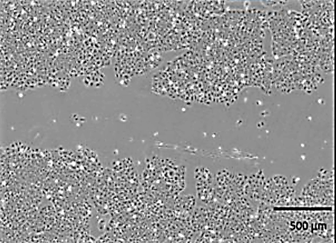
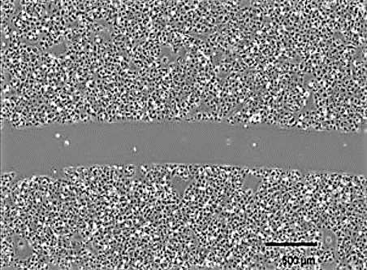
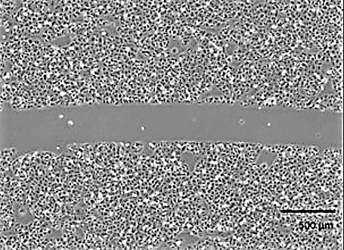
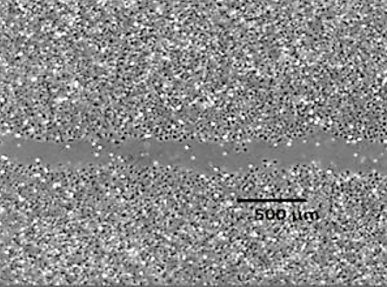
Supplement Fig. 3
A
Parent
LP/CD44+
0h
% of scratch area
*
24h
48h
B
* *
LY6D (normalized to GAPDH)
LP/CD44+

