Slide 1
Supplementary Figures S1 to S3
Nature Article type: Articles
Title: ‘Roly-poly toy’ motion during pollen exudation promotes rapid pollen adhesion in rice
Authors:
Hiroshi Wada^{1, 2†, *}, Yuto Hatakeyama^{1, 2†}, Rosa Erra-Balsells³, Takumi Muneta¹, Hiroshi Nonami¹, Hikari Ueda^{1,4,5}, Yoko Yamaga-Hatakeyama¹, Naoya Miyashita¹, and Takuya Araki¹
Affiliations:
¹Graduate School of Agriculture, Ehime University, 3-5-7 Tarumi, Matsuyama, Ehime 790-8566, Japan
²Kyushu Okinawa Agricultural Research Center, National Agriculture and Food Research Organization, 496 Izumi, Chikugo, Fukuoka 833-0041, Japan
³Department of Organic Chemistry and CIHIDECAR-CONICET, University of Buenos Aires, Buenos Aires 1428, Argentina
⁴Sumika Agrotech Corporation Ltd., 2370-4 Nobushima, Oyama, Tochigi 323-0152, Japan
⁵The United Graduate School of Agricultural Sciences, Ehime University, Matsuyama, Ehime 790-8566, Japan
†These authors contributed equally to this work.

Slide 2
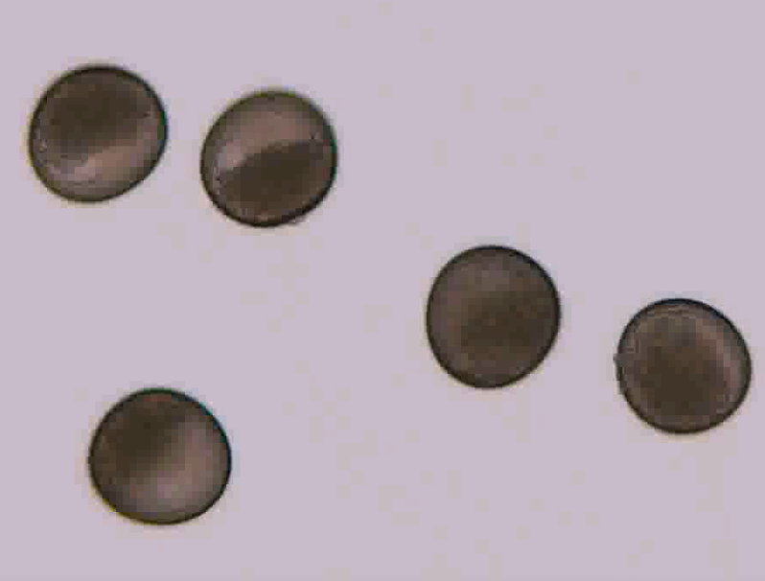
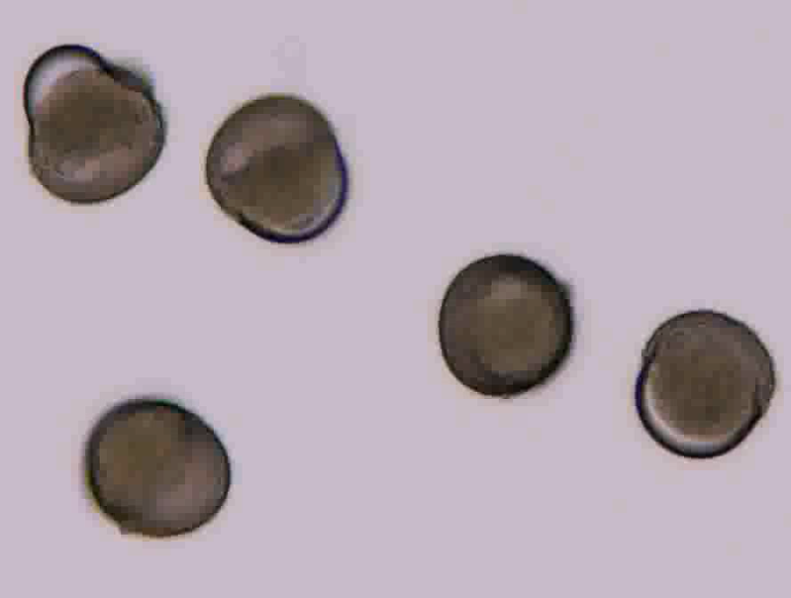
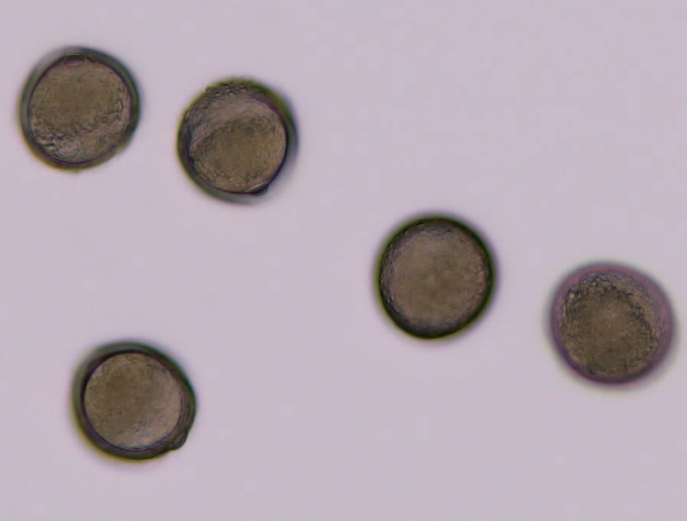
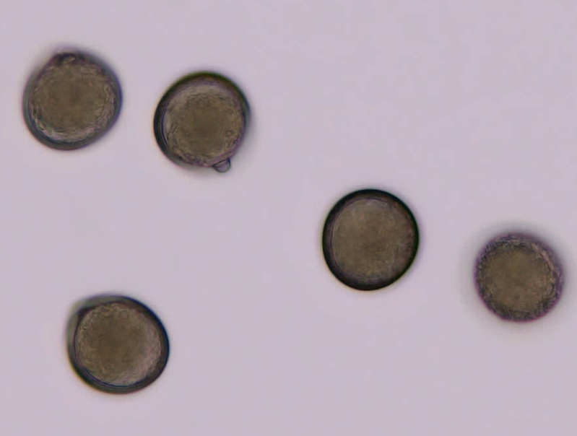
A
B
C
T = 20 s
T = 30 s
D
E
T = 25 s
T = 102 s
T = 340 s
Figure S1. In A, typical image taken at the beginning of exudation observed at 25 s after dipping into the microscopic immersion oil Type A. Numerous exudates are shown in the top and left pollen grains. In B-E, time-course images of pollen grains at 20 s, 30 s, 102 s, and 340 s after dipping into the same oil over time. At 30 s, numerous exudates merged to be large volume of exudate(s) (C). The arrowheads and arrows indicate exudates being eluted from the pollen grains and elongating tube, respectively. Note that rice pollen grains exhibited polarity (see B-D) prior to pollen exudation and the localisation of vacuoles was observable at the exactly opposite side of starch granules located in each grain, where the germination aperture is localised. Bars in A-E show 50 μm.

Slide 3

HV
anther
Orbitrap mass spectrometer
*exudates
*
*
ca. 25 s
Piezo-manipulator
mounted on 3D move/rotation micro-manipulator
Orifice
stigmatic papillae cells
180º
rotation
stigma
attached spikelet
Vibration free table
STEP 1 STEP 2 STEP 3 STEP 4
Pollination
Nanolitre fluid
collection
Reorientation of
the probe tip
picoPPESI-MS analysis
Figure S2. Illustrated workflow of artificial self-pollination, instantly followed by on-site real-time picoPPESI-MS analysis in picolitre fluids exudated from pollen grains. Also, see Supplementary Video S2.

Slide 4
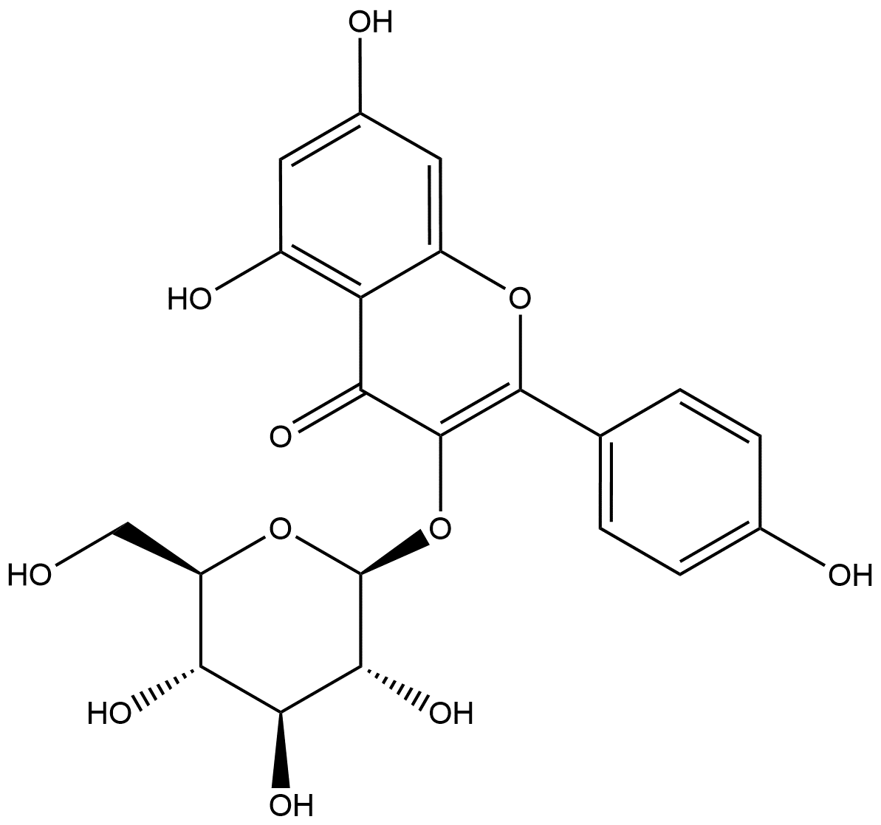
A
(3.99E+5)
327.05
100
MS/MS
90
[Astragalin-H]⁻
80
447.09
70
327.05
-120(C₄H₈O₄)
357.06
60
Relative Intensity (%)
-120(C₄H₈O₄)
50
40
-90(C₃H₆O₃)
30
20
357.06
-90(C₃H₆O₃)
387.07
429.08
10
285.04
369.06
-18 (H₂O)
0
339.05
411.07
B
447.09
1000
MS/MS
327.05
800
357.06
600
Intensity
400
429.08
200
285.04
387.06
0
0
100
200
300
400
500
m/z
Figure S3.1. (A) PicoPPESI-MS/MS negative ion mode spectrum of a putative Astragalin-related peak ([M-H]⁻, m/z 447.09) obtained from the rice stigma tissue extracts (see Materials and Methods). Fragmentation was induced with a 25 % normalized collision energy. (B) MS/MS spectrum for Astragalin from Thing Metabolome Repository data bank (http://metabolites.in/things/peak/221023/neg/4093). According to the MS/MS spectrum in A, the precursor ion was identified to be [Astragalin-H]⁻ (see Fig. S3.2 for the chemical identification).

Slide 5
A
**
(3.99E+5)
327.05
100
MS/MS
-120(C₄H₈O₄)
80
**
*
-90(C₃H₆O₃)
[Astragalin-H]⁻
327.05
-120(C₄H₈O₄)
357.06
60
447.09
Relative Intensity (%)
40
*
20
357.06
-90(C₃H₆O₃)
429.08
285.04
339.05
369.06
387.07
411.07
-18 (H₂O)
B
0
(1.47E+4)
MS/MS/MS
339.05
100
80
-72(C₃H₄O₂)
-60(C₂H₄O₂)
60
-46(CH₂O₂)
297.04
-60(C₂H₄O₂)
Relative Intensity (%)
297.04
-30 (CH₂O)
-18 (H₂O)
40
285.04
-72(C₃H₄O₂)
285.04
357.06
-90(C₃H₆O₃)
311.06
357.06
-90(C₃H₆O₃)
20
327.05
0
357.06
C
(6.40E+3)
MS/MS/MS
299.06
100
327.05
-43 (C₂H₃O)
299.06
-28(CO)
80
-28(CO)
60
Relative Intensity (%)
327.05
-120(C₄H₈O₄)
327.05
-120(C₄H₈O₄)
40
284.03
-43(C₂H₃O)
20
284.03
0
150
200
250
300
350
400
450
500
m/z
Figure S3.2. (A) PicoPPESI-MS/MS negative ion mode spectrum of a putative Astragalin-related peak ([M-H]⁻, m/z 447.09) obtained from the rice stigma tissue extracts (see Materials and Methods). Fragmentation was induced with a 25 % normalized collision energy. (B) picoPPESI-MS/MS/MS negative ion mode spectrum of m/z 357.06 (*) generated from fragmentation of a putative Astragalin-associated m/z 447.09 signal. Rearrangement possibilities of H from –HO group is indicated in red. (C) picoPPESI-MS/MS/MS negative ion mode spectrum of m/z 327.05 (**) generated from fragmentation of another putative Astragalin-associated m/z 447.09 signal. Fragmentation in (B) and (C) was both induced with a 40% collision energy. According to the MS/MS and MS/MS/MS spectra in A-C, together with Fig. S3.1, the precursor ion observed at m/z 447.09 was identified as [Astragalin-H]⁻.

Slide 6
A
(1.20E+5)
489.10
[Sambicyanin-2H]⁻
100
MS/MS
90
579.13
80
459.09
-120(C₄H₈O₄)
-210
-180
-150
-120 (C₄H₈O₄)
70
-90(C₃H₆O₃)
60
-CH₂O
-CH₂O
-CH₂O
-CH₂O
-60(C₂H₄O₂)
Relative Intensity (%)
50
519.11
-60(C₂H₄O₂)
489.10
-90(C₃H₆O₃)
40
519.11
30
519.11
-60(C₂H₄O₂)
20
399.07
-18 (H₂O)
10
-30(CH₂O)
369.06
459.09
561.12
429.08
0
B
579.14
1000
MS/MS
800
459.10
600
Intensity
400
489.11
200
369.06
0
0
100
200
300
400
500
600
m/z
Figure S3.3. (A) PicoPPESI-MS/MS negative ion mode spectrum of a putative Sambicyanin-related peak ([M-2H]⁻, m/z 579.13) obtained from the rice stigma tissue extracts (see Materials and Methods). Fragmentation was induced with a 25 % normalized collision energy. (B) MS/MS spectrum for Sambicyanin ([M-2H]⁻) from Thing Metabolome Repository data bank (http://metabolites.in/things/peak/221001/neg/7488). According to the MS/MS spectrum, the precursor ion was identified as [Sambicyanin-2H]⁻.

Slide 7
A
(1.88E+4)
[Astragalin+Cl]⁻
100
MS/MS
423.01
483.04
90
-156
80
-138
70
-90(C₃H₆O₃)[1]
-78(C₂H₃ClO)[2]
60
-60(C₂H₄O₂)-18(H₂O)[3]
50
-60(C₂H₄O₂)[4]
Relative Intensity (%)
405.00
466.99
485.02
40
30
422.01
20
404.00
-16
10
327.00
344.96
392.99
0
B
(9.02E+3)
MS/MS
404.99
100
90
404.00
422.01
483.04
80
70
423.00
-156
60
-138
50
or
-90(C₃H₆O₃)[1]
Relative Intensity (%)
-78(C₂H₃ClO)[2]
40
-60(C₂H₄O₂)-18(H₂O)[3]
485.02
30
-60(C₂H₄O₂)[4]
20
405.00
-78(C₂H₃ClO)
392.99
466.99
10
327.00
-16
344.96
0
140
160
180
200
220
240
260
280
300
320
340
360
380
400
420
440
460
480
500
m/z
Figure S3.4. (A) PicoPPESI-MS/MS negative ion mode spectrum of a putative Astragalin-related peak ([M+Cl]⁻, m/z 483.04) obtained from the rice stigma tissue extracts (see Materials and Methods). Fragmentation was induced with a 28 % normalized collision energy. (B) PicoPPESI-MS/MS negative ion mode spectrum of a putative Astragalin-related peak ([M+Cl]⁻, m/z 483.04) obtained from 0.5mM Astragalin (Kaempferol 3-β-D-glucopyranoside) solution with 100 mM NaCl. Fragmentation was induced with a 35 % normalized collision energy. According to the MS/MS spectra, the precursor ion at m/z 615.03 was identified as [Astragalin+Cl]⁻. Rearrangement possibilities of H from –HO group is indicated in red.

Slide 8
A
(4.01E+2)
466.99
100
MS/MS
90
80
70
[Sambicyanin-H+Cl]⁻
60
330.96
536.98
615.03
-284(C₁₀H₁₇O₇Cl)
50
-222(C₈H₁₄O₇)[5]
Relative Intensity (%)
40
-148
30
-62(C₂H₃Cl)[6]
-74
-70
-78(C₂H₃ClO)[4]
20
-62
10
392.97
599.00
0
B
(2.59E+3)
466.99
100
MS/MS
90
-62(C₂H₃Cl)[6]
-222(C₈H₁₄O₇)[5]
80
70
536.98
60
or
-78(C₂H₃ClO)[4]
50
464.94
615.03
Relative Intensity (%)
40
536.98
-78(C₂H₃ClO)
-150(C₅H₁₀O₅)[3]
30
-90(C₃H₆O₃)[2]
20
392.97
-60(C₂H₄O₂)[1]
10
330.96
404.97
524.98
599.00
554.99
0
200
250
300
350
400
450
500
550
600
650
700
m/z
Figure S3.5. (A) PicoPPESI-MS/MS negative ion mode spectrum of a putative Sambicyanin-related peak ([M-H+Cl]⁻, m/z 615.03) obtained from the rice stigma tissue extracts (see Materials and Methods). Fragmentation was induced with a 30 % normalized collision energy.
(B) PicoPPESI-MS/MS negative ion mode spectrum of a putative Sambicyanin-related peak ([M-H+Cl]⁻, m/z 615.03) obtained from the 1:1 mixture of 0.71 mM Sambicyanin (Cyanidin 3-sambubioside) chloride in MeOH and 200 mM NaCl solution. Fragmentation was induced with a 30 % normalized collision energy. According to the MS/MS spectra, the precursor ion at m/z 615.03 was identified as [Sambicyanin-H+Cl]⁻. Rearrangement possibilities of H from –HO group is indicated in red.

Slide 9
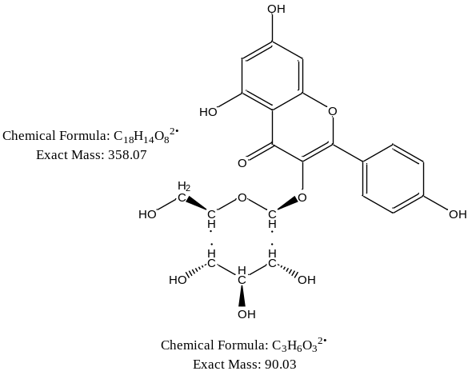
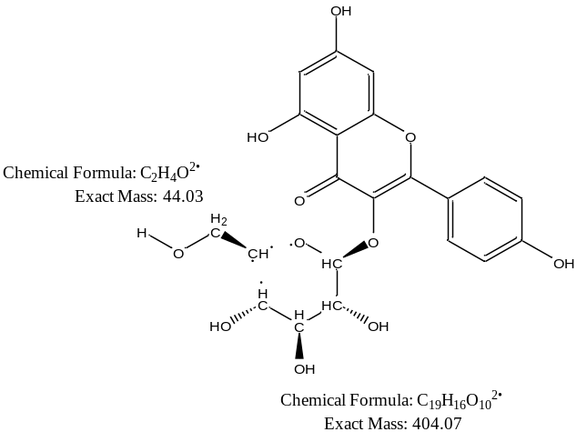
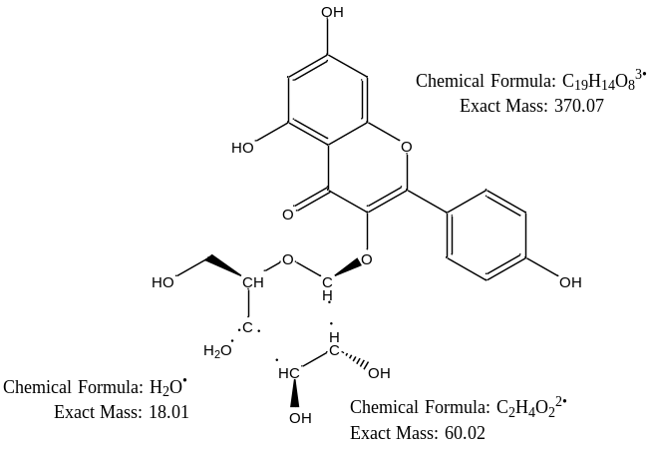




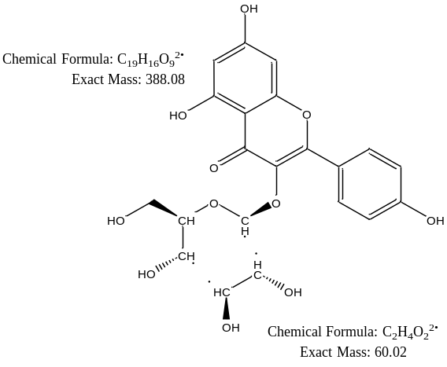
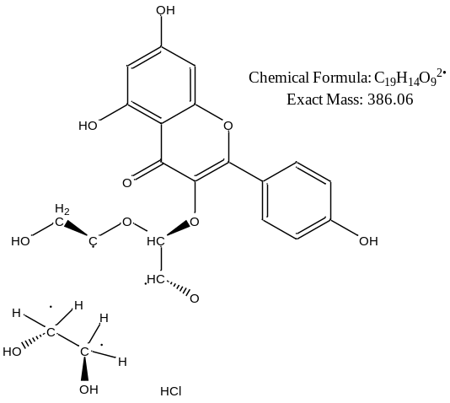
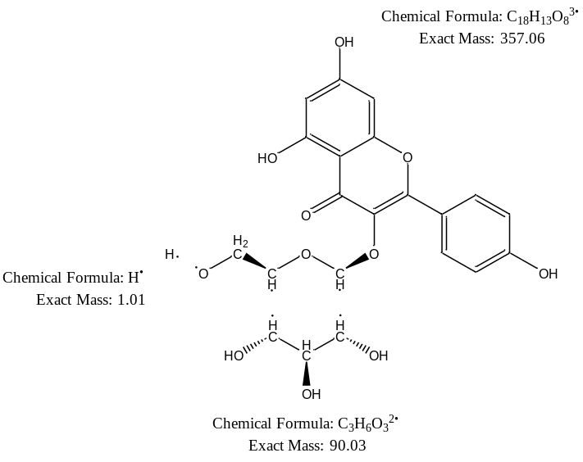




[Astragalin+Cl]⁻
483.04
-90(C₃H₆O₃)[1]
=392.99
-78(C₂H₃ClO)[2]
=405.00
-60(C₂H₄O₂)-18(H₂O)[3]
=405.00
+Cl
H rearrangement
+Cl
+Cl
-60(C₂H₄O₂)[4]
=423.01
-98(C₂HClO₂)[5]
=385.12
-126(C₃H₄ClO₃)[6]
=357.01
+Cl
-H
H rearrangement
H rearrangements
+HCl
Figure S3.6. Proposed fragmentation patterns for Astragalin-related ions ([M+Cl]⁻) during MS/MS analysis. Rearrangement possibilities of H from –HO group is indicated in red.

Slide 10
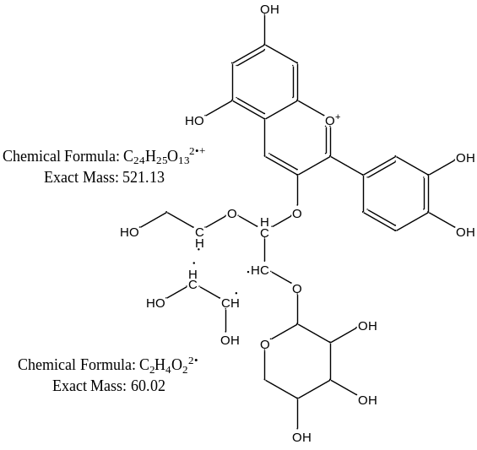
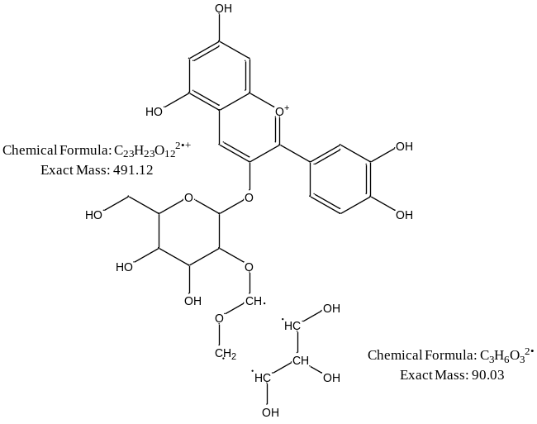
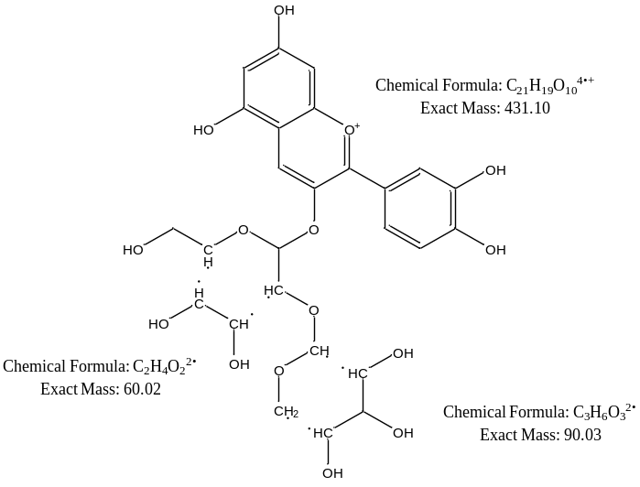



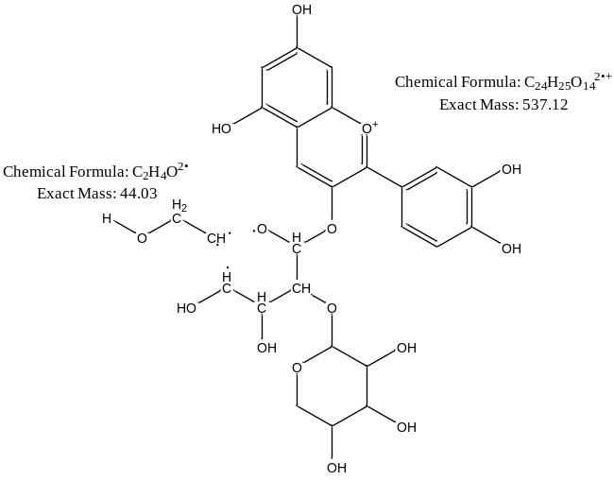
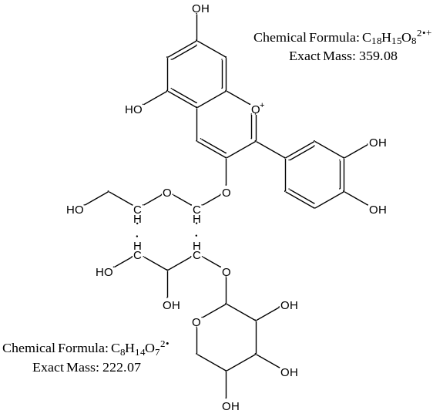
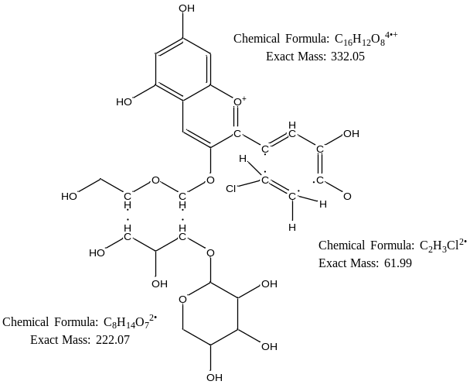



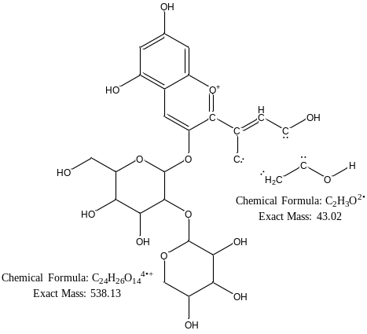


[Sambicyanin-H+Cl]⁻
615.03
-60(C₂H₄O₂)[1]
=554.99
-90(C₃H₆O₃)[2]
=524.98
-150(C₅H₁₀O₅)[3]
=464.94
-H+Cl
-H+Cl
-H+Cl
-78(C₂H₃ClO)[4]
=536.98
-222(C₈H₁₄O₇)[5]
=392.97
-62(C₂H₃Cl)[6]
=330.96
-H+Cl
H rearrangements
-H+Cl
-H+Cl
Figure S3.7. Proposed fragmentation patterns for Sambicyanin-related ions ([M-H+Cl]⁻) during MS/MS analysis. Rearrangement possibilities of H from –HO group is indicated in red.

Slide 11


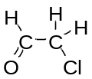



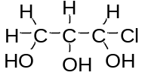


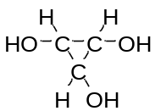
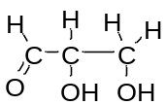
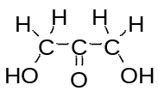
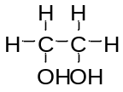



[Astragalin+Cl]⁻ [2]
[Sambicyanin-H+Cl]⁻ [4]
[Astragalin+Cl]⁻ [3][4]
[Sambicyanin-H+Cl]⁻ [1]
[Astragalin+Cl]⁻ [6]
[Astragalin+Cl]⁻ [5]
[Astragalin+Cl]⁻ [1]
[Sambicyanin-H+Cl]⁻ [2]
Figure S3.8. Proposed molecular structures for fragments lost based on the m/z ions detected by picoPPESI-MS/MS analysis.

