Slide 1
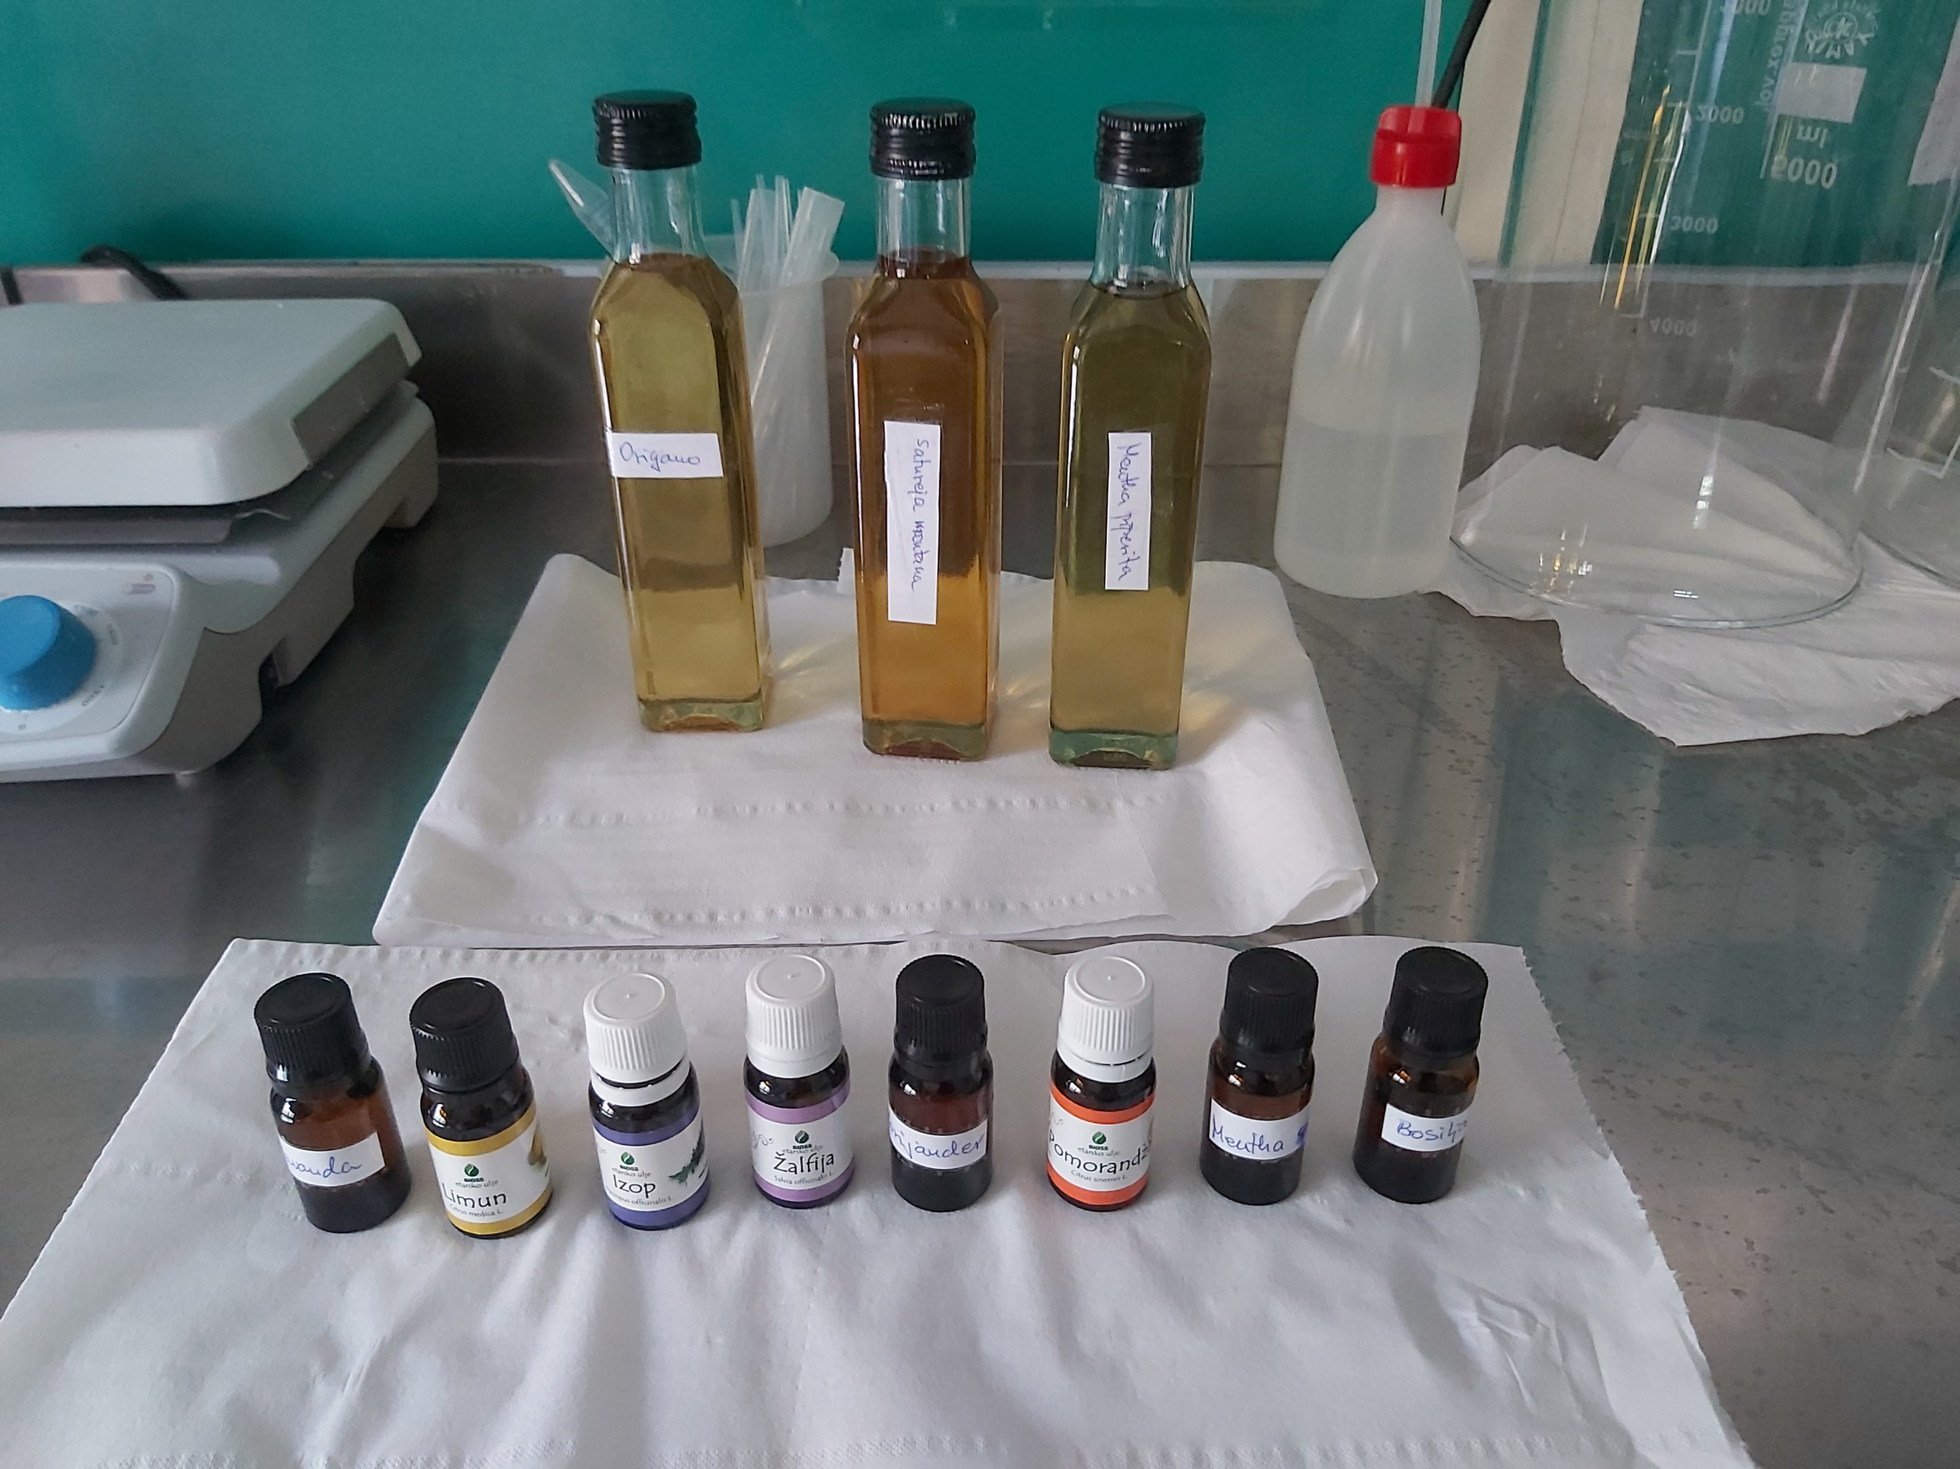
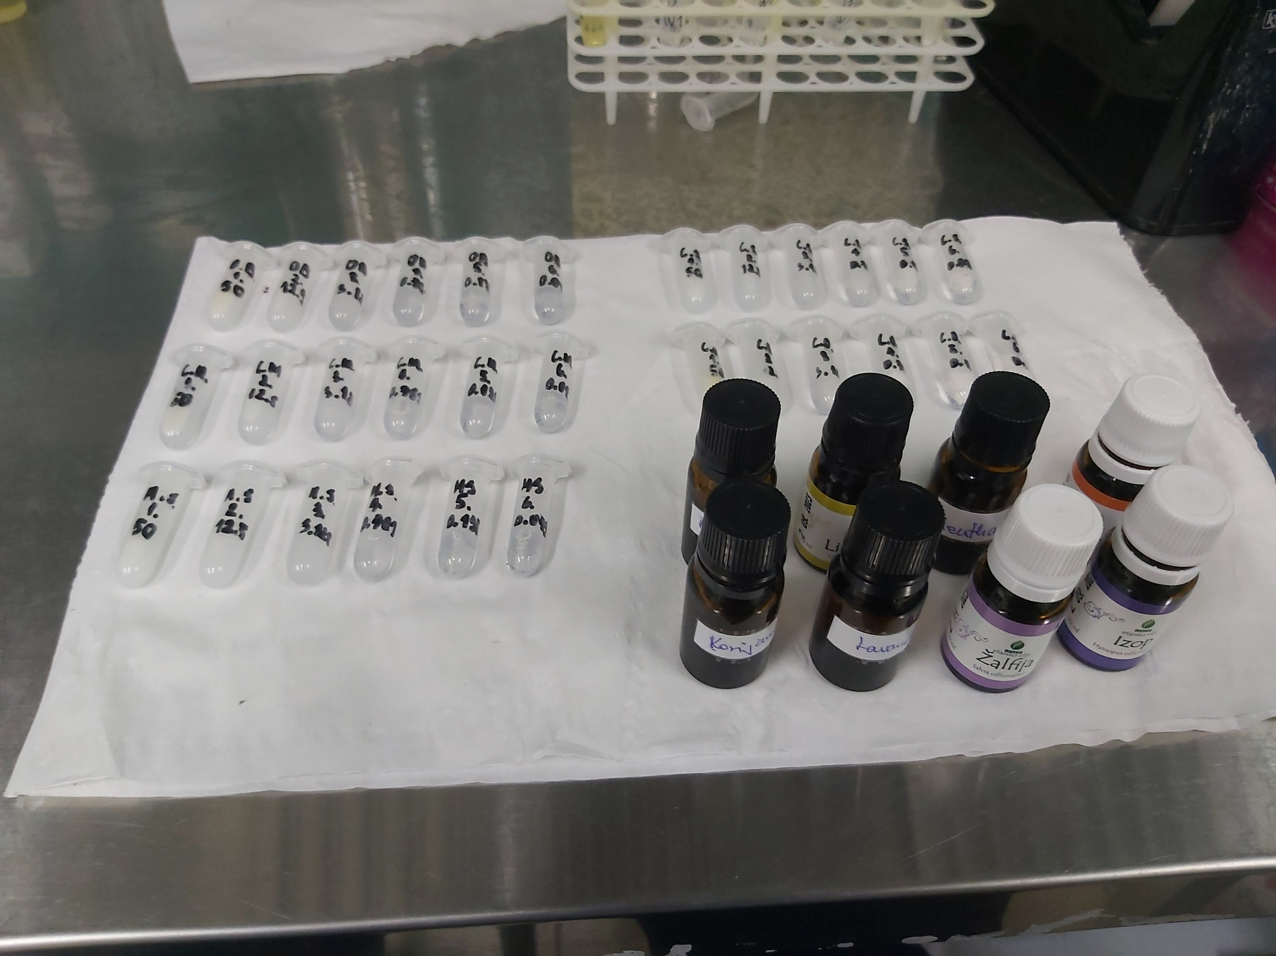
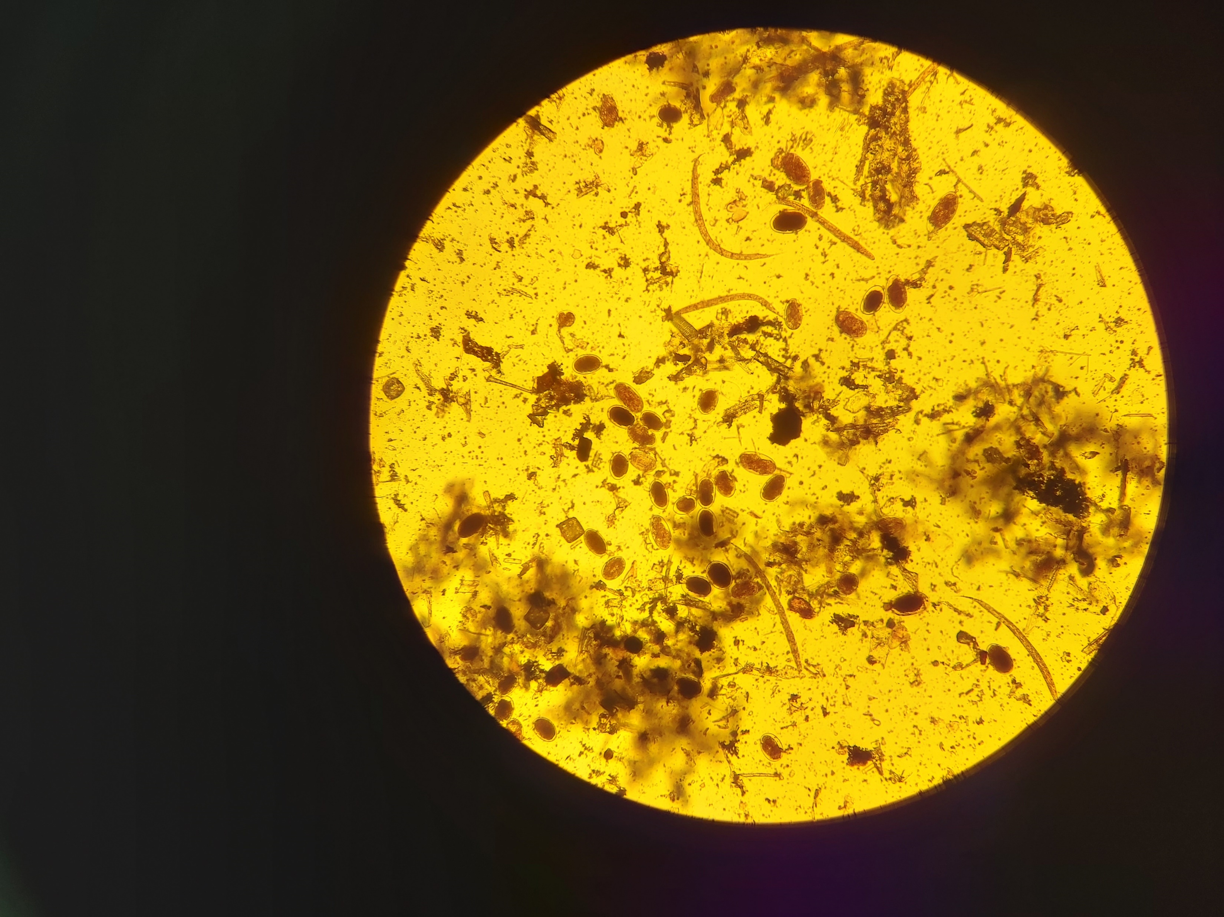
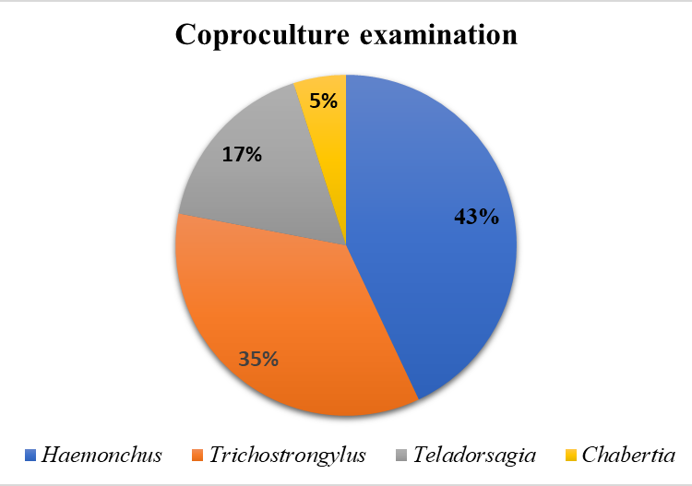
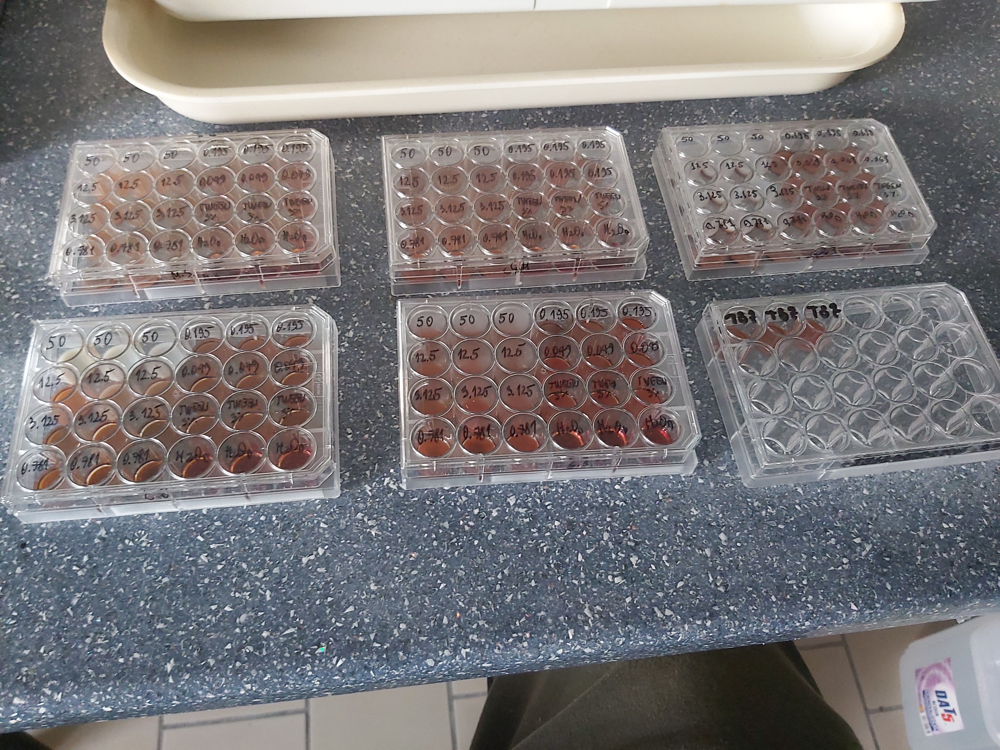
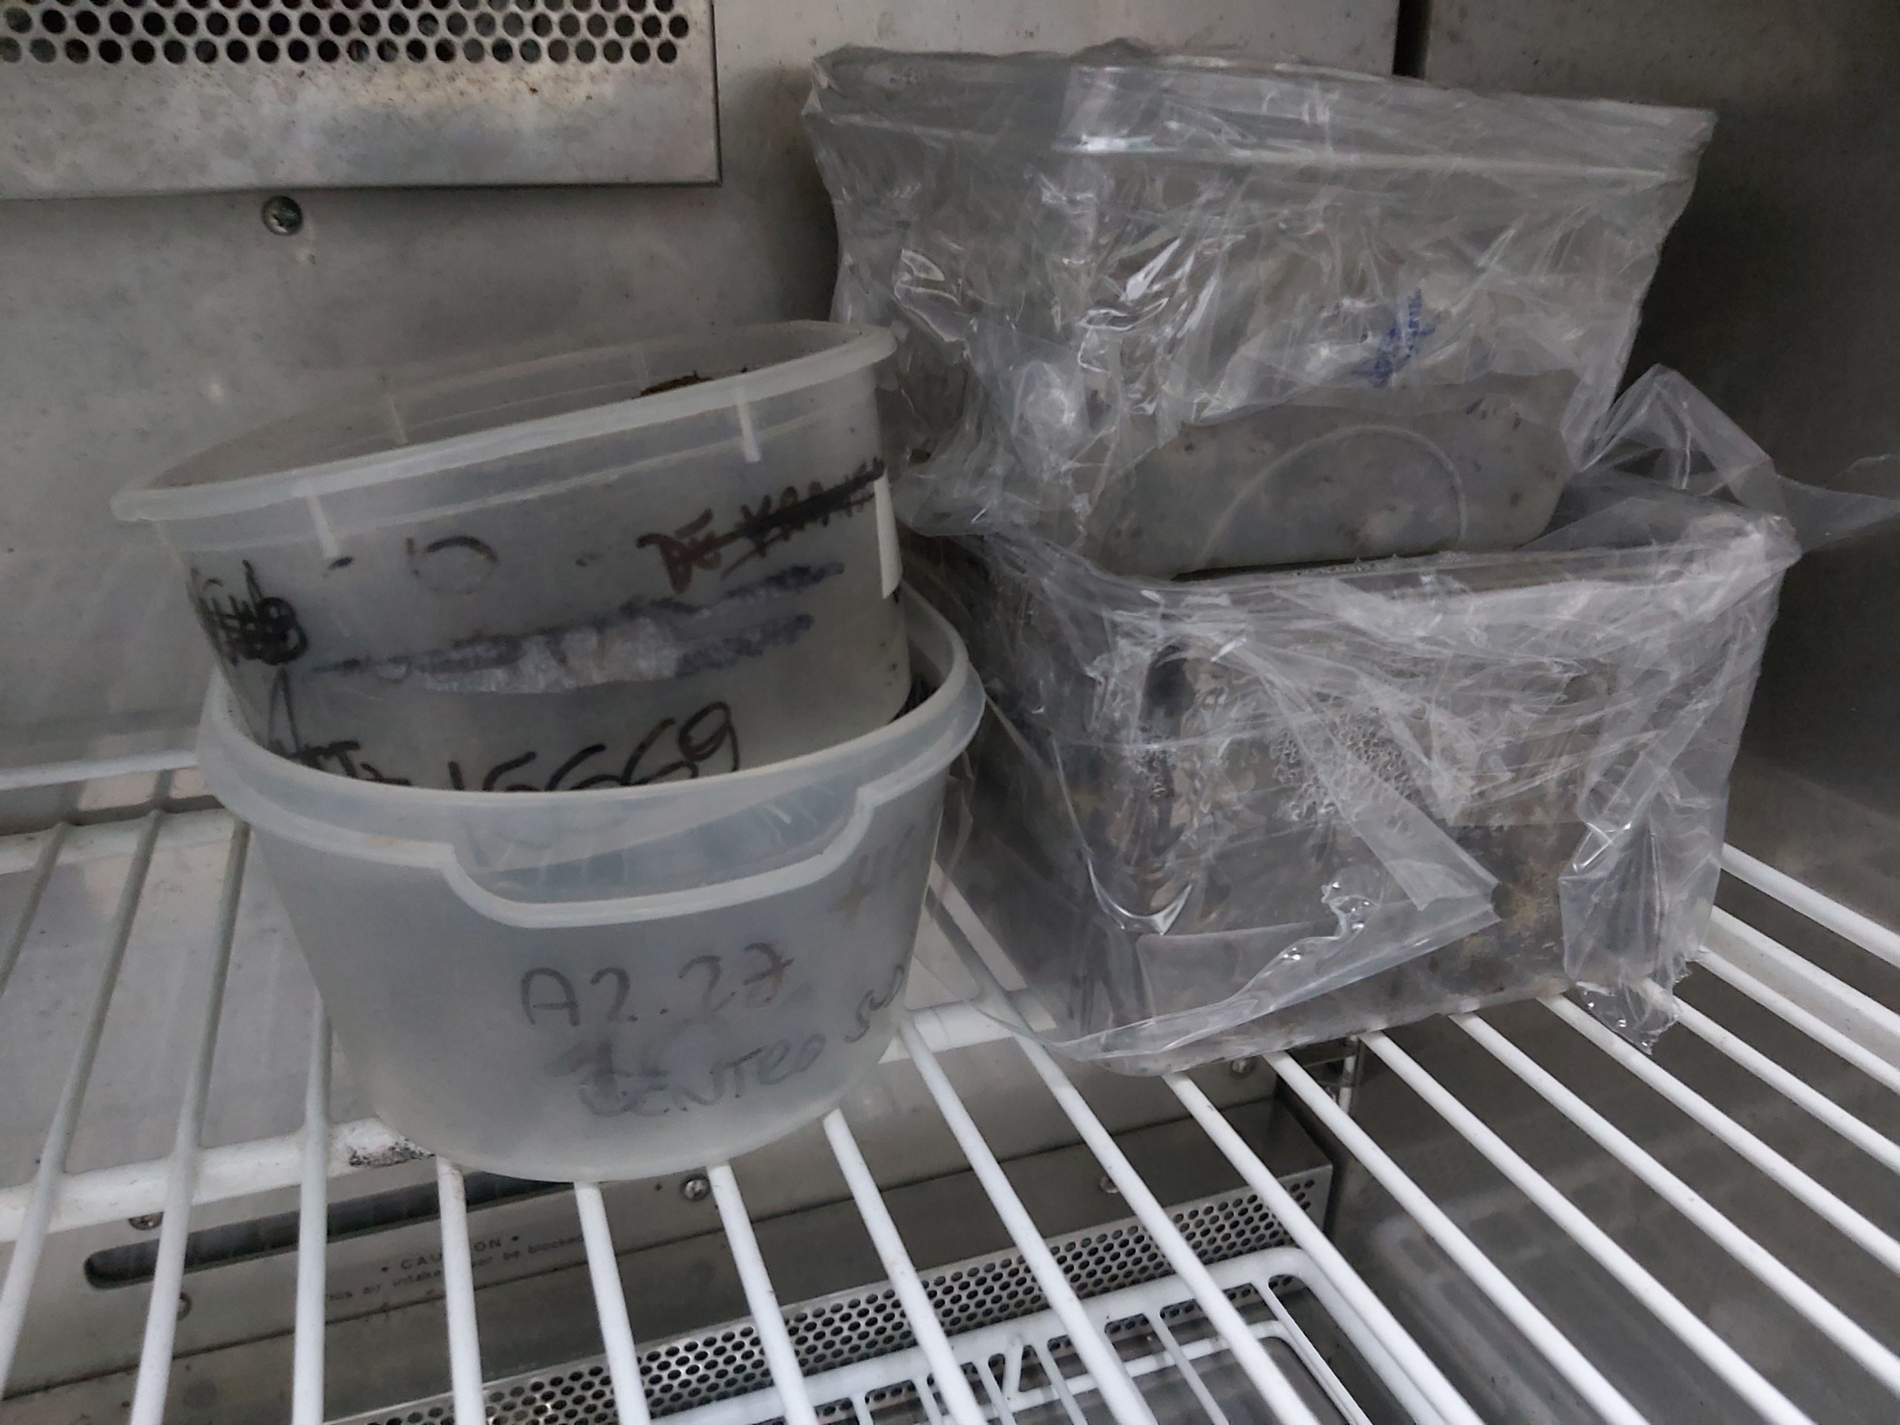
AIM
METHODS
RESULTS
The exclusive use of commercial, synthetic anthelmintics is no longer a sustainable option due to the development of resistance in gastrointestinal nematodes (GINs) in sheep, and the problem of residues of these drugs in animal products and the environment. The aim of this study was to investigate the anthelmintic potential of seven essential oils (EOs) from different plants in vitro, and thus preliminarily evaluate the possibility of their use in future treatment of these parasites
- EOs: Citrus x sinensis (L.) Osbeck, Citrus medica (L.), Mentha spicata (L.), Hyssopus officinalis (L.), Lavandula angustifolia Mill., Salvia officinalis (L.) and Ocimum basilicum (L.)
- Analysis of the chemical composition of EOs tested: gas chromatography and mass spectrometry (GC-MS)
- In vitro evaluation of anthelmintic efficacy against GINs in sheep: egg hatch test (EHT) performed at 8 concentrations (50, 12.5, 3.125, 0.781, 0.195, 0.049, 0.025 and 0.0125 mg/ml)
- Coproculture examination for the identification of GIN genera on which EOs are tested
- Main compounds of the three most effective EOs: carvone (64.4%), trans-4-caranone (8.67%), limonene (4.37%) in M. spicata; linalool (62.8%), γ-muurolene (4.45%) and estragole (3.78%) in O. basilicum; cis- pinocamphone (47.6%), β-pinene (13.5%) and trans-pinocamphone (12.2%) in H. officinalis
Essential oil | Efficacy range (%) | IC₅₀ (mg/ml) | R²
Mentha spicata | 13.0-92.7 | 0.07 | 0.93
Ocimum basilicum | 23.3-93.3 | 0.08 | 0.98
Hyssopus officinalis | 42.7-91.3 | 0.19 | 0.93
Lavandula angustifolia | 28.0-84.7 | 0.31 | 0.98
Citrus sinensis | 14.7-86.3 | 0.50 | 0.97
Salvia officinalis | 15.0-89.0 | 0.53 | 0.99
Citrus medica | 12.3-95.0 | 2.52 | 0.92

