Slide 1
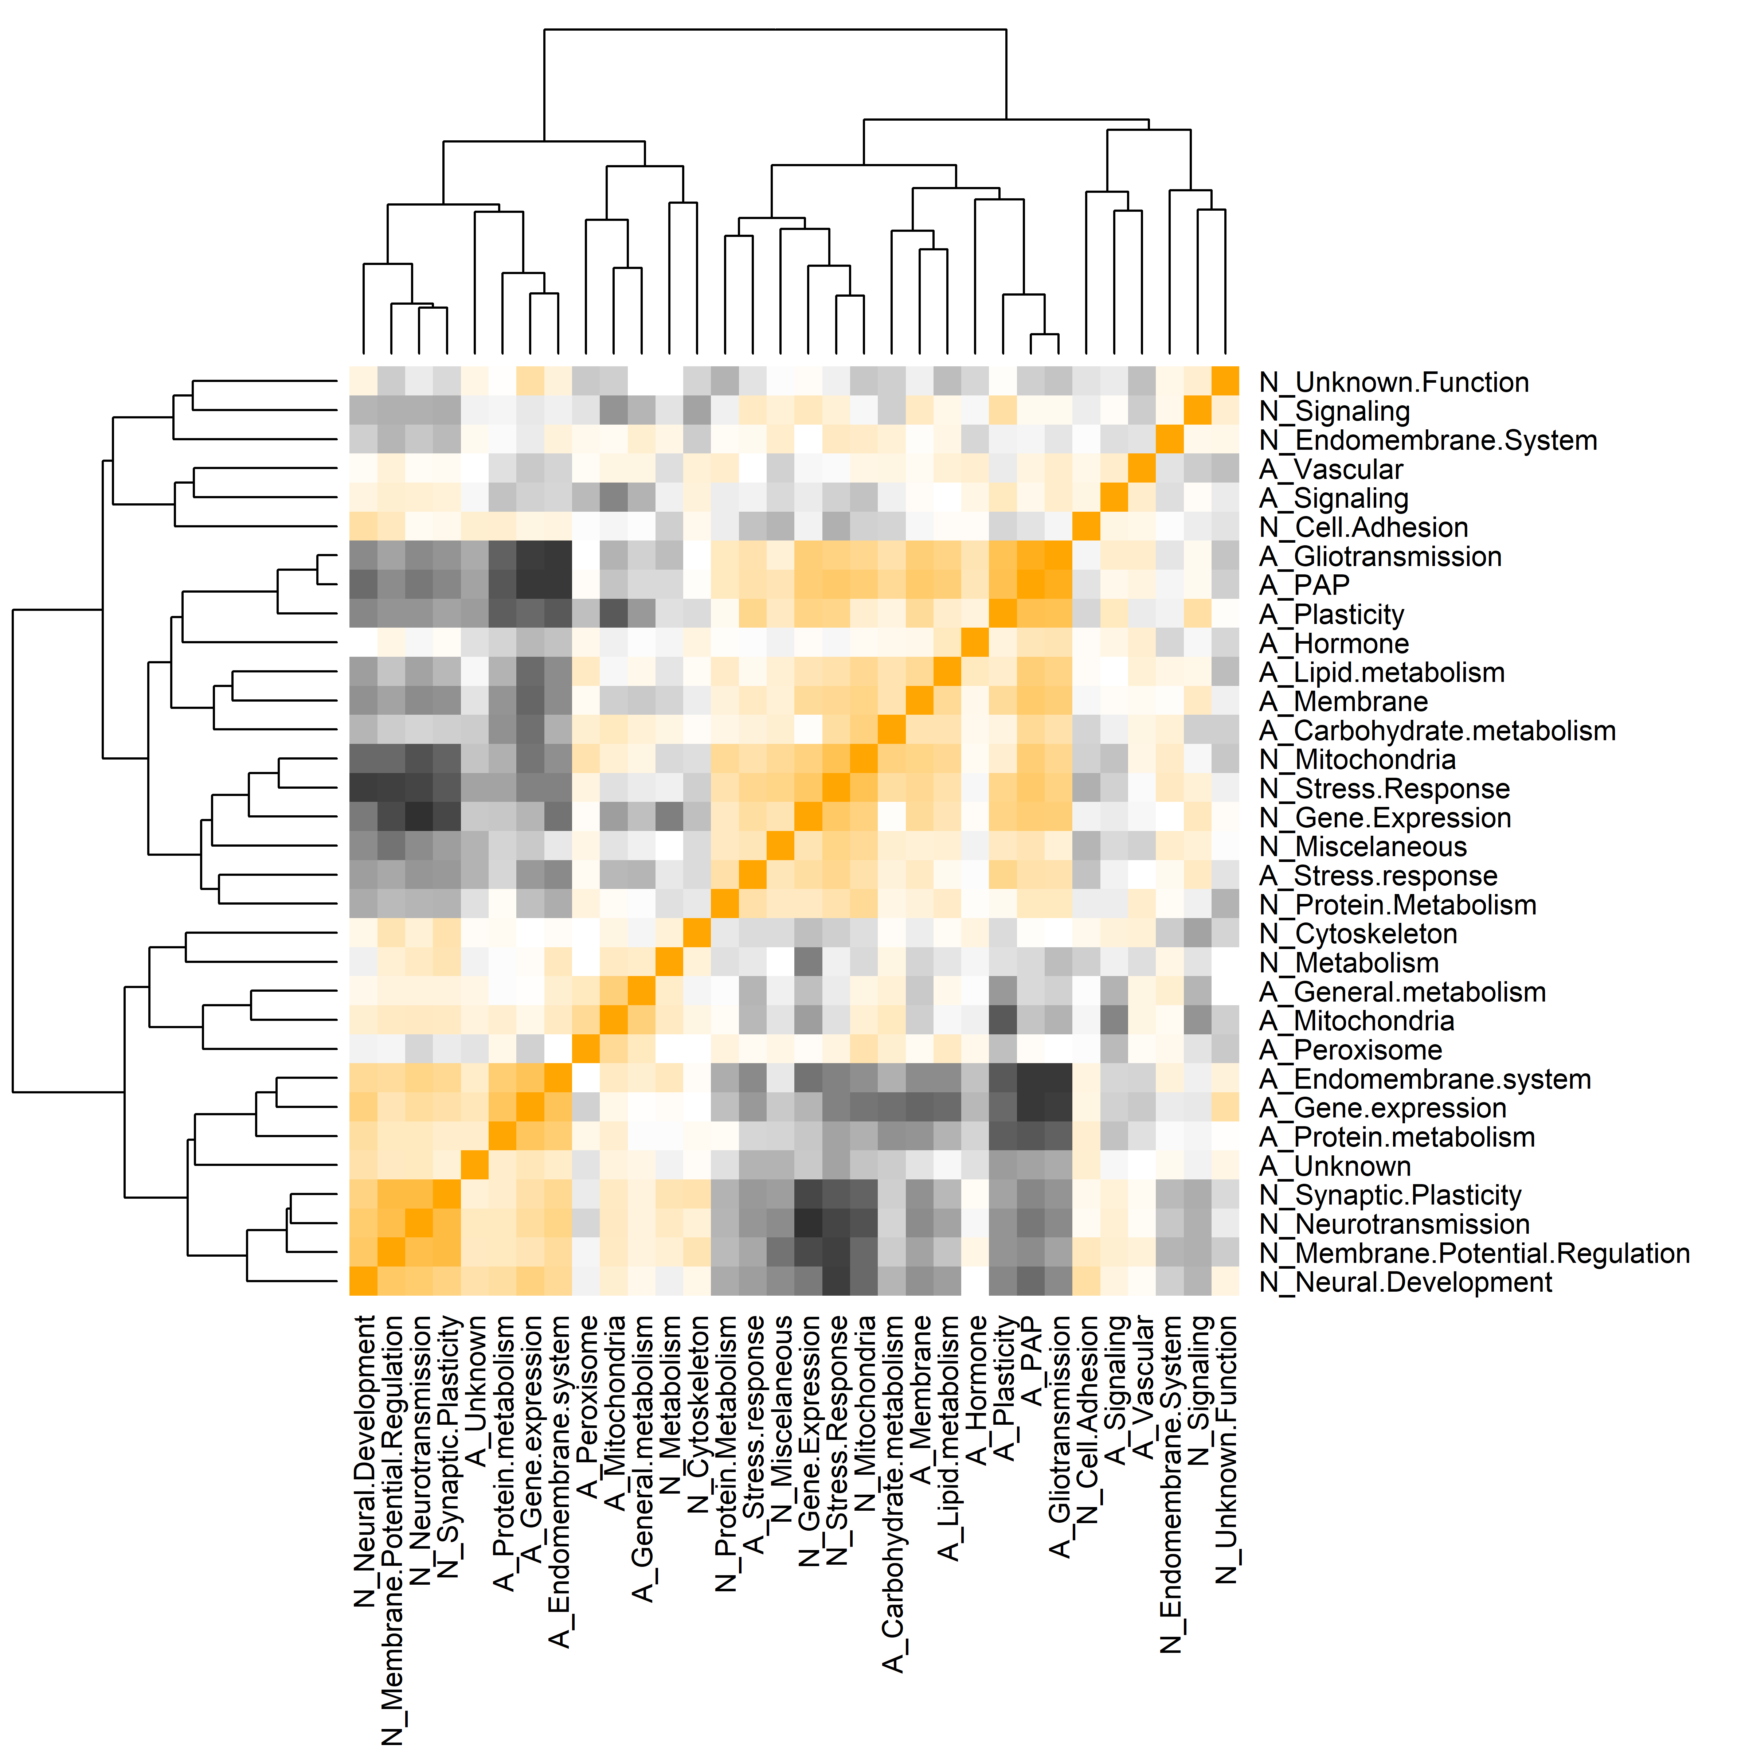
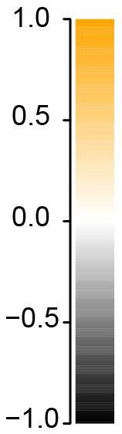
A
ROSMAP
Pearson
correlation
2
6
1
4
5
3
6
2
5
4
1
3
Additional Fig 9

Slide 2
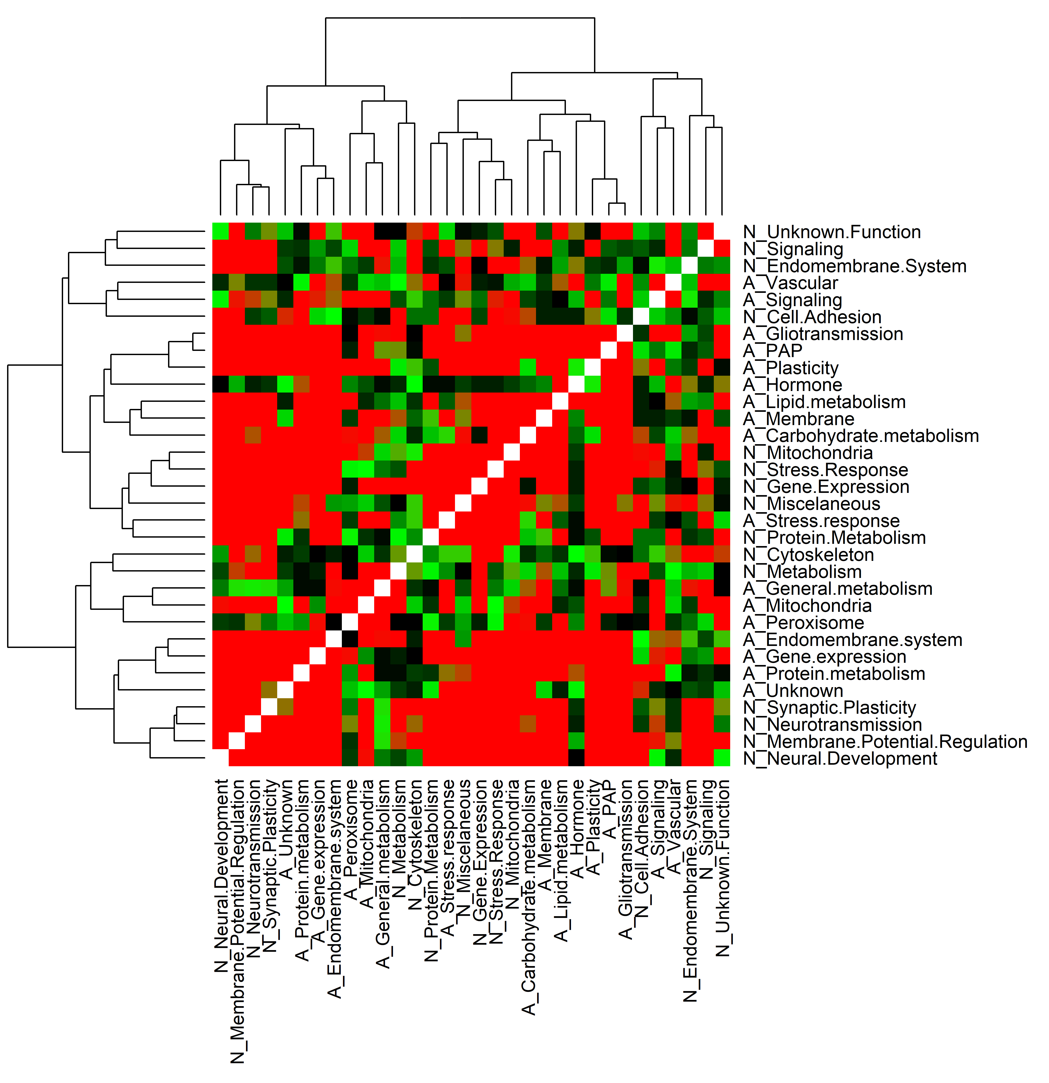
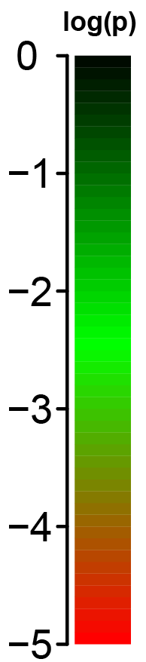
B
ROSMAP
log(p)
1
4
5
2
6
3
6
2
5
4
1
3

Slide 3
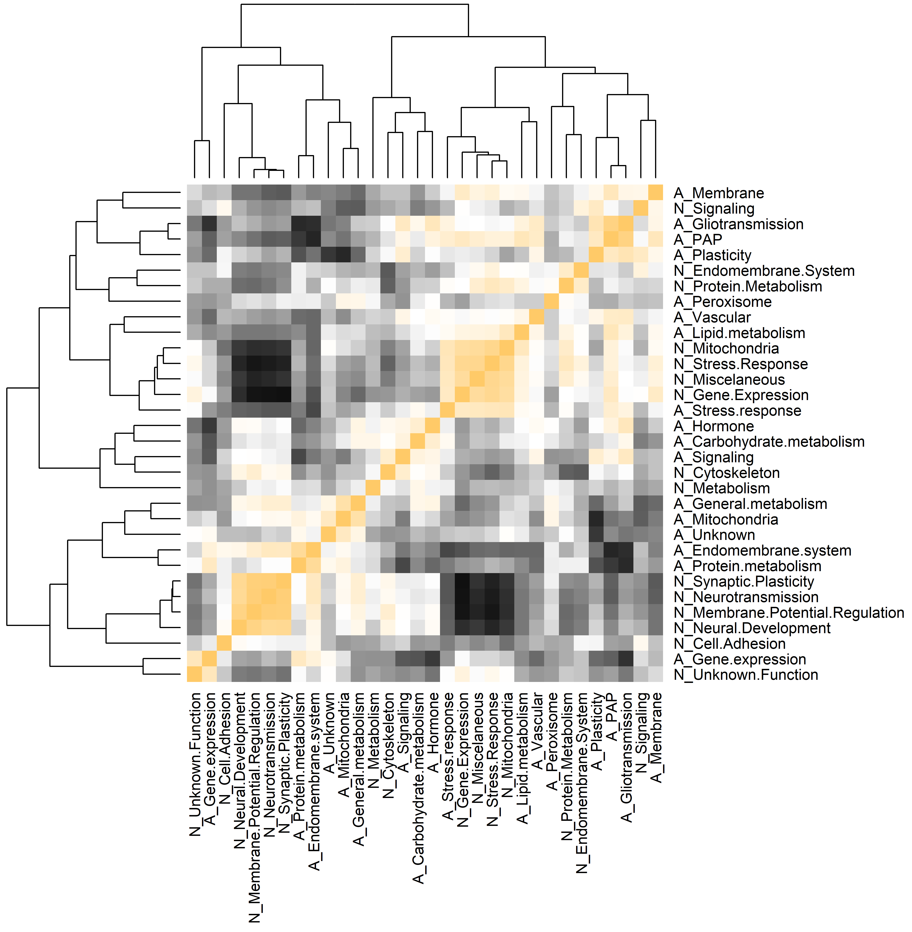
C
MAYO
Pearson
correlation

Slide 4
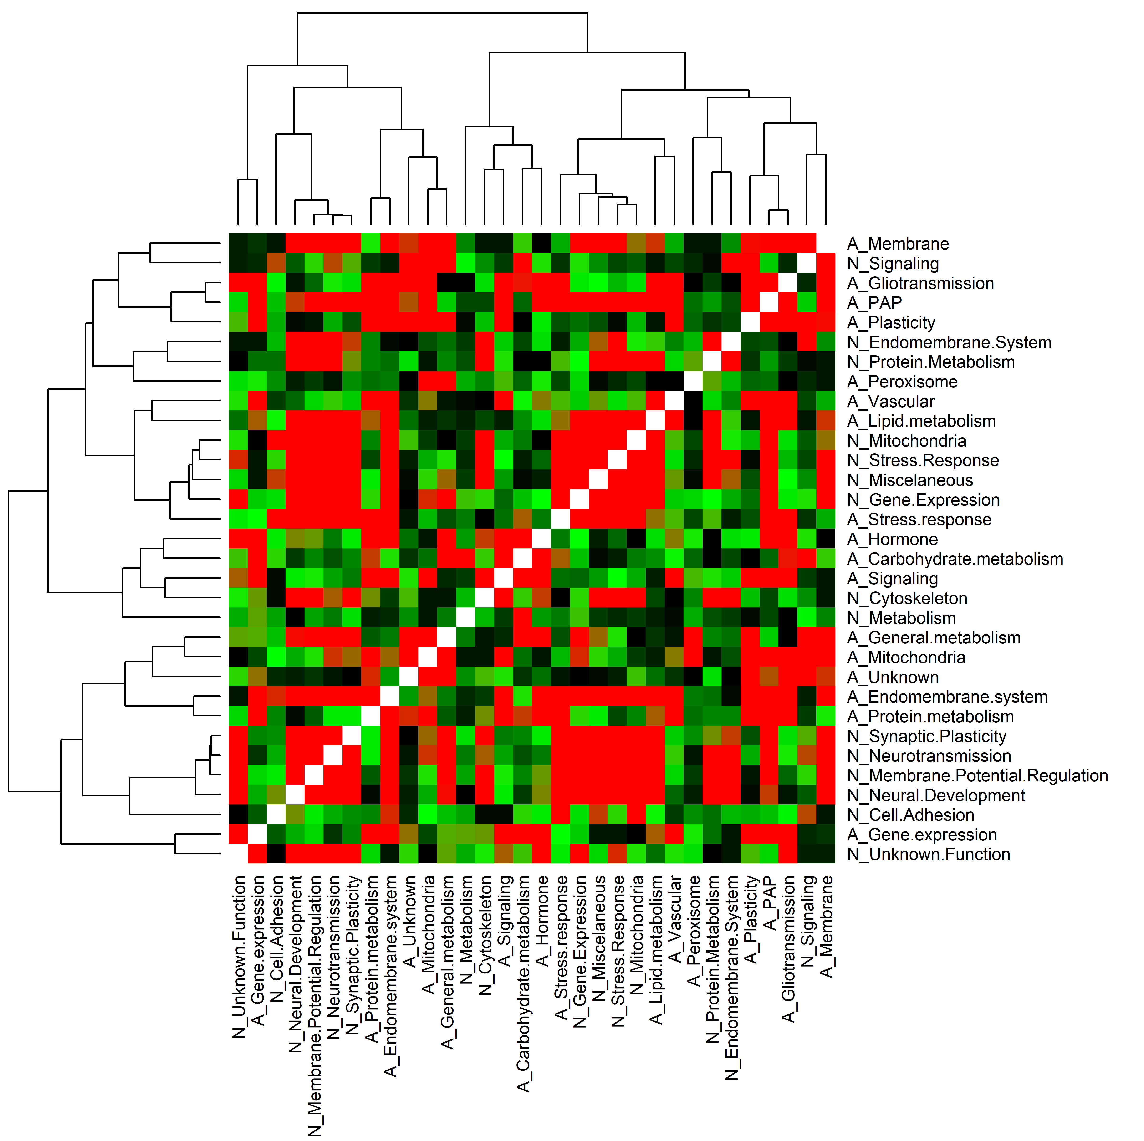
D
MAYO
log(p)

Slide 5
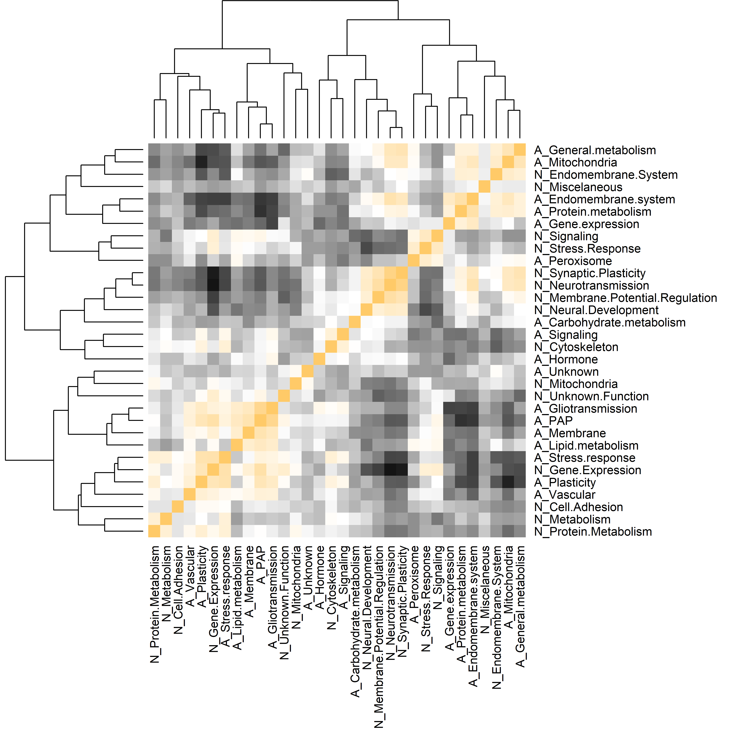
E
MtSINAI
Pearson
correlation

Slide 6
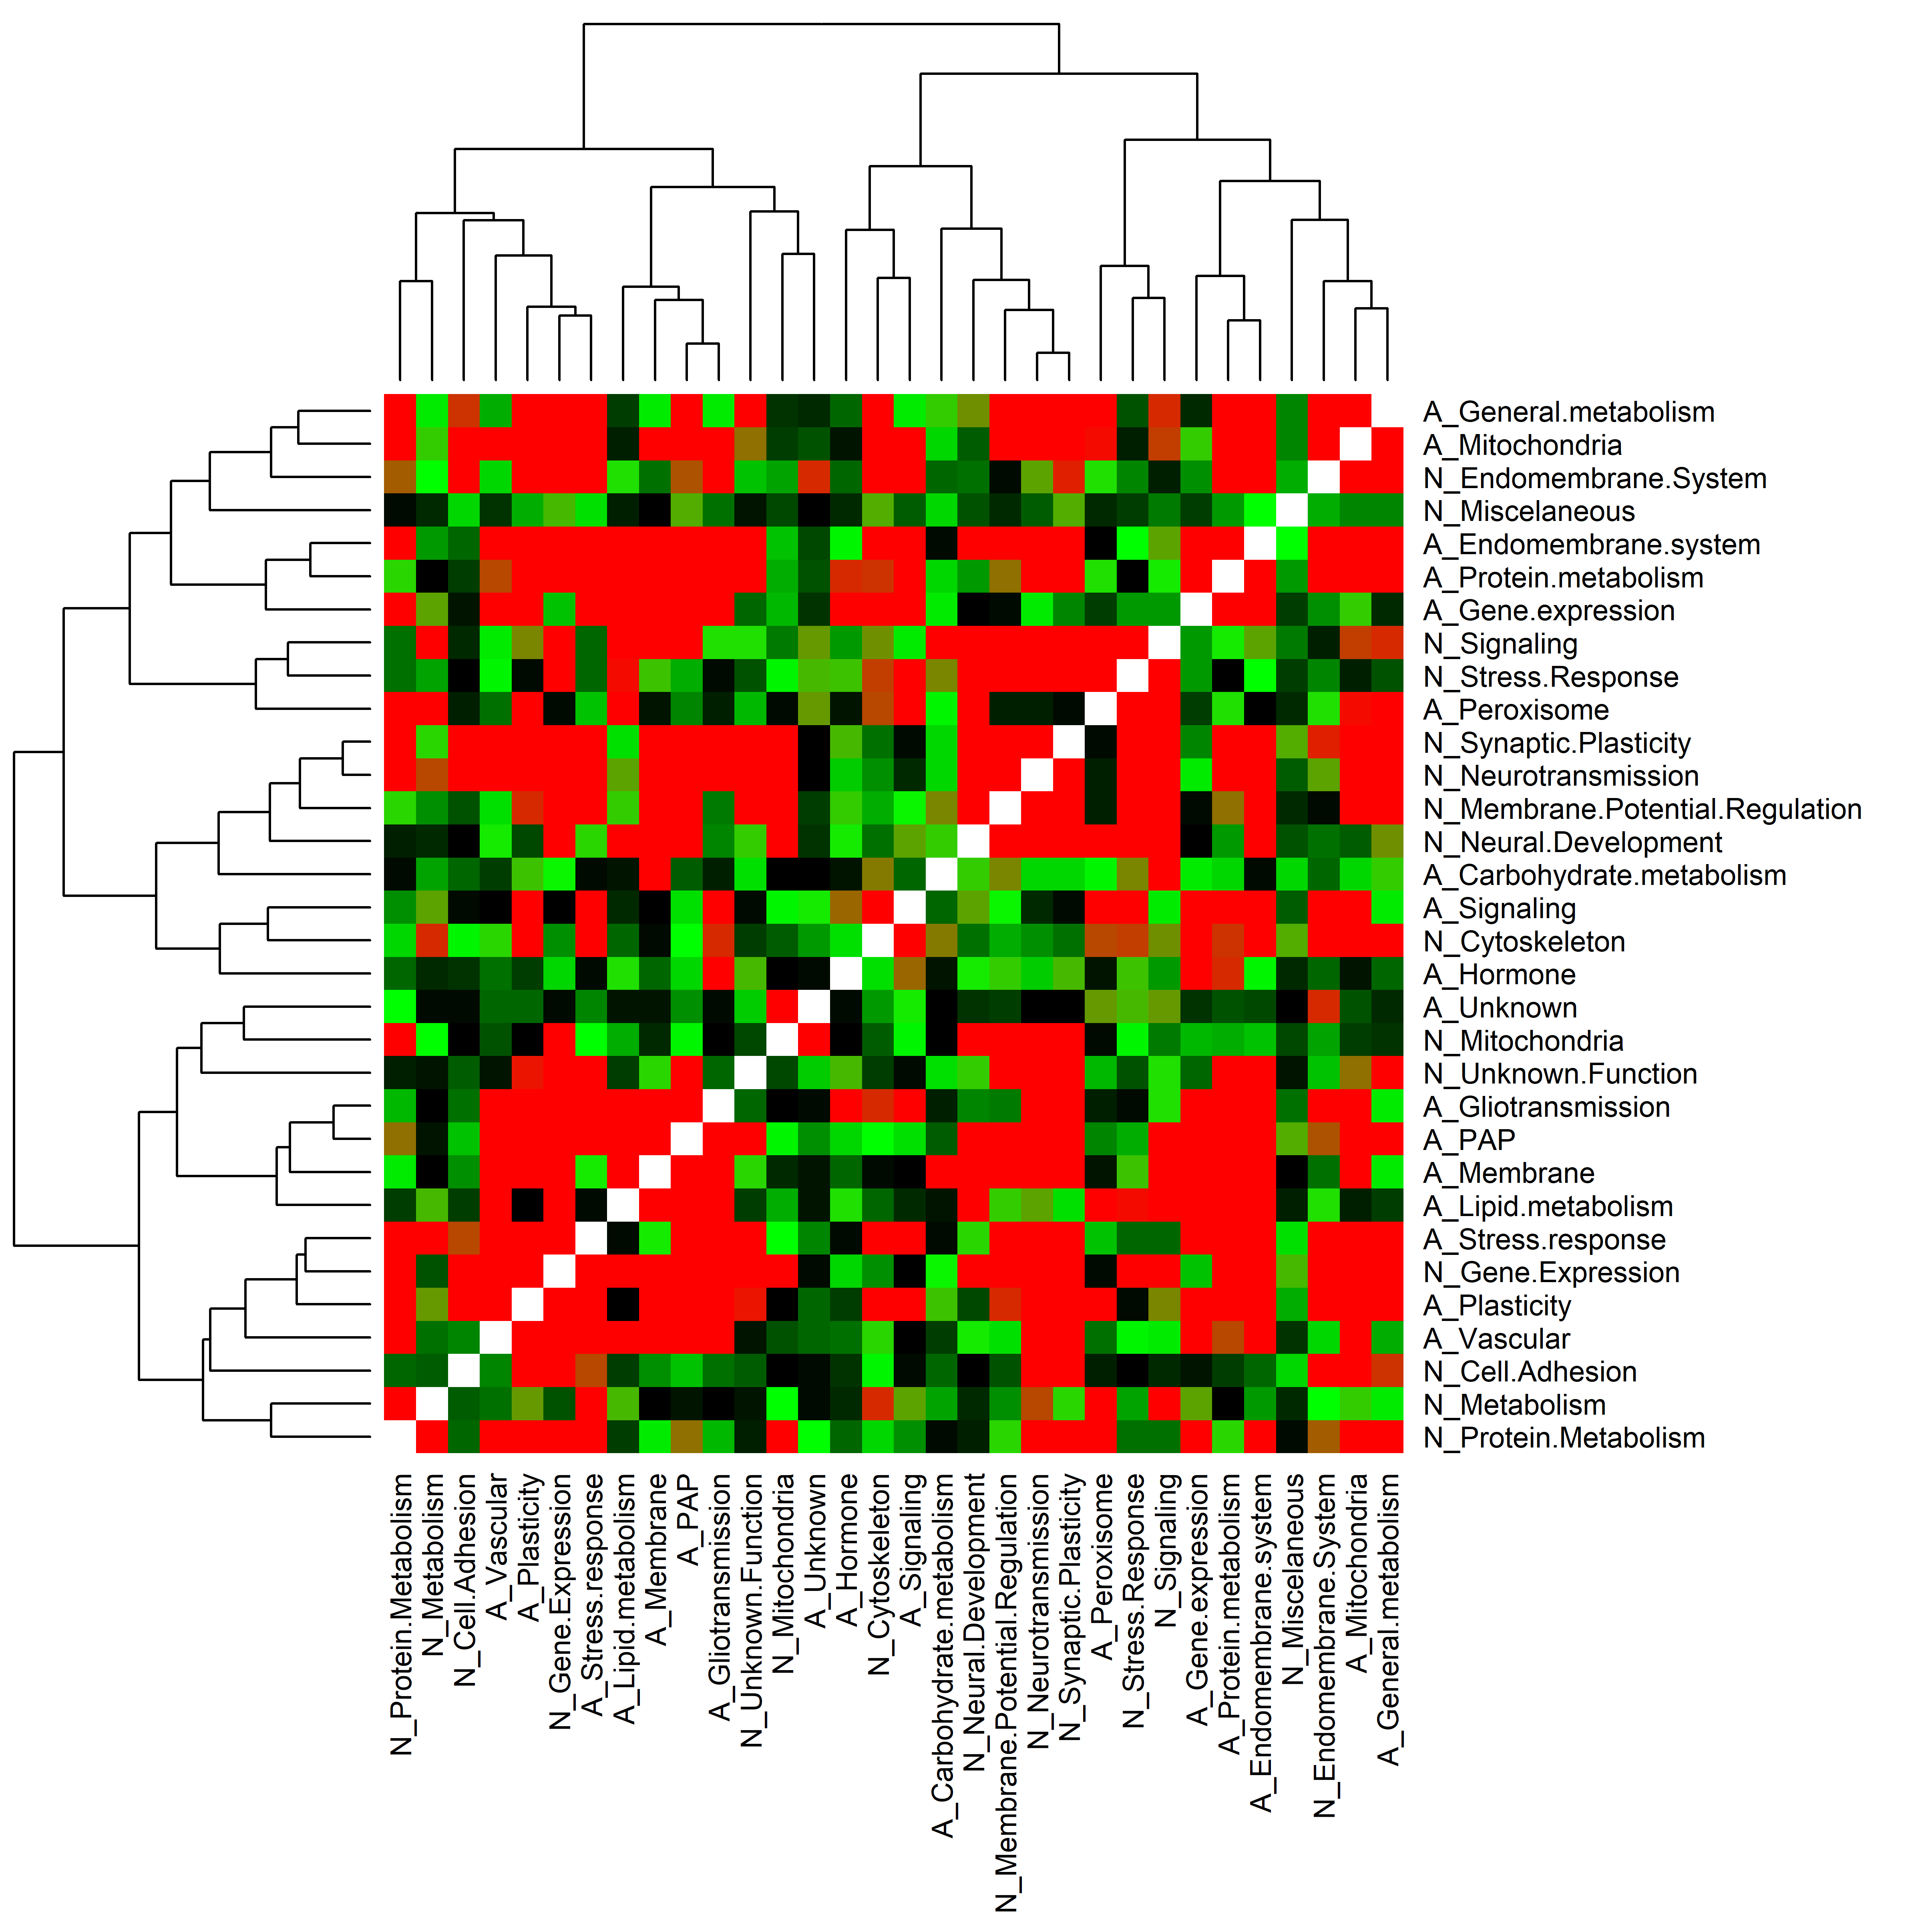
F
MtSINAI
log(p)

