Slide 1
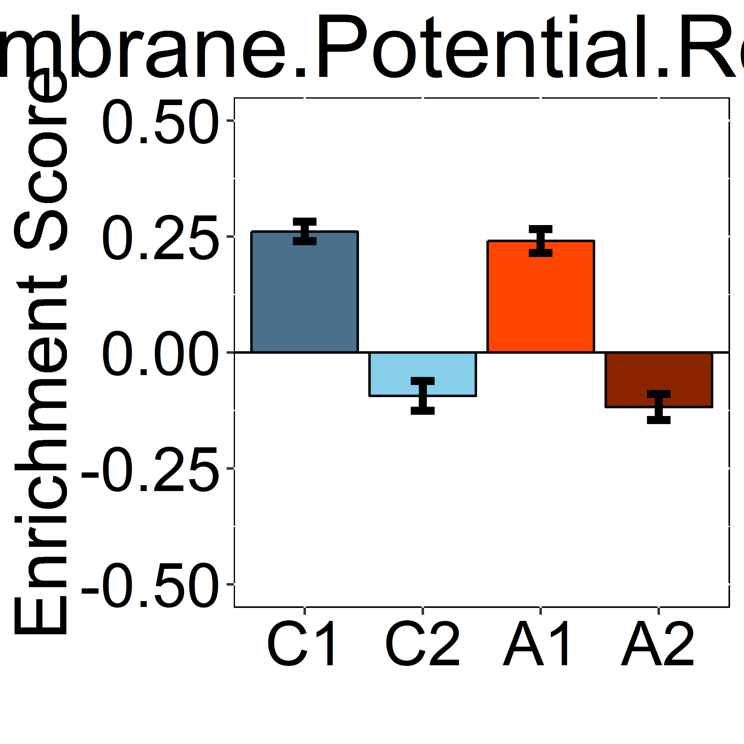
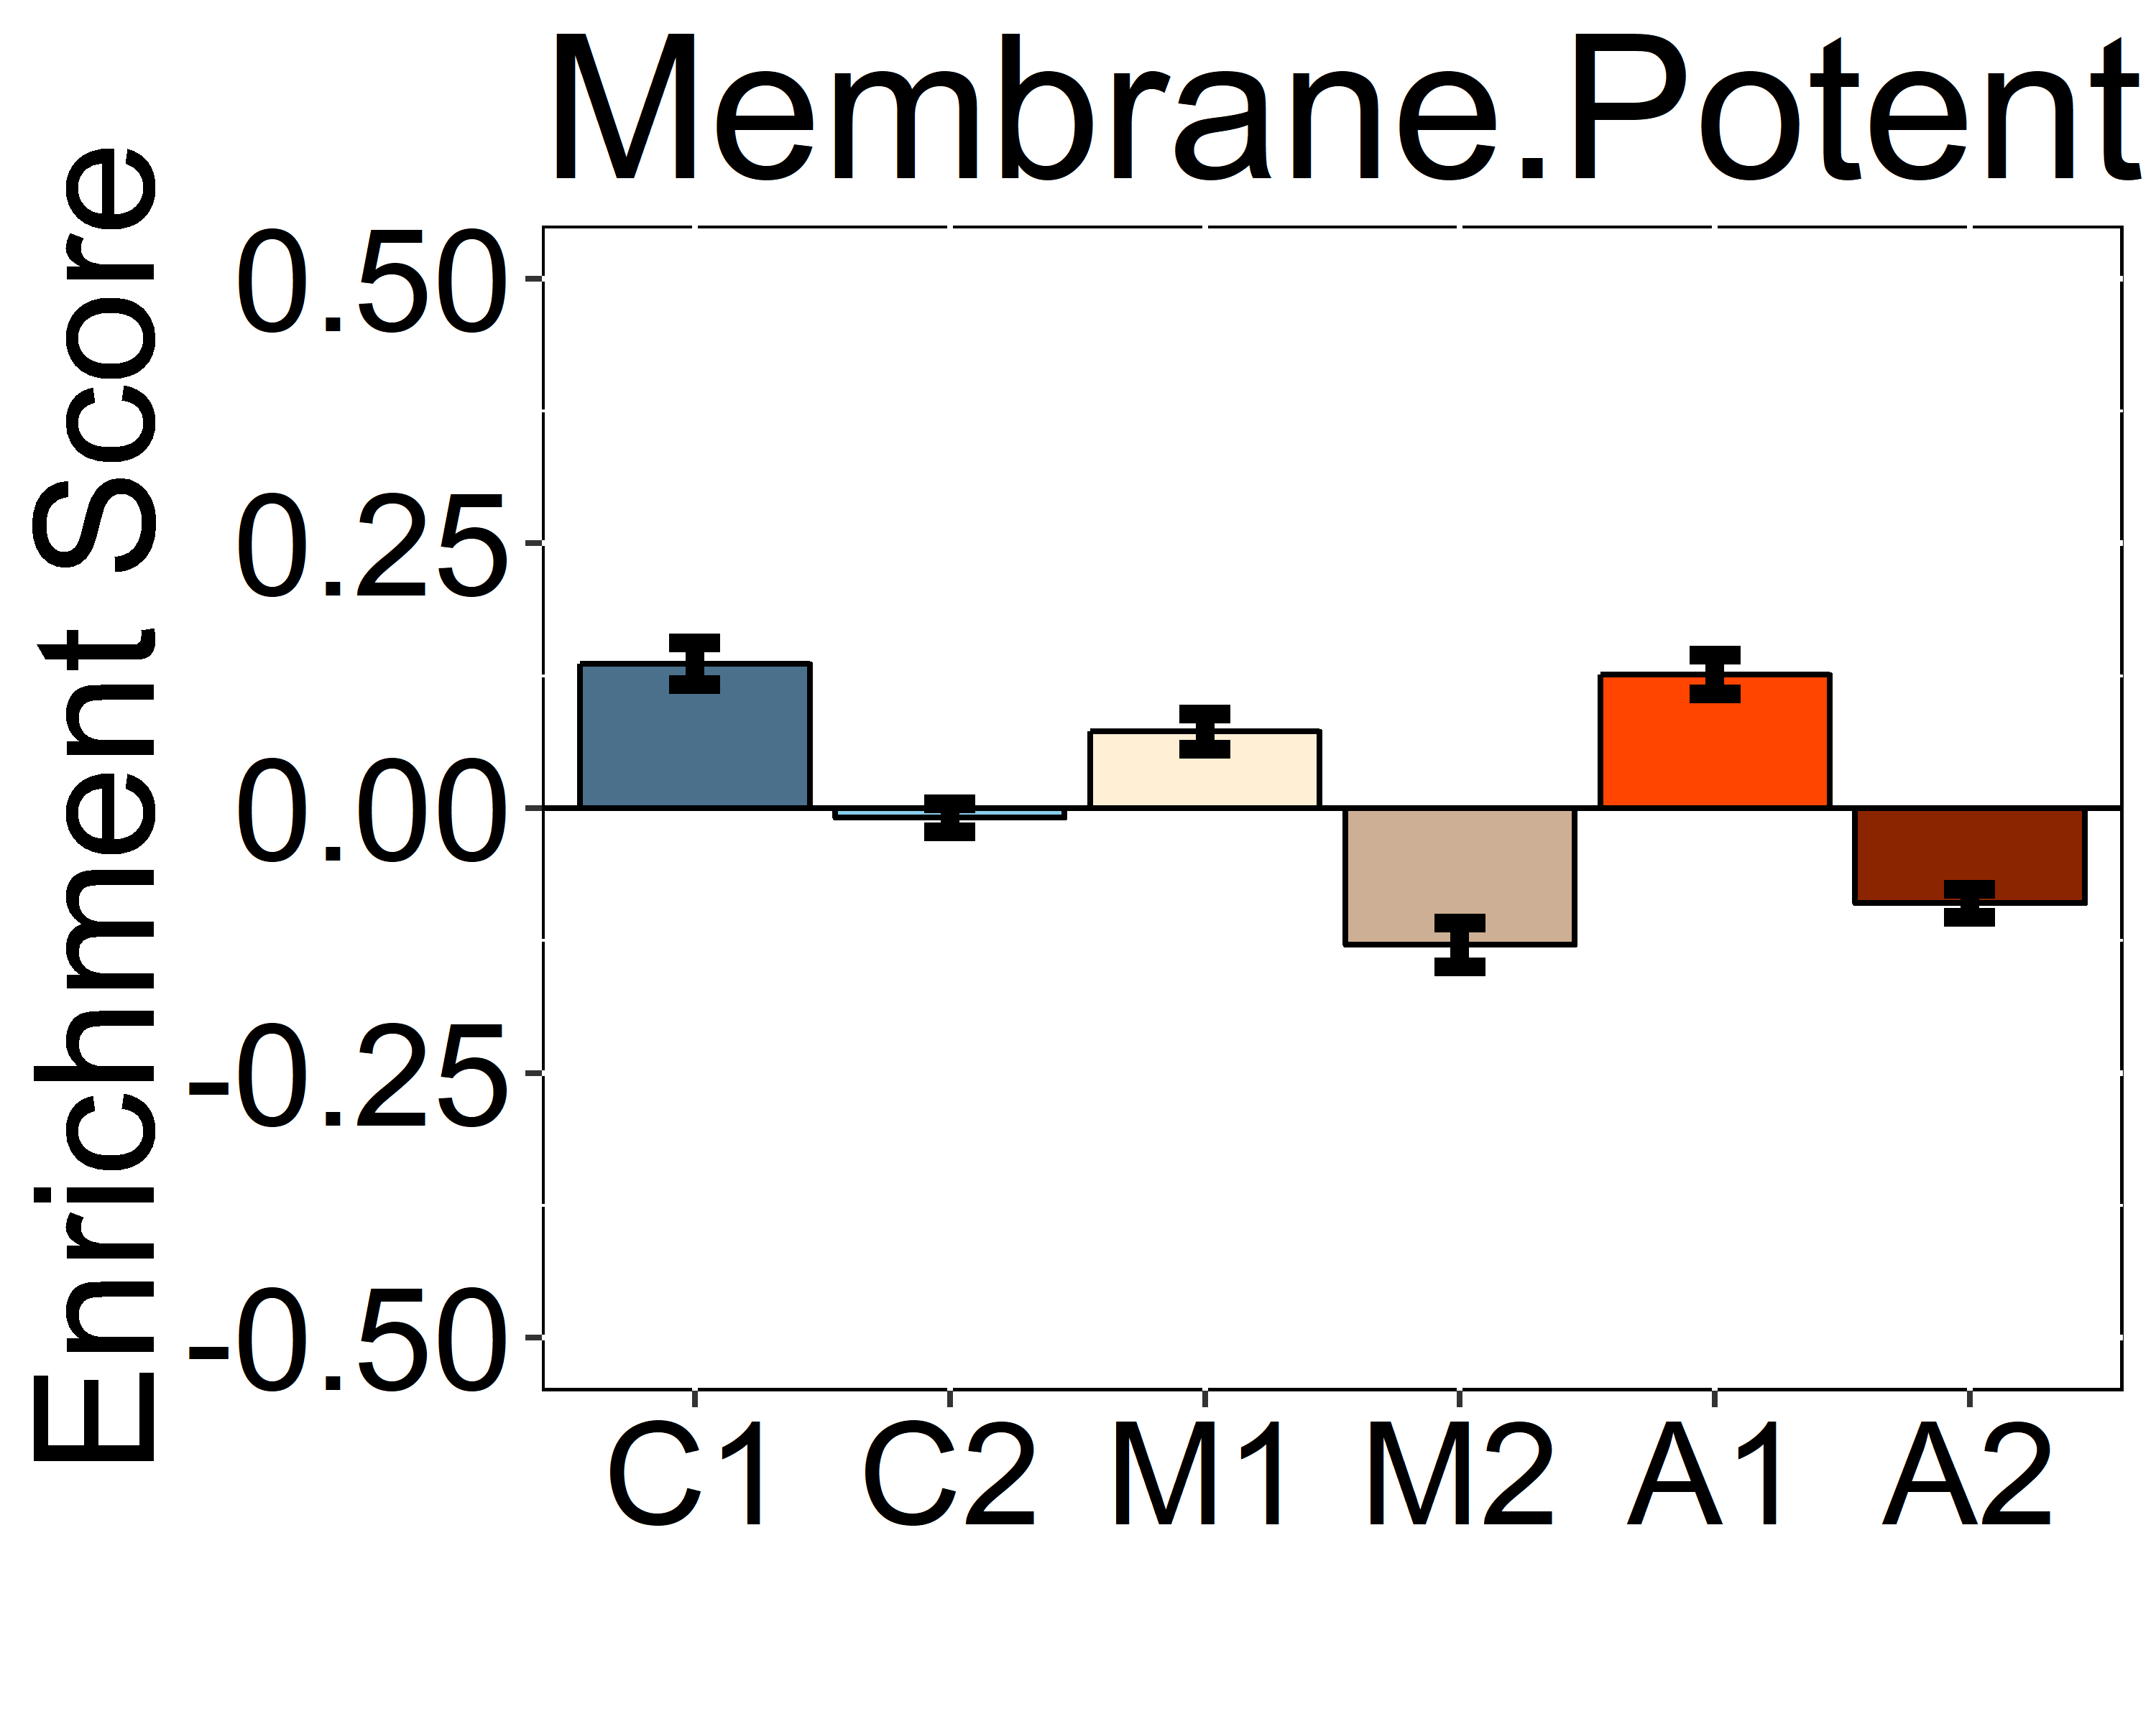
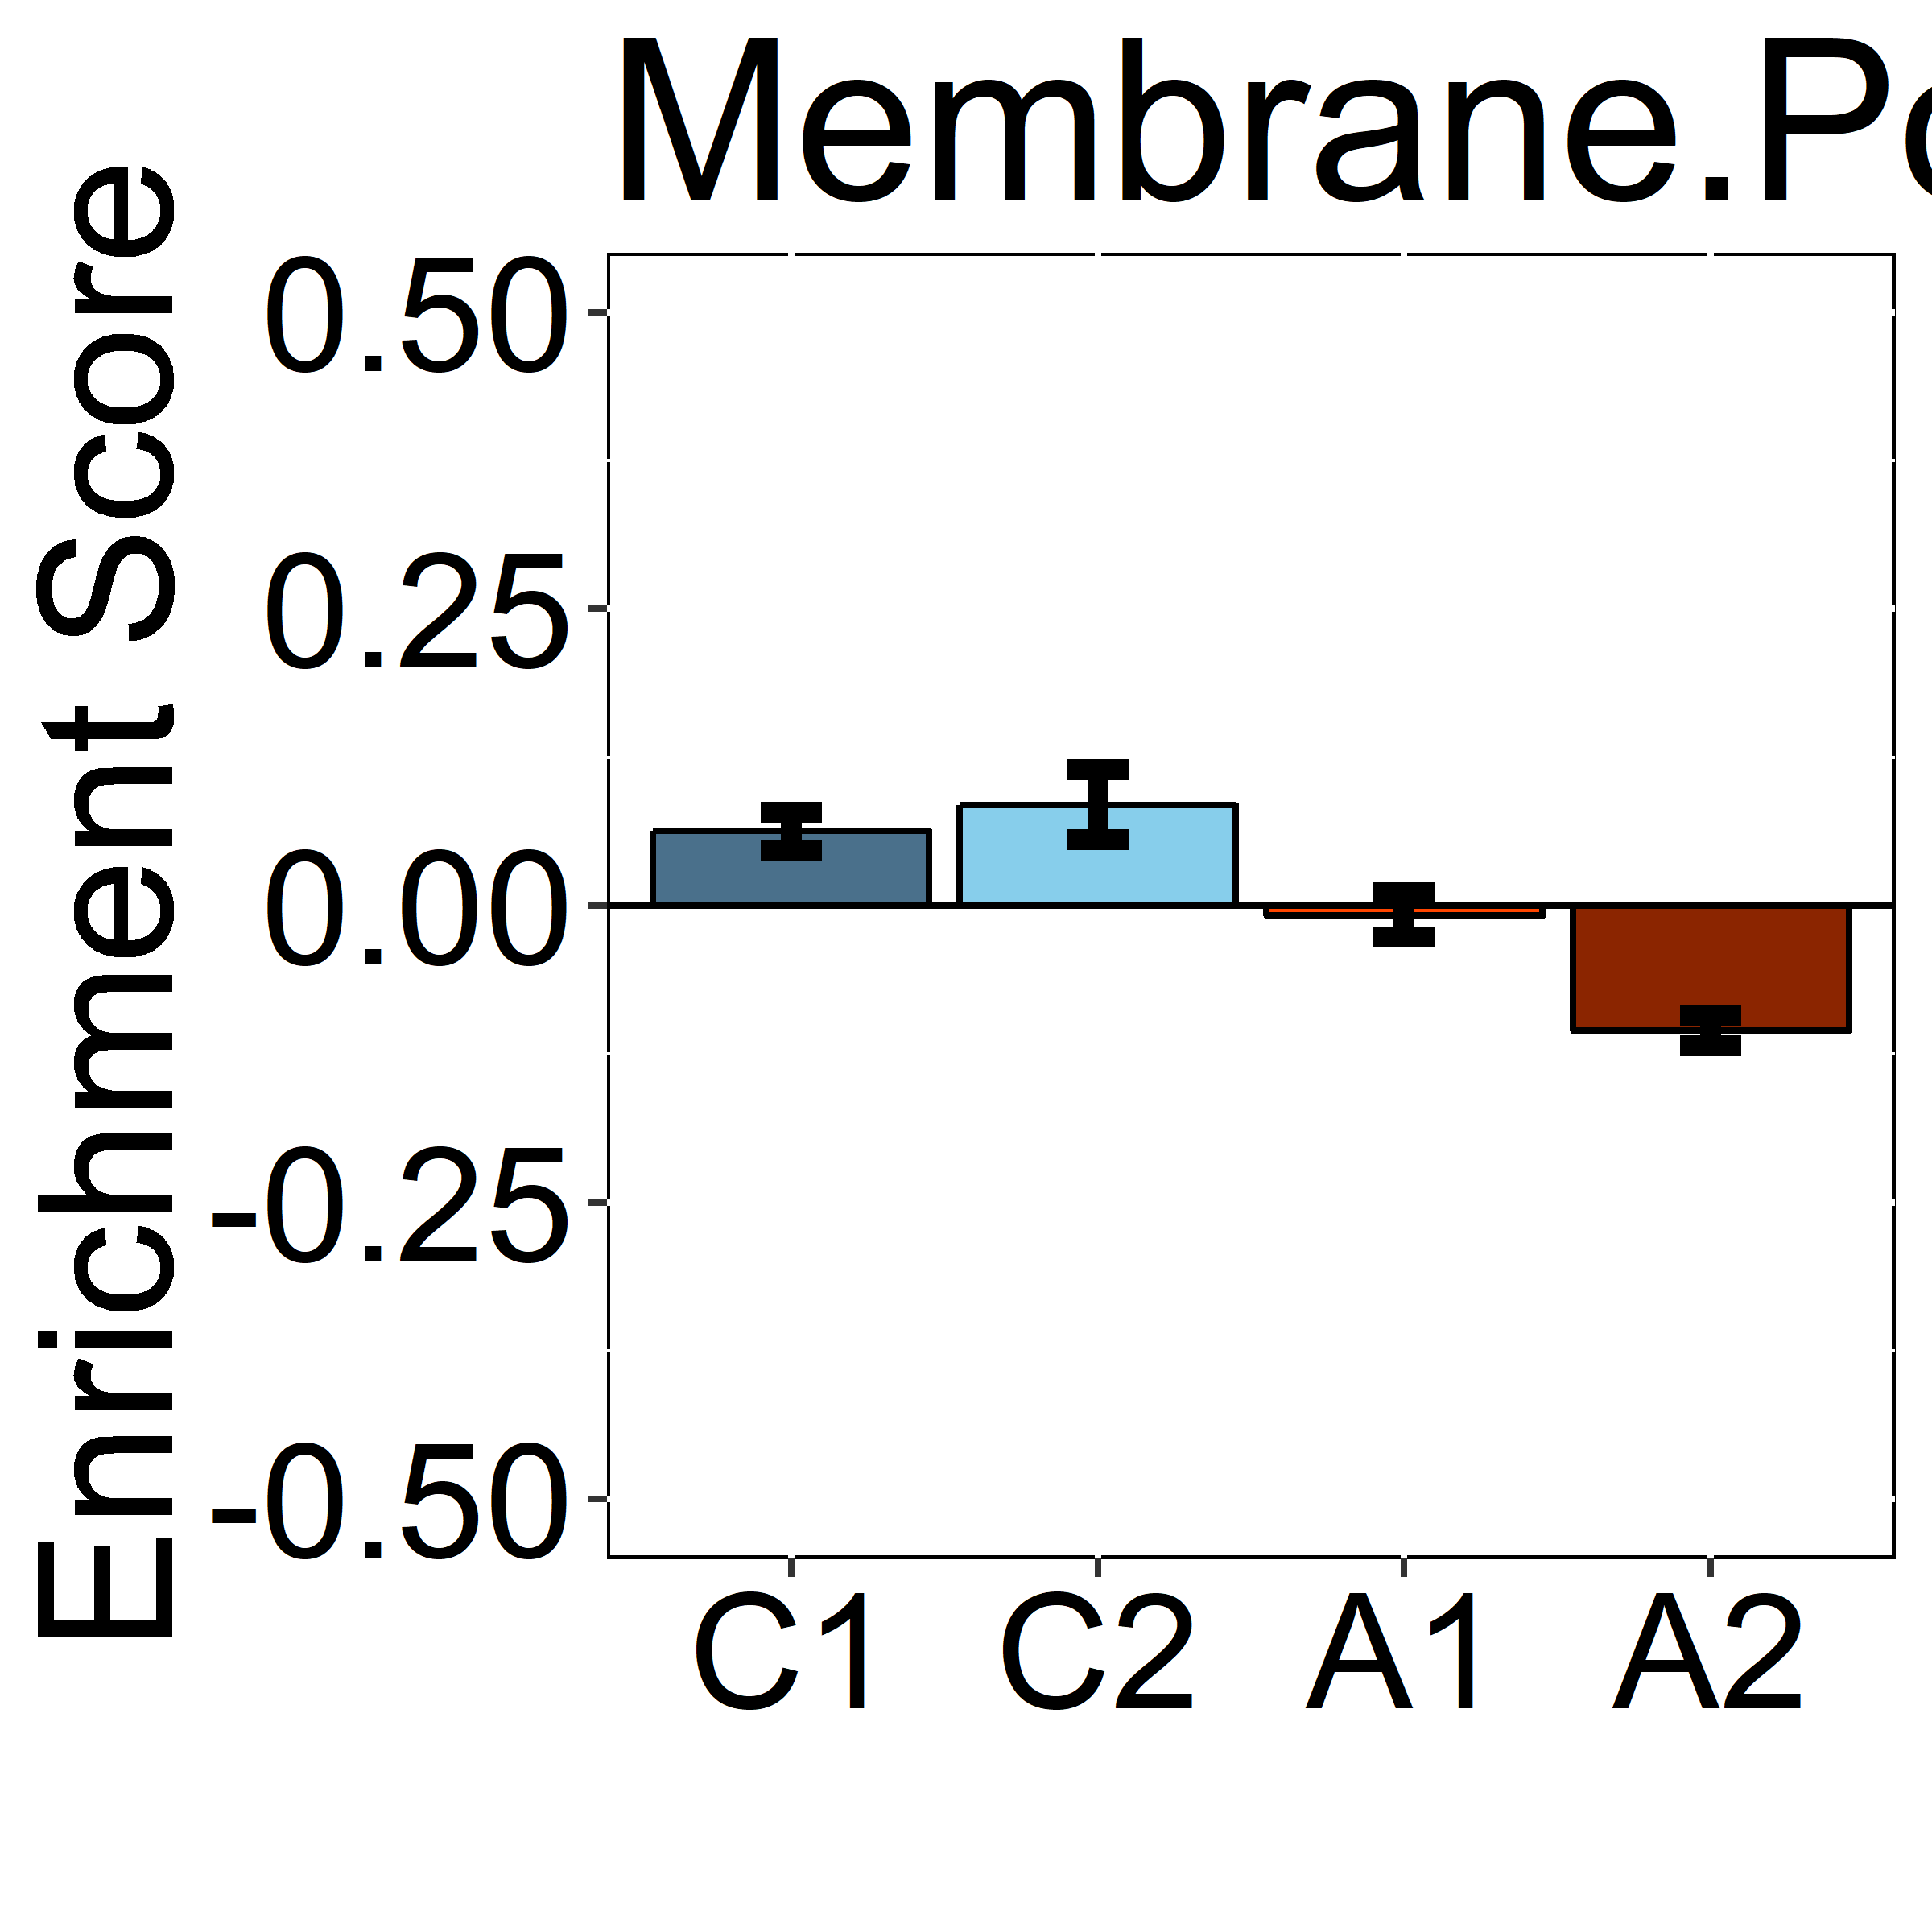
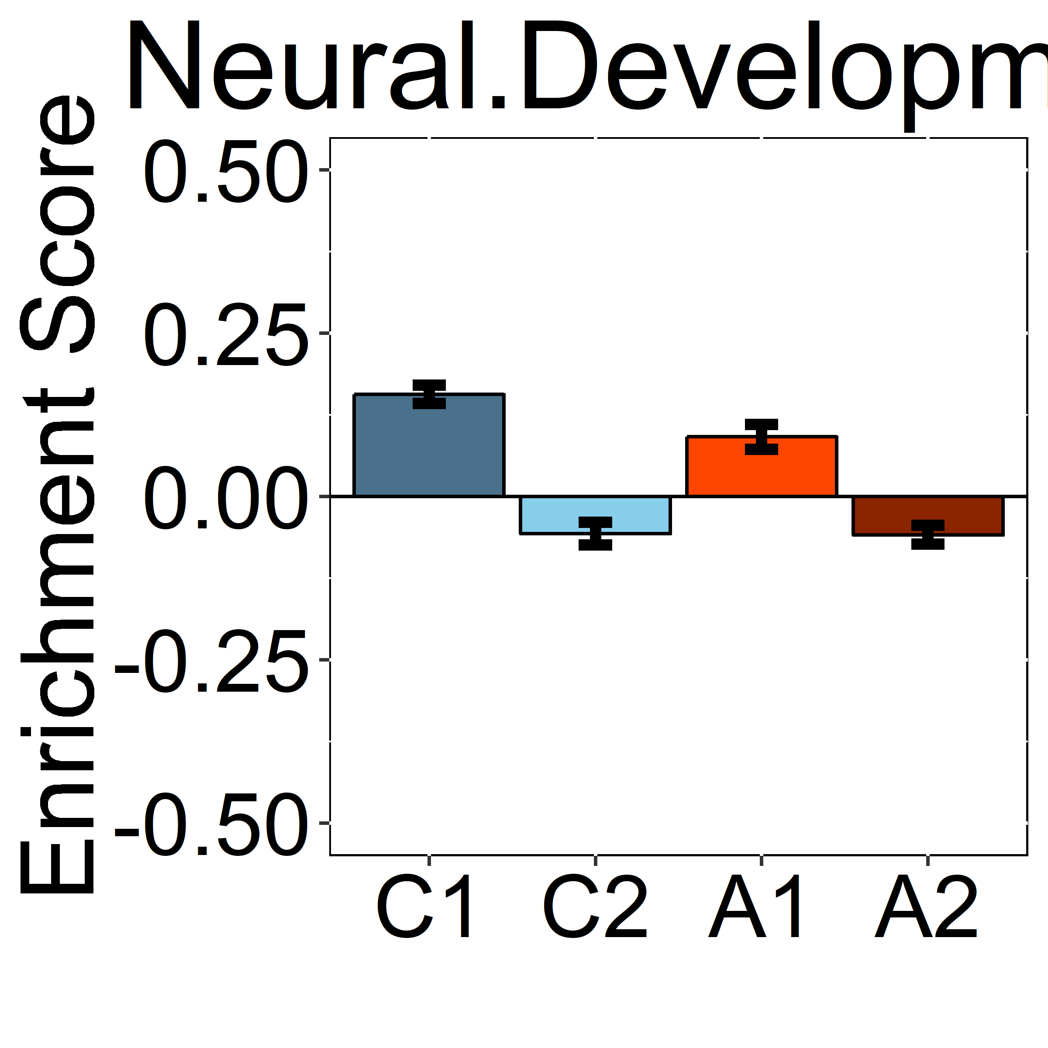
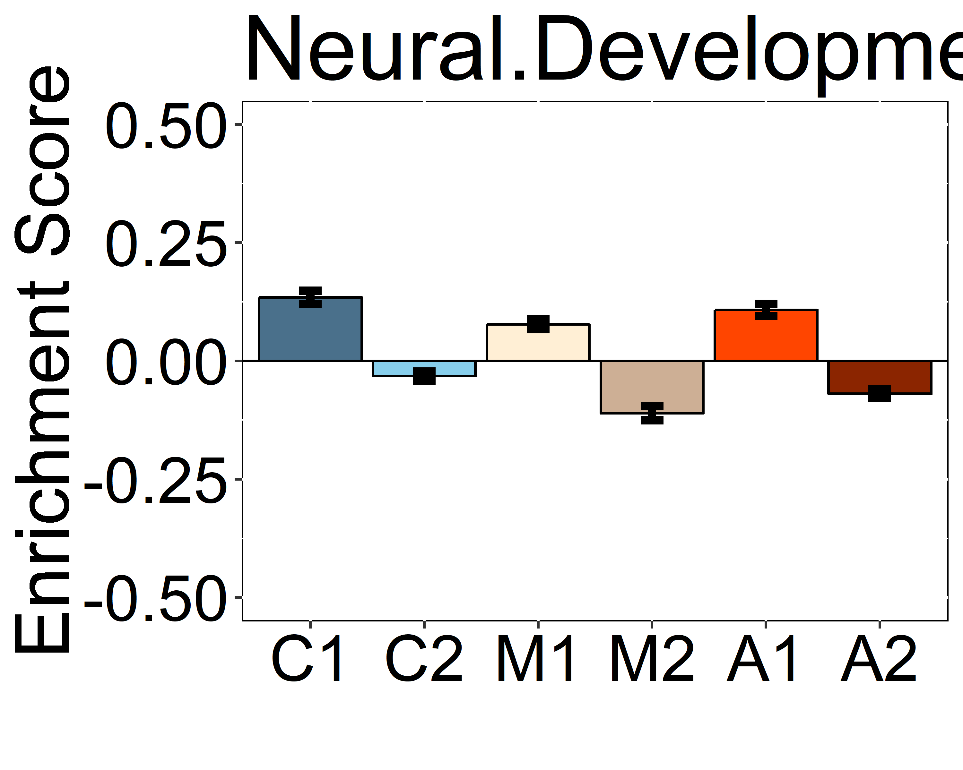
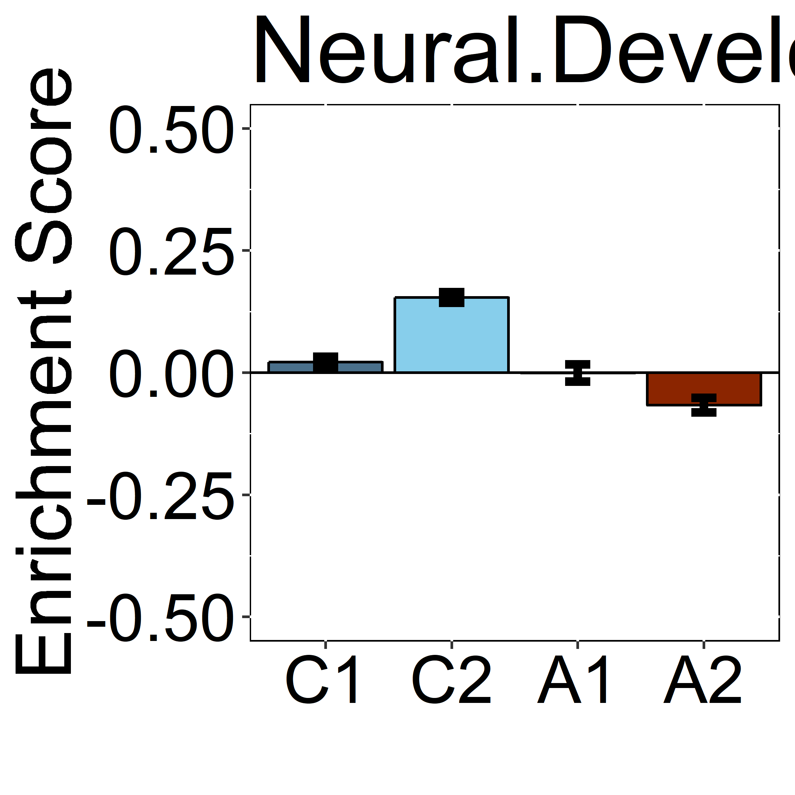
Control 1
Control 2
MCI 1
MCI 2
LOAD 1
LOAD 2
MAYO
ROSMAP
MtSINAI
MEMBRANE-POTENTIAL
REGULATION
*
*
#
&
&
NEURAL
DEVELOPMENT
#
#
&
*
&
Additional file 6

