Slide 1
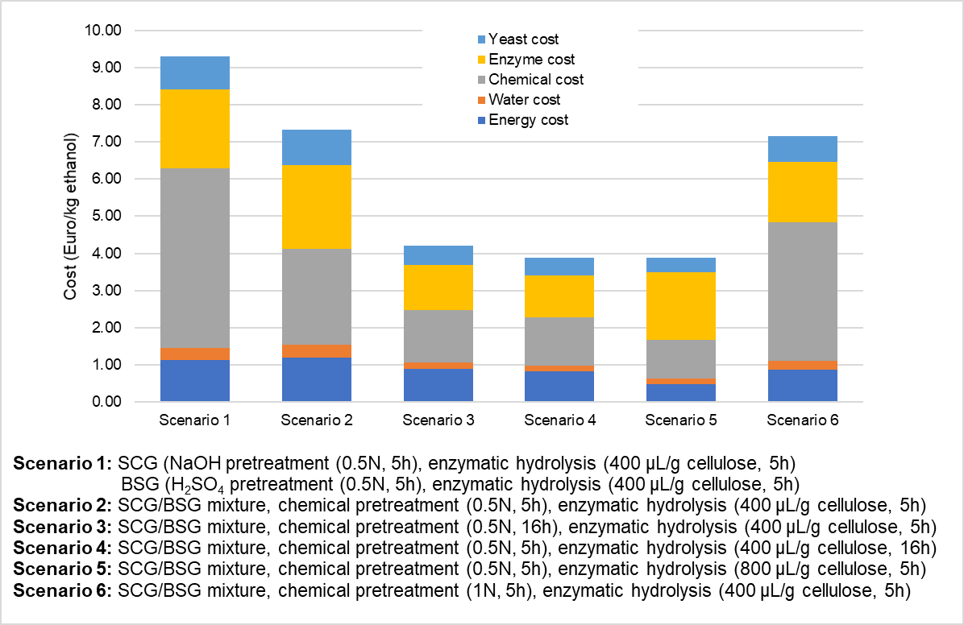
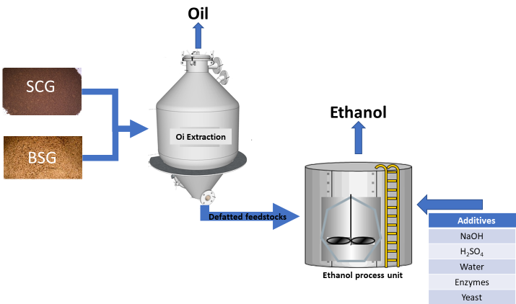
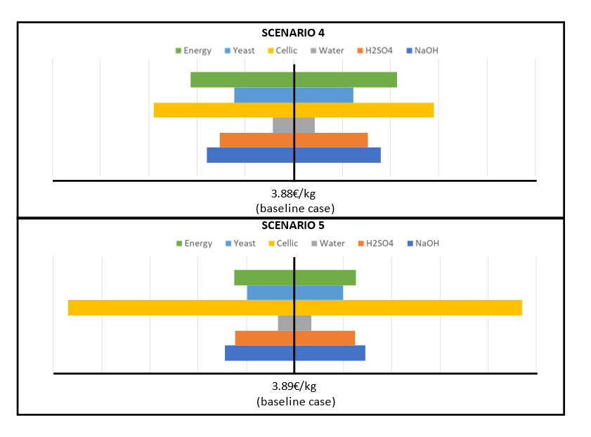
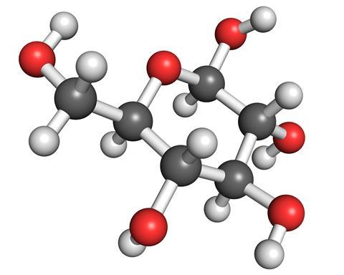

Experimental Set up
Preliminary Techno-economic analysis
Biorefinery Conceptual Design
FEEDSTOCKS
Brewer’s spent grains | Coffee spent grains
Ethanol Production Cost
Oil Extraction
Pretreatment
Alkaline | Acid
Sensitivity Analysis
Enzymatic Hydrolysis
Fermentation

