Slide 1
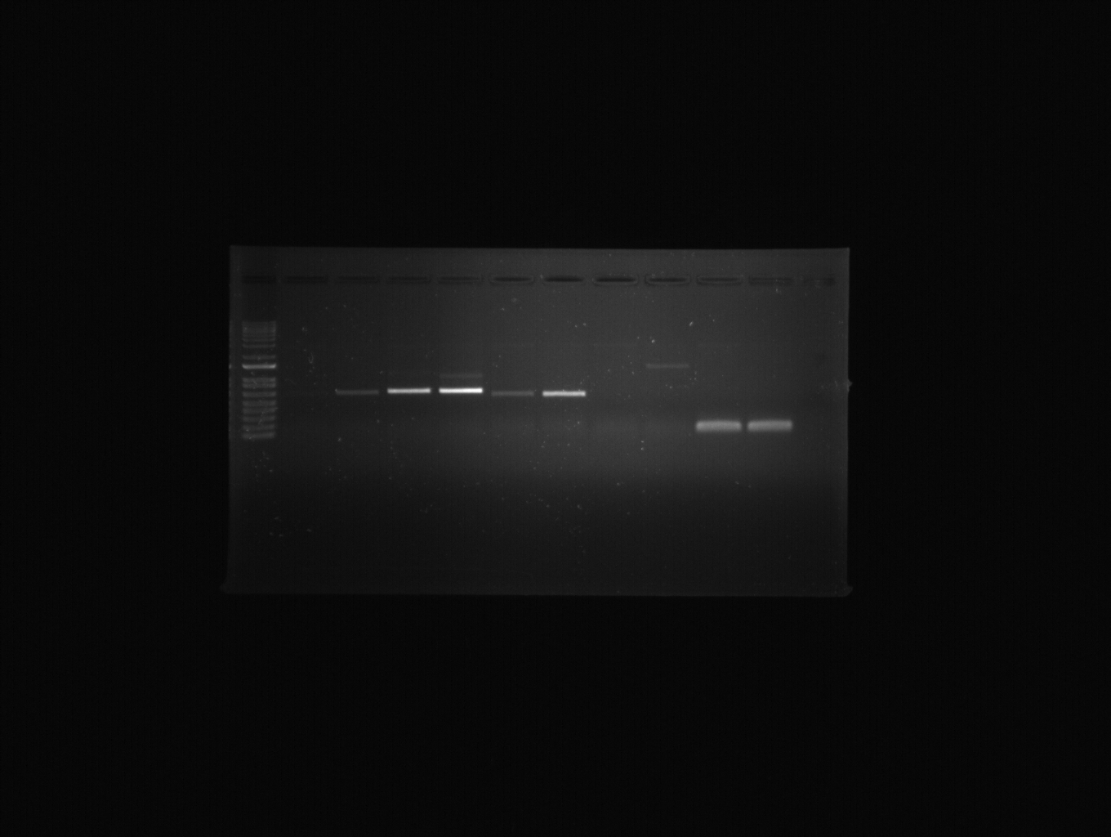
S. Figure 1
LAS
REV
STM
WUS
rbc L
W M
W M
W M
W M
W M
S. Figure 1. Reverse-transcription PCR of genes involved in axillary stem initiation; STM, LAS, REV, WUS. PCR conditions: 95 °C for 30 s, 28 cycles including 95 °C for 30 s, 58 °C for 30 s, and 72 °C for 1 min, and 72 °C for 5 min. Ten μL of PCR product were load on 1% agar for electrophoresis. W, wild type; M, mutant.

Slide 2
S. Table 1
Primer Name | Sequences (5’ to 3’) | Reference
rbcL_F rbcL_R | ATGTCACCACAAACAGAGACTAAAGC GTAAAATCAAGTCCACCRCG | Anabalόn et al (2022)
LAS F LAS R | CCTCATCTCATCATCAACGCAC AGCTAGTGCCATGAAGATACCG | In this study
REV F REV R | GCAAGGTCGTTATTGACTATTG TTCACACAAAAGACCAGTTTAC | In this study
STM F STM R | GACCAAGTATGAGCAAGAGCTT GAGAAGAGAGGGAGAAATGTCC | In this study
WUS F WUS R | CGACAGTATGGTAAGATCGAGG TTTCATCATGCATGGGAGTCCG | In this study

