Slide 1
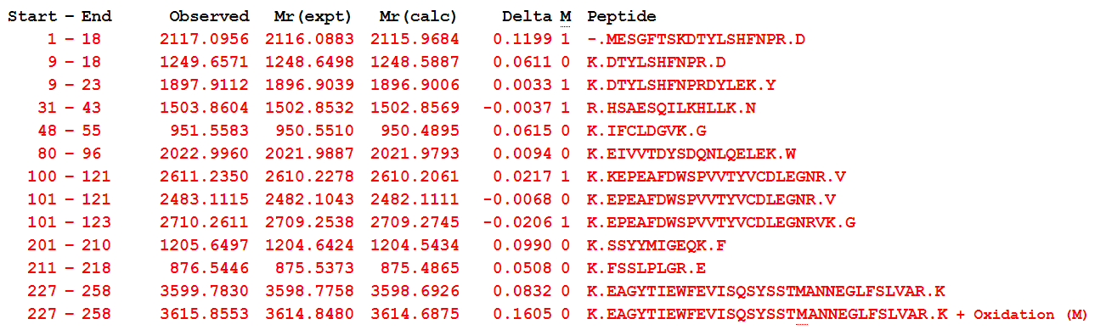
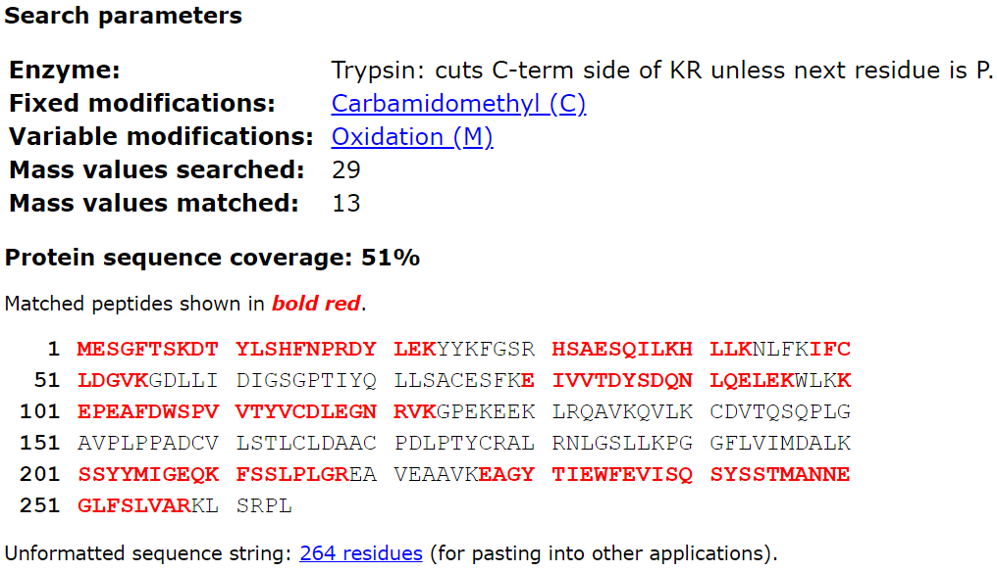
S1
A
A List of the Digested Peptides
B
NNMT Protein Sequence
Kikuchi-Koike et al.

Slide 2
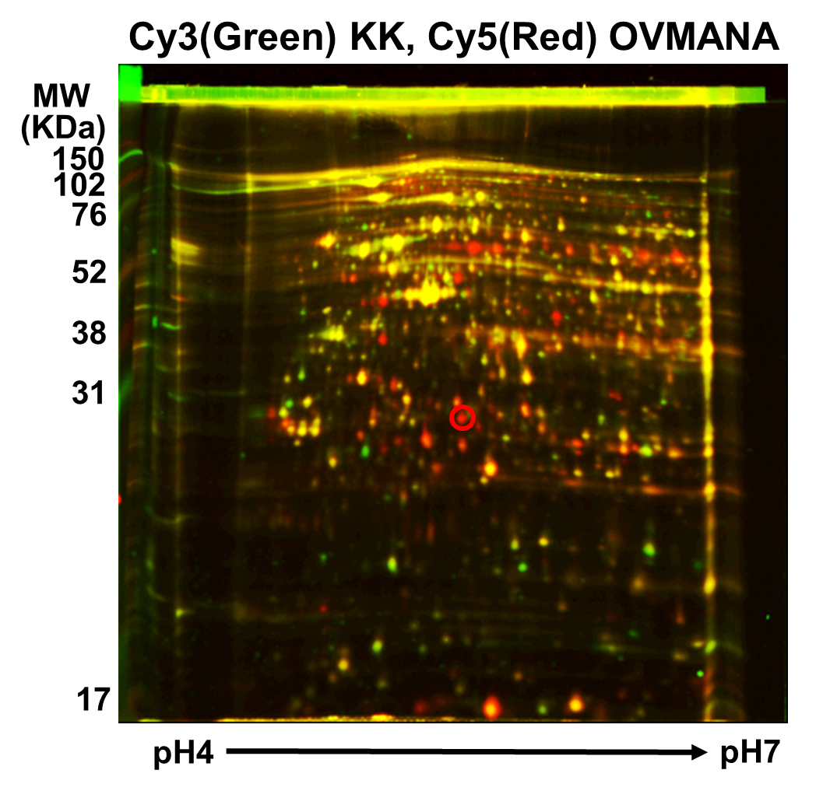
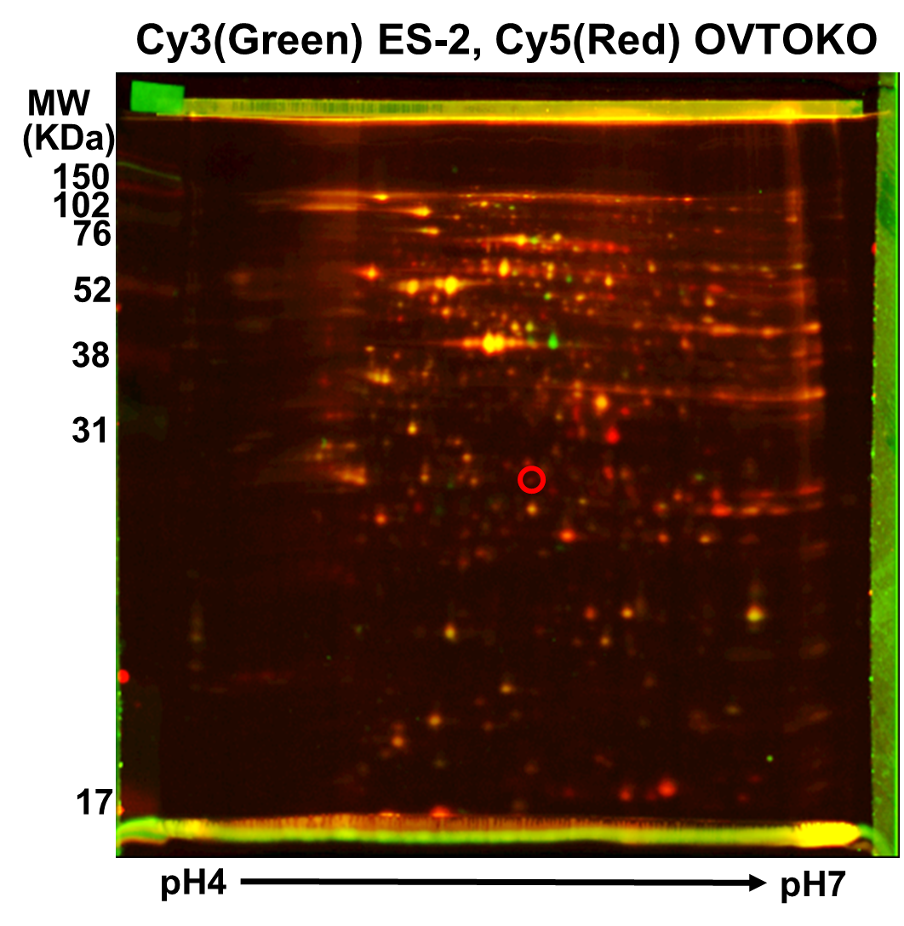
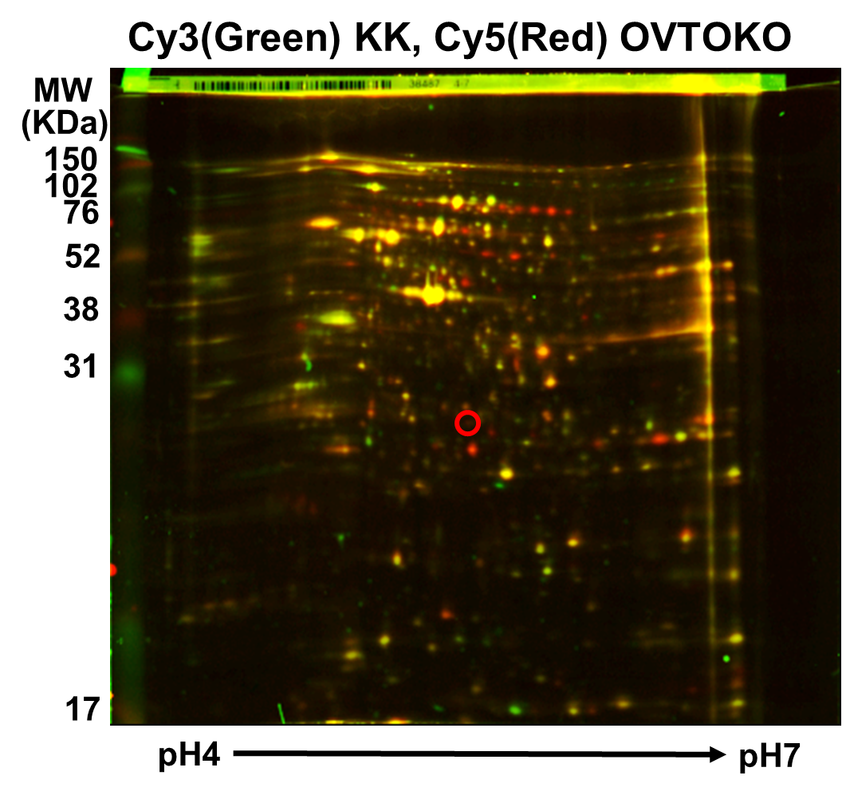
S2
A
Fluorescence-Labeled Two-Dimensional Differential Gel Electrophoresis (2D-DIGE)
B
Fluorescence-Labeled Two-Dimensional Differential Gel Electrophoresis (2D-DIGE)
C
Fluorescence-Labeled Two-Dimensional Differential Gel Electrophoresis (2D-DIGE)
Kikuchi-Koike et al.

Slide 3
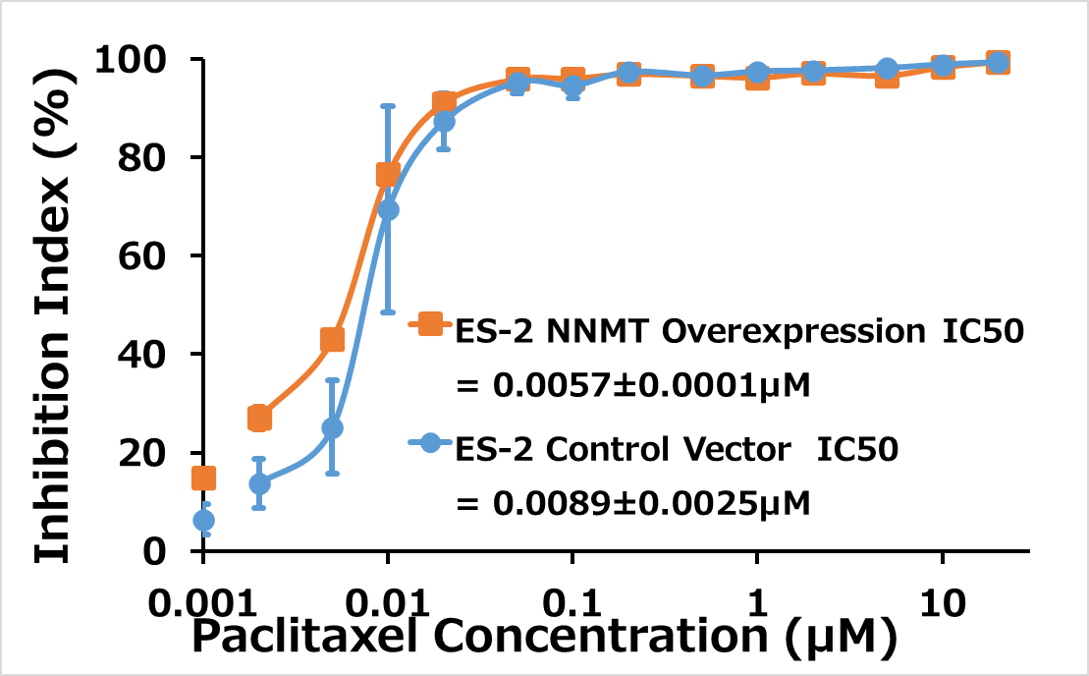
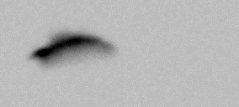
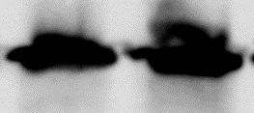
S3
A
WST-8 assay
B
Western Blot Analysis
NNMT
GAPDH
ES-2 NNMT
ES-2 empty vector
Kikuchi-Koike et al.

