Slide 1
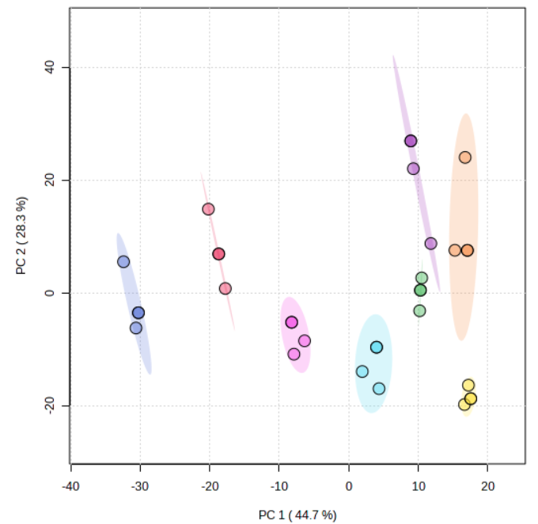
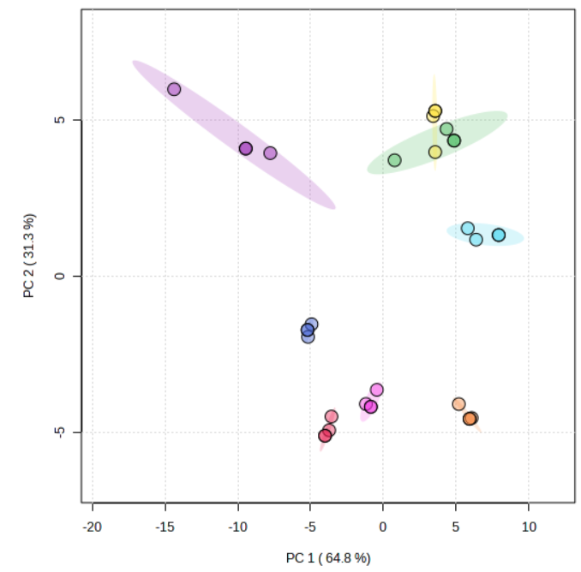
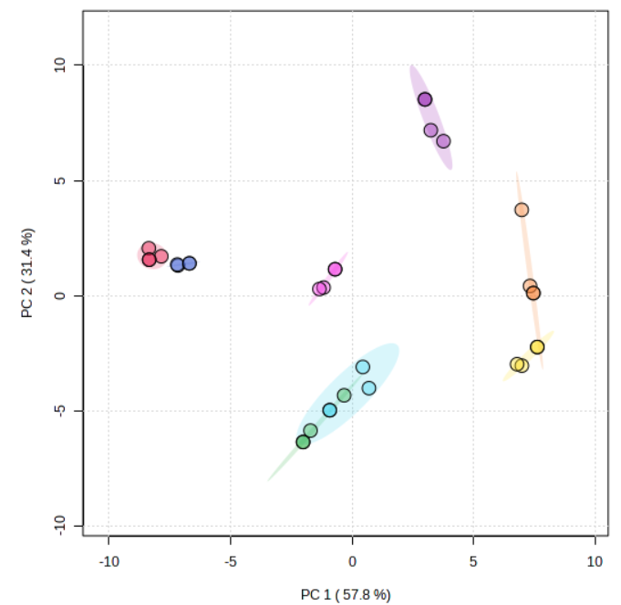
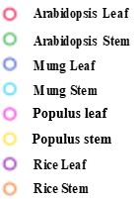
Figure S1
(a)
(b)
(c)
Principal component analysis of absorption spectra within (a) 800-2000 cm⁻¹ (b) 1000-1100 cm⁻¹ and (c) 1390-1420 cm⁻¹ wavenumber for total sugar, cellulose and lignin respectively in ATR-FTIR

Slide 2
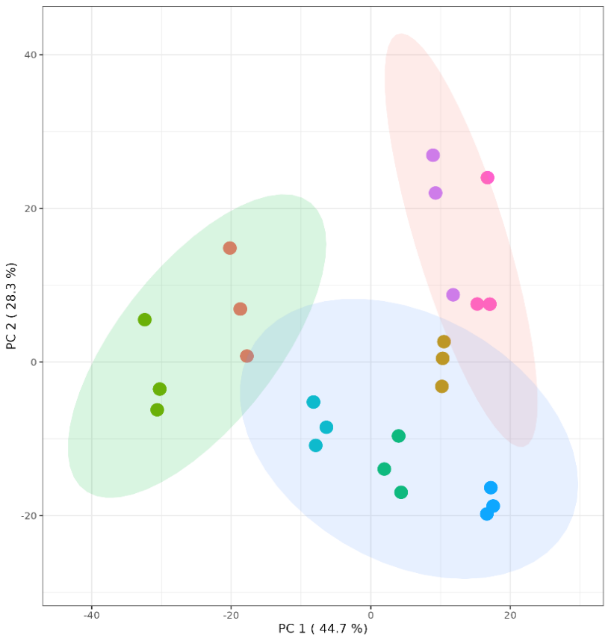
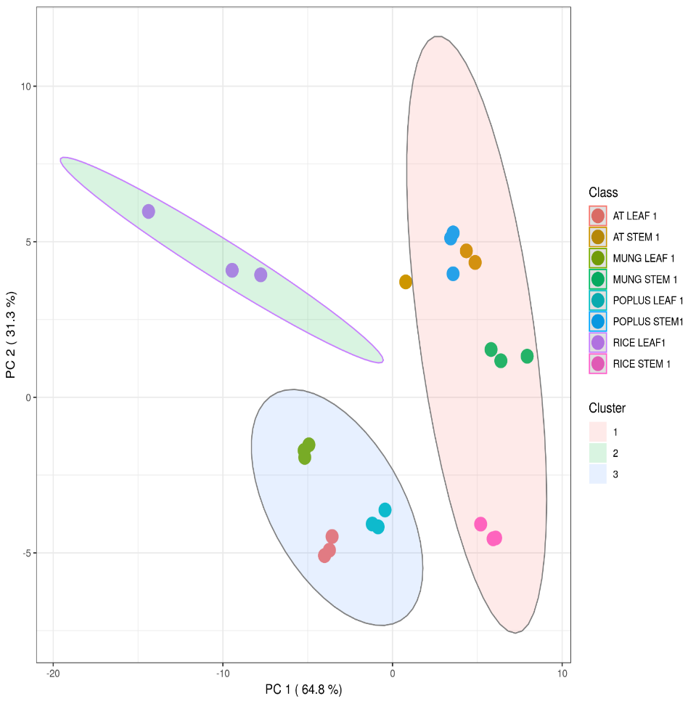
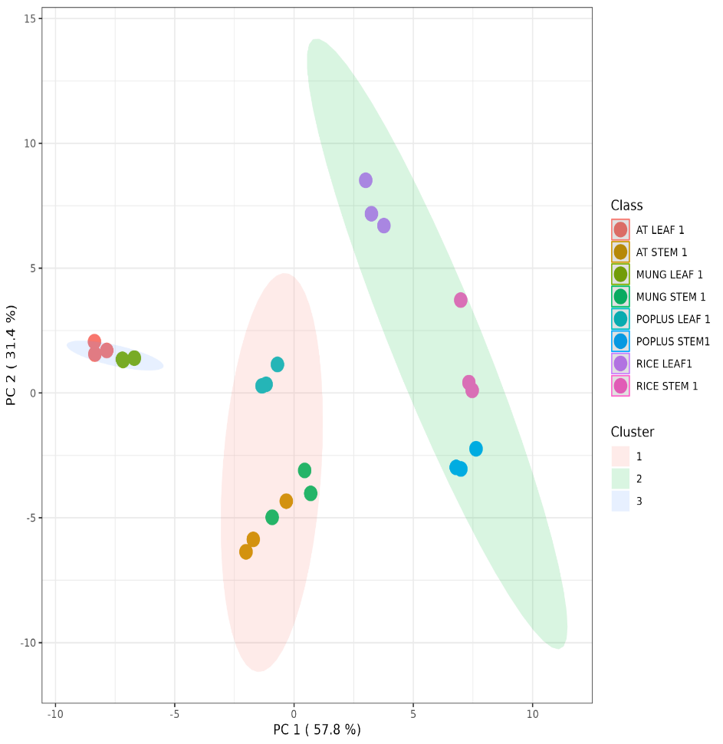

Figure S2
(a)
(b)
(c)
K-mer analysis of absorption spectra within (a) 800-2000 cm⁻¹ (b) 1000-1100 cm⁻¹ and (c) 1390-1420 cm⁻¹ wavenumber for total sugar, cellulose and lignin respectively in ATR-FTIR

Slide 3
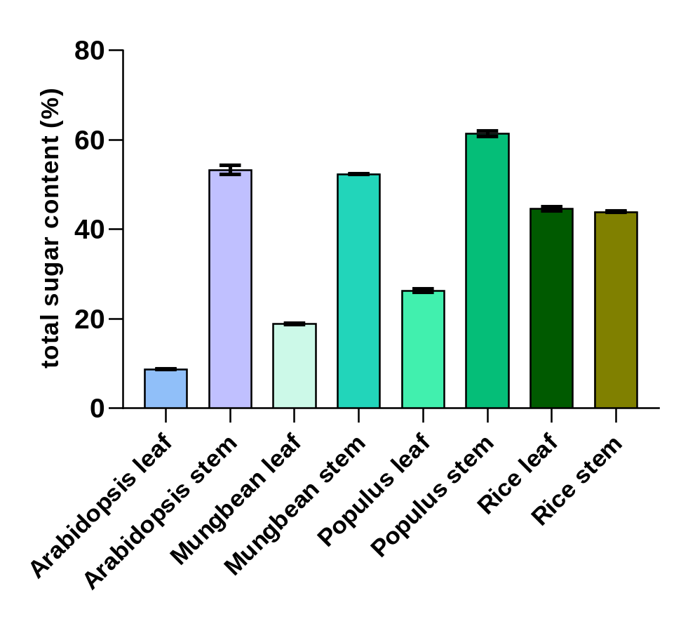
Figure S3
Total cell wall sugar analysis by phenol-sulphuric acid method. Data represents mean ± SD with n = 2.

