Slide 1
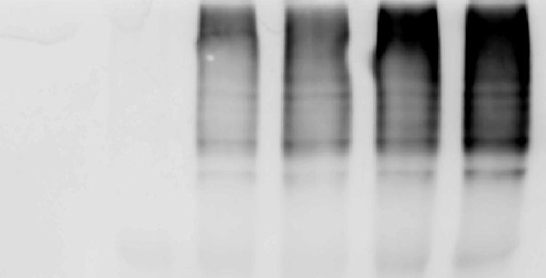

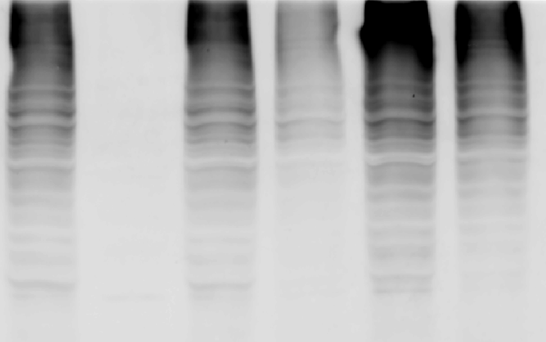

Supplementary Figure 1.DMOG increased CDH1 ubiquitination levels
CDH1-Flag
−
+
293T
Ub-HA
+
−
+
+
+
+
+
+
+
+
DMOG
−
−
−
+
−
+
MG132
−
−
−
−
+
+
IP
HA
Flag
input
HA
Flag
Flag-tagged CDH1 was expressed in 293T cells. The ubiquitination levels of CDH1 expressed from cells under the treatment of DMOG were analyzed.

