Slide 1
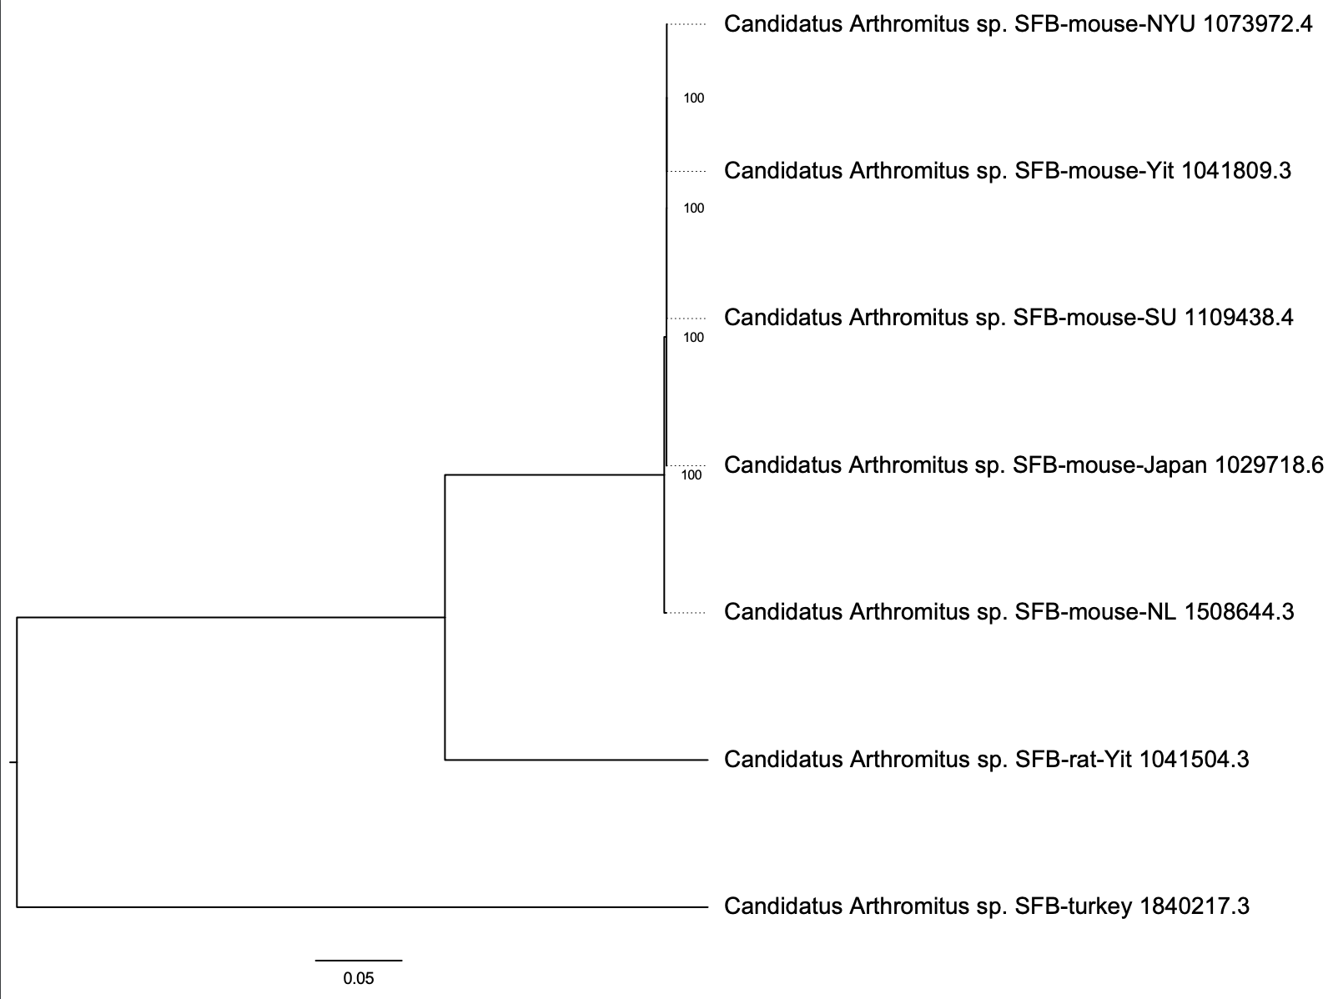
Figure S2
Notes:
Figure S2

