Slide 1
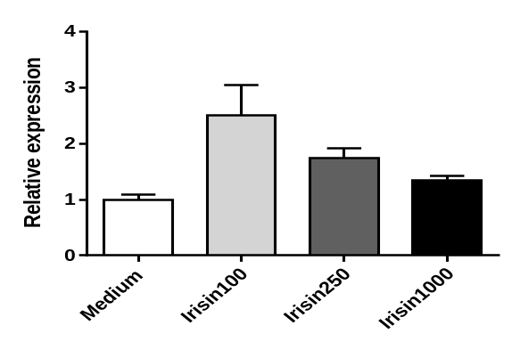
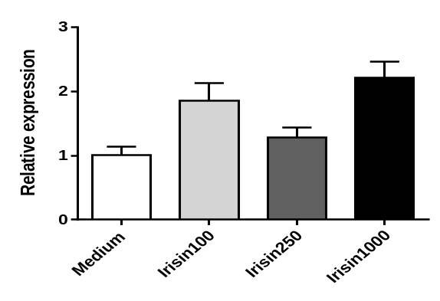
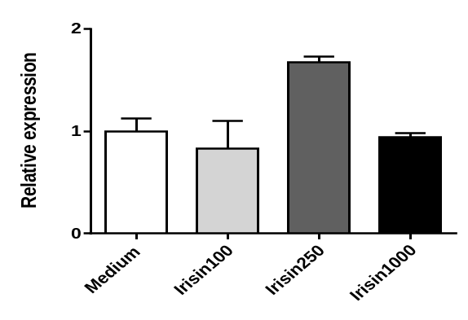
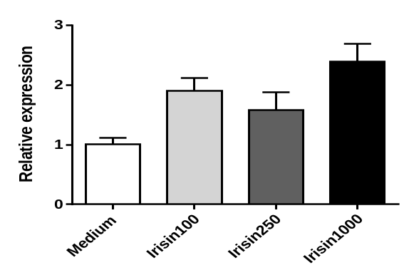
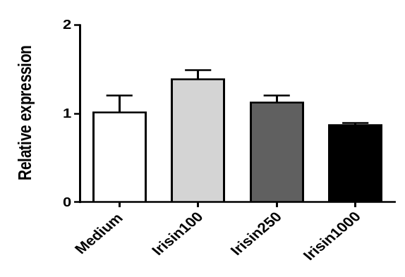
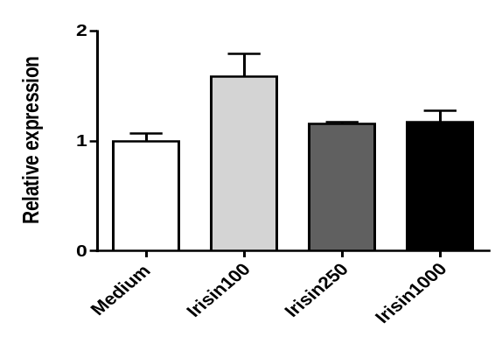
Muc2
CDX2
Lysozyme
*
***
***
***
**
CHGA
EpCAM
LGR5
***
***
**
**
Supplementary Figure 2. A. Gaowa et al.
Irisin
Notes:
Next, gene expression analysis revealed that Irisin induced intestinal epithelial specific genes Mucin2 (goblet cell marker), CDX2 (enterocyte cell marker), CHGA (enteroendocrine cell marker), and Lysozyme (Paneth cell marker) in the organoids.
More importantly, the expression of LGR5, an intestinal stem cell marker gene, upregulated by Irisin.

